Slide 1
How many dirty diapers is too many dirty diapers: Assessing the link between GI distress, diet, microbiome and Autism; “Jimmy, eat your veggies so you don’t get Autism.”
Ahmad & Ben

Slide 2
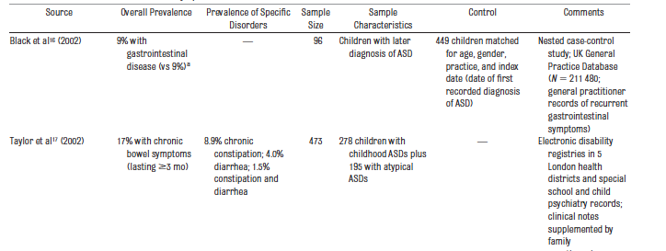
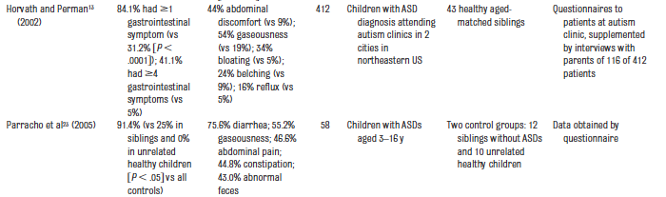
ASD GI Issues (9-91%)…huh?
…
Buie, 2010, Pediatrics
Notes:
Lots of discussion
Lots of disagreement

Slide 3
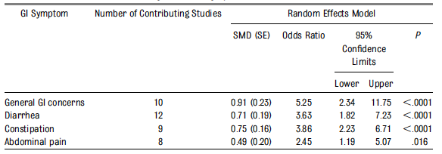
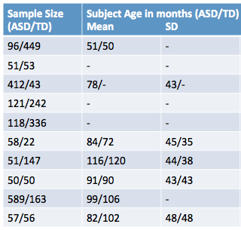
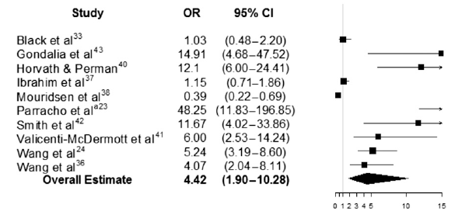
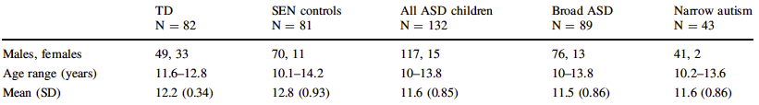
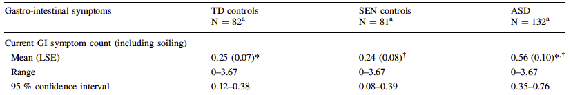
ASD GI Issues: Meta Analysis
McElhanon, 2014, Pediatrics
Chandler, 2013
J. Autism Dev.
Disorder
Notes:
Even Meta analyses looks laughably inconsistent

Slide 4
Sample Size (ASD/TD) | Subject Age in months (ASD/TD) Mean SD Range
96/449 | 51/50 | - | -
51/53 | - | - | 24-144
412/43 | 78/- | 43/- | -
121/242 | - | - | -
118/336 | - | - | -
58/22 | 84/72 | 45/35 | 36-192
51/147 | 116/120 | 44/38 | -
50/50 | 91/90 | 43/43 | -
589/163 | 99/106 | - | 12-216
57/56 | 82/102 | 48/48 | -

Slide 5
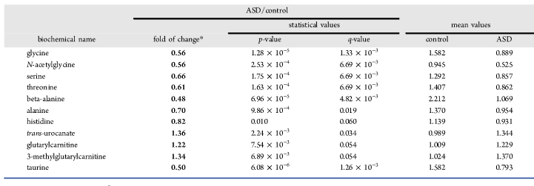
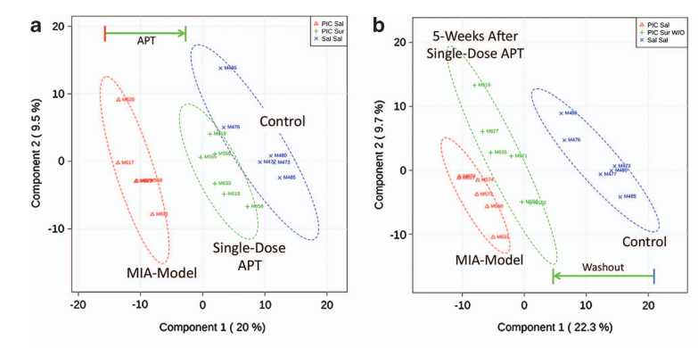
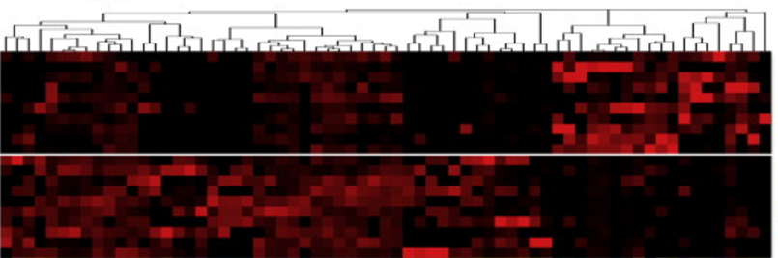
Microbiome in ASD
Gut Microbiome Metabolites
(Ming, 2012, J. Proteome Research)
Disbiosis in MIA model
(Hsiao, 2013, Cell)
Anti-Purinergic Therapy
(Naviaux, 2014, Nature)
Poly(I:C) | Saline

Slide 6

Cohort
479 Subjects (Final Dx < 29mo)
293 ASD
186 TD
Completed Feeding Survey
Age split: young, middle, old

Slide 7
GI Composite (GIC)
Q27: Constipation
Q28: Diarrhea
Q29: Gas
Q30: Bloating
Q31: Abdominal Pain
Q32: Belch
Q33: Stool Impact
Q34: Reflux (excluded)

Slide 8
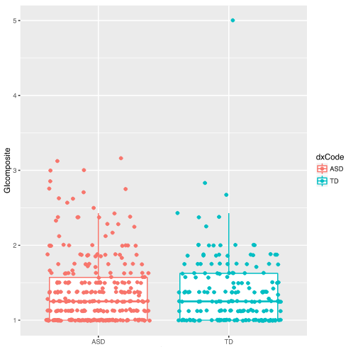
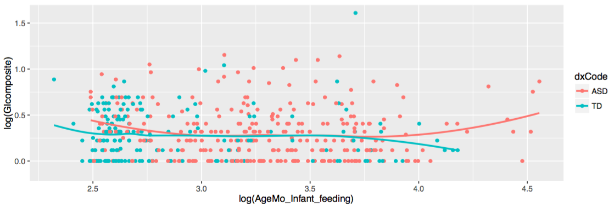
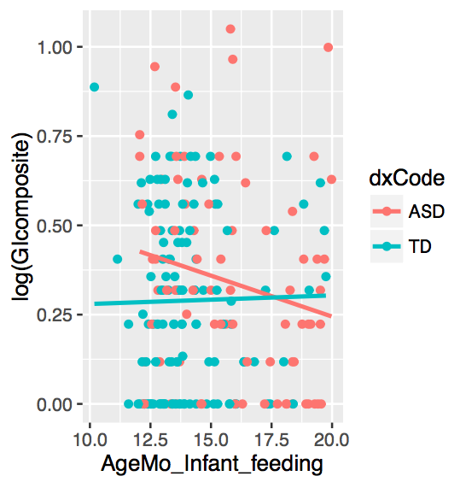
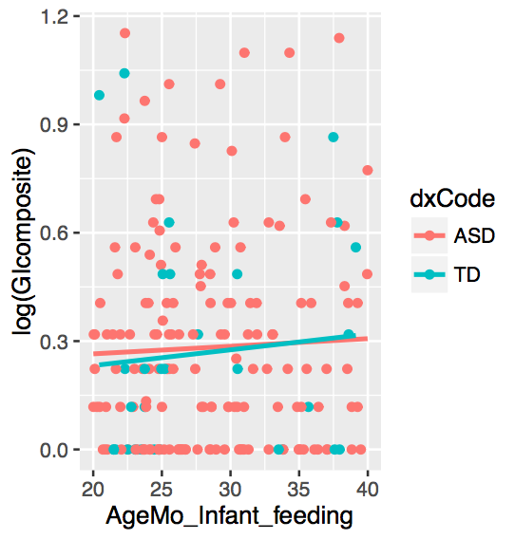
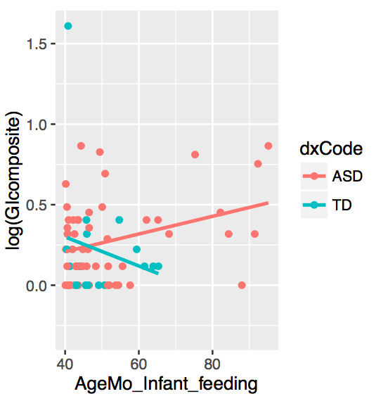
Unweighted GI Composite (uGIC)
No Difference
* Distinct ASD intercept
* Significant ASD x Age interaction
(p=0.048)
* Distinct ASD intercept (p=.05)
Notes:
Significance of interaction model p=.043

Slide 9
ASD GI Issues: Meta Analysis
McElhanon, 2014, Pediatrics
Young
Middle
Old
Chandler, 2013
J. Autism Dev.
Disorder
Notes:
Even Meta analyses looks laughably inconsistent

Slide 10
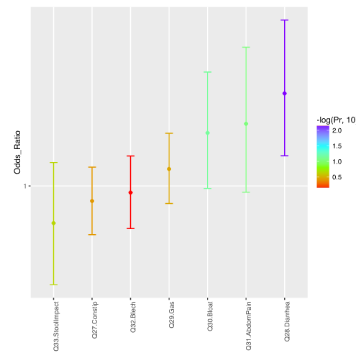
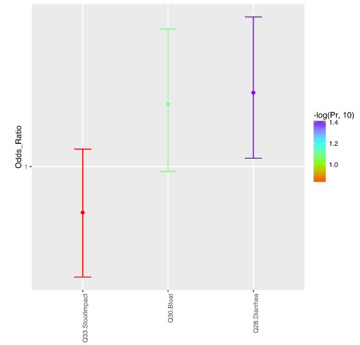
Weighted GI Composite (wGIC)
Univariate Screen
Multivariate Model
Age excluded

Slide 11
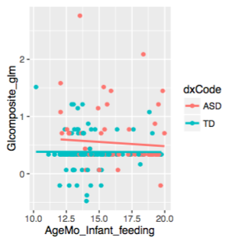
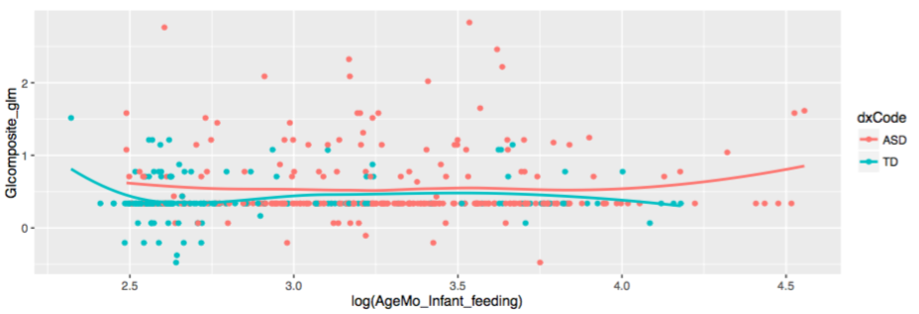
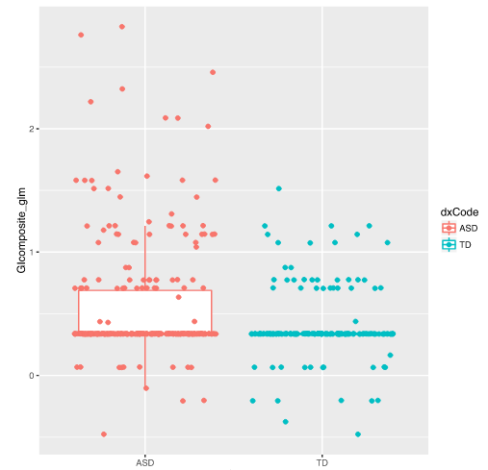
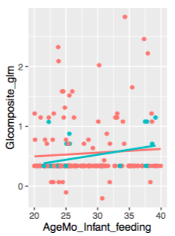
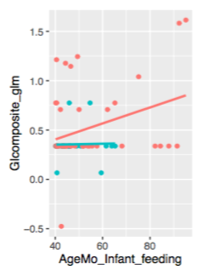
Weighted GI Composite (wGIC)
* Distinct ASD intercept (p=.003)
No difference
No difference

Slide 12
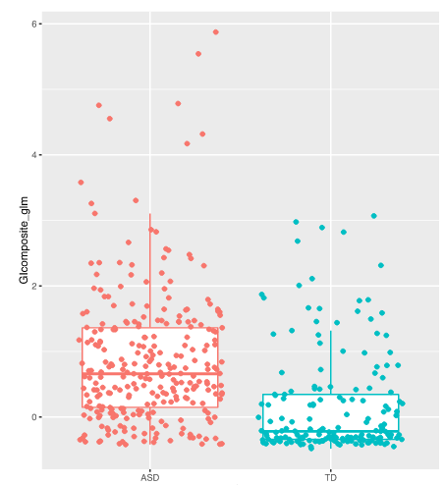
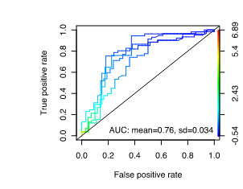
Weighted GI Composite (wGIC)
Age included

Slide 13
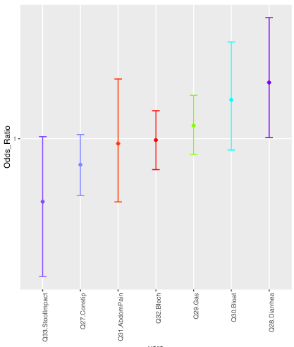


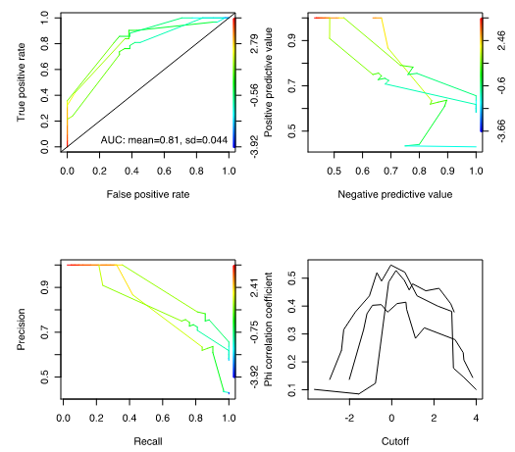
GI Variables: CSBS controlled
Univariate Screen
Multivariate Model
2x Risk

Slide 14
Whole Feed Survey
Food Choices
GI distress
Refusal/Fussiness
Mealtime Issues

Slide 15
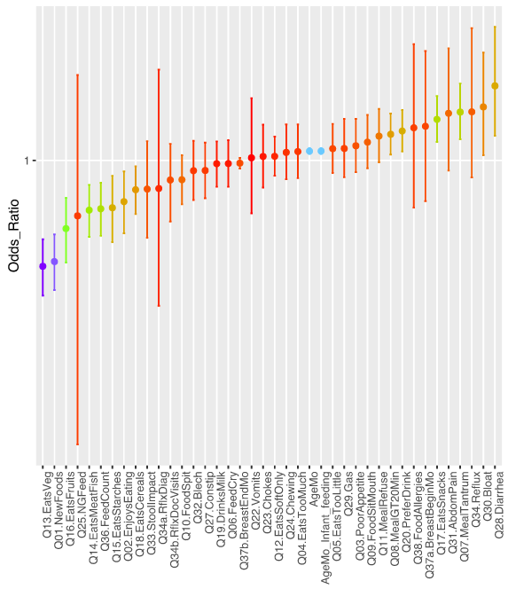
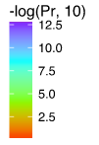
Univariate Screening
2x Protection

Slide 16
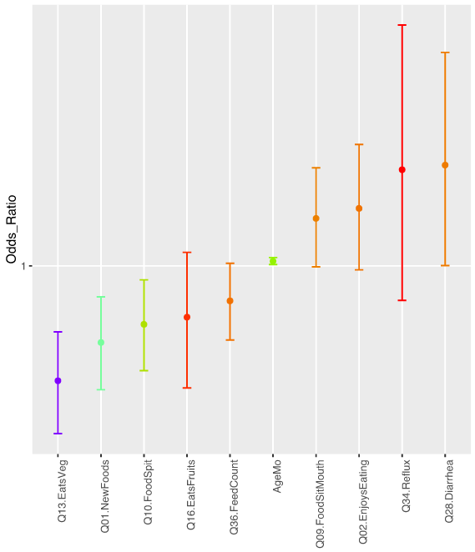

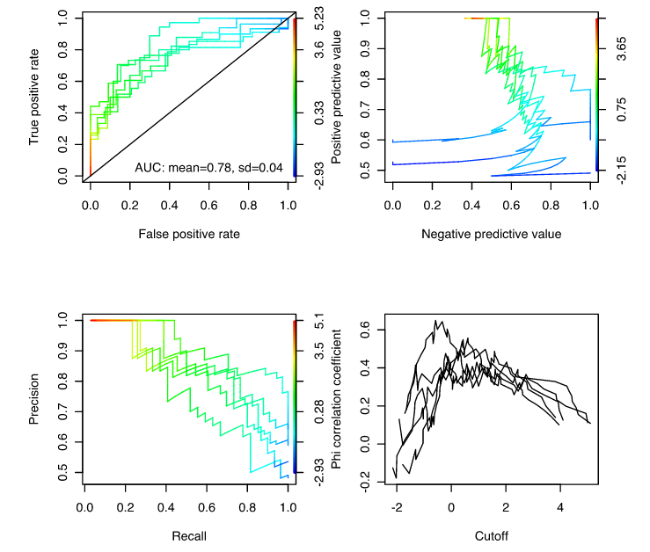
Multivariate Model
2x Protection

Slide 17
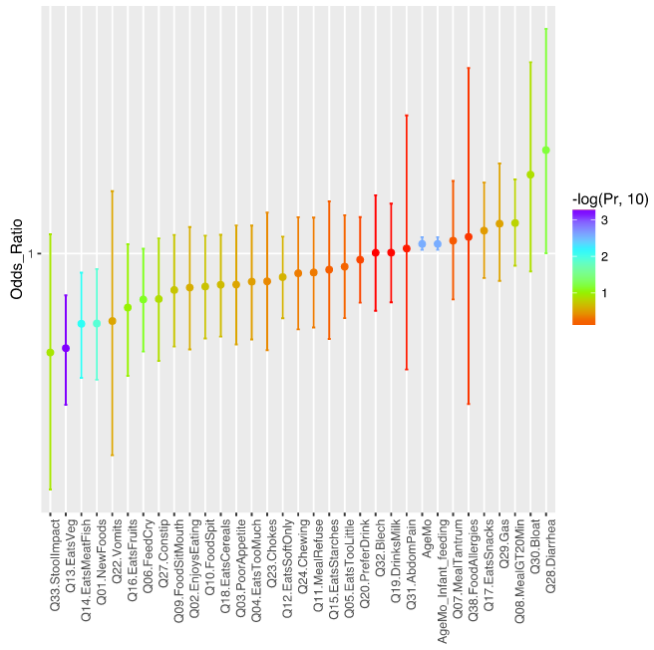
Whole Feed Survey: CSBS control
Univariate Screen
2x Protection

Slide 18
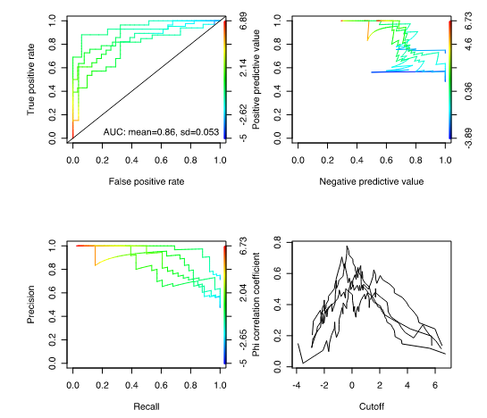
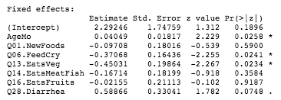
Whole Feed Survey: CSBS control
Multivariate
Backward Selection

Slide 19

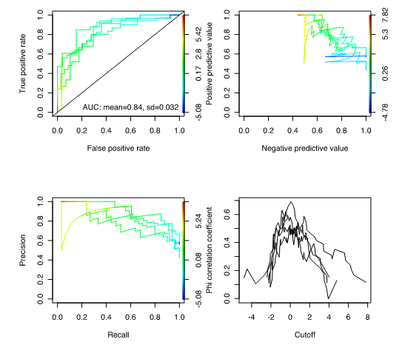
Whole Feed Survey: CSBS control
Multivariate
Backward Selection

Slide 20

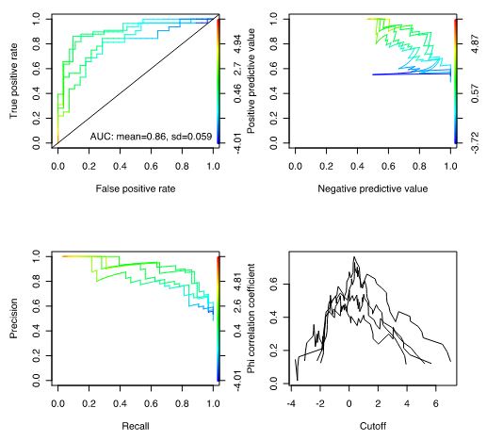
Whole Feed Survey: CSBS control
Minimal Multivariate
Model

Slide 21
Microbiome, GI and Vegetables Diversity
Zimmer et al, 2012, J. Autism Dev. & Disorder
Albenberg, 2014, Gastroenterology
Food Diversity ←→ Nutrient Diversity ←→ Microbiome Diversity
American Gut Microbiome Project (unpublished)
Vegetable Diversity
←→
Microbiome Diversity
Oriach, 2016, Clinical Nutrients Experiments: Veggies may be neuro-therapeutics
Veggie Diet Decrease Pathobiots [Glick-Bauer,2014,Nutrients ]
Dec: B. fragelis [Ferrocino,2015,PlosOne], Clostridium [Matijasic,2014,Euro J. Nutrition]
Inc: B. prevotella, B. thetaiotaomicron, C. clostridioforme & F. prausnitzi [Matijasic,2014]
B = Bacteroides, C = Clostridium, F = Faecalibacterium

Slide 22
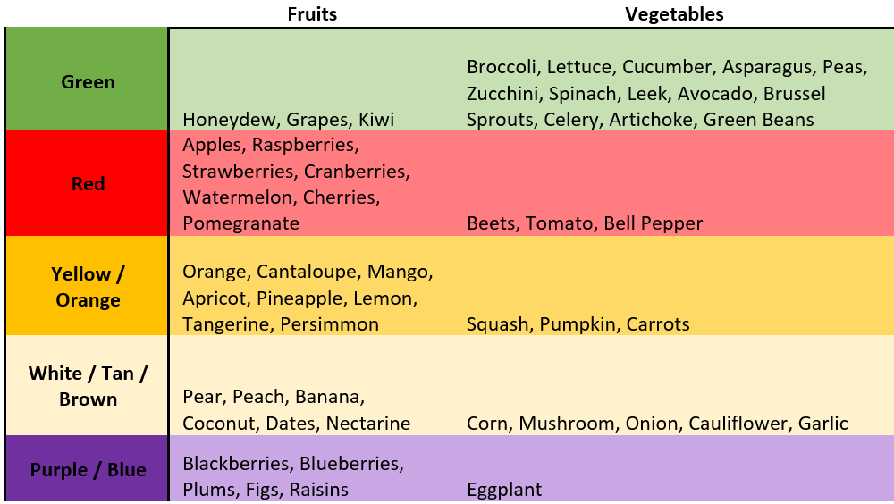
Microbiome, GI and Vegetables Diversity

Slide 23
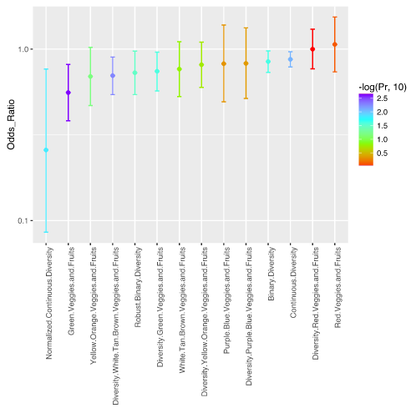
Fruit and Veggie Diversity: Univariate Screening

Slide 24
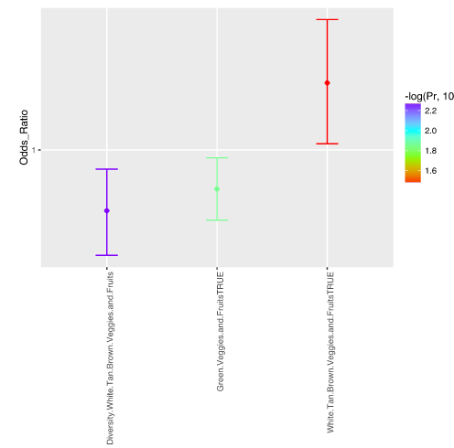
Fruit and Veggie Diversity: Multivariate Model

Slide 25
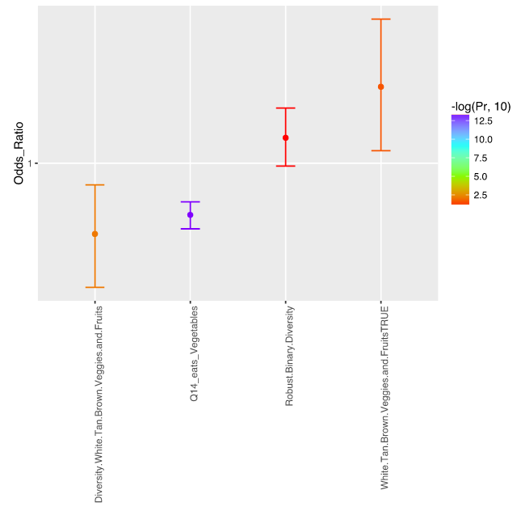
Fruit and Veggie Diversity: Multivariate Model

Slide 26
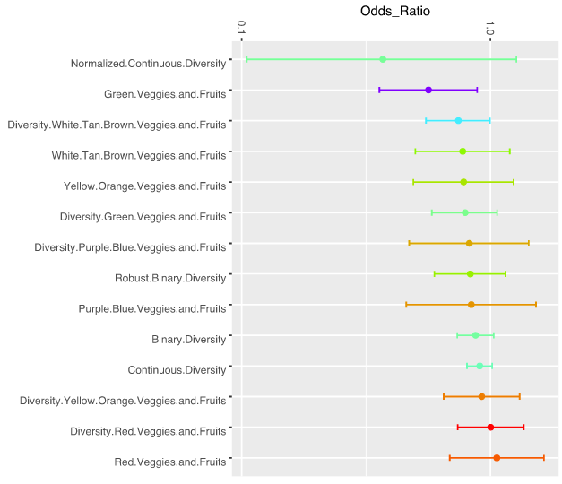

Fruit and Veggie Diversity: Univariate Screening + Veg. control

Slide 27
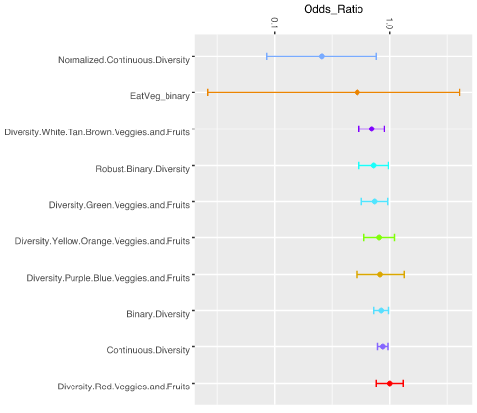
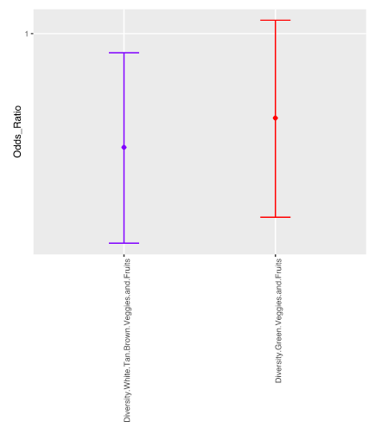


Fruit and Veggie Diversity: WITH Binary Veggie
1.5x Protection

Slide 28
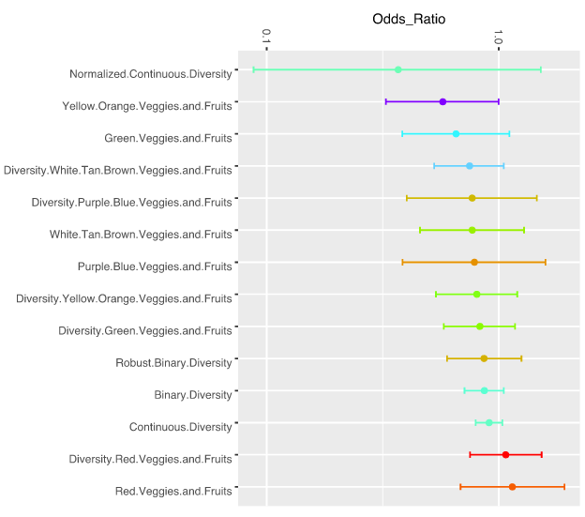

Fruit and Veggie Diversity: Univariate Screening + CSBS control

Slide 29
Acknowledgements
ACE

