Slide 1
Data Driven Regulator Prediction

Slide 2
eQTL: GWAS for Gene Expression
GWAS
Predict changes in phenotype from SNP
eQTL
Predict changes in expression from SNP, aggregate SNPs to genes

Slide 3
GTEx
GTEx version 6.0 database of Genotypes and Phenotypes
phs000424.v6.p1, 2015-10-05 released
dbGaP; approved protocol 9112
RNA-seq and genotype
Samples
551 donors
Matched phenotypic information
9,590 RNA-seq assays
Human genomics. The Genotype-Tissue Expression (GTEx) pilot analysis: multitissue gene regulation in humans.Consortium, G.T. and GTEx Consortium.Science. 2015; 348: 648–660

Slide 4
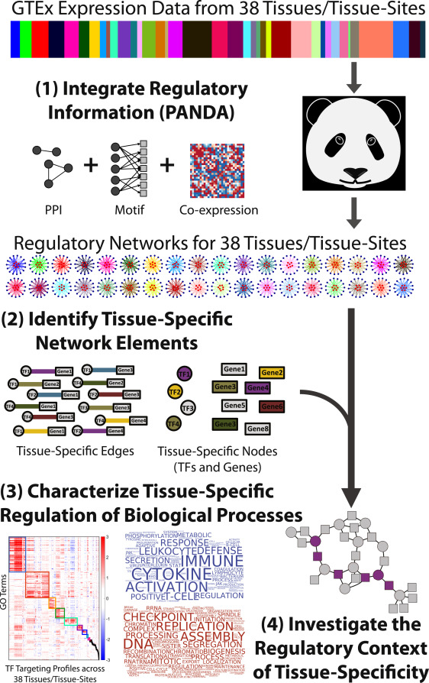
Tissue-specific TF-network Reconstruction: inferring trans-eQTL from cis-eQTL and
Cis-eQTL [Fagny et al. (2017)]
Identify relevant regions of the promotor (<1Mb)
TF motif analysis
Extract direct/inferred TF binding motifs (CIS-BP)
Find motifs in promoter regions [Grant et al., 2011]
Filtered TF-motif-gene associations by GTEx expression data
Prior protein-protein interaction
Infer TF-TF interactions from StringDB
PANDA – “pathway message carrying capacity”
Used to integrate cis-eQTL, motif and PPI data to predict trans-eQTL [Glass et al., 2013]
Paper: https://doi.org/10.1016/j.celrep.2017.10.001
Data: https://doi.org/10.5281/zenodo.838733

Slide 5
Search in predicted trans-eQTLs
Common regulators of gene list
Cdf-all:
Likelihood that the regulator is a TF for the whole list
Percentile(# of targets hit by a TF) relative to (# of targets hit by any TF in a random list
Cdf-spec:
Likelihood that the regulator is a TF for a sublist
Percentile(# of targets hit by a TF) relative to (# of targets hit by this TF in a random list
Gene List
Random Gene List
TF 1
TF 2
TF 3
TF | Hits | Rand Hits | Hits % (any TF) | Hits % (this TF)
TF1 | 8 | 6 | P(8,μ=3) ~ *** | P(8,μ=6) ~ *
TF2 | 0 | 2 | P(0,μ=3) | P(0,μ=2)
TF3 | 0 | 1 | P(0,μ=3) | P(0,μ=1)
μ=3

Slide 6
Top HS Regulators: cdf_all sorted (best whole-list regulators)
names | occurance | cdf_all | cdf_spec | gene_assc
MAZ | 17 | 0.999915 | 1 | HS3ST6,EXTL3,NDST3,NDST4,HS3ST5,HS3ST4,HS3ST3A1,NDST1,HS3ST1,EXTL1,EXTL2,GLCE,HS2ST1,HS6ST3,HS6ST2,EXT1,EXT2
SP3 | 17 | 0.999915 | 0.996 | HS3ST6,EXTL3,NDST3,HS3ST5,HS3ST4,HS3ST3A1,NDST1,HS3ST1,EXTL1,EXTL2,GLCE,HS2ST1,HS6ST3,HS6ST2,HS6ST1,EXT1,EXT2
FOXP1 | 16 | 0.99978 | 0.984 | EXTL3,NDST3,NDST4,HS3ST5,HS3ST4,HS3ST3A1,NDST1,HS3ST1,EXTL1,EXTL2,GLCE,HS2ST1,HS6ST2,HS6ST1,EXT1,EXT2
BPTF | 15 | 0.999339 | 0.988 | EXTL3,NDST3,NDST4,HS3ST5,HS3ST4,HS3ST3A1,NDST1,HS3ST1,EXTL1,EXTL2,GLCE,HS2ST1,HS6ST2,HS6ST1,EXT2
SP1 | 15 | 0.999339 | 0.984 | HS3ST6,EXTL3,NDST3,HS3ST5,HS3ST4,HS3ST3A1,NDST1,HS3ST2,HS3ST1,EXTL1,EXTL2,GLCE,HS2ST1,HS6ST2,HS6ST1
ZNF263 | 14 | 0.998322 | 0.988 | HS3ST6,EXTL3,NDST3,HS3ST5,HS3ST4,HS3ST3A1,NDST1,HS3ST1,EXTL1,GLCE,HS6ST2,EXT1,EXT2,HS3ST3B1
ARID3A | 14 | 0.998322 | 0.756 | EXTL3,NDST3,NDST4,HS3ST5,HS3ST3A1,NDST1,HS3ST1,EXTL2,GLCE,HS2ST1,HS6ST2,HS6ST1,EXT1,EXT2
PAX4 | 12 | 0.993814 | 0.968 | EXTL3,NDST3,HS3ST5,HS3ST4,HS3ST3A1,HS3ST1,EXTL2,GLCE,HS2ST1,HS6ST2,HS6ST1,EXT2
ZBTB7B | 12 | 0.993814 | 0.952 | HS3ST6,EXTL3,NDST3,HS3ST5,HS3ST4,NDST1,HS3ST2,HS3ST1,EXTL1,HS2ST1,HS6ST3,HS6ST1
FOXA2 | 10 | 0.983087 | 0.86 | EXTL3,NDST3,HS3ST5,HS3ST3A1,EXTL1,EXTL2,GLCE,HS2ST1,HS6ST1,EXT2
FUBP1 | 10 | 0.983087 | 0.792 | EXTL3,NDST3,HS3ST5,HS3ST3A1,NDST1,HS3ST1,EXTL2,HS6ST2,EXT1,EXT2
ZNF281 | 10 | 0.983087 | 0.664 | HS3ST6,HS3ST5,HS3ST4,NDST1,HS3ST2,HS3ST1,EXTL1,HS2ST1,HS6ST2,HS3ST3B1
FOXP4 | 10 | 0.983087 | 0.272 | EXTL3,HS3ST5,HS3ST4,NDST1,HS3ST1,EXTL1,GLCE,HS2ST1,HS6ST1,EXT2
TBX2 | 9 | 0.974486 | 1 | EXTL3,NDST3,HS3ST3A1,NDST1,EXTL1,HS6ST2,HS6ST1,EXT1,EXT2
FOXD3 | 9 | 0.974486 | 0.88 | EXTL3,NDST3,HS3ST5,HS3ST3A1,NDST1,EXTL2,HS6ST2,EXT1,EXT2
FOXL1 | 9 | 0.974486 | 0.816 | EXTL3,NDST3,NDST4,HS3ST5,HS3ST3A1,GLCE,HS6ST1,EXT1,EXT2
FOXM1 | 9 | 0.974486 | 0.784 | EXTL3,NDST3,NDST4,HS3ST5,HS3ST3A1,NDST1,EXTL2,HS2ST1,EXT2
PITX2 | 9 | 0.974486 | 0.768 | EXTL3,HS3ST5,HS3ST4,HS3ST3A1,NDST1,EXTL1,GLCE,HS2ST1,HS6ST1
ZNF148 | 9 | 0.974486 | 0.6 | HS3ST6,EXTL3,HS3ST4,NDST1,HS3ST1,EXTL1,HS2ST1,HS6ST2,HS3ST3B1
SP4 | 8 | 0.962166 | 0.992 | HS3ST6,EXTL3,HS3ST3A1,NDST1,EXTL2,GLCE,HS2ST1,HS3ST3B1
WT1 | 8 | 0.962166 | 0.864 | HS3ST6,EXTL3,HS3ST3A1,NDST1,HS3ST2,EXTL1,EXTL2,HS2ST1
KLF15 | 8 | 0.962166 | 0.84 | HS3ST6,EXTL3,HS3ST4,EXTL1,EXTL2,HS2ST1,HS6ST2,EXT1
FOXG1 | 8 | 0.962166 | 0.752 | EXTL3,NDST3,HS3ST3A1,NDST1,EXTL2,HS2ST1,HS6ST2,HS6ST1
ONECUT2 | 8 | 0.962166 | 0.72 | EXTL3,HS3ST5,HS3ST3A1,NDST1,EXTL1,EXTL2,GLCE,HS2ST1
FOXJ2 | 8 | 0.962166 | 0.648 | EXTL3,NDST4,HS3ST5,HS3ST3A1,NDST1,HS6ST2,EXT1,EXT2
FOXF1 | 8 | 0.962166 | 0.616 | EXTL3,NDST3,HS3ST5,HS3ST3A1,HS3ST1,HS2ST1,HS6ST2,EXT1

Slide 7
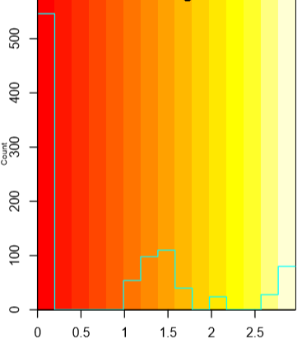
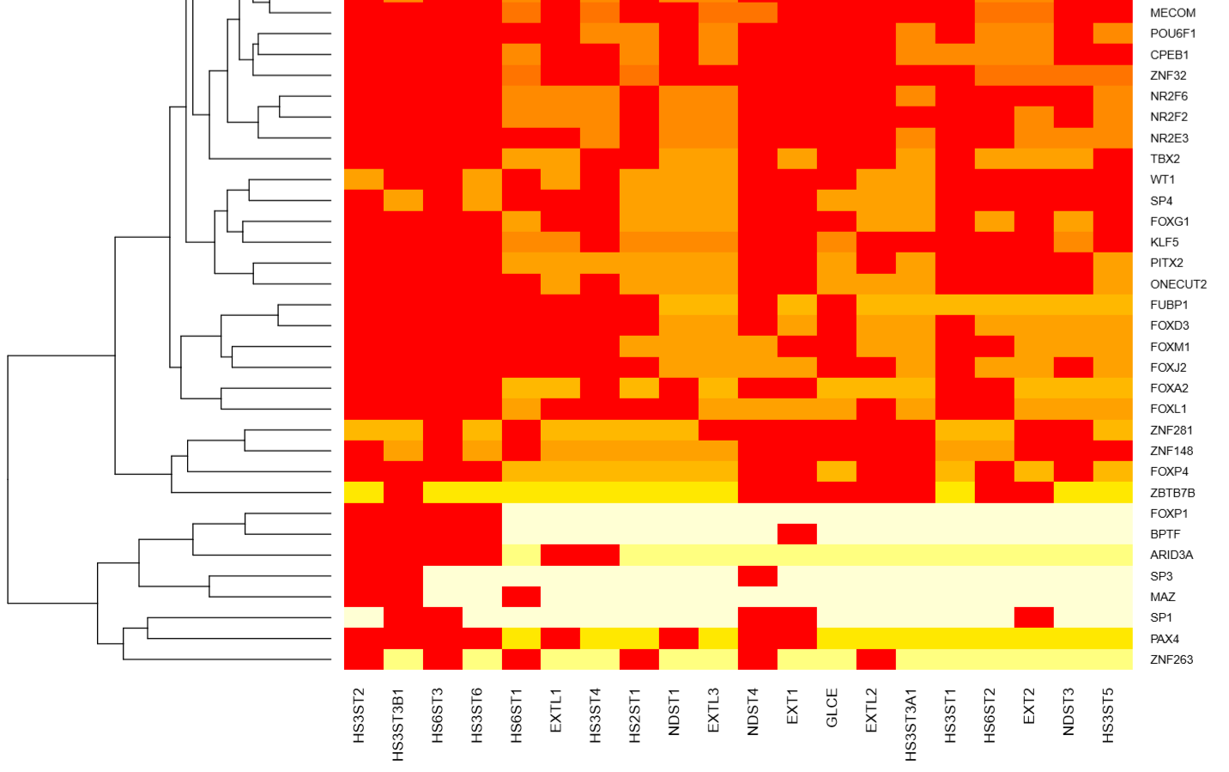
Heatmap: Whole-list regulators
-log10(1-percentile)

Slide 8
Top HS Regulators: cdf_spec sorted (best sublist regulators)
names | occurance | cdf_all | cdf_spec | gene_assc
ATF1 | 3 | 0.739618 | 1 | HS3ST3A1,HS3ST2,GLCE
IRF4 | 5 | 0.88493 | 1 | NDST3,HS3ST4,GLCE,HS6ST2,EXT2
MAZ | 17 | 0.999915 | 1 | HS3ST6,EXTL3,NDST3,NDST4,HS3ST5,HS3ST4,HS3ST3A1,NDST1,HS3ST1,EXTL1,EXTL2,GLCE,HS2ST1,HS6ST3,HS6ST2,EXT1,EXT2
TBX2 | 9 | 0.974486 | 1 | EXTL3,NDST3,HS3ST3A1,NDST1,EXTL1,HS6ST2,HS6ST1,EXT1,EXT2
JUND | 5 | 0.88493 | 0.996 | EXTL3,NDST3,NDST4,EXTL1,EXT2
SCRT1 | 4 | 0.829657 | 0.996 | EXTL1,HS2ST1,HS6ST3,EXT2
SMAD2 | 4 | 0.829657 | 0.996 | EXTL3,EXTL1,EXTL2,HS6ST3
SP3 | 17 | 0.999915 | 0.996 | HS3ST6,EXTL3,NDST3,HS3ST5,HS3ST4,HS3ST3A1,NDST1,HS3ST1,EXTL1,EXTL2,GLCE,HS2ST1,HS6ST3,HS6ST2,HS6ST1,EXT1,EXT2
SREBF1 | 4 | 0.829657 | 0.996 | HS3ST4,HS3ST2,EXTL1,EXTL2
CENPB | 1 | 0.343516 | 0.992 | HS6ST2
SP4 | 8 | 0.962166 | 0.992 | HS3ST6,EXTL3,HS3ST3A1,NDST1,EXTL2,GLCE,HS2ST1,HS3ST3B1
BPTF | 15 | 0.999339 | 0.988 | EXTL3,NDST3,NDST4,HS3ST5,HS3ST4,HS3ST3A1,NDST1,HS3ST1,EXTL1,EXTL2,GLCE,HS2ST1,HS6ST2,HS6ST1,EXT2
JUN | 5 | 0.88493 | 0.988 | EXTL3,NDST3,HS3ST3A1,EXTL1,EXT1
NFATC1 | 7 | 0.9451 | 0.988 | HS3ST6,EXTL3,NDST4,HS3ST5,NDST1,HS2ST1,EXT1
NR2C1 | 4 | 0.829657 | 0.988 | HS3ST6,EXTL3,EXTL1,EXT2
SMARCC1 | 5 | 0.88493 | 0.988 | EXTL3,HS3ST5,NDST1,HS3ST2,EXTL1
ZNF263 | 14 | 0.998322 | 0.988 | HS3ST6,EXTL3,NDST3,HS3ST5,HS3ST4,HS3ST3A1,NDST1,HS3ST1,EXTL1,GLCE,HS6ST2,EXT1,EXT2,HS3ST3B1
ZNF350 | 4 | 0.829657 | 0.988 | EXTL3,NDST1,EXT1,EXT2
FOXP1 | 16 | 0.99978 | 0.984 | EXTL3,NDST3,NDST4,HS3ST5,HS3ST4,HS3ST3A1,NDST1,HS3ST1,EXTL1,EXTL2,GLCE,HS2ST1,HS6ST2,HS6ST1,EXT1,EXT2
MECOM | 6 | 0.920908 | 0.984 | EXTL3,NDST4,HS3ST4,HS6ST2,HS6ST1,EXT2
PAX6 | 2 | 0.588129 | 0.984 | EXTL3,GLCE
PROX1 | 1 | 0.343516 | 0.984 | EXT2
SP1 | 15 | 0.999339 | 0.984 | HS3ST6,EXTL3,NDST3,HS3ST5,HS3ST4,HS3ST3A1,NDST1,HS3ST2,HS3ST1,EXTL1,EXTL2,GLCE,HS2ST1,HS6ST2,HS6ST1

Slide 9
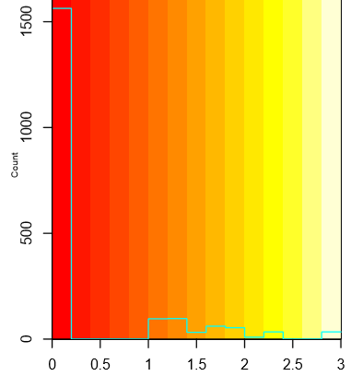
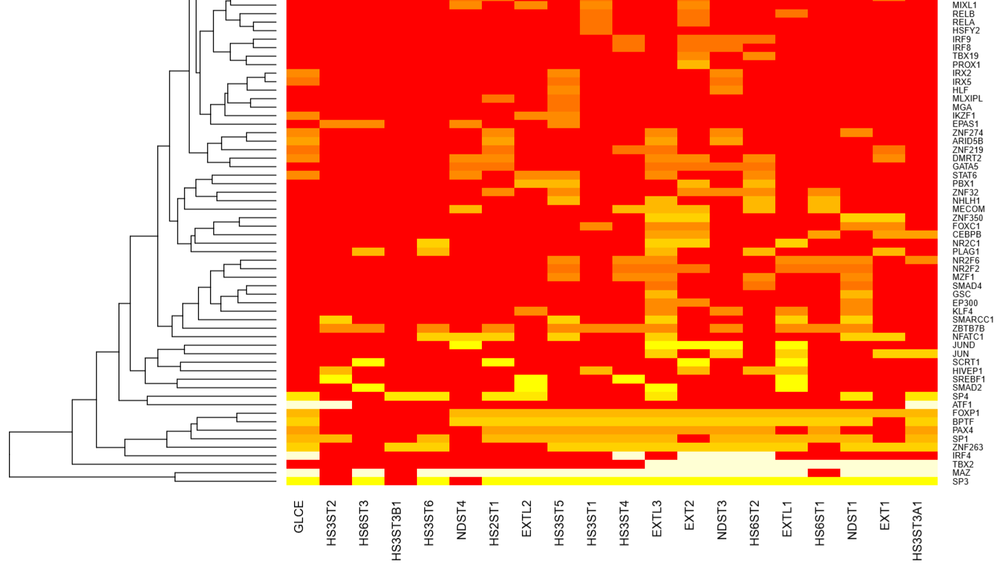
Heatmap: Sub-list regulators
-log10(1-percentile)

Slide 10
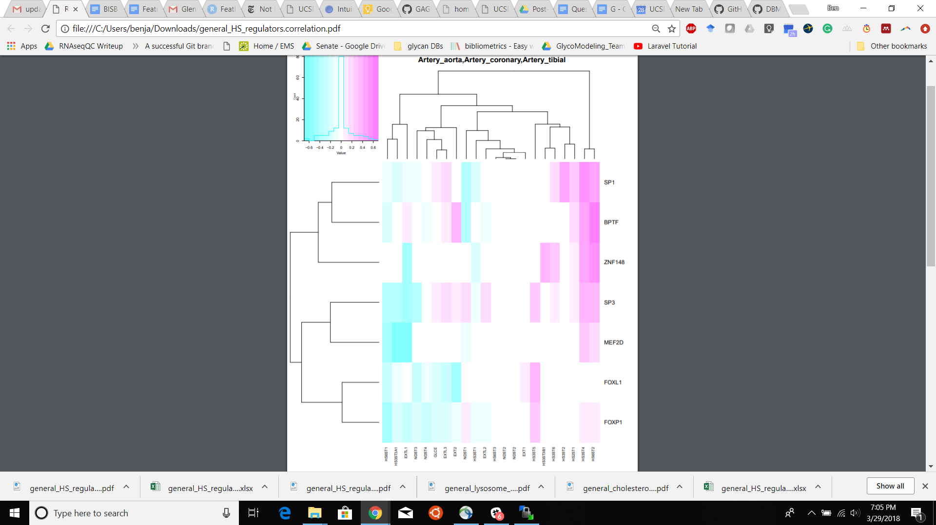
Direction of expression (artery specific)
Spearman Correlation

Slide 11
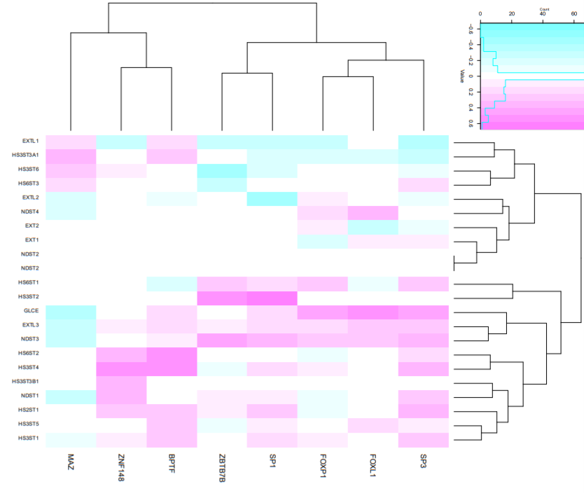
Direction of expression (all tissues)
Spearman Correlation

Slide 12
Future Directions
Concerns
Not sufficiently innovative, just querying an existing dataset
Opportunities
Regression Models: Predicting Transcription Given TF Abundance (this would be innovative)
Make a website that is the public portal for this dataset

