Slide 2
Original
VJ
resize
VJ
resize
LBP
norm
VJ
resize
LBPH
norm
VJ
resize
LBPH
conc
VJ
resize
LBP
conc
VJ
resize
HOG
conc
PCA
norm
VJ
resize
HOG
conc
norm
VJ
resize
HOG
conc

Slide 3
Original
VJ
resize
featurizer
classifiers
HOG
HOG + PCA
LBP
LBPH
ICA
SVM
MLP
Ensemble
CNN*
Pré-processamento
28,28
64,32
64,64
128,64
100,100
VJ
resize
LBP
norm
VJ
resize
LBPH
norm

Slide 4
Original
VJ
resize
featurizer
classifiers
HOG
HOG + PCA
LBP
LBPH
ICA
SVM
MLP
Ensemble
Pré-processamento
28,28
64,32
64,64
128,64
100,100
Original
VJ
resize
classifiers
Pré-processamento
CNN
28,28
100,100

Slide 5
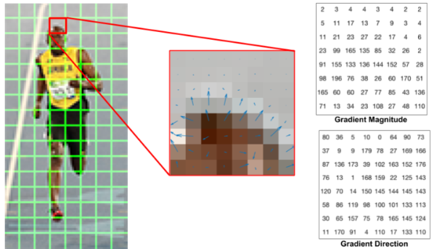
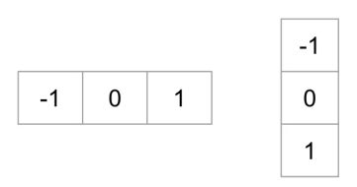
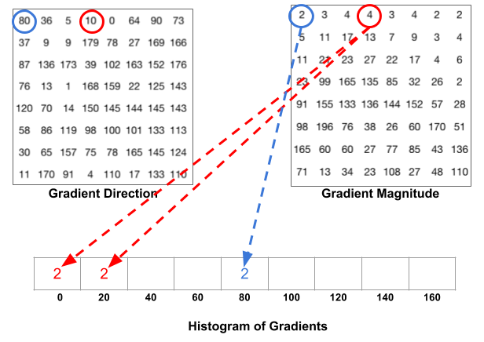
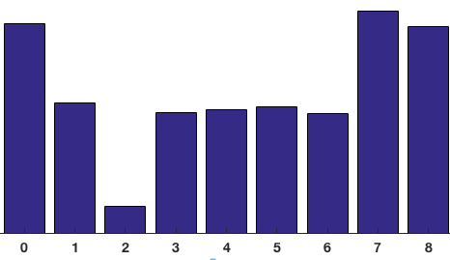
Etapa 2
Etapa 3
Etapa 4

