Slide 1
DATABASE SYSTEMS SOEN 363 – WINTER 2020 Project Phase 2: MongoDB
Firas Sawan ID#26487815 Kenza Boulisfane ID# 40043521

Slide 2
CHOESN SYSTEM
For the purposes of this project we chose to go with MongoDB, a document- based NoSQL system.
MongoDB provides high levels of scalability and flexibility as well relatively easy querying and indexing strategies.
The main reason we decided to go with MongoDB is because it is simple for developers to learn and use, while still providing all the capabilities needed to meet the most complex requirements.
We used MongoExpress, which is a lightweight web-based administrative interface deployed to manage the MongoDB databases interactively.

Slide 3
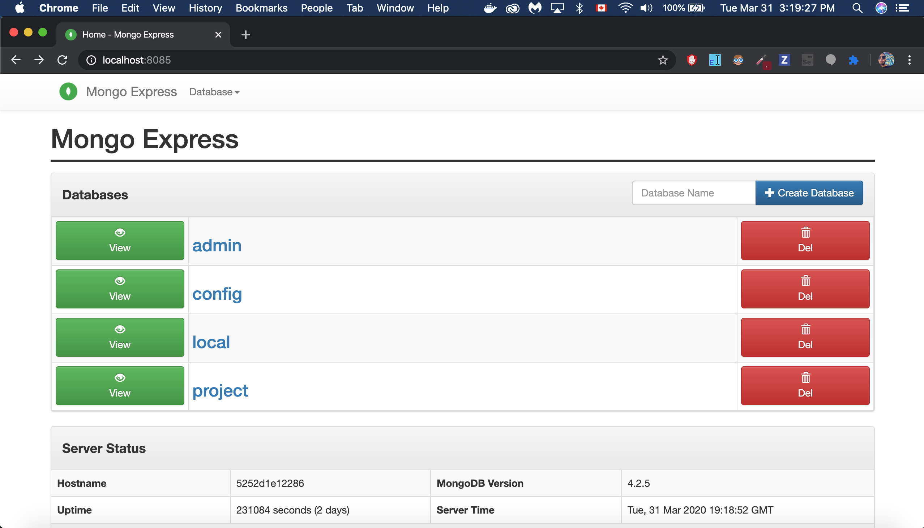
Mongo Express
Importing our data to MongoExpress was done with the help of Docker and a script that we could run in command line to facilitate the importation process

Slide 4
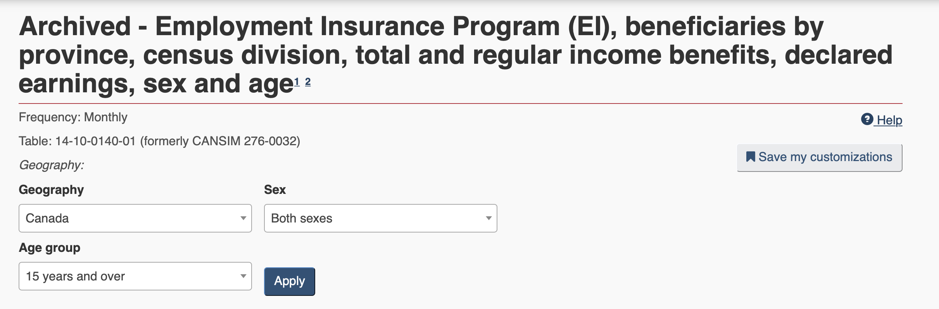
DATASET:
Our Dataset covers Employment Insurance Program Information (EI) for the years 1997-2014
It contains data about income benefits presented by province, census division, total and regular income benefits, sex, age and the value of the benefits.
Database size is 850 Megabytes

Slide 5
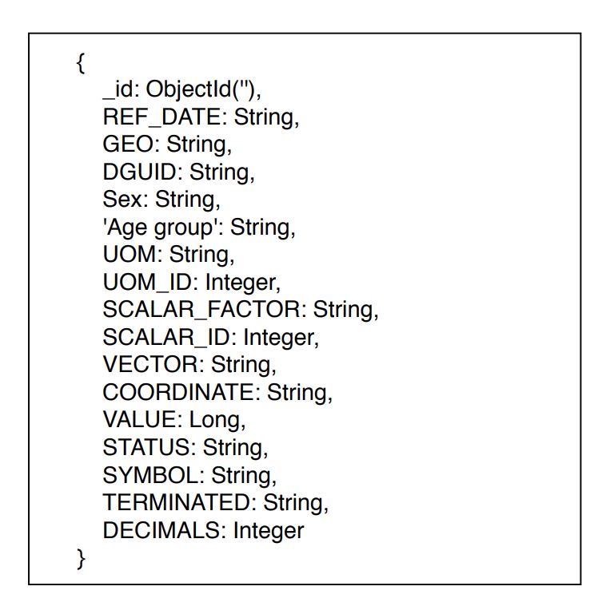
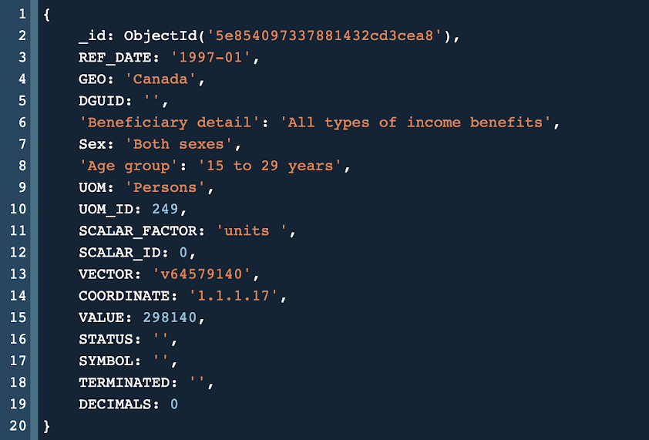
DATA MODEL

Slide 6
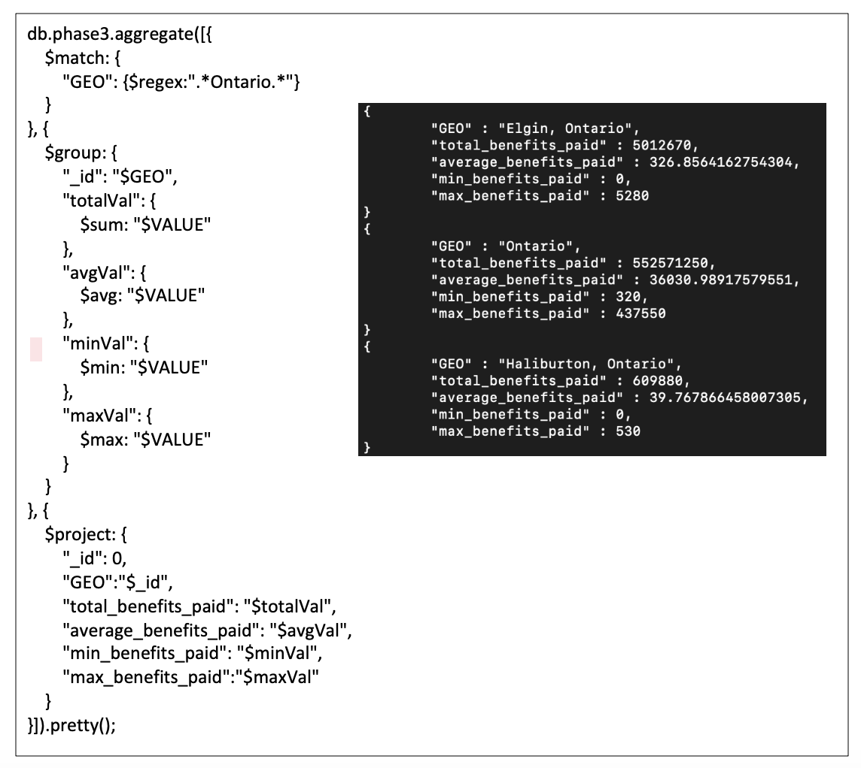
Query 1
For each location in the province of Ontario, find the total, average, min, and max value of all benefits ever received.
(Sample output in black screenshot)

Slide 7
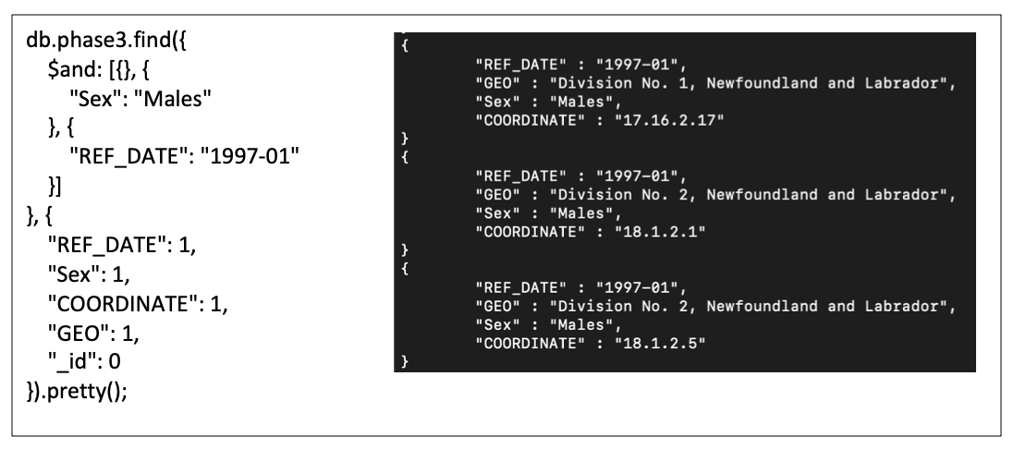
Query 2
Find out the coordinates of all areas in which males received benefits in January of 1997.
(Sample output in black screenshot)

Slide 8
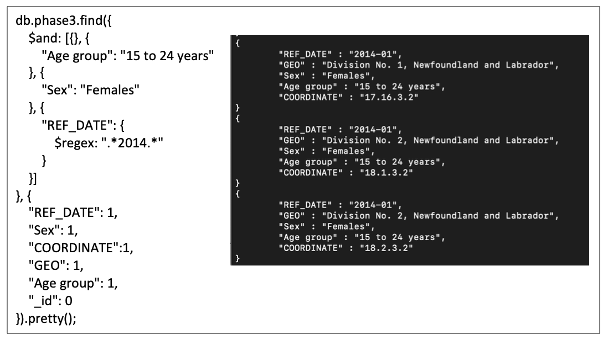
Query 3
Find the geolocation of all females aged between 15-24 years old that received benefits in the year 2014.
(Sample output in black screenshot)

Slide 9
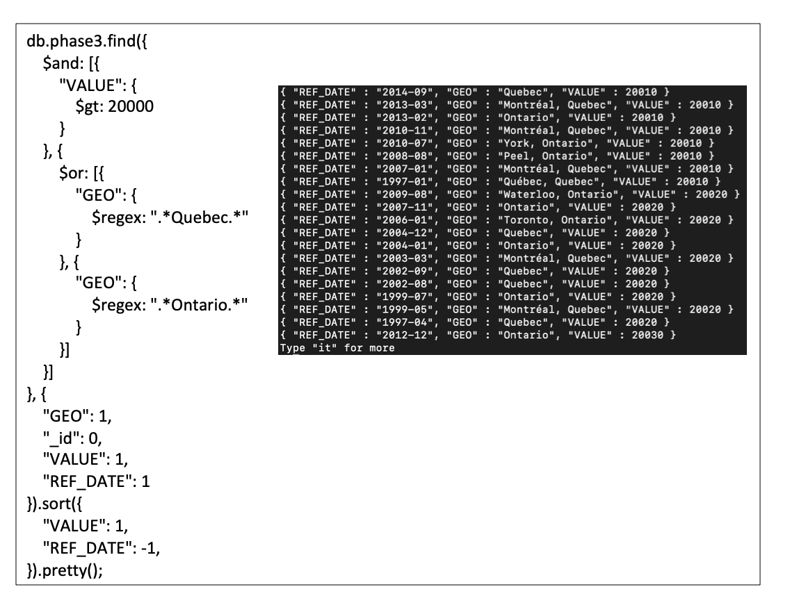
Query 4
Find all income benefit values higher than 20,000 sorted in ascending order of value and exclusively in the geolocations of either Quebec and Ontario. Then sort the result in descending order of the date.
(Sample output in black screenshot)

Slide 10
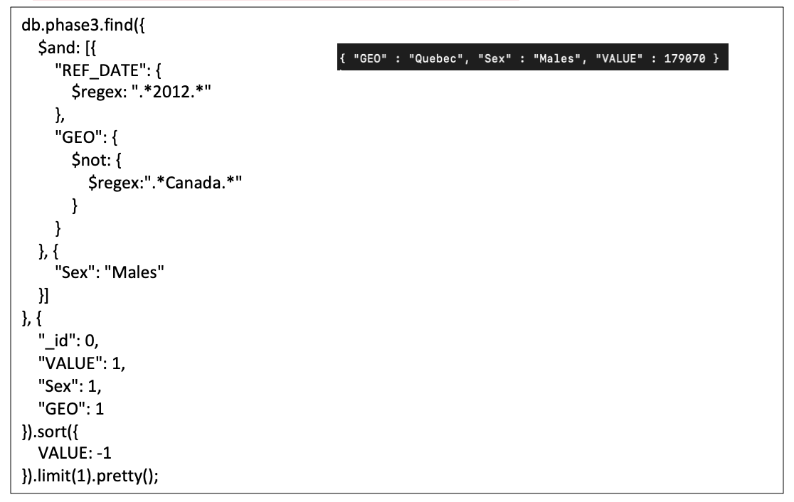
Query 5
Find the geolocation with the highest value for income benefits in the year 2012 where the sex of the beneficiary is Males.
(Full output in black screenshot)

Slide 11
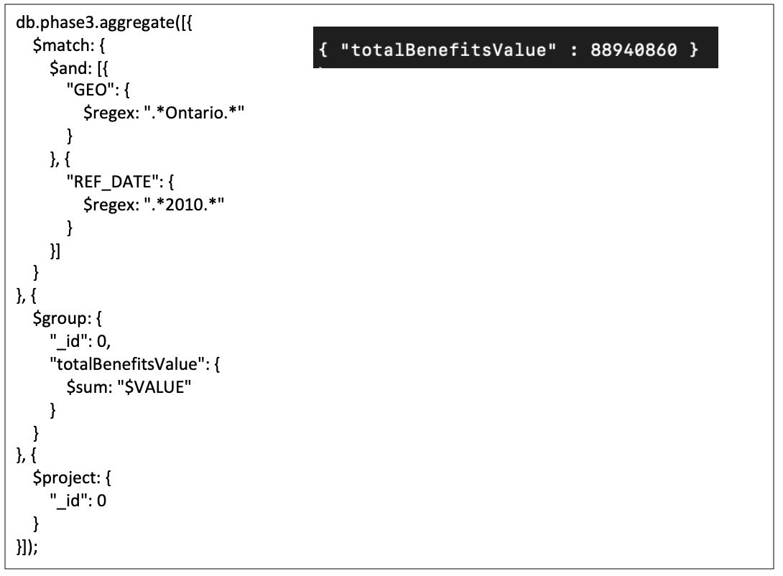
Query 6
Find the total value of all benefits collected in Ontario the year 2010, we can do this using an aggregate function.
(Full output in black screenshot)

Slide 12
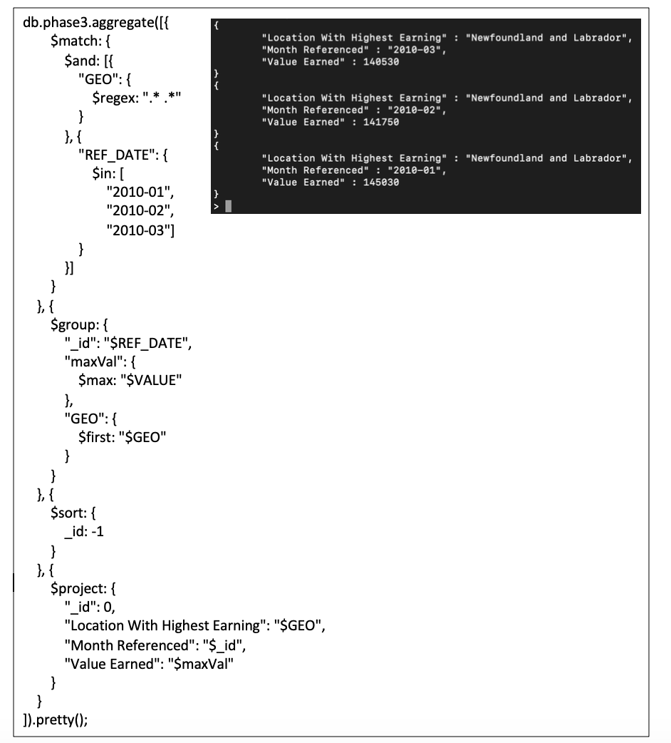
Query 7
For the first 3 months in the year 2010, find the location with the highest value of collected benefits. Display the location and the value collected.
(Full output in black screenshot)

Slide 13
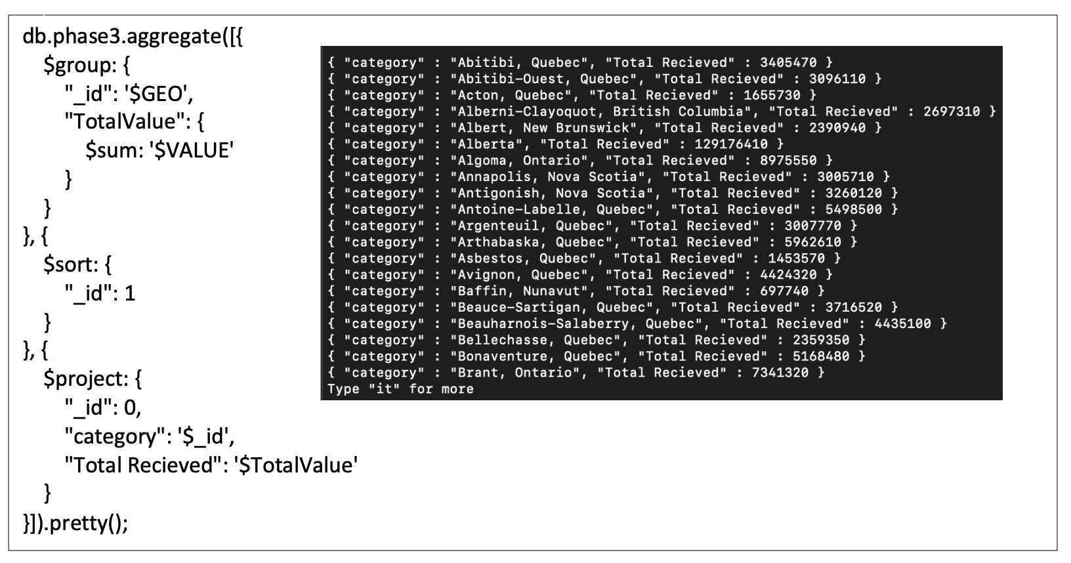
Query 8
Find the total value of all beneficiaries that were received per geolocation,
This should cover all years available in the dataset and display the total value that each location has been granted. Sorted in ascending alphabetical order of Geolocation.
(Sample output in black screenshot)

Slide 14
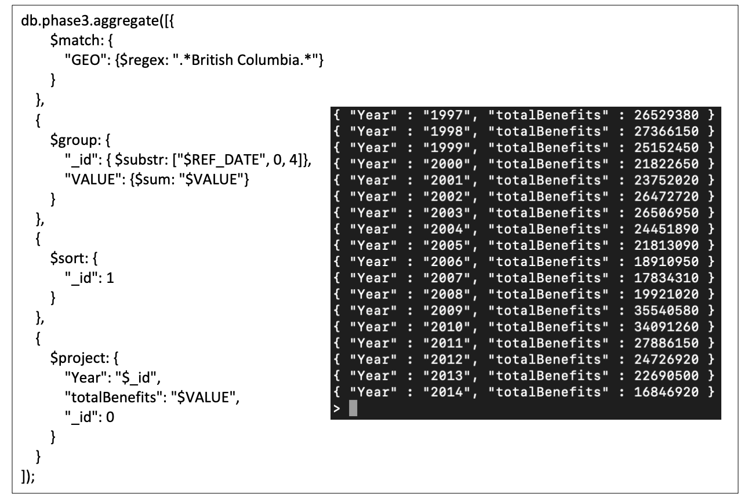
Query 9
For each year, find the total sum of benefits paid in British Columbia. Then sort the years in ascending order of that total.
(Full output in black screenshot)

Slide 15
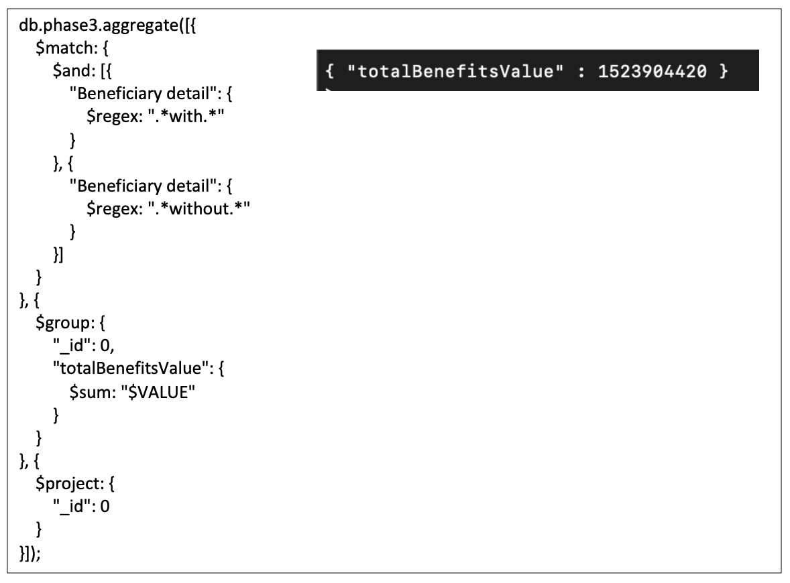
Query 10
Find the total value of benefits that was paid to both people with declared income and those without declared income.
(Full output in black screenshot)

Slide 16
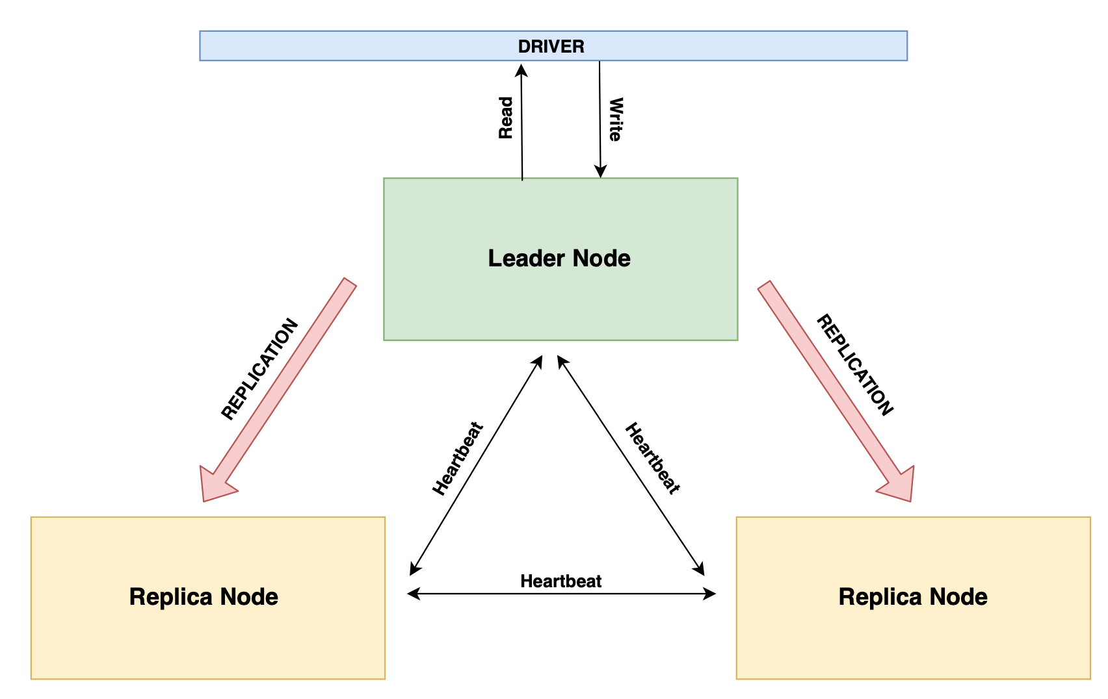
Consistency and Availability
Default Behavior involves sending all read and writes to the leader node. Provides consistency but not availability.
This is because the leader node might die and there is a delay for the system to elect a new replica node to respond.
Other issues include network issues or when a node disconnects from a cluster due to a partitioned network = No 24/7 Availability.

Slide 17
Consistency and Availability SOLUTIONS !!
Option 1: Make it possible for the MongoDB client to read from replica nodes = breaks consistency in a scenario where one of the replica nodes has not yet been updated. (Provides eventual consistency).
Option 2:
Employ MongoDB’s write concerns. Write concerns are a way for us to specify the number of nodes to which the data should be written in order to constitute a successful write operation = Same data across all nodes and we ensure consistency.

Slide 18
Consistency and Availability Conclusions
Employing these 2 techniques ensures that we have a system that is fully consistent.
We still experience some unavailability when it comes to write operations. This is because although we can solve the availability issue for reads via a few configurations in the client, there is no solution for the availability of the writes.
Therefore……
MongoDB system is fully consistent (with some configuration).
MongoDB system is fully available for read operations, but not always available for write operations.

Slide 19
Indexing techniques
Indexing facilitates query operations by reducing the latency over which data is retrieved.
It does so by minimizing the number of documents that need to be scanned.
Collections with high read-to-write ratios are better at utilizing indexes than those with a high write-to-read ratio.

Slide 20
Indexing techniques
Three of MongoDB’s indexing techniques are relevant to the database we chose, namely these techniques are:
Single Field Indexes: assign a single field of a document as an index (Value of 1 or -1)
Compound Indexes: assign more than one field of a document as an index (Value of 1 or -1)
Text Indexes: instead of numbered indexes we use a string of text as an index. Text indexes are interesting since we can assign a weight to each index. Weights give priority when it comes to query searches.
Multikey indexes and Hashed indexes are also discussed in the report.

Slide 21
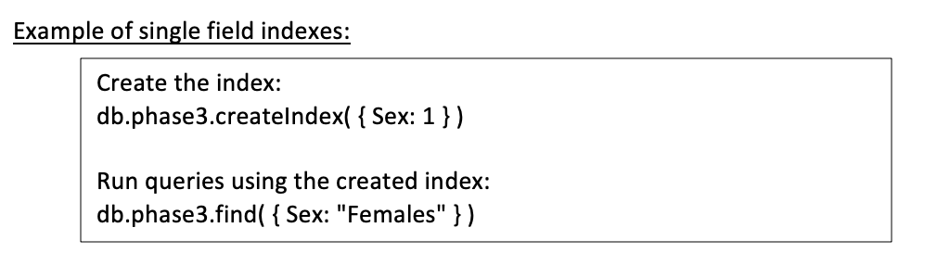
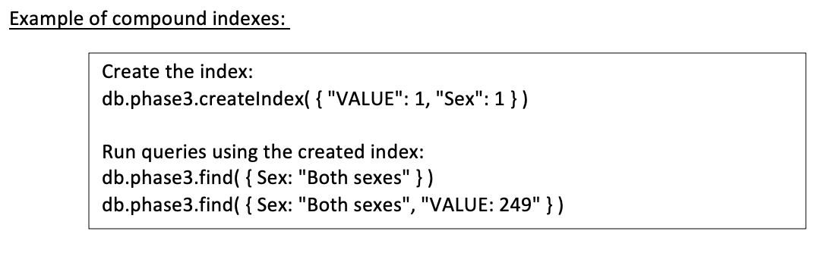
Indexing techniques

Slide 22
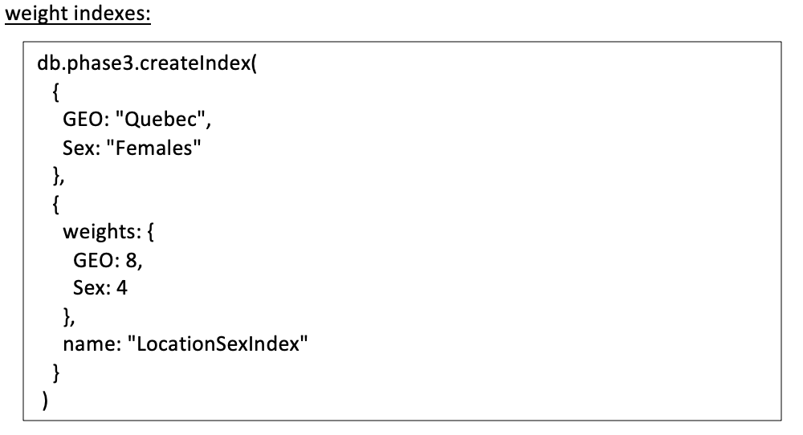
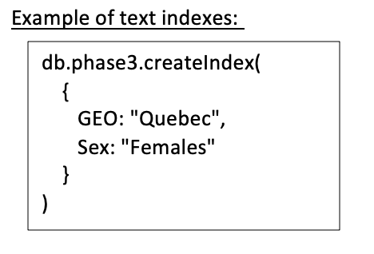
Indexing techniques

Slide 23
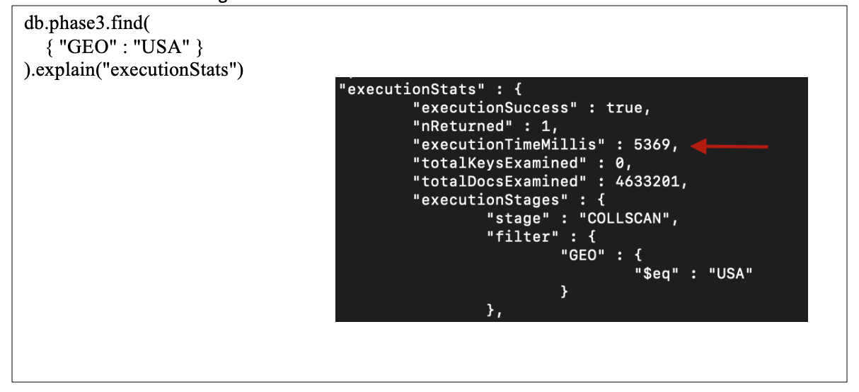
Indexing techniques Example
First, we begin by showing the execution time it takes to find a retrieve data from our database when there is no indexing at all.

Slide 24
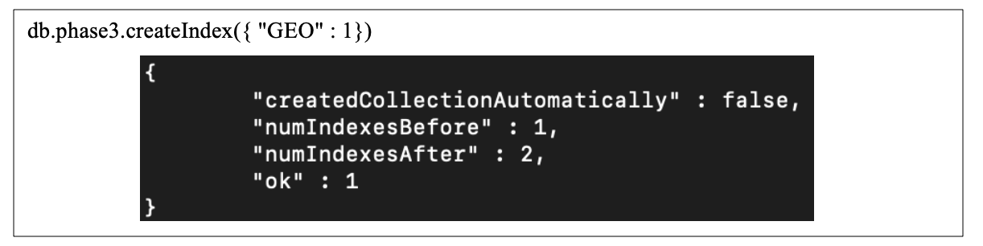
Indexing techniques Example
Then we will create an index for GEO field in our database using the following query:

Slide 25
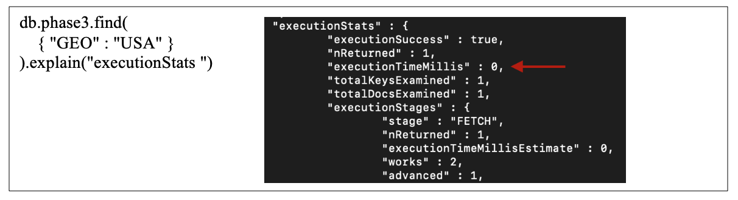
Indexing techniques Example
Finally we will test again our query from above to check the execution stats and verify that the retrieval time has in fact decreased post indexing:
Notice that adding the index has indeed resulted in a huge decrease in the amount time taken to search through our documents making it almost immediate and showing the benefits of indexing.

