Slide 1

Thank You
This PowerPoint document contains the images that you requested.
Copyright Notice
All materials on this Site are protected by United States copyright law and may not be reproduced, distributed, transmitted, displayed, or otherwise published without the prior written permission of Wolters Kluwer. You may not alter or remove any trademark, copyright or other notice.
However, provided that you maintain all copyright, trademark and other notices contained therein, you may download material (one machine readable copy and one print copy per page) for your personal, non-commercial use only. Please refer to this link for further information on how to apply for permission for re-use
Any information posted to discussion forums (moderated and un-moderated) is for informational purposes only. We are not responsible for the information or the result of its practice.

Slide 2
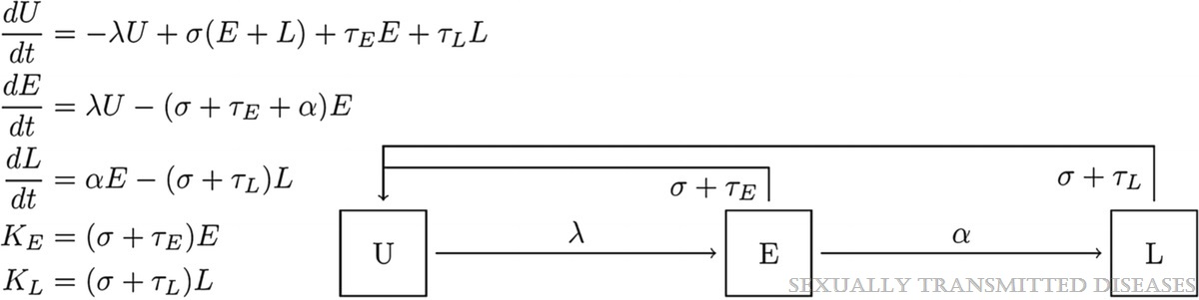
Panel 1
Estimates of the Prevalence and Incidence of Syphilis in the United States, 2018
Spicknall, Ian H.; Kreisel, Kristen M.; Weinstock, Hillard S.
Sexually Transmitted Diseases48(4):247-252, April 2021.
doi: 10.1097/OLQ.0000000000001364
Model differential equations and schematic. Syphilis state space is described by people being uninfected (U), early infected (E), and late infected (L). The annual number of early case reports (KE) and late case reports (KL) is used to fit thismodel by specifying stage-specific rates of symptomatic treatment seeking, background screening, and initial state space description. Each subpopulation based on age and sex is fit separately, allowing for subpopulation specific parameter values. Additional modeling simulation code is available in the Supplemental Materials, http://links.lww.com/OLQ/A602.

Slide 3
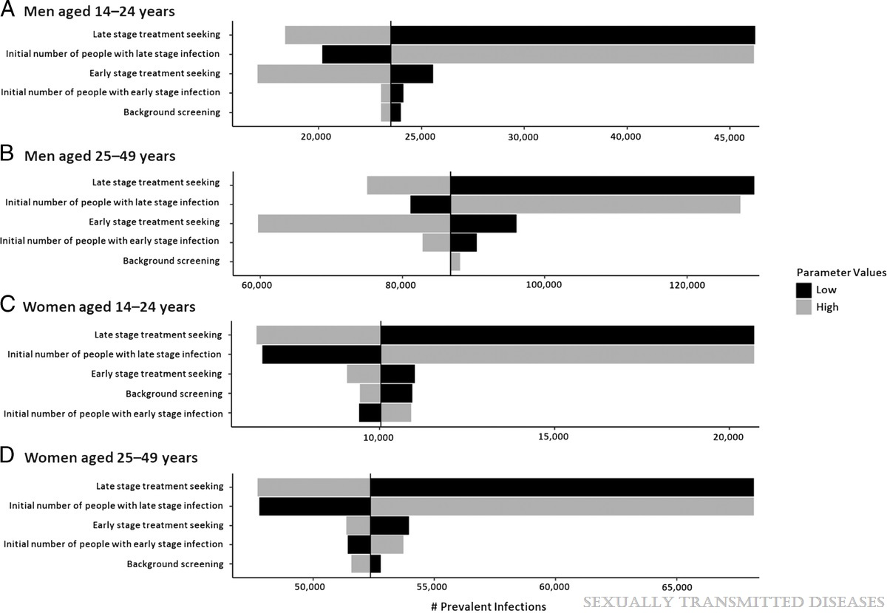
Figure 1
Estimates of the Prevalence and Incidence of Syphilis in the United States, 2018
Spicknall, Ian H.; Kreisel, Kristen M.; Weinstock, Hillard S.
Sexually Transmitted Diseases48(4):247-252, April 2021.
doi: 10.1097/OLQ.0000000000001364
Ranked uncertainty impact analysis of model parameters on the number of prevalent syphilitic infections, by sex and age group, United States, 2018.

Slide 4
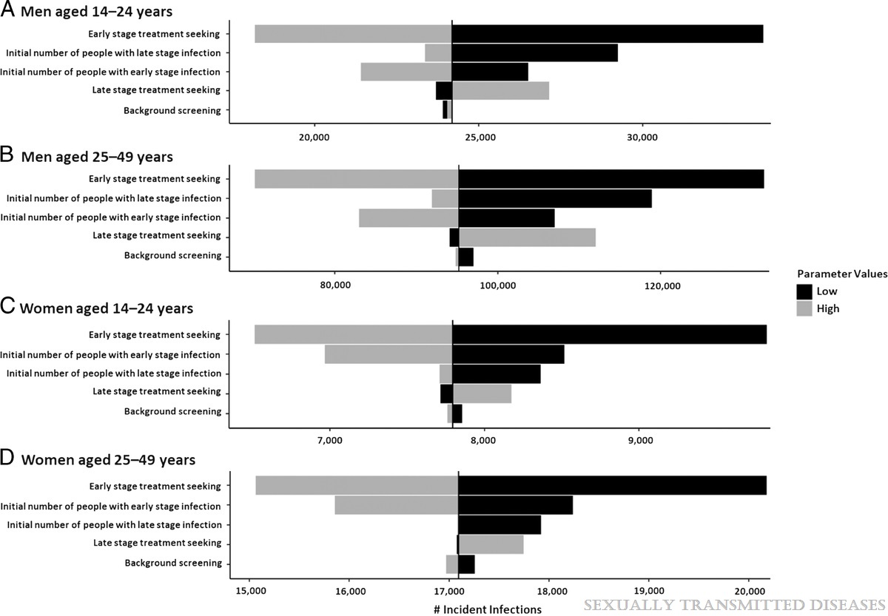
Figure 2
Estimates of the Prevalence and Incidence of Syphilis in the United States, 2018
Spicknall, Ian H.; Kreisel, Kristen M.; Weinstock, Hillard S.
Sexually Transmitted Diseases48(4):247-252, April 2021.
doi: 10.1097/OLQ.0000000000001364
Ranked uncertainty impact analysis of model parameters on the number of incident syphilitic infections, by sex and age group, United States, 2018.

