Slide 1
Iterative Applications with MapReduce
UW Educational Outreach (UWEO) course CLOUD 303
April 16, 2012
Jaliya Ekanayake, PhD

Slide 2







About me…
University of Moratuwa
Sri Lanka (BSc Eng.)
MS and PhD in Computer Science

Slide 3
Summary
Big-data & its Challenges
MapReduce
Iterative Algorithms with MapReduce
Daytona & Twister
Programming Abstraction
Architecture
Scheduling
Iteration Support
Daytona – Demo
Other Runtimes
Assignment
Notes:
Please ask questions
Let’s be interactive
Tell me if the stuff seems too basic for you guys

Slide 4
The Data Deluge
According to one estimate, mankind created 150 exabytes (billion gigabytes) of data in 2005. This year, it will create 1,200 exabytes
Size of the web ~ 3 billion web pages
During 2009, American drone aircraft flying over Iraq and Afghanistan sent back around 24 years’ worth of video footage
~108 million sequence records in GenBank in 2009, doubling in every 18 months
~20 million purchases at Walmart a day
90 million Tweets a day
Astronomy, Particle Physics, Medical Records …
Notes:
For each category, give examples, e.g. Astronomy solon 20 TB night,
http://www.datacenterknowledge.com/archives/2009/12/22/the-data-crunching-powerhouse-behind-avatar/

Slide 5

Data Deluge => Compute Intensive Processing
Require Large
Processing Power
> O (n)
Processors are not going to get faster
Multi /Many core architectures => Thousand cores to clusters and millions in data centers
Parallelism is a must to process data in a meaningful time

Slide 6
The State of the Art
PIG Latin, Sawzall
Workflows, DAGMAN
Grid, Condor, PBS
MapReduce, Dryad, Pregel
MPI, PVM, HPF
Threads, TPL, PLINQ, OpenMP
OpenCL, CUDA
Custom
Built
Platform as a Service
e.g. Windows Azure
Infrastructure as a Service
e.g. Amazon EC2
Operating Systems
Hypervisors
Hardware
High level programming models such as MapReduce show promising results in data intensive processing
Notes:
Draw a picture covering the technologies. Bottom layers hardware+virtualization, next cores, and then the technologies that can use cores like PLINQ, Tasks, threads, OpenMP etc. Then the distributed runtiems, list them and show the HPC class and the new trend, Moving computing to data. MapReduce, DryadLINQ

Slide 7
MapReduce
Data Partitions
Map(Key, Value)
A hash function maps the results of the map tasks to r reduce tasks
Reduce(Key, List<Value>)
Reduce Outputs
Implementations support:
Splitting of data
Passing the output of map functions to reduce functions
Sorting the inputs to the reduce function based on the intermediate keys
Quality of services
Example: WordCount / MapReduce in Simpler Terms
Notes:
Use board to explain typical Hadoop architecture if the student’s are not familiar with the concept.

Slide 8
Features of Existing Architectures(1)
Google, Apache Hadoop, Sector/Sphere,
Dryad/DryadLINQ (DAG based)
Programming Model
MapReduce (Optionally “map-only”)
Focus on Single Step MapReduce computations (DryadLINQ supports more than one stage)
Input and Output Handling
Distributed data access (HDFS in Hadoop, Sector in Sphere, and shared directories in Dryad)
Outputs normally goes to the distributed file systems
Intermediate data
Transferred via file systems (Local disk-> HTTP -> local disk in Hadoop)
Easy to support fault tolerance
Considerably high latencies
Notes:
Cascading is there, but that is for multiple MapReduce computations.

Slide 9
Features of Existing Architectures(2)
Scheduling
A master schedules tasks to slaves depending on the availability
Dynamic Scheduling in Hadoop, static scheduling in Dryad/DryadLINQ
Naturally load balancing
Fault Tolerance
Data flows through disks->channels->disks
A master keeps track of the data products
Re-execution of failed or slow tasks
Overheads are justifiable for large single step MapReduce computations
Iterative MapReduce ?

Slide 10
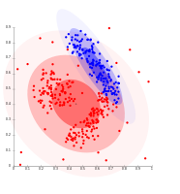
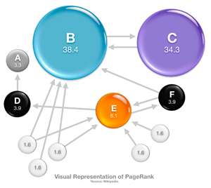
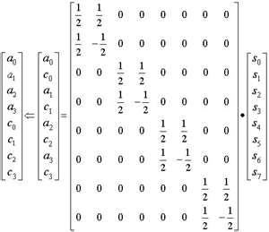
Iterative Algorithms
Many Machine Learning Algorithms
Clustering
K-means
Deterministic Annealing Clustering
PageRank
Classification
Multidimensional Scaling
Linear Algebra

Slide 11
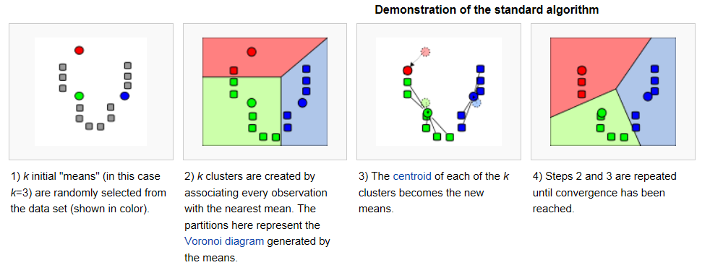
An Example – KMeans Clustering
Source: Wikipedia
Demo

Slide 12
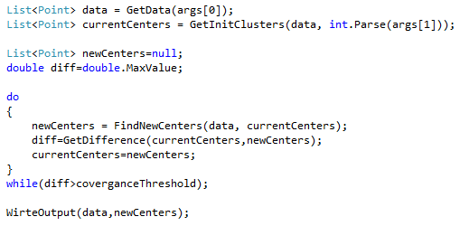
KMeans Clustering – The Code
What happen when the data become big?
How can we scale this?

Slide 13
Parallel KMeans
Use the board ☺
How about MapReduce?
while(condition){
Read Data Partitions in Parallel
runMapReduce(..)
May send <Key,Value> pairs directly
Map()
Iterations
Reduce()
Combine() operation
updateCondition()
} //end while

Slide 14

Kmeans in Hadoop Style
Variable Data – e.g. Hadoop distributed cache
Static Data
Loaded in Every Iteration
New map/reduce tasks in every iteration
Map(Key, Value)
Iterate
Local disk -> HTTP -> Local disk
Main Program
Reduce (Key, List<Value>)
Reduce outputs are saved into multiple files
Focuses mainly on single step map->reduce computations
Considerable overheads from:
Reinitializing tasks
Reloading static data
Communication & data transfers

Slide 15
KMeans in Twister Style
Static Data
Loaded only once
Configure()
Iterate
Main Program
Long running map/reduce tasks (cached)
Map(Key, Value)
Direct data transfer via pub/sub
Reduce (Key, List<Value>)
Combiner operation to collect all reduce outputs
Combine (Map<Key,Value>)
Distributed data access
Distinction on static data and variable data (data flow vs. δ flow)
Cacheable map/reduce tasks (long running tasks)
Combine operation
Support fast intermediate data transfers

Slide 16
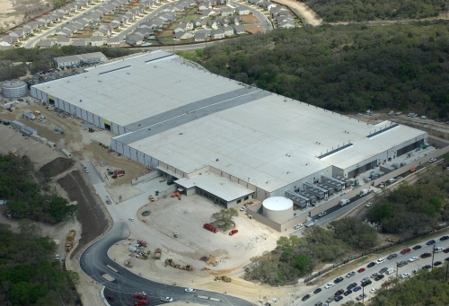
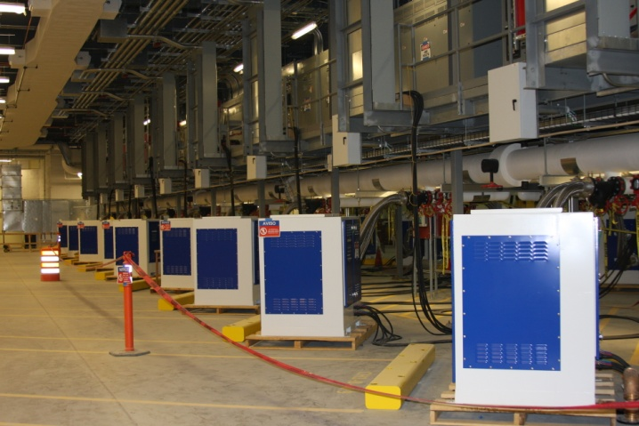
Windows Azure

Slide 17
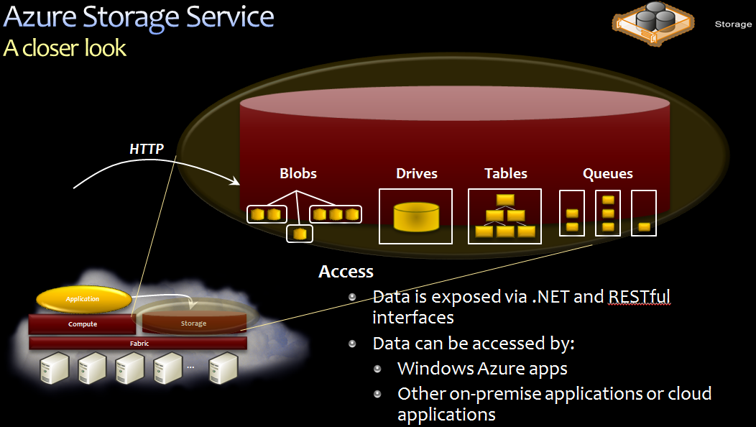
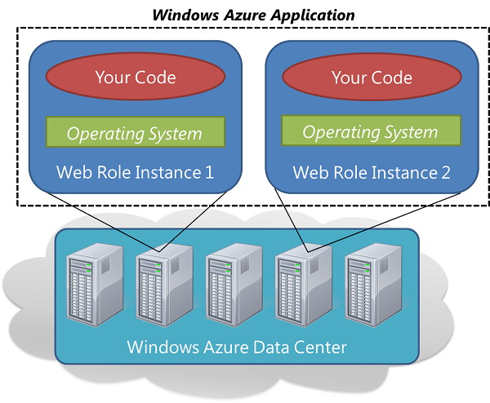
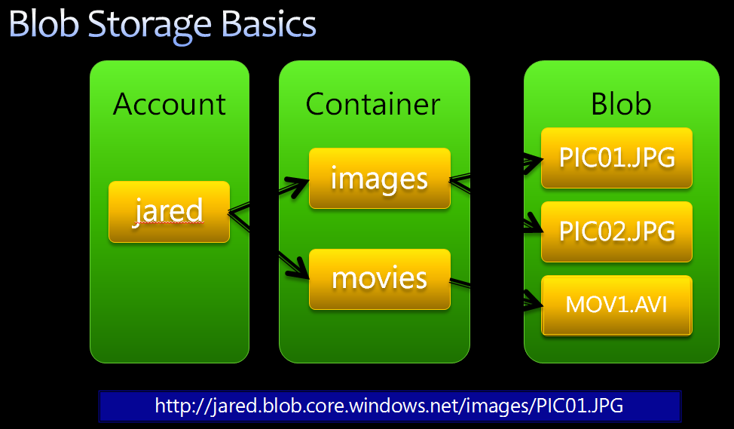
Azure Basics
Storage Services
Blobs/Containers
Table
Queues
SQL Azure
Compute Services (Roles)
Web Role
Worker Role
Source: Introduction To Windows Azure

Slide 18
Daytona
Enhanced MapReduce on Windows Azure
Jaliya Ekanayake, Wei Lu, Roger Barga

Slide 19
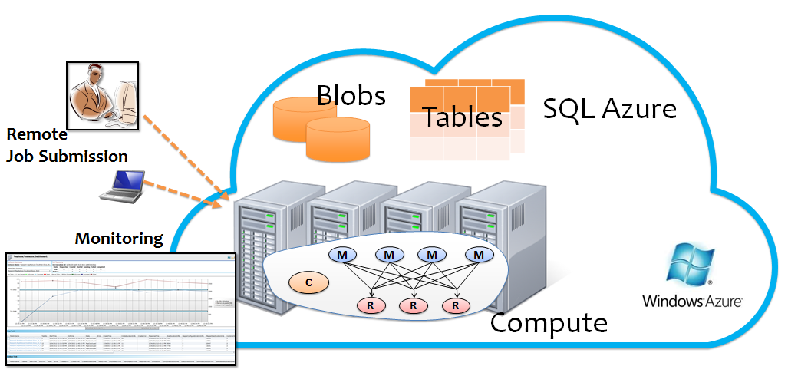
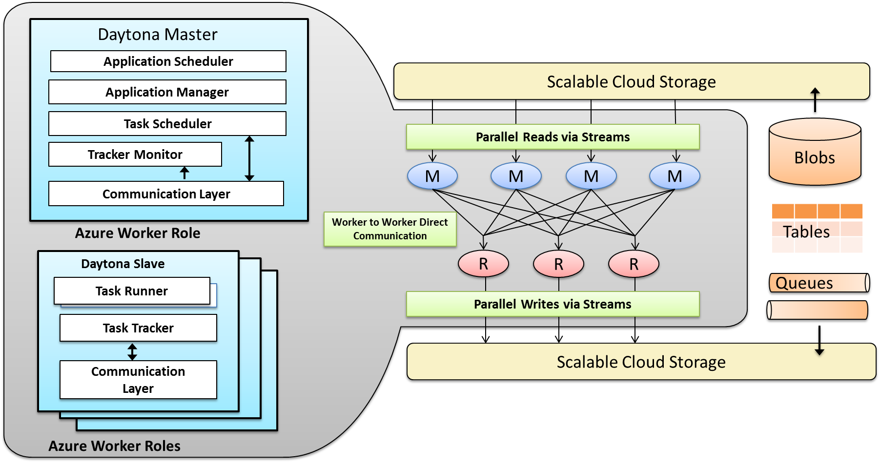
Overview – Project Daytona
Designed for Windows Azure and builds upon Azure services
Integrated with Azure data storage services and can stream data in parallel
Optimized for data analytics and machine learning algorithms

Slide 20
Programming Abstraction
Controller
Map
Example
IEnumerable<KeyValuePair<string, int>>
Map(int key, string value, …)
{
…
yield return new KeyValuePair(word, 1);
}
void Run()
{
Job job1 = new Job(Map1,Reduce1,..);
Job1. Run();
Job job2 = new Job(Map2,Reduce2,..);
while(SomeCondition)
{
job2.AddOrReplaceParameters(..);
job2.Run();
}
Job job3 = new Job(Map3,Reduce3,..);
job3.Run();
}
Reduce & Local Combiner
IEnumerable<KeyValuePair<string, int>>
Reduce(string key, IEnumerable<int> values,…)
{
…
yield return
new KeyValuePair(key, values.Sum());
}
IDataPartitioner
e.g. BlobTextPartitioner
IRecordReader
e.g. BlobTextReader
IRecordWriter
e.g. BlobTextWriter
IKeyPartitioner
e.g. HashKeyPartitioner

Slide 21
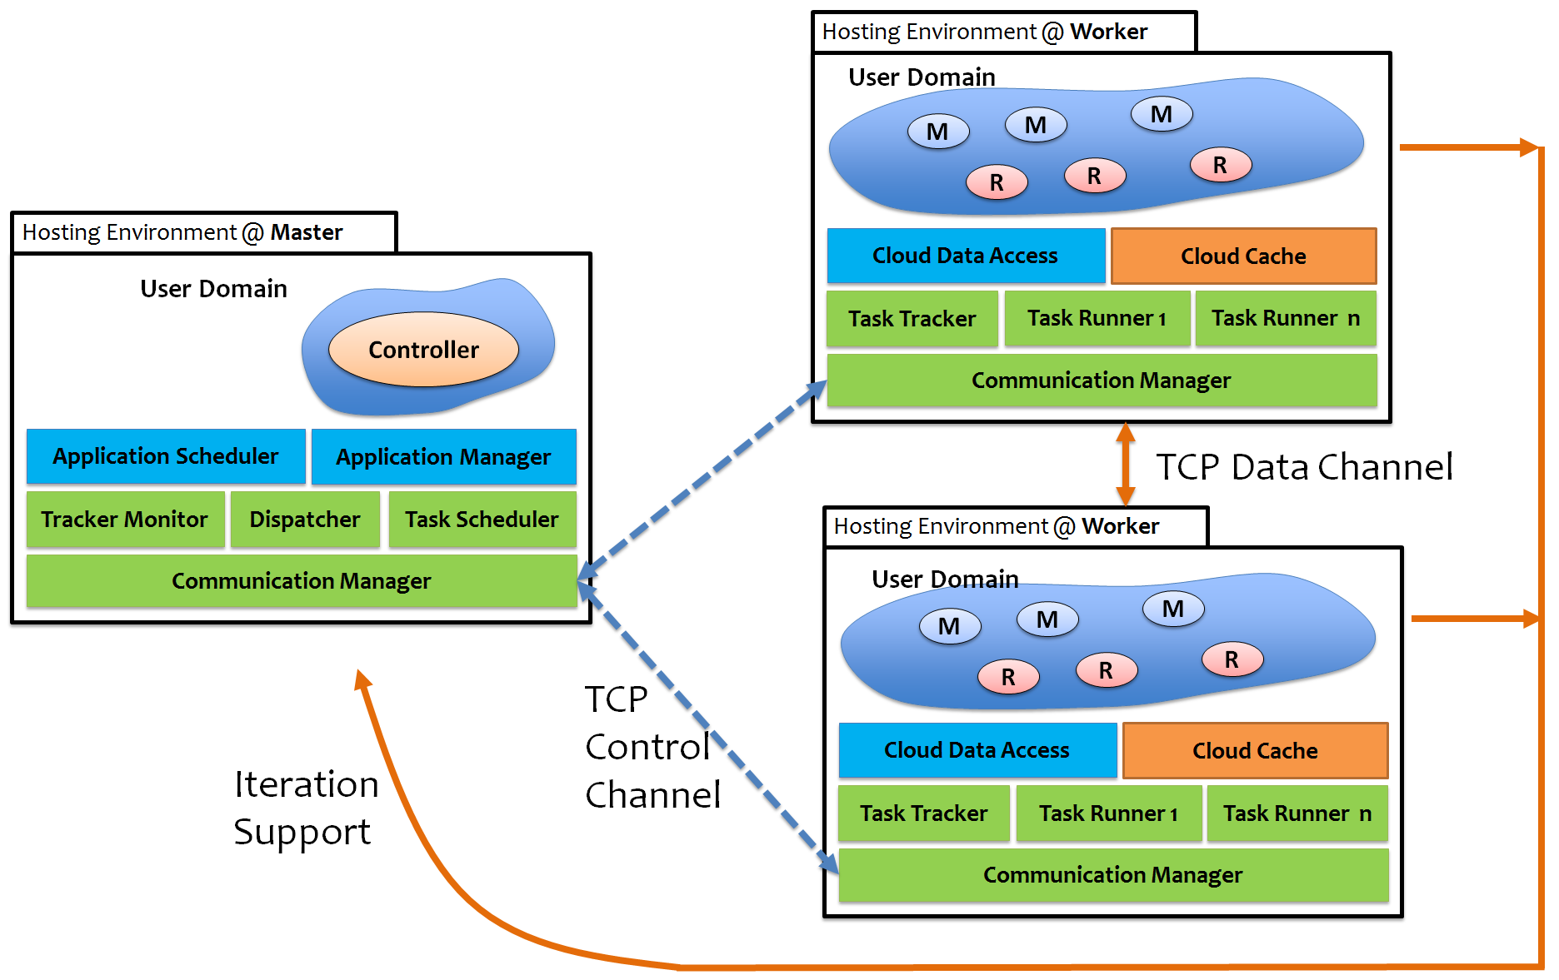
Architecture
Application = Collection of MapReduce jobs i.e. Single Controller containing multiple MapReduce jobs
ApplicationScheduler is a FIFO Queue
Per Application ApplicationManager executes the Controller which produces Map/Reduce tasks
TaskScheduler + Dispatcher schedule the tasks to available Slave Nodes
TaskRunner is an execution thread – Map/Reduce tasks run in “threads”
User code is executed in a separate AppDomain created per Application (reuse)
Map -> Reduce data transfer via TCP
A data channel from Reduce to Controller
TaskScheduler reschedules failed/zombie tasks

Slide 22
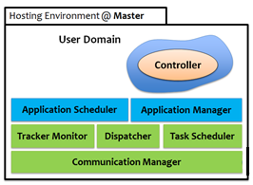
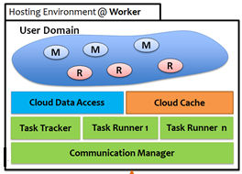
Scheduling
Map Tasks
Scheduling
Reduce Tasks
Map Slots
Reduce Slots
Slave Nodes has a configurable number of Map/Reduce slots
Each slave informs its slot capacity to the Master during the initial registration
TrackerMonitor at the Master keeps track of the availability of Slaves using heartbeats
Master’s TaskScheduler simply fills the available slots in Slaves
Supports three scheduling policies
Round-Robin
Simple Iterative
Data Locality Aware

Slide 23
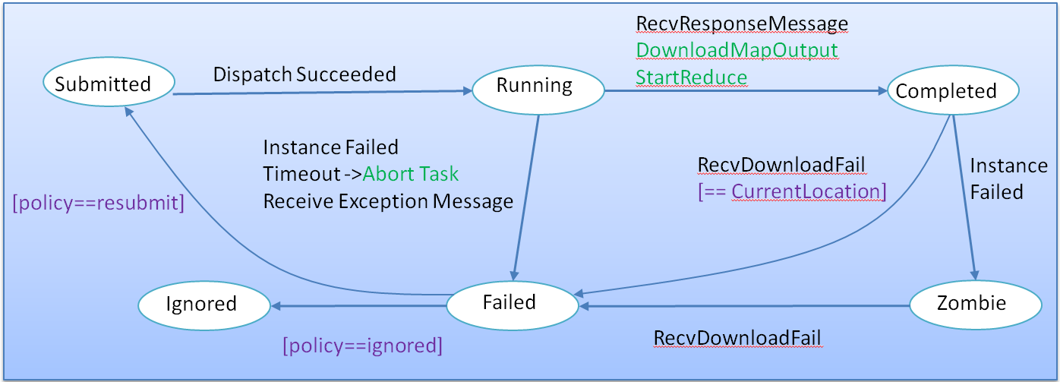
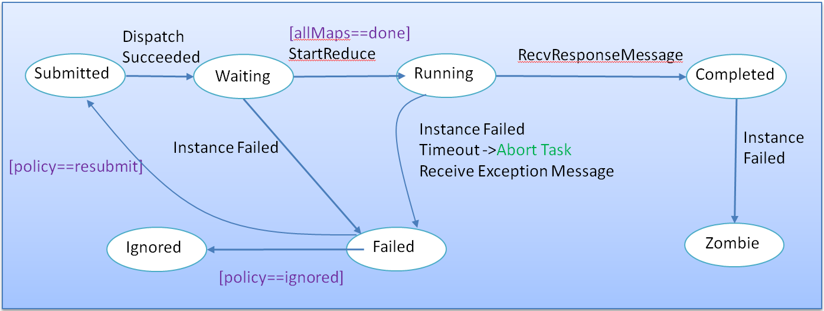
Fault Tolerance
The Master enforces the following state-machines for Map and Reduce tasks
User exceptions are evaluated against a user provided exception handler at the Controller
Each task is retried multiple times for runtime errors or timeouts
Multiple failed dispatch attempts or failed tasks results in the removal of Slave from the Master’s list
Slaves will re-register with the Master – (Azure automatically restarts crashed slaves)
User can add more Slave nodes during the computation and the scheduler will utilize them immediately – Dynamic flexibility
State Transitions for Map Tasks
State Transitions for Reduce Tasks

Slide 24
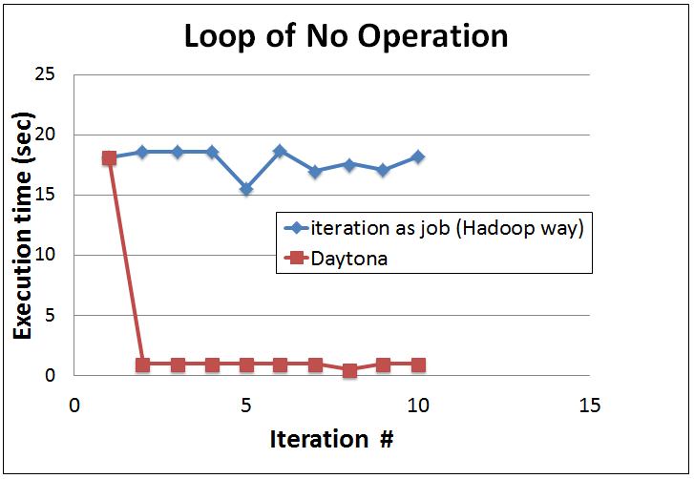
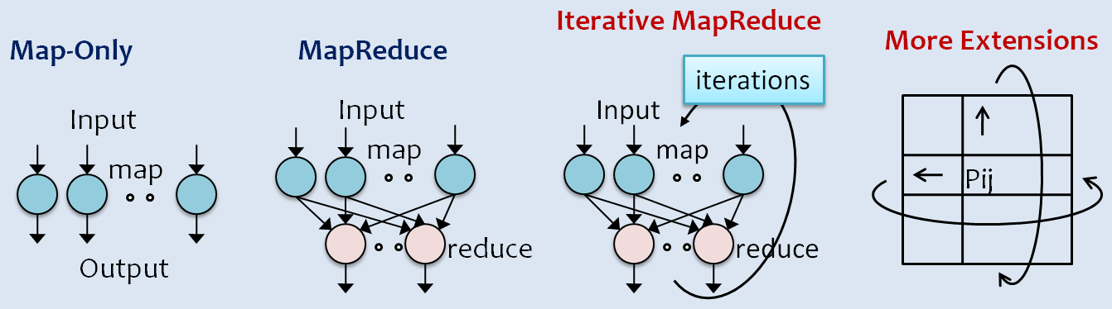
Iteration Support - Runtime Optimizations
Introduced Controller-Map-Reduce pattern
Enables checking for convergence criteria at the controller for iterative applications
Supports getting reduce output directly at the controller (for relatively smaller outputs)
e.g. cluster centers, rank vector etc…
Tasks are run in threads sharing an AppDomain per application created at Slaves
Avoid creating processes
Copy execution code (dlls + exes) only once
Minimize task creation overhead
Simple Iterative & Data Locality Aware Scheduler
Expand the Applicability of MapReduce to more classes of Applications

Slide 25
Daytona Demo
Local Debug Mode
In Windows Azure

Slide 26
Other Runtimes
Twister
Long running tasks
Static and variable data distinction
Global combine stage
Efficient communication
HaLoop
Loop aware task scheduling
Map input cache
Reduce input cache
Reduce output cache
Spark
Resilient Distributed Datasets
Pregel
Graph like processing runtime
i-MapReduce
Twister4Azure
Twister programming model on Windows Azure
Uses cloud services to achieve robustness

Slide 27
Some Useful References
Data-Intensive Text Processing with MapReduce
Hadoop Book
Programming Windows Azure
Microsoft Daytona

Slide 28
Thank You!
Questions?

