Slide 1
Data-Intensive and Scalable Computing in the Cloud
Bill Howe, Phd
eScience Institute, UW
Notes:
Four sections:
Background, Introduction (Past)
--
Case Studies (Present)
-- Genomics Workshop
-- Armeda
-- Smugmug?
-- Need economics examples
Data-Intensive Computing (Past, Present, Future)
-- Big: Scalability, RDBMS, MapReduce
-- Complex: Fusion Tables, GoogleBase, SQLShare
Future
-- Moving to the cloud
-- Cloud standards
-- Security/Privacy: HIPA, financial,

Slide 2
Contact
Instructor: Bill Howe, Phd
Email: billhowe@cs.washington.edu
Phone: (206) 616-5828
Office: Allen 450
Period: Mar 26 - Jun 4, 2012

Slide 3
Class Meeting Time: Mondays, 6:00-9:00 p.m.
Class Meeting Place: ST 359
Web:
http://www.cs.washington.edu/homes/billhowe/cloudbigdata
Office Hours: by appointment

Slide 4
Learning Objectives
Develop a basic test application in each of several selected technologies
Evaluate application requirements and recommend an appropriate data-intensive computing technology platform or platforms to satisfy them
Evaluate an existing data-intensive computing application and identify opportunities for improvement
Explain the relative strengths and weaknesses of selected major data-intensive computing and data management platforms in use today.
Explain the major technology trends that are influencing the industry.

Slide 5
Course Structure
Each class will be roughly broken into
1-hour lecture
1-hour case study and/or demonstration of a specific system
1-hour of hands-on work on the assignment
Several good reasons to use some class time to start on the assignment
troubleshooting, discussion, you’re all busy
“flipping” the class (e.g., Khan Academy)
Each week, we will consider a category of scalable data platform through a lecture and consider a representative example from this category in detail through a demo.

Slide 6
Assessment
Assignments: 80%, Participation: 20%.
Participation will be a combination of attendance and discussion involvement; in class and online involvement will both contribute.
Assignments will typically not be graded in terms of correct/incorrect answers, but students will be expected to demonstrate effort and insight.
Discussion between students is not discouraged; the goal is to learn as much as possible in a short time, and discussion is a very efficient way to do this. Some assignments may be completed in groups, depending on students’ experience level. In these cases, a portion of the grade will be based on peer review by one’s group members.

Slide 7
My Background
BS Industrial and Systems Engineering, GA Tech 99
Consulting 99-01
Deloitte; Independent (Microsoft, Siebel, Schlumberger, Verizon)
Phd, Computer Science, Portland State University 01-07
Dissertation: “GridFields: Model-Driven Data
Manipulation in the Physical Sciences“
Advisor: David Maier
NSF Science and Technology Center for Coastal 07-09
Margin Observation and Prediction (CMOP)
Data Architect, Research Scientist
University of Washington 09-12
Affiliate Assistant Professor, CSE
Senior Research Scientist, eScience Institute
Director of Research, Scalable Data Analytics, eScience Institute

Slide 8


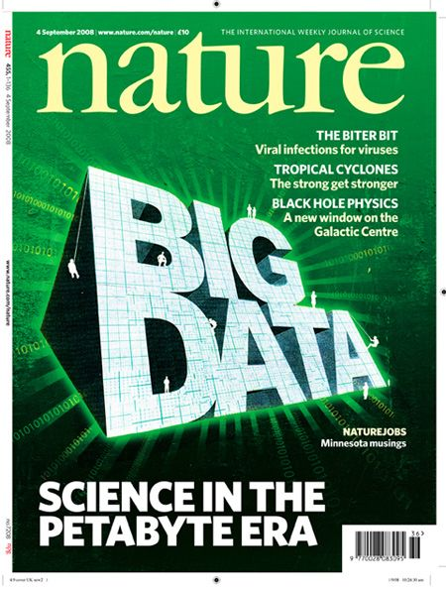

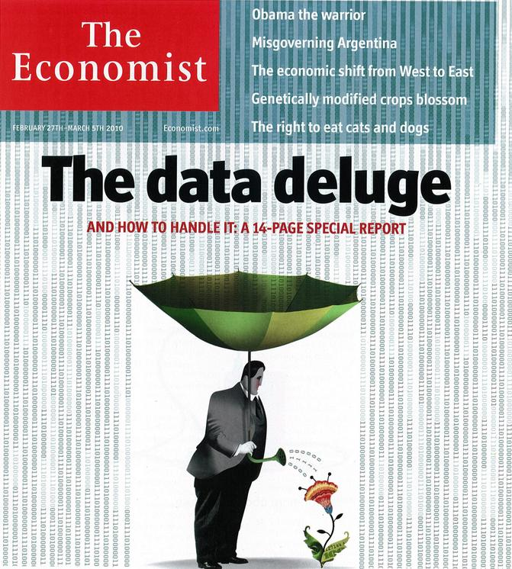
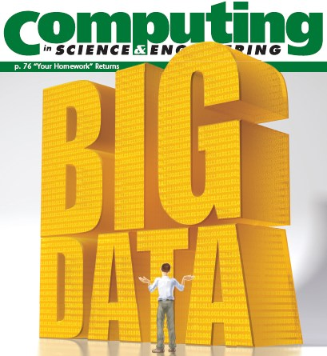
“It’s a great time to be a data geek.”
-- Roger Barga, Microsoft Research
“The greatest minds of my generation are trying
to figure out how to make people click on ads”
-- Jeff Hammerbacher, co-founder, Cloudera

Slide 9
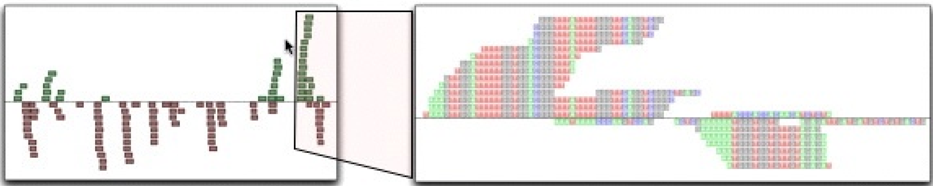
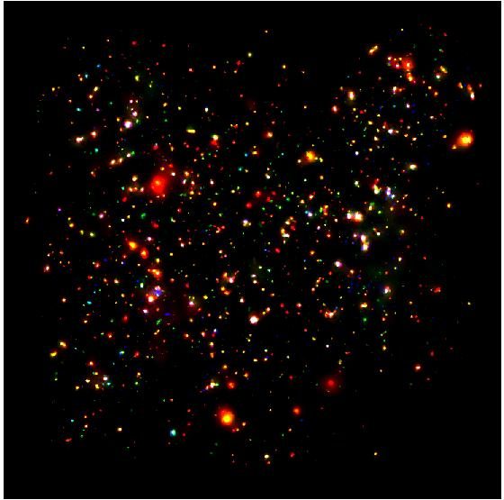
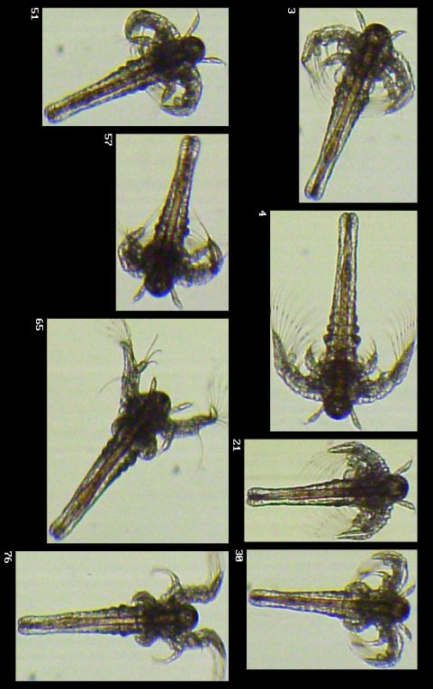
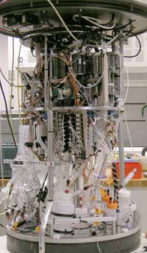
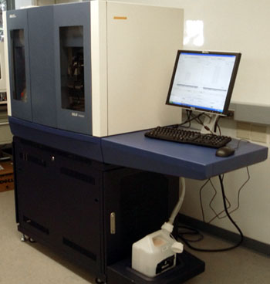

Science is reducing to a database problem
Old model: “Query the world” (Data acquisition coupled to a specific hypothesis)
New model: “Download the world” (Data acquisition supports many hypotheses)
Astronomy: High-resolution, high-frequency sky surveys (SDSS, LSST, PanSTARRS)
Biology: lab automation, high-throughput sequencing,
Oceanography: high-resolution models, cheap sensors, satellites
40TB / 2 nights
~1TB / day
100s of devices
Notes:
Drowning in data; starving for information
We’re at war with these engineering companies. FlowCAM is bragging about the amount of data they can spray out of their device. How to use this enormous data stream to answer scientific questions is someone else’s problem.
“Typical large pharmas today are generating 20 terabytes of data daily. That’s probably going up to 100 terabytes per day in the next year or so.”
“tens of terabytes of data per day” -- genome center at Washignton University
Increase data collection exponentially with flowcam

Slide 10
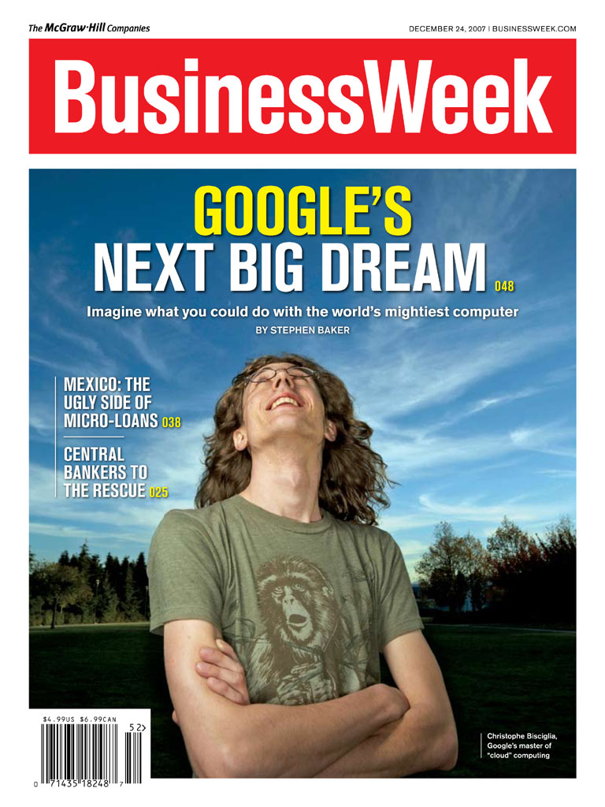
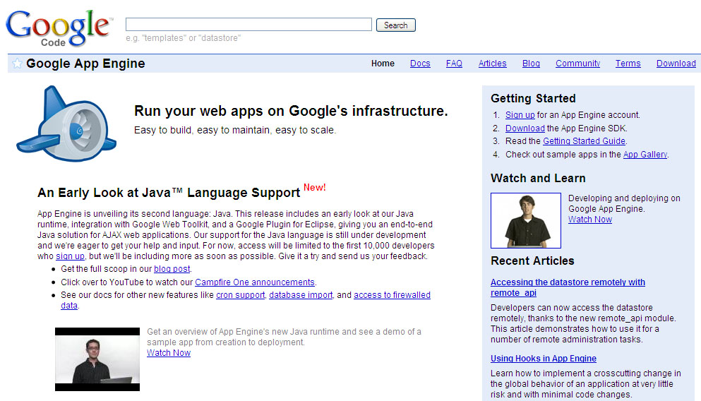
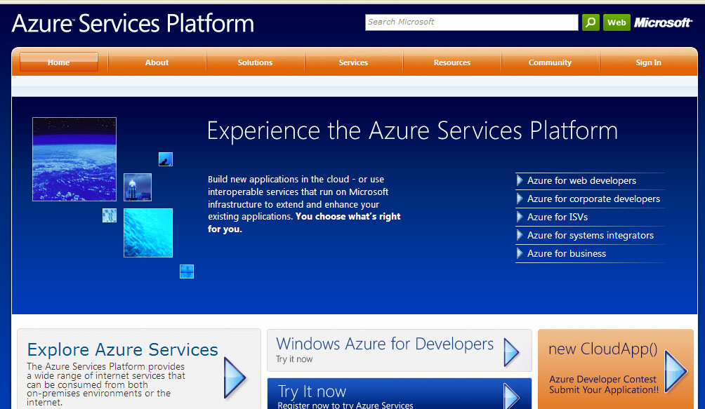
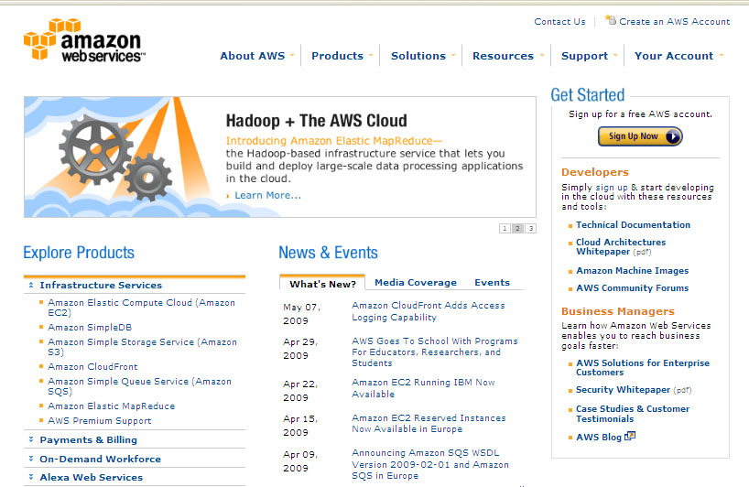
Big Data is married to the Cloud: Scalable computing and storage for everyone

Slide 11

Motivation
Economies of Scale
Elasticity
Notes:
Economy

Slide 12
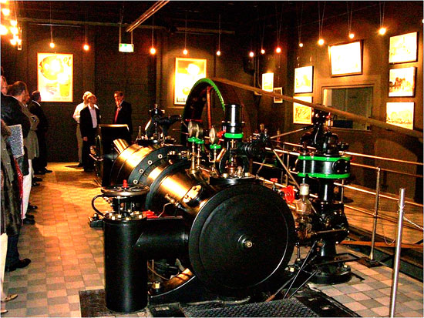
Generator

Slide 13
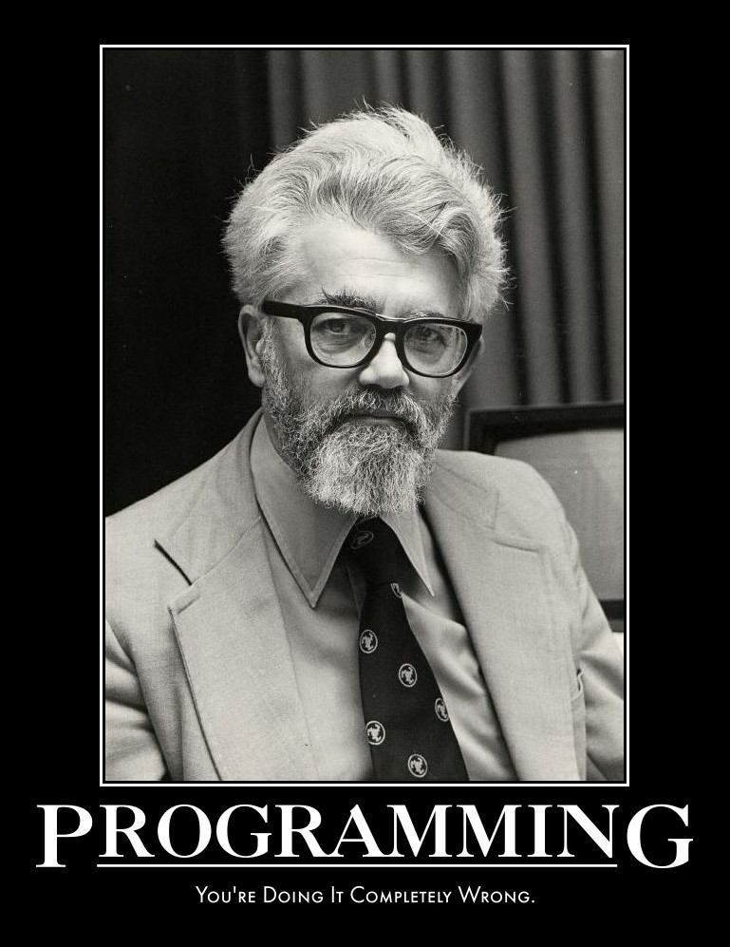
"... computing may someday be organized as a public utility just as
the telephone system is a public utility... The computer utility could
become the basis of a new and important industry.”
-- John McCarthy
Emeritus at Stanford
Inventor of LISP
1961

Slide 14
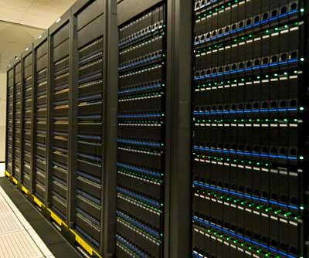

Economies of Scale
src: Armbrust et al., Above the Clouds: A Berkeley View of Cloud Computing, 2009

Slide 15
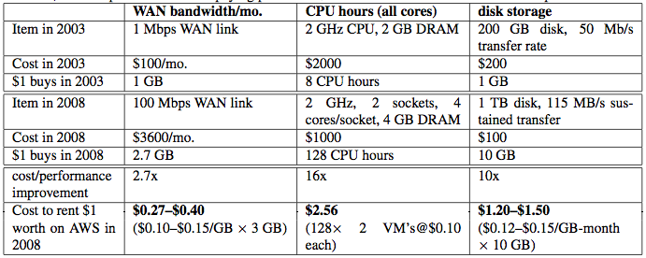
Economies of Scale
src: Armbrust et al., Above the Clouds: A Berkeley View of Cloud Computing, 2009
Utilization, Power, Cooling?

Slide 16
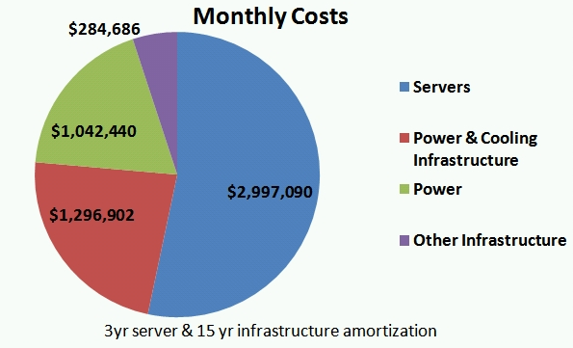
Economies of Scale
src: James Hamilton, Amazon.com

Slide 17
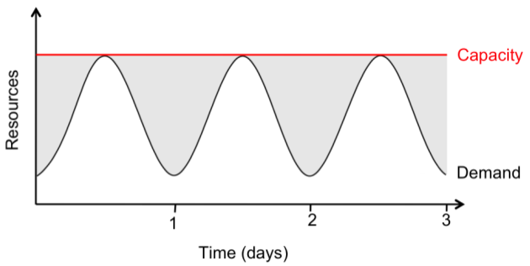
Elasticity
Provisioning for peak load
src: Armbrust et al., Above the Clouds: A Berkeley View of Cloud Computing, 2009

Slide 18
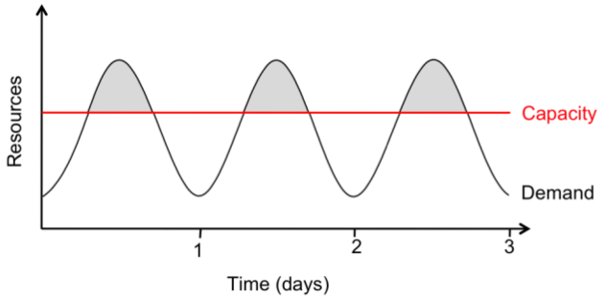
Elasticity
Underprovisioning
src: Armbrust et al., Above the Clouds: A Berkeley View of Cloud Computing, 2009

Slide 19
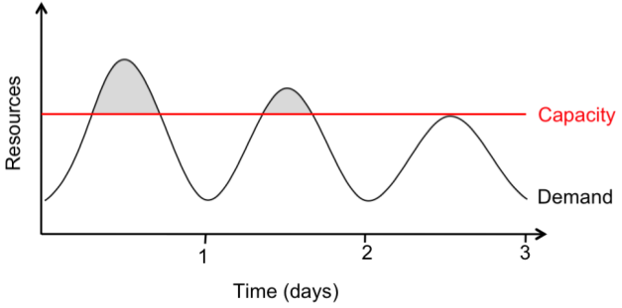
Elasticity
Underprovisioning, more realistic
src: Armbrust et al., Above the Clouds: A Berkeley View of Cloud Computing, 2009

Slide 20
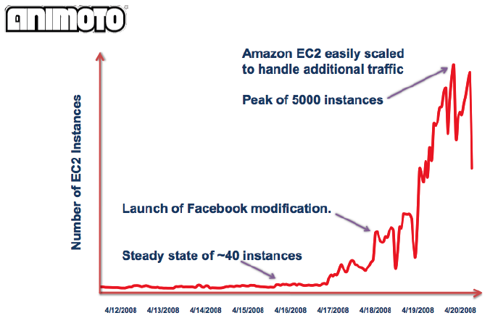
Animoto
[Werner Vogels, Amazon.com]

Slide 21
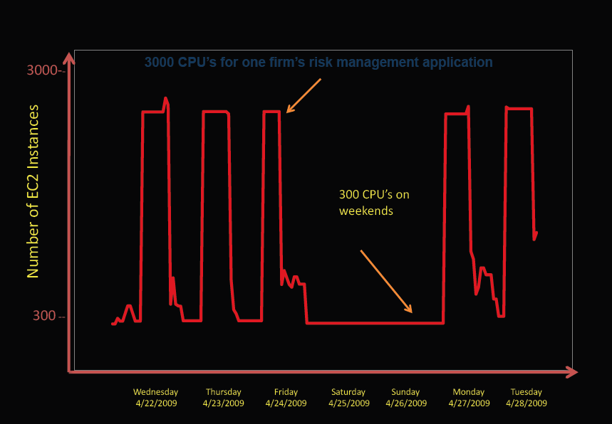
Periodic
[Deepak Singh, Amazon.com]

Slide 22
Growth

Slide 23
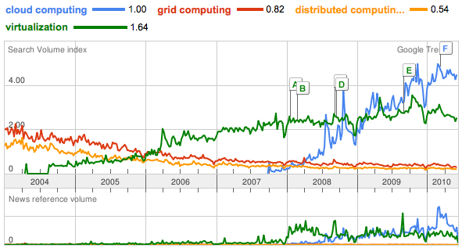
Growth

Slide 24
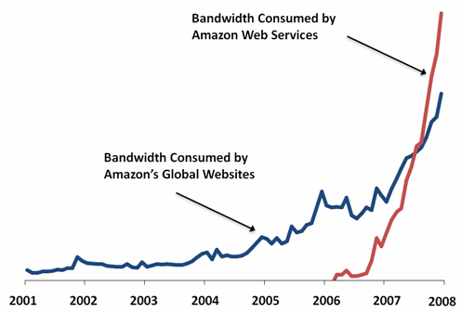
Amazon
[Werner Vogels, Amazon.com]

Slide 25
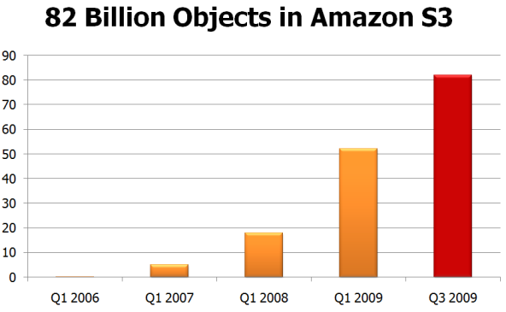
[Werner Vogels, Amazon.com]

Slide 26
History
History

Slide 27












Timeline
2000
2001
2004
2005+
2006
2008
2009
Application Service Providers

Slide 28
Exemplars
Software as a Service
Platform as a Service
Infrastructure as a Service

Slide 29

Grid Computing
Grid vs. Cloud
WAN vs. centralized
Heterogeneous vs. Data Center
Physical vs. Virtualized
Fewer, larger, dedicated allocations
vs. more, smaller, shared allocations
Foster 2002

Slide 30
Cloud Services
Infrastructure-aaS
Platform-aaS
Software-aaS
Constrained
Windows Azure
Google App Engine
EC2
Google Docs
SQL Azure
Force.com
SalesForce.com
S3
Elastic MapReduce
Automation

