Slide 1
Lecture 5: Low Latency NoSQL
Part 1

Slide 2
Roadmap
Homework 3, 4 discussion
Some review, NoSQL roundup
Example: Google BigTable / Apache Hbase
Example: CouchDB

Slide 3
Homework
No assignment this week
Catch up on assignment 3, 4
Assignment 3
Big file: Upload vs. use in place
Change the number of slaves
Assignment 4
Share your upload strategy

Slide 4
Next week: Guest lecture
Jaime Kinney, Amazon
DynamoDB, other data services

Slide 5
Some Review

Slide 6
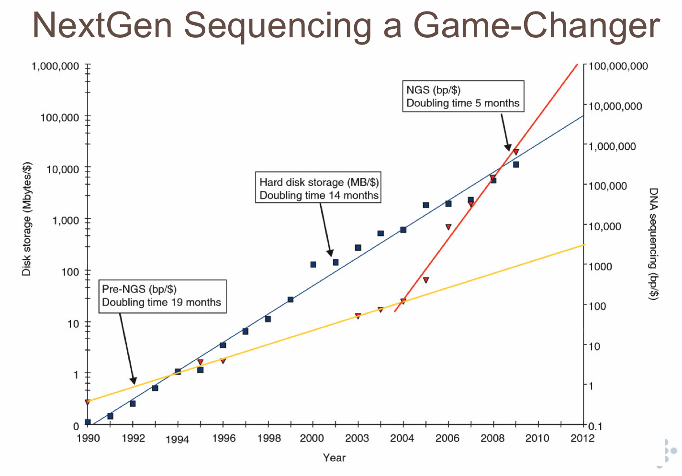

Data-Intensive Scalable Science: Beyond MapReduce
Bill Howe, UW
…plus a bunch of people
src: Lincoln Stein

Slide 7


Solving the Petascale Challenge: What is the rate-limiting step in data understanding?
(1 PB = 1,000,000,000,000,000 B = 10¹⁵ bytes = one quadrillion bytes)
Amount of data in the world
src: Cecilia Aragon
Notes:
The amount of data in the world is increasing exponentially…

Slide 8
Solving the Petascale Challenge: What is the rate-limiting step in data understanding?
(1 PB = 1,000,000,000,000,000 B = 10¹⁵ bytes = one quadrillion bytes)
Amount of data in the world
Processing power: Moore’s Law
src: Cecilia Aragon
Notes:
And processing power, either as raw processor speed or via novel multi-core and many-core architectures, is also continuing to increase exponentially…

Slide 9
Solving the Petascale Challenge: What is the rate-limiting step in data understanding?
(1 PB = 1,000,000,000,000,000 B = 10¹⁵ bytes = one quadrillion bytes)
Amount of data in the world
Processing power: Moore’s Law
Effective Processing Power:
Amdahl’s Law
src: Cecilia Aragon
Notes:
Note: multi-core and many-core architectures are the FUTURE of computer architecture, but they will not scale at the same rate as Moore’s Law because to do so would require PERFECTLY PARELLELIZABLE computations, which Amdahl’s Law gives us the speedup achievable based on the portion of parallelizable vs. serial portion of an algorithm.
This is the picture as it is often drawn… but I think there’s an important piece missing.

Slide 10
Solving the Petascale Challenge: What is the rate-limiting step in data understanding?
(1 PB = 1,000,000,000,000,000 B = 10¹⁵ bytes = one quadrillion bytes)
Amount of data in the world
Processing power: Moore’s Law
Effective Processing Power:
Amdahl’s Law
Human cognitive capacity
Idea adapted from “Less is More” by Bill Buxton (2001)
src: Cecilia Aragon
Notes:
… but human cognitive capacity is remaining constant. How can computing technologies help scientists make sense out of these vast and complex data sets?

Slide 11
Roundup
Hadoop**
Greenplum
Pig**
Dryad
DryadLINQ
HIVE**
Megastore
Dremel / BigQuery
Sawzall
Pregel
SciDB
MapReduce++
SCOPE
SimpleDB
Cassandra**
CouchDB**
MongoDB
SPARK
Twister
HaLoop
BigTable
Elastic MapReduce
S3
Google, Microsoft,Yahoo, Facebook, Amazon, Startup, University Research, UW
**Apache open source project

Slide 12
A (non-disjoint) clustering
Parallel Relational Databases
Teradata, Greenplum, Netezza, Aster Data Systems, Datallegro, Vertica, MonetDB
(Not MySQL or PostgreSQL)
NoSQL systems
“Key-value stores”
Cassandra, CouchDB, MongoDB, Hbase
MapReduce-based systems
Hadoop, Pig, HIVE,
Cloud services
SimpleDB, S3, Megastore, BigQuery

Slide 13
Rough decision procedure
Parallel Relational Databases
Schema?
Complex queries?
Transactions?
High-performance?
indexing, views, cost-based optimization, ….
Are you rich?
~$20k-$125k / TB

Slide 14
Rough decision procedure
Hadoop (locally managed)
Java?
Large unstructured files?
Relatively small number of tasks?
System administration support?
Need to / want to roll your own algorithms?

Slide 15
Rough decision procedure
Hadoop derivatives (Pig, HIVE)
Same as Hadoop, with
A high-level language
Support for multi-step workflows

Slide 16
Rough decision procedure
NoSQL
One object at a time manipulation?
Lots of concurrent users/apps?
Can you live without joins?
System administration?
Need interactive response times?
e.g., you’re powering a web application

Slide 17
Rough decision procedure
Cloud Services
No local hardware
No local sys admin support
Inconsistent workloads

Slide 18
Roadmap
Intro
Decision procedures
NoSQL example: Apache Hbase / Google BigTable
NoSQL example: CouchDB
Discriminators
Programming Model
Consistency, Latency
Cloud vs. Local

Slide 19
Google BigTable
OSDI paper in 2006
Some overlap with the authors of the MapReduce paper
Complementary to MapReduce
Recall: What is MapReduce *not* designed for?
Notes:
Low latency
Transactions

Slide 20
Data model
“a sparse, distributed, persistent multi-dimensional sorted map”

Slide 21
Rows
Data is sorted lexicographically by row key
Row key range broken into tablets
Recall: What was Teradata’s model of distribution?
A tablet is the unit of distribution and load balancing

Slide 22
Column families
Column names of the form family:qualifier
“family” is the basic unit of
access control
memory accounting
disk accounting
Typically all columns in a family the same type

Slide 23
Timestamps
Each cell can be versioned
Each new version increments the timestamp
Policies:
“keep only latest n versions”
“keep only versions since time t”

Slide 24
Tablet management
Master assigns tablets to tablet servers
Tablet server manages reads and writes from its tablets
Clients communicate directly with tablet server
Tablet server splits tablets that have grown too large.

Slide 25
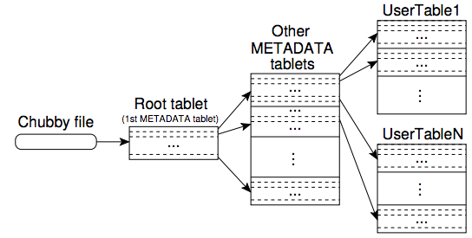
Tablet location metadata
Chubby: distributed lock service

Slide 26
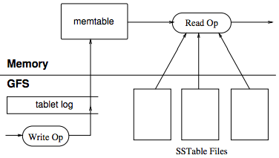
Write processing
minor compaction: write memtable buffer to a new SSTable
recent sequence of updates in memtable
major compaction: rewrite all SSTables into one SSTable; clean deletes

Slide 27
Other tricks
Compression
specified by clients
Bloom filters
fast set membership test for (row, column) pair
reduces disk accesses during reads
Locality Groups
Groups of column families frequently accessed together
Immutability
SSTables (disk chunks) are immutable
Only the memtable needs to support concurrent updates (via copy-on-write)

Slide 28
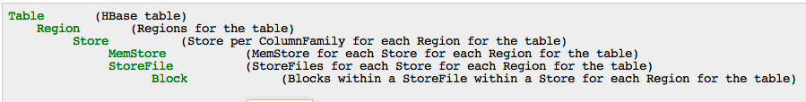
HBase
Implementation of Google BigTable
Compatible with Hadoop
TableInputFormat allows reading of BigTable data in the map phase
One mapper per tablet
Aside: Speculative Execution?

Slide 29
Roadmap
Intro
Decision procedures
NoSQL example: Apache Hbase / Google BigTable
NoSQL example: CouchDB
Discriminators
Programming Model
Consistency, Latency
Cloud vs. Local

Slide 30
CouchDB: Data Model
Document-oriented
Document = set of key/value pairs
Ex:
{
"Subject": "I like Plankton"
"Author": "Rusty"
"PostedDate": "5/23/2006"
"Tags": ["plankton", "baseball", "decisions"]
"Body": "I decided today that I don't like baseball. I like plankton."
}

Slide 31
CouchDB: Updates
ACID
Atomic, Consistent, Isolated, Durable
Lock-free concurrency
Optimistic – attempts to edit dirty data fail
No transactions
Transaction: Sequence of related updates
Entire sequence considered ACID

Slide 32
CouchDB: Views
"_id":"_design/company",
"_rev":"12345",
"language": "javascript",
"views":
{
"all": {
"map": "function(doc) {if (doc.Type=='customer’) emit(null, doc) }"
},
"by_lastname": {
"map": "function(doc) {if (doc.Type=='customer’) emit(doc.LastName, doc) }"
},
"total_purchases": {
"map": "function(doc) {if (doc.Type=='purchase’) emit(doc.Customer, doc.Amount)}",
"reduce": "function(keys, values) { return sum(values) }"
}
}
}

Slide 33
Roadmap
Intro
Decision procedures
NoSQL example: CouchDB
Discriminators
Programming Model
Consistency, Latency
Cloud vs. Local

Slide 34
Joins
Ex: Show all comments by “Sue” on any blog post by “Jim”
Method 1:
Lookup all blog posts by Jim
For each post, lookup all comments and filter for “Sue”
Method 2:
Lookup all comments by Sue
For each comment, lookup all posts and filter for “Jim”
Method 3:
Filter comments by Sue, filter posts by Jim,
Sort all comments by blog id, sort all blogs by blog id
Pull one from each list to find matches

Slide 35
Programming Models: My Terminology
Lookup
put/get objects by key only
Ex: Cassandra
Filter
Non-key access.
No joins. Single-relation access only. May look like SQL.
Ex: SimpleDB, Google Megastore
MapReduce
Two functions define a distributed program: Map and Reduce
RA-like
A set of operators akin to the Relational Algebra
Ex: Pig, MS DryadLINQ
SQL-like
Declarative language
Includes joins
Ex: HIVE, Google BigQuery

Slide 36
Cloud Services
Product | Provider | Prog. Model | Storage Cost | Compute Cost | IO Cost
Megastore | Google | Filter | $0.15 / GB / mo. | $0.10 / corehour | $.10 / GB in, $.12 / GB out
BigQuery | Google | SQL-like | Closed beta | Closed beta | Closed beta
Microsoft Table | Microsoft | Lookup | $0.15 / GB / mo. | $0.12 / hour and up | $.10 / GB in, $.15 / GB out
Elastic MapReduce | Amazon | MR, RA-like, SQL | $0.093 / GB / mo. | $0.10 / hour and up | $0.10 / GB in, $0.15 / GB out (1st GB free)
SimpleDB | Amazon | Filter | $0.093 / GB / mo. | 1st 25 hours free, $0.14 after that | $0.10 / GB in, $0.15 / GB out (1st GB free)
http://escience.washington.edu/blog

Slide 37
CAP Theorem [Brewer 2000, Lynch 2002]
Consistency
Do all applications see all the same data?
Availability
If some nodes fail, does everything still work?
Partitioning
If your nodes can’t talk to each other, does everything still work?
CAP Theorem: Choose two, or sacrifice latency
Databases: Consistency, Availability
NoSQL: Availability, Partitioning
But: Some counterevidence – “NewSQL”

Slide 38
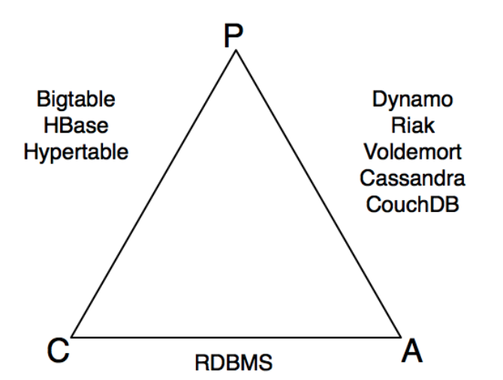
src: Shashank Tiwari

Slide 39
“Eventual Consistency”
Write conflicts will eventually propagate throughout the system
What the application sees in the meantime is sensitive to replication mechanics and difficult to predict
Contrast with RDBMS, Paxos: Immediate (or “strong”) consistency, but there may be deadlocks
Lots of variants, lots of research

Slide 40
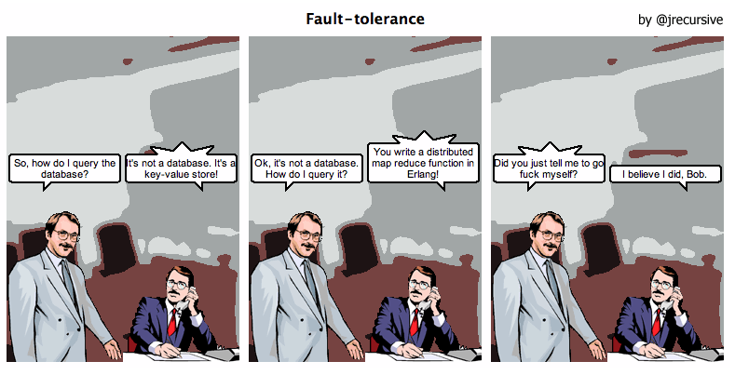
The “NoSQL” Movement

Slide 41
"What information consumes is rather obvious: it consumes the attention of its recipients. Hence a wealth of information creates a poverty of attention, and a need to allocate that attention efficiently among the overabundance of information sources that might consume it."
-- Herbert Simon

