Slide 1
Lecture 7: More Google Tools

Slide 2
Roadmap
Homework 4, 6 discussion (there was no 5)
Google Cloud Data Services

Slide 3
Commercial Services Roundup
API | Data type | Amazon | Microsoft | Google
put/get | Files/Blobs | S3 | Azure Blobs | Cloud Storage
filter/lookup | Tables | SimpleDB | Azure Tables | App Engine Datastore
enqueue/dequeue | Queues | SQS | Azure Queue | --
MapReduce | KeyValue | EMR | Daytona | --
Iterative MapReduce | KeyValue | -- | Daytona | --
single-site RDBMS, full SQL | Relations | RDS | SQLAzure | Cloud SQL
Parallel query | relations | -- | -- | Big Query
perf-guaranteed lookup | -- | DynamoDB | -- | --

Slide 4
Google Cloud Storage
Cost
$0.12 / GB / month (scales down over a TB)
S3: $0.125 / GB / month (scales down over a TB, and reduced redundancy storage is $0.093 / GB / month)

Slide 5
Google Cloud Storage
API
Projects > Buckets > Objects
Flat namespace (like S3)
GET/PUT/DELETE on buckets and objects
Http request Header options
max-keys (limit the number of returned values)
prefix (filter returned list)
marker (start from the middle of the list)
location (find geographical location)
acl (change permissions)

Slide 6
Google Cloud Storage: Other features
Resumable Uploads:
POST with x-goog-resumable -> upload id
PUT with upload id
if an error occurs, query for status
PUT with remaining bytes
Boto support
Streaming upload from clients (gsutils and boto)
Object versions (like S3)

Slide 7
App Engine Datastore
“NoSQL schemaless object datastore, with a query engine and atomic transactions”
Data Model:
Kind: Container of Similar Records
Ex: Person, Customer
A Kind has properties
but not all records need have all properties
think BigTable

Slide 8
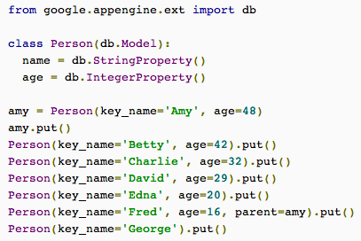
App Engine Datastore

Slide 9
App Engine Datastore: GQL

Slide 10
App Engine Datastore: Consistency
“To obtain strongly consistent query results, you need to use an ancestor query limiting the results to a single entity group.
This works because entity groups are a unit of consistency as well as transactionality. All data operations are applied to the entire group; an ancestor query won't return its results until the entire entity group is up to date.
If your application relies on strongly consistent results for certain queries, you may need to take this into consideration when designing your data model.”

Slide 11
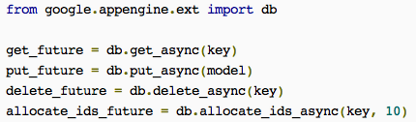
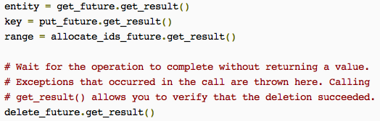
App Engine Datastore: Async

Slide 12
App Engine Datastore: Bottom Line
Use it when you need some other Google API that relies on it.

Slide 13
Google Cloud SQL
Hosted MySQL
Import via MySQL dumps uploaded to Cloud Storage

Slide 14
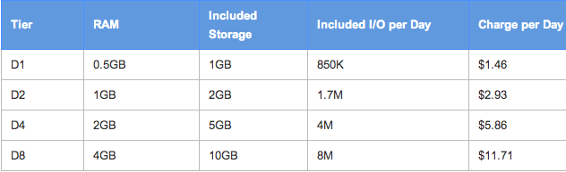
Google Cloud SQL
Pricing:

Slide 15
Google Big Query
Overview
Full SQL (unlike App Engine)
Billions of rows
Compare with
Amazon RDS?
Elastic MapReduce?
SQL Azure?

Slide 16
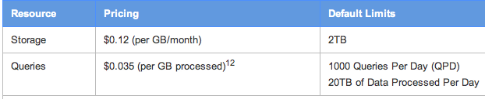
Google Big Query
Pricing:

Slide 17
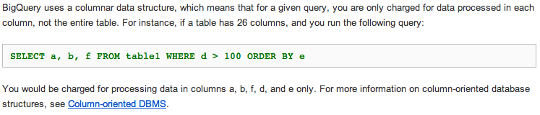
Google BigQuery: Column-store

Slide 18
Google BigQuery: “Small” Joins
BigQuery provides real-time query performance for JOIN statements where one of the two sides is small.
Here “small” means less than 8MB of compressed data.
We expect this 8MB limit to continue to increase over time. For simplicity, we always require the table on the right side of any JOIN clause to be small.
Outer joins with a small table on the "outer" side are unsupported, which means that we only support left outer joins.

Slide 19
Google BigQuery: Limits
Queries:
Rate limit: 2 concurrent queries
Daily limit: 1,000 queries
Maximum query length: 10KB
Maximum response size: Approximately 64MB*
Imports
Rate limit: 2 imports per minute
Daily limit: 1,000 import requests per day (including failures)
Maximum number of files to import per request: 500
Maximum import size per file: 4GB**
Maximum import size per job: 100GB**
Exports
Rate limit: 2 exports per minute
Daily Limit: 50 exports per day

