Slide 1
Lecture 8: Some Synthesis

Slide 2
Roadmap
Homework 7 discussion
Engineering Issues
Pricing
3/5/N Vs of Big Data
Security
If time: Graphs, Social networks
Assignment 8: Big Data Design

Slide 3
Homework 7
select count(*) from
(
select year, month, day
from publicdata:samples.gsod
where tornado
group by year, month, day
) x;

Slide 4
Homework 7
SELECT A.STATIONNAME, B.mn_tmp MAX_MEAN_TMP
FROM (select max(mean_temp) mn_tmp,
integer(station_number) station_number
from publicdata:samples.gsod
group by station_number ) AS B
JOIN (
select integer(USAF) USAF, STATIONNAME
from station_data.station_data
) AS A ON B.station_number = A.USAF
WHERE A.STATIONNAME contains "LYON";
Notes:
anybody go over 100GB?

Slide 5
Homework 7
SELECT MAX(gsod.mean_temp) AS max_mean_temp
FROM (
SELECT INTEGER(station_number) AS station_number,
INTEGER(wban_number) AS wban_number, mean_temp
FROM publicdata:samples.gsod
) AS gsod
JOIN ( SELECT INTEGER(USAF) AS USAF,
INTEGER(WBAN) AS WBAN
FROM station_data.station_data
WHERE STATIONNAME CONTAINS "LYON"
) as sd ON gsod.station_number=sd.USAF
AND gsod.wban_number=sd.WBAN;

Slide 6
Homework 7
select station_data.stationname, max(mean_temp)
FROM (SELECT INTEGER(station_number) AS station_number, mean_temp as mean_temp FROM publicdata:samples.gsod) AS gsod
JOIN (SELECT INTEGER(USAF) AS USAF, stationname as stationname FROM [station_data.station_data] where (REGEXP_MATCH (stationname, "LYON*"))) as station_data
ON gsod.station_number = station_data.USAF
group by station_data.stationname;

Slide 7
Engineering

Slide 8
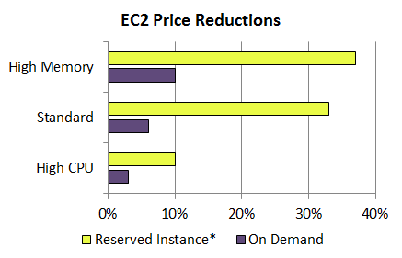
src: Typepad
http://aws.typepad.com/aws/2012/03/dropping-prices-again-ec2-rds-emr-and-elasticache.html

Slide 9
Pricing Trends
http://escience.washington.edu/blog/cloud-economics-visualizing-aws-prices-over-time
http://www.cs.washington.edu/homes/billhowe/aws_price_history/allsix.html

Slide 10
Possible Topics
“NewSQL”
column-oriented
transaction
Engineering / Economics
“Securing Big Data”?
MapReduce Algorithms
when? what?
Design patterns for key-value stores
“Beautiful Data”
Schema design? Concurrency?
Concurrency, “Eventual Consistency”, CAP

Slide 11
Case studies
Transactional Systems
Migrating transactional systems to the cloud
e.g., airline reservations
not just hosted RDBMS, but “cloudified”
Bioinformatics
Real science
(more generally, an end-to-end case)
Social network, analytics
Documents/Text DB (unstructured)
log files, web servers

Slide 12
Data Engineering

Slide 13
The 3/5/N Vs of Big Data
Variety
a clean schema? unstructured log files? images? documents?
Volume
100 GB, 10 TB, 1 PB?
Velocity
“Refers to the low-latency, real-time speed at which analytics needs to be applied. Examples of monitoring and analyzing such information includes weather, traffic, trading, critical healthcare - any system where there is continuous feed from different sources, and the analytics feedback needs to be looped back into the sources of information for better monitoring.”
Variability, Veracity, Vulnerability??

Slide 14
Design Space
Grid
Internet
Data-
parallel
Dryad
Search
Scale-out
Shared
memory
Private
data
center
Transaction
HPC
Latency
Throughput
slide src: Michael Isard, MSR
14
Notes:
Dryad is optimized for: throughput, data-parallel computation, in a private data-center.
14

Slide 15
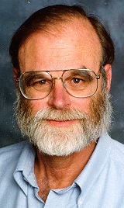
Gray’s Laws of Data Engineering
slide source: Alex Szalay, keynote, eScience 2008
Jim Gray:
Need scale-out solution for analysis
Take the analysis to the data!
Start with “20 queries”
Go from “working to working”
Notes:
15

Slide 16
20 Questions
Example: Sloan Digital Sky Survey
“Find all galaxies with unsaturated pixels within 1 arcsecond of a given point in the sky (right ascension and declination)”
“Find all elliptical galaxies with spectra that have an anomalous emission line”
“Provide a list of moving objects consistent with an asteroid”
“Find all objects within 1' of one another other that have very similar colors: that is where the color ratios u-g, g-r, r-I are less than 0.05m. (Magnitudes are logarithms so these are ratios.) This is a gravitational lens query”

Slide 17
DISCUSSion

Slide 18
Graph data
Key feature: Recursive
“Find everyone in John’s network who ever worked at Google”
SQL?
MapReduce?

Slide 19
Example: Reachability
BTC2010, 680GB
A(y) :- R(1234, b, y)
A(y) :- A(z), R(z,b,y)

Slide 20
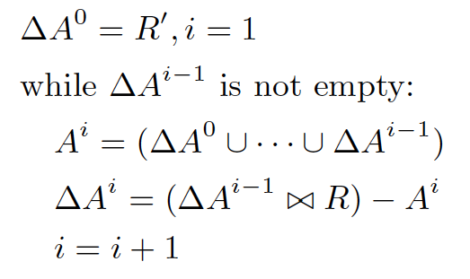
Basic Semi-Naïve Evaluation
Join
Dupe-elim

Slide 21
In MapReduce
(compute next generation of nodes)
Join
(remove the ones we’ve already seen)
Dupe-elim
ΔA_{i}
M
r
M
r
R⁰
M
r
M
r
R¹
M
Anything new?
i=i+1
Client
done

Slide 22
What’s the problem?
Bu, Howe, Balazinska, Ernst VLDB10, VLDBJ12
Join
Dupe-elim
ΔA_{i}
M
r
M
r
R⁰
M
r
M
r
R¹
M
R is loop invariant, but gets loaded and shuffled on each iteration
Cache it on the reduce side, reuse the cache on each iteration

Slide 23
BTC2010, 680GB
Cache-enabled join

Slide 24
time (s)
iteration #

Slide 25
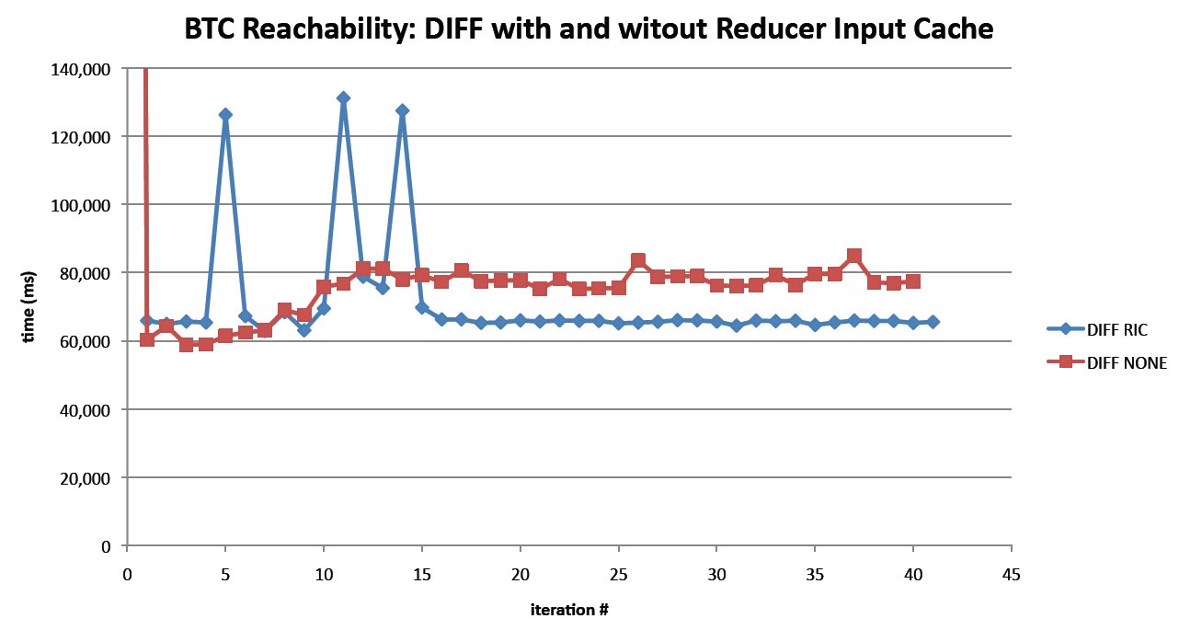
BTC2010, 680GB
Cache-enabled dupe-elim

Slide 29
Loop unrolling
A(y) :- R(1234, b, y)
B(y) :- A(z), R(z,b,y)
A(y) :- B(z), R(z,b,y)
Run two joins for every dupe-elim

Slide 30
Pre-project
S(x,y) :- R(x, b, y)
A(y) :- S(1234, y)
A(y) :- A(z), S(z, y)
Remove unneeded attributes to shrink cache and reduce transfer cost.

