Slide 1
Lecture 9: Transactional Workloads Graph Analytics (maybe)

Slide 2
Roadmap
Background on Distributed Concurrency Control
NoSQL vs. SQL
Query Evaluation for Social network Analysis
Makeup Class

Slide 3
Review: NoSQL
“Not Only SQL”
“Not Relational”
“NoSchema”

Slide 4
NoSQL: 6 characteristics [Rick Cattell 2010]
the ability to horizontally scale “simple operation” throughput over many servers (put, get),
the ability to replicate and to distribute (partition) data over many servers,
a simple call level interface or protocol (in contrast to a SQL binding),
a weaker concurrency model than the ACID transactions of most relational (SQL) database systems,
efficient use of distributed indexes and RAM for data storage,
the ability to dynamically add new attributes to data records.

Slide 5
Origins
Memcached demonstrated that in-memory indexes can be highly scalable, distributing and replicating objects over multiple nodes.
Amazon’s Dynamo paper argued that eventual consistency was the key to scalability: data fetched are not guaranteed to be up-to-date, but updates are guaranteed to be propagated to all nodes eventually
BigTable demonstrated that persistent record storage could be scaled to thousands of nodes

Slide 6
Cattell’s Recommendations
Key-value stores (memchached, Voldemort)
if you have a simple application with only one kind of object
you only need to look up objects up based on one attribute.
Document stores (CouchDB, MongoDB)
multiple different kinds of objects
need to look up objects based on multiple fields

Slide 7
Cattell’s Recommendations (2)
Extensible Record Stores (HBase, BigTable)
Same recommendations as document stores
higher throughput (e.g., sub-record transactions)
often stronger concurrency guarantees
greater complexity (e.g., designing attribute groups)
NewSQL Relational Databases (VoltDB, Clustrix)
you have many tables, you need SQL, full transaction support
Still emphasize small-scope operations for scalability (single-record lookups and edits)
But can support large-scope operations (joins, multi-node x-actions)

Slide 8
Transaction Support
ACID
Atomicity
Consistency
Isolation
Durability
“BASE”
Basically Available, Soft state, Eventually consistent
Notes:
Atomicity: Either all changes performed by transaction occur or none occurs
Consistency: A transaction as a whole does not violate integrity constraints
Isolation: Transactions appear to execute one after the other in sequence
Durability: If a transaction commits, its changes will survive failures

Slide 9
What could go wrong?
Why is it hard to provide ACID properties?
Client 1:
INSERT INTO SmallProduct(name, price)
SELECT pname, price FROM Product WHERE price <= 0.99;
DELETE Product WHERE price <=0.99;
Client 2:
SELECT count(*) FROM Product
SELECT count(*) FROM SmallProduct

Slide 10
What could go wrong?
Client 1:
UPDATE SET Account.amount = 1000000000
WHERE Account.number = ‘my-account’
Client 2:
SELECT Account.amount
FROM Account
WHERE Account.number = ‘my-account’
Abort and rollback

Slide 11
Concurrent execution problems
Write-read conflict: dirty read (includes inconsistent read)
A transaction reads a value written by another transaction that has not yet committed
Read-write conflict: unrepeatable read
A transaction reads the value of the same object twice. Another transaction modifies that value in between the two reads
Write-write conflict: lost update
Two transactions update the value of the same object. The second one to write the value overwrite the first change

Slide 12
Data Models: Sets of Attribute-Value Pairs
“Tuple”: Implies a schema
“Document”: Implies nesting
“Extensible Record”: Tuple with added fields
“Object”: May hold references to other objects

Slide 13
Distributed Transactions
Scheduling
Two-Phase Commit
Multi-version Concurrency Control

Slide 14
Concurrency Control
Multiple concurrent transactions T₁, T₂, …
They read/write common elements A₁, A₂, …
How can we prevent unwanted interference ?
The SCHEDULER is responsible for that

Slide 15
Schedules
A schedule is a sequence of interleaved actions from all transactions

Slide 16
Example
T1 | T2
READ(A, t) | READ(A, s)
t := t+100 | s := s*2
WRITE(A, t) | WRITE(A,s)
READ(B, t) | READ(B,s)
t := t+100 | s := s*2
WRITE(B,t) | WRITE(B,s)

Slide 17
A Serial Schedule
T1 | T2
READ(A, t)
t := t+100
WRITE(A, t)
READ(B, t)
t := t+100
WRITE(B,t)
 | READ(A,s)
 | s := s*2
 | WRITE(A,s)
 | READ(B,s)
 | s := s*2
 | WRITE(B,s)
Notes:
Schedule is serial if it reflects a serial execution.
In this example, two serial schedules are possible.

Slide 18
Serializable Schedule
A schedule is serializable if it is equivalent to a serial schedule
Notes:
Reminder: why do we want interleaving? For performance.

Slide 19
A Serializable Schedule
T1 | T2
READ(A, t)
t := t+100
WRITE(A, t)
 | READ(A,s)
 | s := s*2
 | WRITE(A,s)
READ(B, t)
t := t+100
WRITE(B,t)
 | READ(B,s)
 | s := s*2
 | WRITE(B,s)
This is NOT a serial schedule, but is serializable

Slide 20
A Non-Serializable Schedule
T1 | T2
READ(A, t)
t := t+100
WRITE(A, t)
 | READ(A,s)
 | s := s*2
 | WRITE(A,s)
 | READ(B,s)
 | s := s*2
 | WRITE(B,s)
READ(B, t)
t := t+100
WRITE(B,t)

Slide 21
Serializable Schedules
The role of the scheduler is to ensure that the schedule is serializable
Q: Why not run only serial schedules ? I.e. run one transaction after the other ?

Slide 22
Serializable Schedules
The role of the scheduler is to ensure that the schedule is serializable
Q: Why not run only serial schedules ? I.e. run one transaction after the other ?
A: Because of very poor throughput due to disk latency.
Lesson: main memory databases may do serial schedules only

Slide 23
A Serializable Schedule
T1 | T2
READ(A, t)
t := t+100
WRITE(A, t)
 | READ(A,s)
 | s := s + 200
 | WRITE(A,s)
 | READ(B,s)
 | s := s + 200
 | WRITE(B,s)
READ(B, t)
t := t+100
WRITE(B,t)
Schedule is serializable because t=t+100 and s=s+200 commute
We don’t expect the scheduler to schedule this

Slide 24
Ignoring Details
Assume worst case updates:
We never commute actions done by transactions
As a consequence, we only care about reads and writes
Transaction = sequence of R(A)’s and W(A)’s
T₁: r₁(A); w₁(A); r₁(B); w₁(B)
T₂: r₂(A); w₂(A); r₂(B); w₂(B)
Notes:
Example: Two people book two seats each on an airplane (but ignore seat selection).

Slide 25
Conflicts
Write-Read – WR
Read-Write – RW
Write-Write – WW

Slide 26
Conflicts
Two actions by same transaction T_{i}:
r_{i}(X); w_{i}(Y)
Two writes by T_{i}, T_{j} to same element
w_{i}(X); w_{j}(X)
w_{i}(X); r_{j}(X)
Read/write by T_{i}, T_{j} to same element
r_{i}(X); w_{j}(X)
A “conflict” means: you can’t swap the two operations
Notes:
Conflict: pair of consecutive actions in schedule s.t. if swapped, then behavior changes.
Conflict serializability is a stronger condition than serializability (although have to be careful because of things like phantom problem)

Slide 27
Conflict Serializability
A schedule is conflict serializable if it can be transformed into a serial schedule by a series of swappings of adjacent non-conflicting actions
Example:
r₁(A); w₁(A); r₂(A); w₂(A); r₁(B); w₁(B); r₂(B); w₂(B)
r₁(A); w₁(A); r₁(B); w₁(B); r₂(A); w₂(A); r₂(B); w₂(B)

Slide 28
Testing for Conflict-Serializability
Precedence graph:
A node for each transaction T_{i},
An edge from T_{i} to T_{j} whenever an action in T_{i} conflicts with, and comes before an action in T_{j}
The schedule is serializable iff the precedence graph is acyclic

Slide 29
Example 1
r₂(A); r₁(B); w₂(A); r₃(A); w₁(B); w₃(A); r₂(B); w₂(B)
1
2
3
Notes:
Arrow: two transactions, same element, at least one action is a write

Slide 30
Example 1
r₂(A); r₁(B); w₂(A); r₃(A); w₁(B); w₃(A); r₂(B); w₂(B)
B
A
1
2
3
This schedule is conflict-serializable
Notes:
Arrow: two transactions, same element, at least one action is a write

Slide 31
Example 2
r₂(A); r₁(B); w₂(A); r₂(B); r₃(A); w₁(B); w₃(A); w₂(B)
1
2
3

Slide 32
Example 2
r₂(A); r₁(B); w₂(A); r₂(B); r₃(A); w₁(B); w₃(A); w₂(B)
B
A
1
2
3
B
This schedule is NOT conflict-serializable

Slide 33
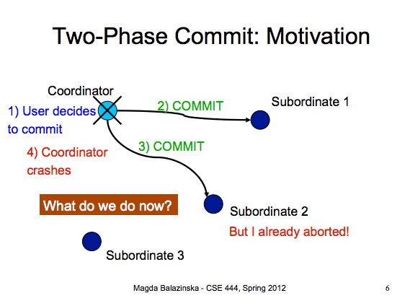
Transactions

Slide 34
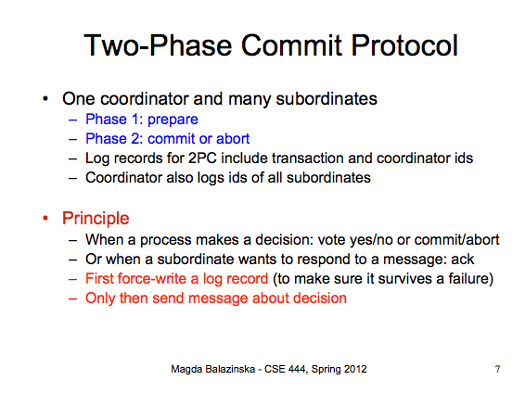

Slide 35
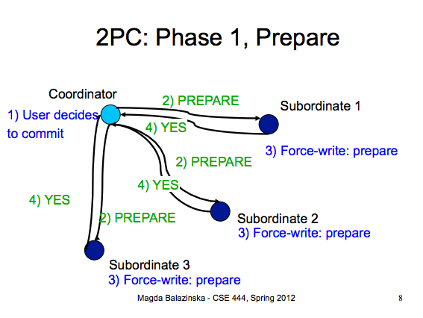

Slide 36
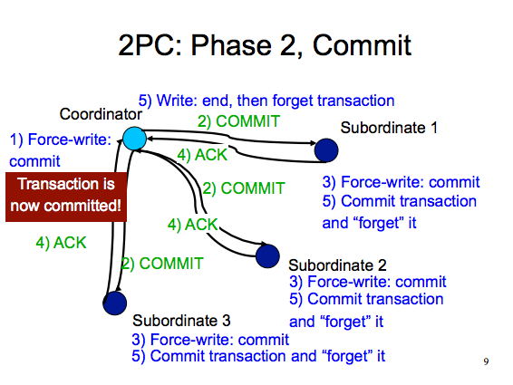

Slide 37
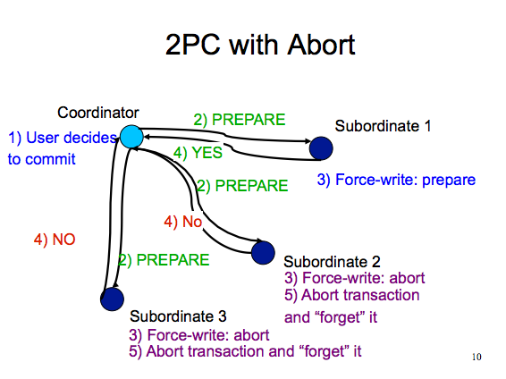

Slide 38
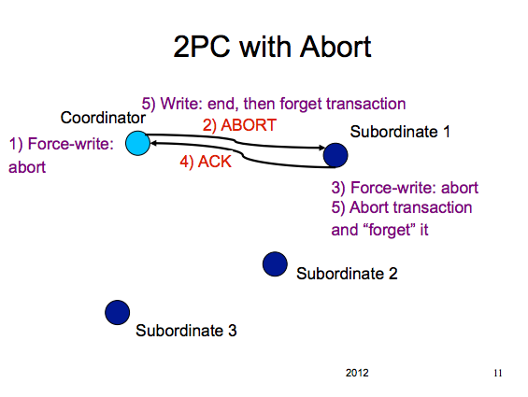

Slide 39
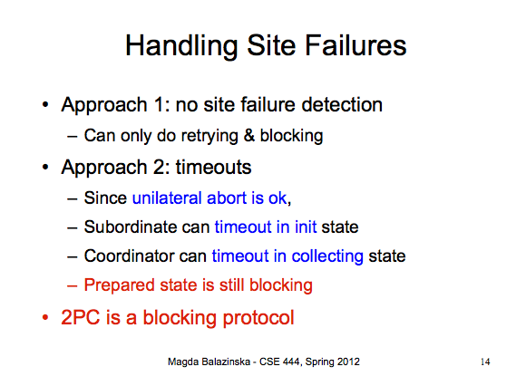

Slide 40
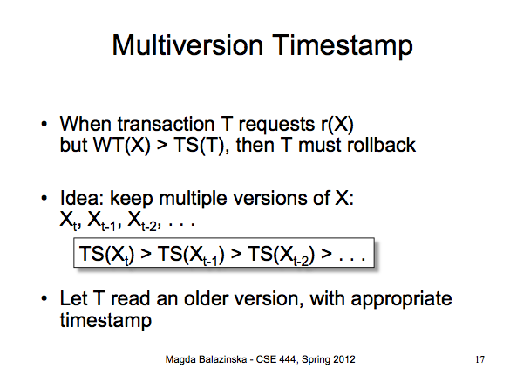
Multi-version Concurrency Control

Slide 41
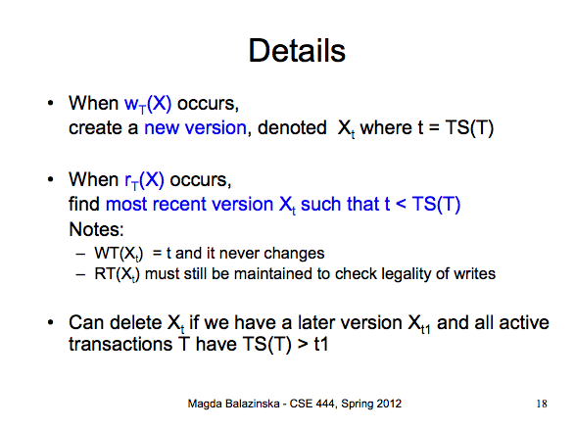

Slide 42
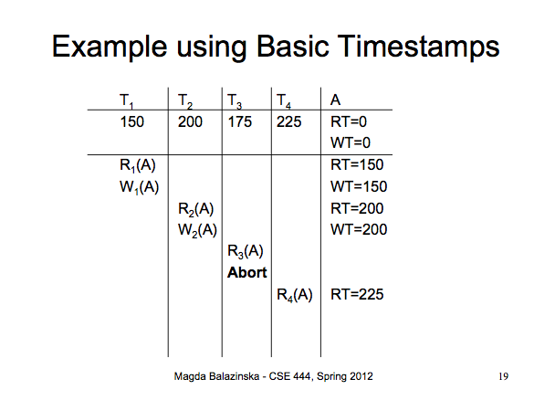

Slide 43
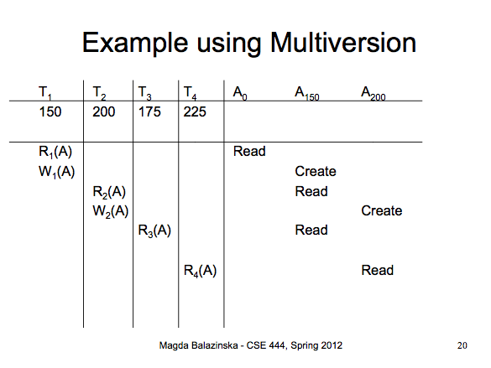

Slide 44
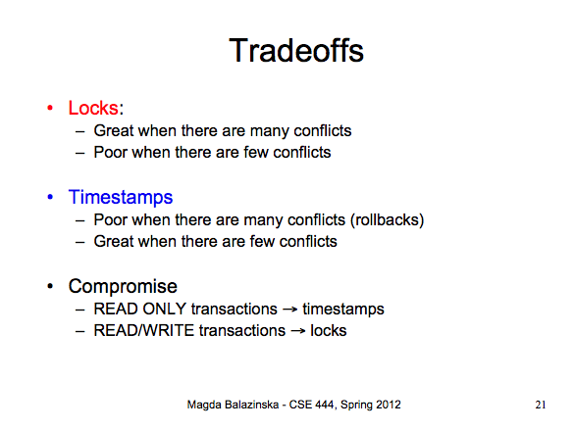

Slide 45
Eventual Consistency
Definition: in absence of updates, all replicas converge towards identical copies
Only requirement: Updates must eventually propagate to all replicas
Things work fine so long as user accesses same replica

Slide 46
Client-centric consistency
Assume read operations by a single process P at two different local copies of the same data store
Four different consistency semantics
Monotonic reads: Once read, subsequent reads on that data items return same or more recent values
Monotonic writes: A write must be propagated to all replicas before a successive write by the same process
Resembles FIFO consistency (writes from same process are processed in same order)
Read your writes: read(x) always returns write(x) by that process
Writes follow reads: write(x) following read(x) will take place on same or more recent version of x
Epidemic and gossiping protocols

Slide 47
Another approach: Calvin

Slide 48
CAP Theorem [Brewer 2000, Lynch 2002]
Consistency
Do all applications see all the same data?
Availability
If some nodes fail, does everything still work?
Partitioning
If your nodes can’t talk to each other, does everything still work?
CAP Theorem: Choose two, or sacrifice latency
Databases: Consistency, Availability
NoSQL: Availability, Partitioning
But: Some counterevidence – “NewSQL”

Slide 49
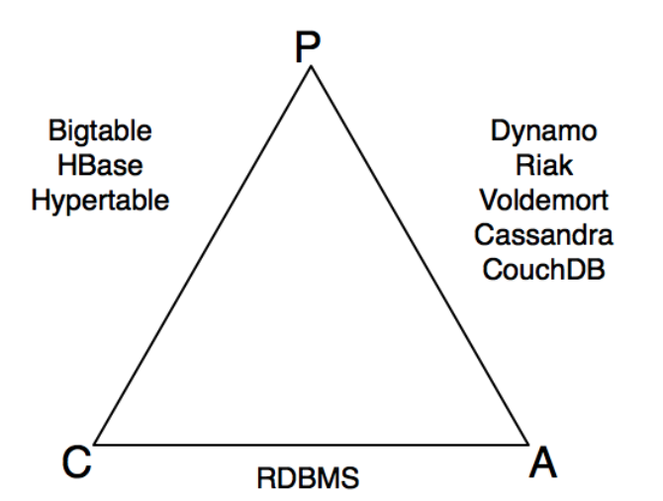
src: Shashank Tiwari

Slide 50
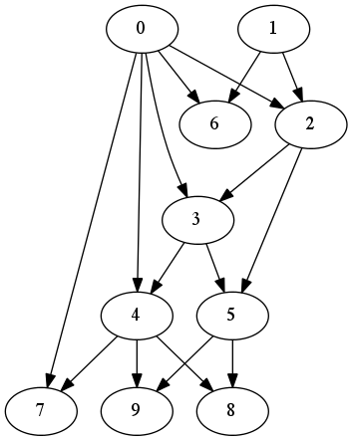
Graph data
Key feature: Recursive
“Find everyone in John’s network who ever worked at Google”
SQL?
MapReduce?

Slide 51
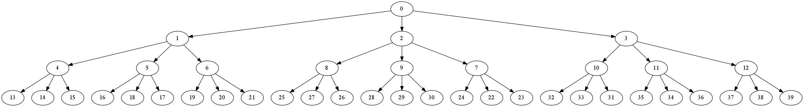
SQL: WITH Clause
WITH DirectReports(ManagerID, EmployeeID, Title, EmployeeLevel) AS
(
SELECT ManagerID, EmployeeID, Title, 0 AS EmployeeLevel
FROM dbo.MyEmployees
WHERE ManagerID IS NULL
UNION ALL
SELECT e.ManagerID, e.EmployeeID, e.Title, EmployeeLevel + 1
FROM dbo.MyEmployees AS e
INNER JOIN DirectReports AS d
ON e.ManagerID = d.EmployeeID
)
SELECT ManagerID, EmployeeID, Title, EmployeeLevel
FROM DirectReports
ORDER BY ManagerID;

Slide 52
Example: Reachability
A(y) :- R(1234, b, y)
A(y) :- A(z), R(z,b,y)

Slide 53
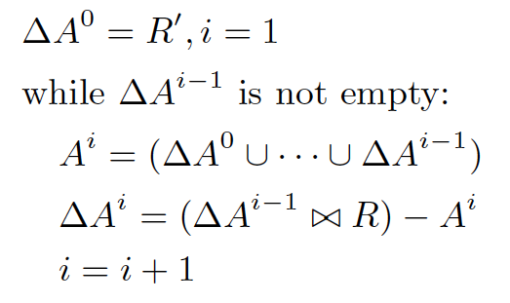
Basic Semi-Naïve Evaluation
Join
Dupe-elim

Slide 54
In MapReduce
(compute next generation of nodes)
Join
(remove the ones we’ve already seen)
Dupe-elim
ΔA_{i}
M
r
M
r
R⁰
M
r
M
r
R¹
M
Anything new?
i=i+1
Client
done

Slide 55
What’s the problem?
Bu, Howe, Balazinska, Ernst VLDB10, VLDBJ12
Join
Dupe-elim
ΔA_{i}
M
r
M
r
R⁰
M
r
M
r
R¹
M
R is loop invariant, but gets loaded and shuffled on each iteration
Cache it on the reduce side, reuse the cache on each iteration

Slide 56
BTC2010, 680GB

Slide 57
time (s)
iteration #

Slide 58
BTC2010, 680GB

Slide 60
Loop unrolling
A(y) :- R(1234, b, y)
B(y) :- A(z), R(z,b,y)
A(y) :- B(z), R(z,b,y)
Run two joins for every dupe-elim

Slide 61
Pre-project
S(x,y) :- R(x, b, y)
A(y) :- S(1234, y)
A(y) :- A(z), S(z, y)
Remove unneeded attributes to shrink cache and reduce transfer cost.

