Slide 1
Lecture 3: MapReduce and Parallel Algorithms

Slide 2
Tonight
Review
“Scalability”
MapReduce
Assignment: MapReduce Basics

Slide 3
Review
MADSkills paper takeaway
Even “non-relational” tasks can be expressed in the database
Why might this be a good idea?
LINQ paper takeaway
Relational abstractions can be embedded in a programming language – no database required.
Why might this be a good idea?

Slide 4
What Does Scalable Mean?
Operationally:
In the past: “Works even if data doesn’t fit in main memory”
Now: “Can make use of 1000s of cheap computers”
Formally:
In the past: If you have N data items, you must do no more than N^{k} operations -- “polynomial time algorithms”
Soon: If you have N data items, you must do no more than N * log(N) operations -- “logarithmic time algorithms”
Soon, you’ll only get one pass at the data
So you better make that one pass count

Slide 5
Example: Find matching sequences
Given a set of sequences
Find all sequences equal to “GATTACGATATTA”

Slide 6
TACCTGCCGTAA
GATTACGATATTA

Slide 7
GATTACGATATTA
TACCTGCCGTAA = GATTACGATATTA?
No.
time = 0

Slide 8
GATTACGATATTA
CCCCCAATGAC = GATTACGATATTA?
No.
time = 1

Slide 9
GATTACGATATTA
GATTACGATATTA contains GATTACGATATTA?
Yes!
Send it to the output.
time = 17

Slide 10
GATTACGATATTA
40 records, 40 comparions
N records, N comparisons
The algorithmic complexity is order N: O(N)

Slide 11
TTTTCGTAATT
AAAATCCTGCA
TTTACGTCAA
AAACGCCTGCA
GATTACGATATTA
What if we sort the sequences?

Slide 12
Start at the 50% mark
CTGTACACAACCT
GATTACGATATTA
0%
100%
CTGTACACAACCT < GATTACGATATTA
time = 0
No match.
Skip to 75% mark

Slide 13
GATTACGATATTA
GGATACACATTTA
0%
100%
GGATACACATTTA > GATTACGATATTA
time = 1
No match.
Go back to 62.5% mark

Slide 14
GATATTTTAAGC
GATTACGATATTA
0%
100%
GATATTTTAAGC < GATTACGATATTA
No match.
Skip back to 68.75% mark

Slide 15
GATTACGATATTA
0%
100%
GATTACGATATTA = GATTACGATATTA
Match!
Walk through the records until we fail to match.

Slide 16
GATTACGATATTA
0%
100%
How many comparisons did we do?
40 records, only 4 comparisons
N records, log(N) comparisons
This algorithm is O(log(N)) Far better scalability

Slide 17
Relational Databases
Databases are good at “Needle in Haystack” problems:
Extracting small results from big datasets
Transparently provide “old style” scalability
Your query will always* finish, regardless of dataset size.
Indexes are easily built and automatically used when appropriate
CREATE INDEX seq_idx ON sequence(seq);
SELECT seq
FROM sequence
WHERE seq = ‘GATTACGATATTA’;
*almost

Slide 18
New task: Read Trimming
Given a set of DNA sequences
Trim the final n bps of each sequence
Generate a new dataset

Slide 19
TACCTGCCGTAA
GATTACGATATTA

Slide 20
TACCTGCCGTAA becomes TACCT
time = 0

Slide 21
CCCCCAATGAC becomes CCCCC
time = 1

Slide 22
GATTACGATATTA becomes GATTA
time = 17

Slide 23
Can we use an index?
No. We have to touch every record no matter what.
The task is fundamentally O(N)
Can we do any better?

Slide 25
time = 0

Slide 26
time = 1

Slide 27
time = 2

Slide 28
time = 3

Slide 29
How much time did this take?
7 cycles
40 records, 6 workers
time = 7
O(N/k)

Slide 30
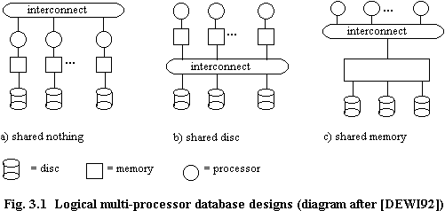
Taxonomy of Parallel Architectures
Scales to 1000s of computers
Easiest to program, but $$$$
Notes:
The goal here is to make Shared Nothing Architecturs easier to program.

Slide 31
Design Space
Grid
Internet
In a few weeks
The area we’re discussing
Data-
parallel
Dryad
Search
DISC
Shared
memory
Private
data
center
Transaction
HPC
Latency
Throughput
slide src: Michael Isard, MSR
31
Notes:
Dryad is optimized for: throughput, data-parallel computation, in a private data-center.
31

Slide 32
Some distributed algorithm…
Map
(Shuffle)
Reduce

Slide 33
MapReduce Programming Model
Input & Output: each a set of key/value pairs
Programmer specifies two functions:
Processes input key/value pair
Produces set of intermediate pairs
Combines all intermediate values for a particular key
Produces a set of merged output values (usually just one)
map (in_key, in_value) -> list(out_key, intermediate_value)
reduce (out_key, list(intermediate_value)) -> list(out_value)
Inspired by primitives from functional programming languages such as Lisp, Scheme, and Haskell
slide source: Google, Inc.

Slide 34
Example: What does this do?
map(String input_key, String input_value):
// input_key: document name
// input_value: document contents
for each word w in input_value:
EmitIntermediate(w, 1);
reduce(String output_key, Iterator intermediate_values):
// output_key: word
// output_values: ????
int result = 0;
for each v in intermediate_values:
result += v;
Emit(result);
slide source: Google, Inc.

Slide 35
Example: Document Processing
Notes:
Want to know the makeup of the text by word length. For example, we’d like to know how many words have greater than 10 characters. We’d also like to know how many words have between 5 and 9 characters, between 2 and 4 and those with just 1 character.
Map will read in text and tag each word as a different color depending on the length of the word.

Slide 36
Example: Word length histogram
How many “big”, “medium”, and “small” words are used?
Notes:
Want to know the makeup of the text by word length. For example, we’d like to know how many words have greater than 10 characters. We’d also like to know how many words have between 5 and 9 characters, between 2 and 4 and those with just 1 character.
Map will read in text and tag each word as a different color depending on the length of the word.

Slide 37
Example: Word length histogram
Big = Yellow = 10+ letters
Medium = Red = 5..9 letters
Small = Blue = 2..4 letters
Tiny = Pink = 1 letter
Notes:
Motivating Map task and intuition behind map…. Think of map as a group by.
Distribution of word lengths

Slide 38
Example: Word length histogram
Split the document into chunks and process each chunk on a different computer
Chunk 1
Chunk 2
Notes:
Motivating Map task and intuition behind map…. Think of map as a group by.
Distribution of word lengths

Slide 39
Example: Word length histogram
Map Task 1
(204 words)
(key, value)
(yellow, 17)
(red, 77)
(blue, 107)
(pink, 3)
(yellow, 20)
(red, 71)
(blue, 93)
(pink, 6 )
Map Task 2
(190 words)
Notes:
Motivating Map task and intuition behind map…. Think of map as a group by.
Distribution of word lengths

Slide 40
Example: Word length histogram
“Shuffle step”
Map task 1
(yellow, 17)
(red, 77)
(blue, 107)
(pink, 3)
(yellow, 20)
(red, 71)
(blue, 93)
(pink, 6 )
Reduce tasks
(yellow, 17)
(yellow, 20)
(red, 77)
(red, 71)
(blue, 93)
(blue, 107)
(pink, 6)
(pink, 3)
(yellow, 37)
(red, 148)
(blue, 200)
(pink, 9)
Map task 2

Slide 41
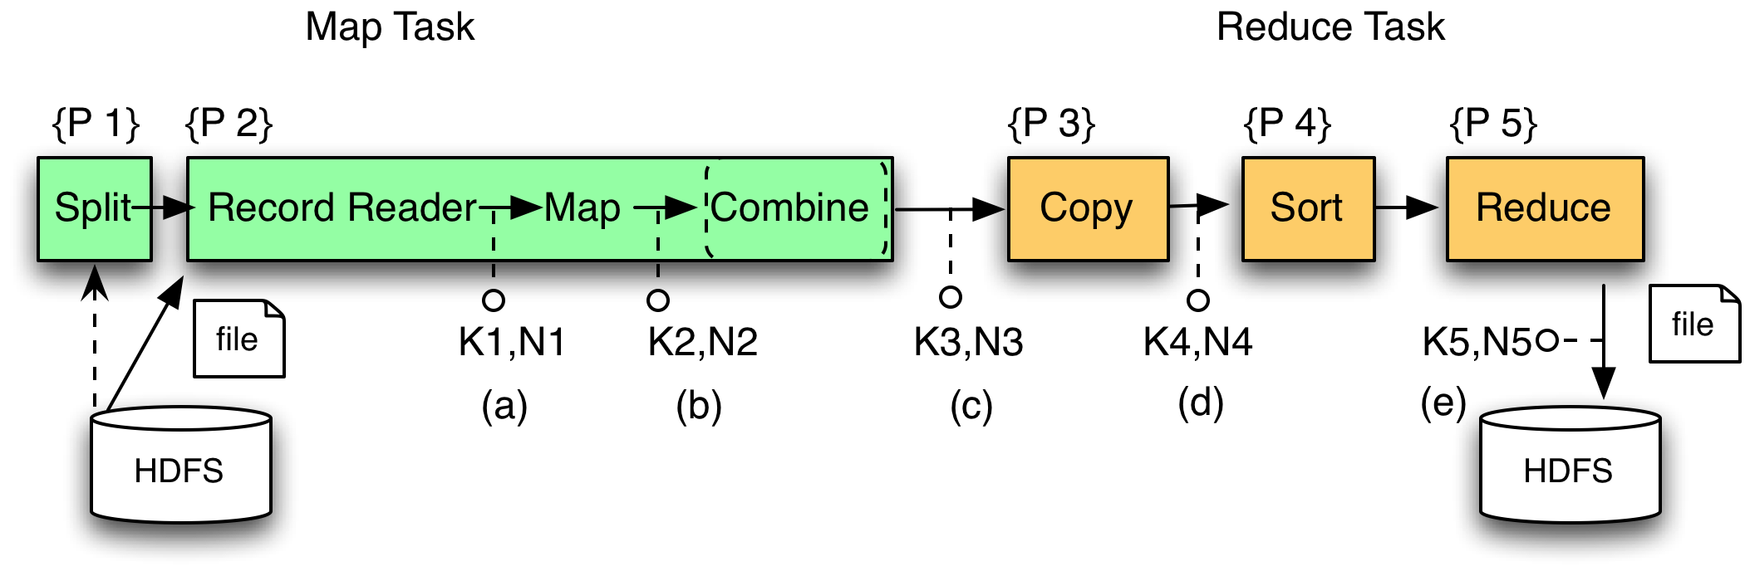
MR Phases
Each Map and Reduce task has multiple phases:
`
Local storage

Slide 42
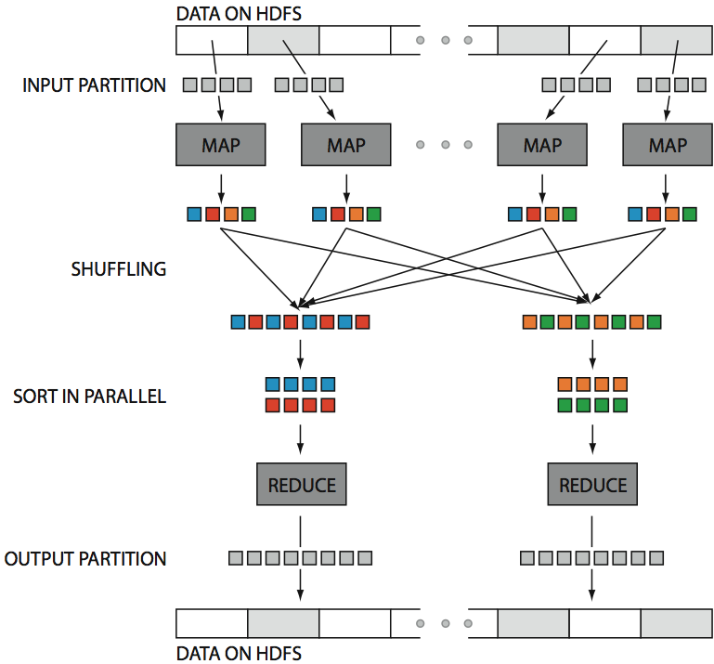
Hadoop in One Slide
src: Huy Vo, NYU Poly

Slide 43
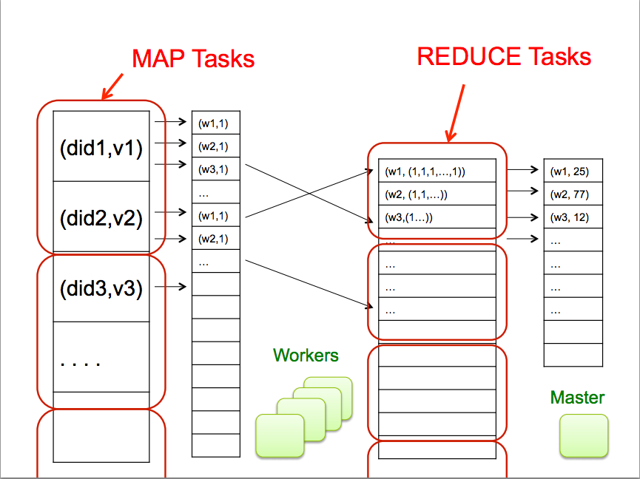

Slide 44
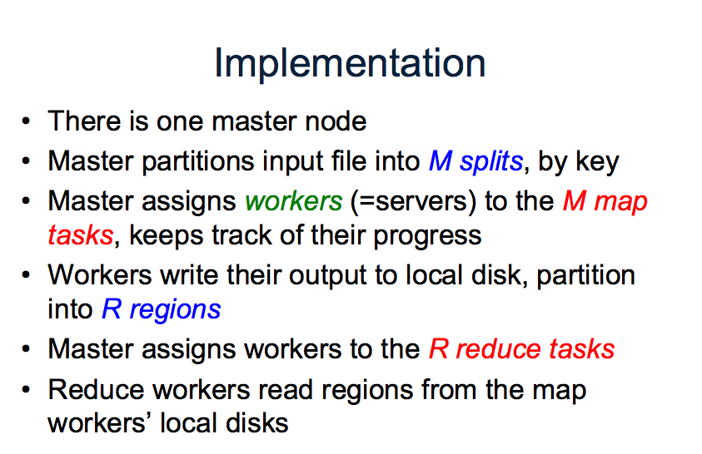

Slide 45
Large-Scale Data Processing
Many tasks process big data, produce big data
Want to use hundreds or thousands of CPUs
... but this needs to be easy
Parallel databases exist, but they are expensive, difficult to set up, and do not necessarily scale to hundreds of nodes.
MapReduce is a lightweight framework, providing:
Automatic parallelization and distribution
Fault-tolerance
I/O scheduling
Status and monitoring

Slide 46
Key Idea: Declarative Languages
Find all orders from today, along with the items ordered
SELECT *
FROM Order o, Item i
WHERE o.item = i.item
AND o.date = today()
join
o.item = i.item
select
date = today()
scan
scan
Item i
Order o

Slide 47
Two notions of parallel query processing
“Distributed Query”
Rewrite the query as a union of subqueries
Workers communicate through standard interfaces, so compatible with federated, heterogeneous, or distributed databases
“Parallel Query”
Each operator is implemented with a parallel algorithm

Slide 48
Distributed Query Example
CREATE VIEW Sales AS
SELECT * FROM JanSales
UNION ALL
SELECT * FROM FebSales
UNION ALL
SELECT * FROM MarSales
CREATE TABLE MarSales(
OrderID INT,
CustomerID INT NOT NULL,
OrderDate DATETIME NULL
CHECK (DATEPART(mm, OrderDate) = 3),
CONSTRAINT OrderIDMonth PRIMARY KEY(OrderID)
)

Slide 49
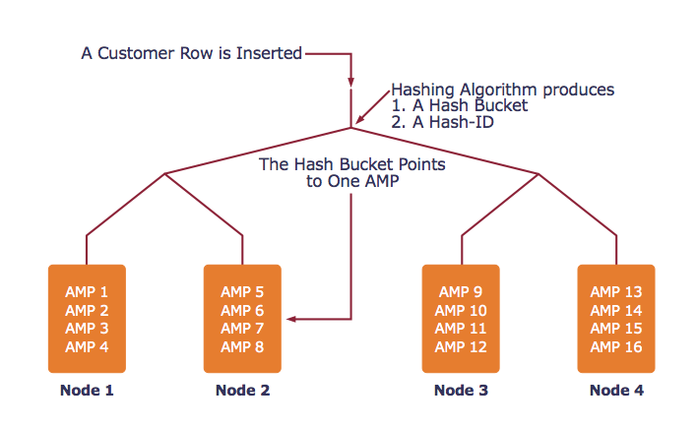
Parallel Query Example: Teradata
AMP = unit of parallelism

Slide 50
Example System: Teradata
Find all orders from today, along with the items ordered
SELECT *
FROM Orders o, Lines i
WHERE o.item = i.item
AND o.date = today()
join
o.item = i.item
select
date = today()
scan
scan
Item i
Order o

Slide 51
Example System: Teradata
AMP 4
AMP 5
AMP 6
hash
hash
hash
h(item)
h(item)
h(item)
select
select
select
date=today()
date=today()
date=today()
scan
scan
scan
Order o
Order o
Order o
AMP 1
AMP 2
AMP 3

Slide 52
Example System: Teradata
AMP 4
AMP 5
AMP 6
hash
hash
hash
h(item)
h(item)
h(item)
scan
scan
scan
Item i
Item i
Item i
AMP 1
AMP 2
AMP 3

Slide 53
Example System: Teradata
join
join
join
o.item = i.item
o.item = i.item
o.item = i.item
AMP 4
AMP 5
AMP 6
contains all orders and all lines where hash(item) = 3
contains all orders and all lines where hash(item) = 2
contains all orders and all lines where hash(item) = 1

Slide 54
MapReduce Contemporaries
Dryad (Microsoft)
Relational Algebra
Pig (Yahoo)
Near Relational Algebra over MapReduce
HIVE (Facebook)
SQL over MapReduce
Cascading
Relational Algebra
Clustera
U of Wisconsin
Hbase
Indexing on HDFS

Slide 55
MapReduce vs RDBMS
RDBMS
Declarative query languages
Schemas
Logical Data Independence
Indexing
Algebraic Optimization
Caching/Materialized Views
ACID/Transactions
MapReduce
High Scalability
Fault-tolerance
“One-person deployment”
DryadLINQ, Pig, HIVE
HIVE, Pig, DryadLINQ
Hbase
Pig, (Dryad, HIVE)

Slide 56
Comparison
 | Data Model | Prog. Model | Services
GPL | * | * | Typing (maybe)
Workflow | * | dataflow | typing, provenance, scheduling, caching, task parallelism, reuse
Relational Algebra | Relations | Select, Project, Join, Aggregate, … | optimization, physical data independence, data parallelism
MapReduce | [(key,value)] | Map, Reduce | massive data parallelism, fault tolerance
MS Dryad | IQueryable, IEnumerable | RA + Apply + Partitioning | typing, massive data parallelism, fault tolerance
MPI | Arrays/ Matrices | 70+ ops | data parallelism, full control

Slide 57
MR VS. Databases
Today’s Reading, Pavlo 2009

Slide 58
Hadoop vs. RDBMS
Pavlo et al. 2009
Comparison of 3 systems
Hadoop
Vertica (a column-oriented database)
DBMS-X (a row-oriented database)
rhymes with “schmoracle”
Qualitative
Programming model, ease of setup, features, etc.
Quantitative
Data loading, different types of queries

Slide 59
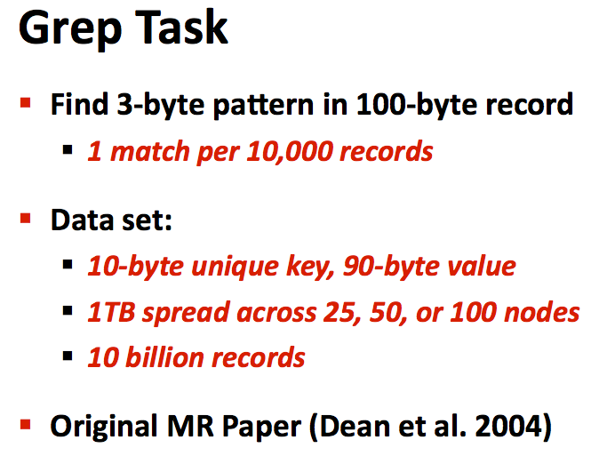

Slide 60
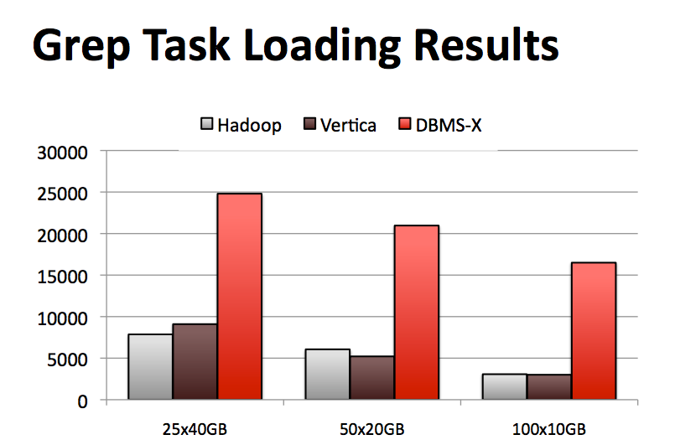

Slide 61
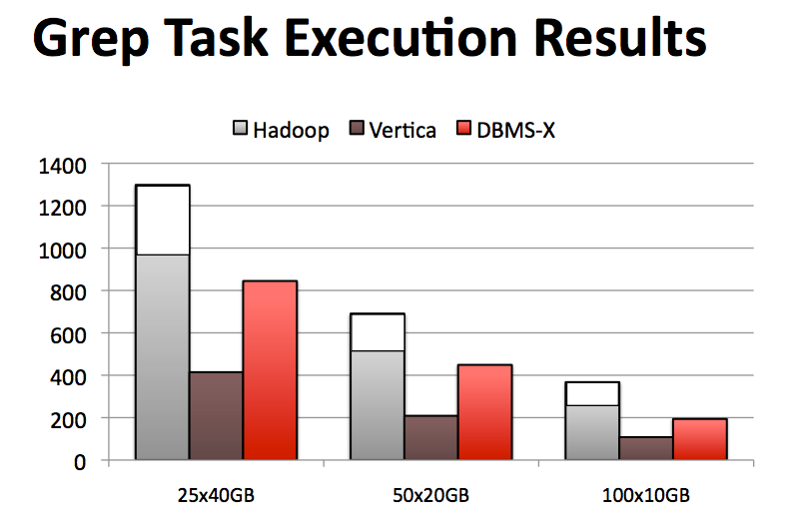

Slide 62
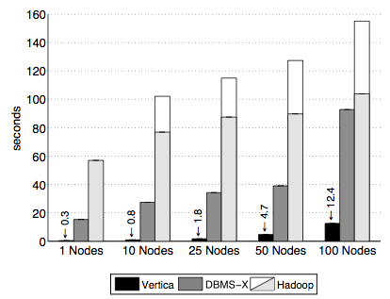
Selection Task
SELECT pageURL, pageRank
FROM Rankings WHERE pageRank > X
1 GB / node

Slide 63
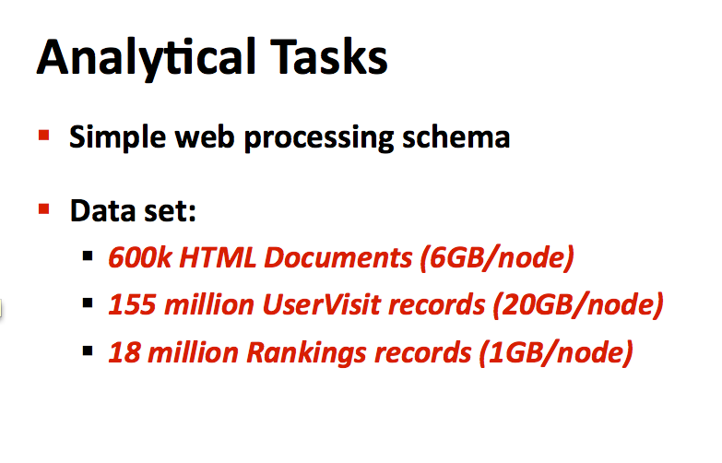

Slide 64
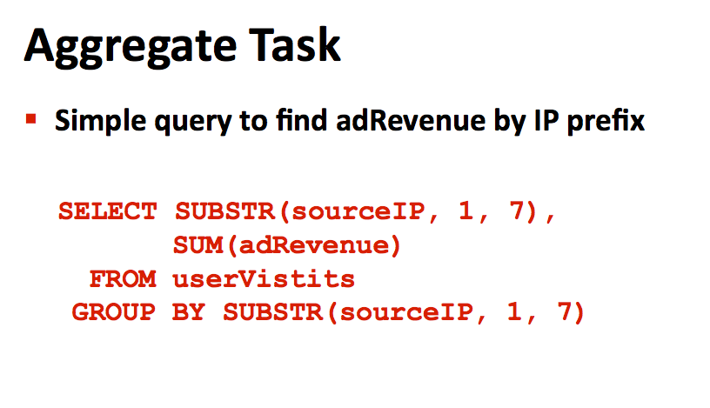

Slide 65
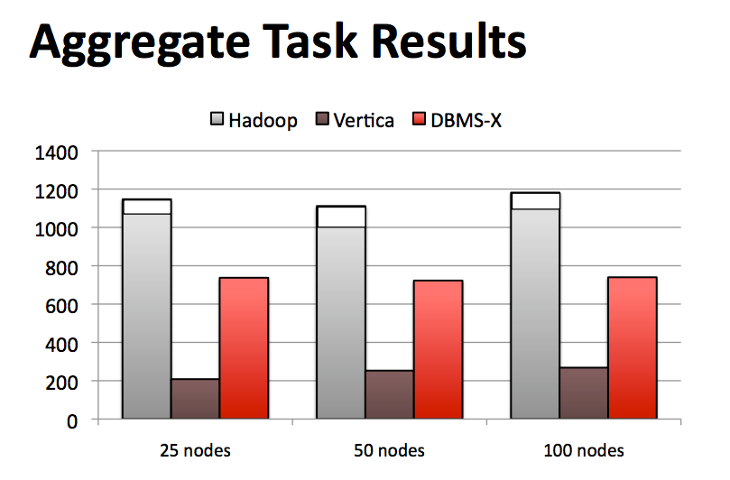

Slide 66
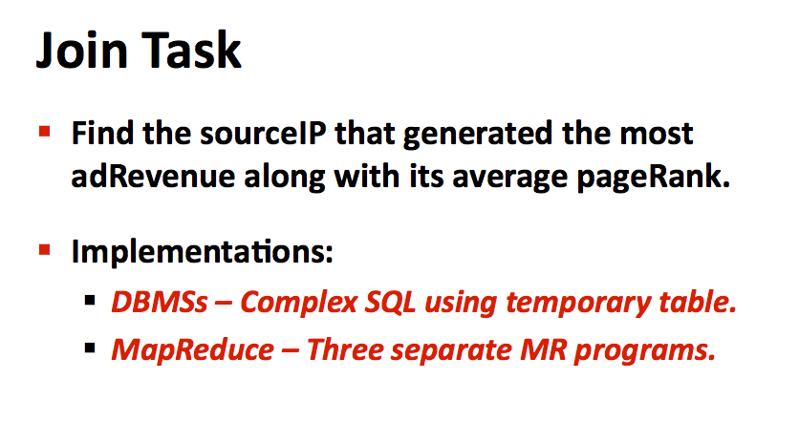

Slide 67
Join Task
SELECT INTO TempsourceIP,
AVG(pageRank)as avgPageRank,
SUM(adRevenue)as totalRevenue
FROM RankingsAS R
, UserVisitsAS UV
WHERE R.pageURL = UV.destURL
AND UV.visitDate
BETWEEN ‘2000-01-15’
AND ‘2000-01-22’
GROUP BY UV.sourceIP;
SELECT sourceIP,
totalRevenue,
avgPageRank
FROM Temp
ORDER BY totalRevenueDESC
LIMIT 1;

Slide 68
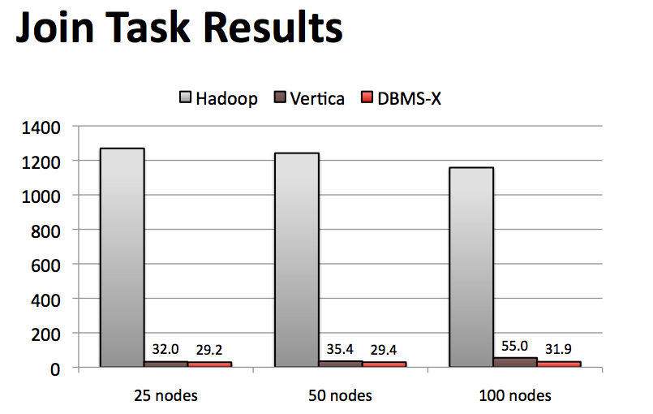

Slide 69
Problems with this analysis?
Other ways to avoid sequential scans?
Fault-tolerance in large clusters?
Tasks that cannot be expressed as queries?

Slide 70
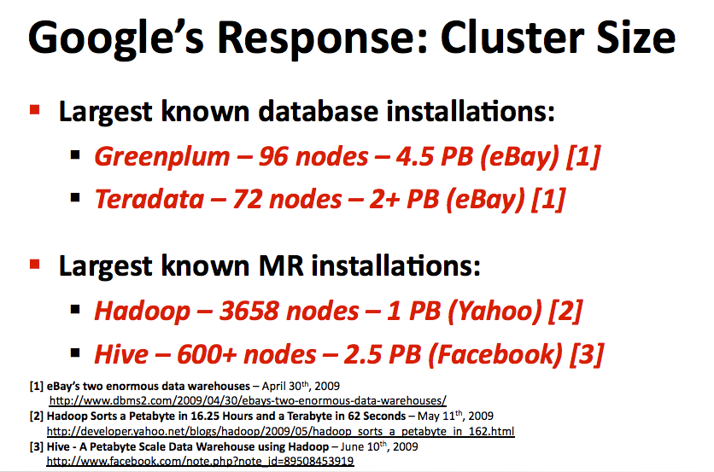

Slide 71
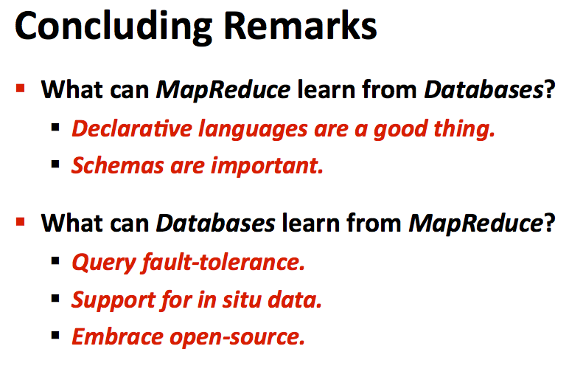

Slide 72
