Slide 1
Introduction to Data Management CSE 344
Lecture 21: Parallel Databases

Slide 2
Announcements
HW6 is posted: due Friday, March 9
Need to access Amazon Web Services
You have $100 credit – more than enough
Need to learn PigLatin: Thursday/Friday
Quickly learn PigLatin: use starter code
Next four lectures: parallel databases
Traditional, MapReduce+PigLatin
Wednesday, March 7
Guest lecture by Prof. Balazinska: No-SQL
Wednesday, March 9
Final review by Paris Koutris

Slide 3
Parallel Computation Today
Two MAJOR trends that are pushing Computer Science toward parallel computation:
Change in Moore's law* (exponential growth in transistors per chip density) no longer results in increased clock speeds.
Increased hardware performance will be available only through parallelism.
Think multicore: 4 cores today, perhaps 64 in a few years.
Cloud computing commoditizes access to large compute clusters.
Ten years ago, only google could afford 1000 servers;
Today you can rent this from Amazon Web Services (AWS)
* Moore's law says that the number of transistors that can be placed inexpensively on an integrated circuit doubles approximately every two years [Intel co-founder Gordon E. Moore described the trend in his 1965 paper and predicted that it will last for at least 10 years]

Slide 4
Big Data
Companies, organizations, scientists have data that is too big, too fast, and too complex to be managed without changing tools and processes.
Relational algebra and SQL are easy to parallelize and parallel DBMSs have already been studied in the 80's!

Slide 5
Data Analytics Companies
As a result, we are seeing an explosion of and a huge success of db analytics companies
Greenplum founded in 2003 acquired by EMC in 2010; A parallel shared-nothing DBMS (this lecture)
Vertica founded in 2005 and acquired by HP in 2011; A parallel, column-store shared-nothing DBMS (see 444 for discussion of column-stores)
DATAllegro founded in 2003 acquired by Microsoft in 2008; A parallel, shared-nothing DBMS
Aster Data Systems founded in 2005 acquired by Teradata in 2011; A parallel, shared-nothing, MapReduce-based data processing system (next lecture). SQL on top of MapReduce
Netezza founded in 2000 and acquired by IBM in 2010. A parallel, shared-nothing DBMS.
Great time to be in the data management, data mining/statistics, or machine learning!

Slide 6
Two Approaches to Parallel Data Processing
Parallel databases, developed starting with the 80s (this lecture)
For both OLTP and Decision Support Queries
Map/reduce, first developed by google, published in 2004 (next lecture)
Only for Decision Support Queries
Today we see convergence of the two approaches (Greenplum,Tenzing SQL)

Slide 7
Parallel DBMSs
Goal
Improve performance by executing multiple operations in parallel
Key benefit
Cheaper to scale than relying on a single increasingly more powerful processor
Key challenge
Ensure overhead and contention do not kill performance

Slide 8
Performance Metrics for Parallel DBMSs
P = the number of nodes (processors, computers)
Speedup:
More nodes, same data ➔ higher speed
Scaleup:
More nodes, more data ➔ same speed
OLTP: “Speed” = transactions per second (TPS)
Decision Support: “Speed” = query time

Slide 9
Linear v.s. Non-linear Speedup
Speedup
×1
×5
×10
×15
# nodes (=P)

Slide 10
Linear v.s. Non-linear Scaleup
Batch
Scaleup
×1
×5
×10
×15
# nodes (=P) AND data size

Slide 11
Challenges to Linear Speedup and Scaleup
Startup cost
Cost of starting an operation on many nodes
Interference
Contention for resources between nodes
Skew
Slowest node becomes the bottleneck

Slide 12
Architectures for Parallel Databases
Shared memory
Shared disk
Shared nothing

Slide 13
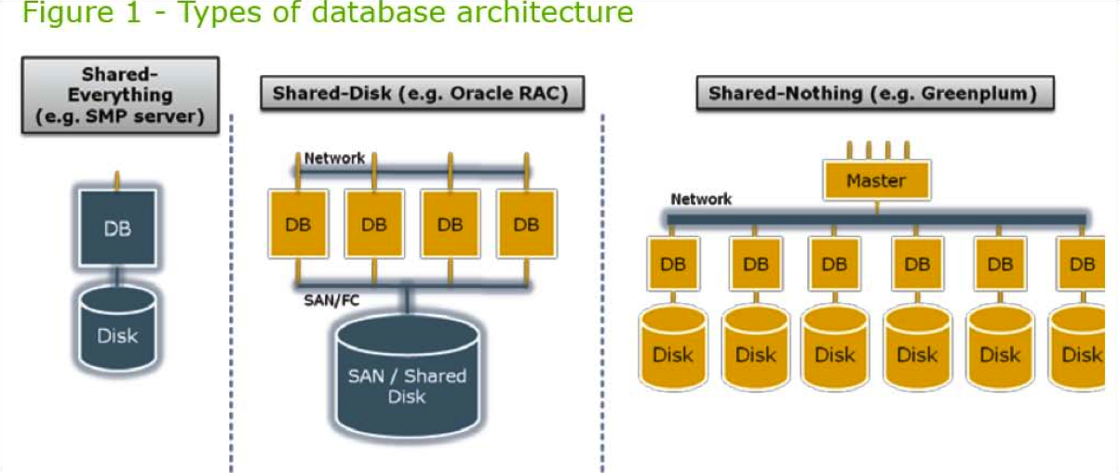
Architectures for Parallel Databases
From: Greenplum Database Whitepaper
SAN = “Storage Area Network”

Slide 14
Shared Memory
Nodes share both RAM and disk
Dozens to hundreds of processors
Example: SQL Server runs on a single machine and can leverage many threads to get a query to run faster (see query plans on IISQLSRV)
Easy to use and program
But very expensive to scale: last remaining cash cows in the hardware industry

Slide 15
Shared Disk
All nodes access the same disks
Found in the largest "single-box" (non-cluster) multiprocessors
Oracle dominates this class of systems.
Characteristics:
Also hard to scale past a certain point: existing deployments typically have fewer than 10 machines

Slide 16
Shared Nothing
Cluster of machines on high-speed network
Called "clusters" or "blade servers”
Each machine has its own memory and disk: lowest contention.
NOTE: Because all machines today have many cores and many disks, then shared-nothing systems typically run many "nodes” on a single physical machine.
Characteristics:
Today, this is the most scalable architecture.
Most difficult to administer and tune.
We discuss only Shared Nothing in class

Slide 17
In Class
You have a parallel machine. Now what?
How do you speed up your database system?

Slide 18
Approaches to Parallel Query Evaluation
cid=cid
cid=cid
Inter-query parallelism
Each query runs on one processor
Only for OLTP queries
Inter-operator parallelism
A query runs on multiple processors
An operator runs on one processor
For both OLTP and Decision Support
Intra-operator parallelism
An operator runs on multiple processors
For both OLTP and Decision Support
cid=cid
pid=pid
pid=pid
Customer
pid=pid
Customer
Customer
Product
Purchase
Product
Purchase
Product
Purchase
cid=cid
pid=pid
Customer
Product
Purchase
cid=cid
pid=pid
Customer
Product
Purchase
We study only intra-operator parallelism: most scalable

Slide 19
Review in Class
Basic query processing on one node.
Given relations R(A,B) and S(B, C), compute:
Selection: σ_{A=123}(R)
Group-by: γ_{A,sum(B)}(R)
Join: R ⋈ S

Slide 20
Horizontal Data Partitioning
Have a large table R(K, A, B, C)
Need to partition on a shared-nothing architecture into P chunks R₁, …, R_{P}, stored at the P nodes
Block Partition: size(R₁)≈ … ≈ size(R_{P})
Hash partitioned on attribute A:
Tuple t goes to chunk i, where i = h(t.A) mod P + 1
Range partitioned on attribute A:
Partition the range of A into -∞ = v₀ < v₁ < … < v_{P} = ∞
Tuple t goes to chunk i, if v_{i-1} < t.A < v_{i}

Slide 21
Parallel GroupBy
R(K,A,B,C), discuss in class how to compute these GroupBy’s, for each of the partitions
γ_{A,sum(C)}(R)
γ_{B,sum(C)}(R)

Slide 22
Parallel GroupBy
γ_{A,sum(C)}(R)
If R is partitioned on A, then each node computes the group-by locally
Otherwise, hash-partition R(K,A,B,C) on A, then compute group-by locally:
R₁
R₂
. . .
R_{P}
Reshuffle R on attribute A
R₁’
R₂’
. . .
R_{P}’

Slide 23
Speedup and Scaleup
The runtime is dominated by the time to read the chunks from disk, i.e. size(R_{i})
If we double the number of nodes P, what is the new running time of γ_{A,sum(C)}(R)?
If we double both P and the size of the relation R, what is the new running time?

Slide 24
Uniform Data v.s. Skewed Data
Uniform partition:
size(R₁) ≈ … ≈ size(R_{P}) ≈ size(R) / P
Linear speedup, constant scaleup
Skewed partition:
For some i, size(R_{i}) ≫ size(R) / P
Speedup and scaleup will suffer

Slide 25
Uniform Data v.s. Skewed Data
Let R(K,A,B,C); which of the following partition methods may result in skewed partitions?
Block partition
Hash-partition
On the key K
On the attribute A
Range-partition
On the key K
On the attribute A

Slide 26
Uniform Data v.s. Skewed Data
Let R(K,A,B,C); which of the following partition methods may result in skewed partitions?
Block partition
Hash-partition
On the key K
On the attribute A
Range-partition
On the key K
On the attribute A
Uniform
Uniform
Assuming uniform hash function
May be skewed
E.g. when all records have the same value of the attribute A, then all records end up in the same partition
May be skewed
Difficult to partition the range of A uniformly.

Slide 27
Parallel Join
In class: compute R(A,B) ⋈ S(B,C)
R₁, S₁
R₂, S₂
. . .
R_{P}, S_{P}

Slide 28
Parallel Join
In class: compute R(A,B) ⋈ S(B,C)
R₁, S₁
R₂, S₂
. . .
R_{P}, S_{P}
Reshuffle R on R.B and S on S.B
R’₁, S’₁
R’₂, S’₂
. . .
R’_{P}, S’_{P}
Each server computes the join locally

