Slide 1
Introduction to Data Management CSE 344
Lecture 23 Analyzing Big Graphs and Pig Latin

Slide 2
Outline
An example of Big Data Analysis
Introduction to Pig System

Slide 3
Graph Databases
Many large databases are graphs
Give examples in class
b
d
a
e
c
f
g
Source | Target
a | b
b | a
a | f
b | f
b | e
b | d
d | e
d | c
e | g
g | c
c | g

Slide 4
Graph Databases
Many large databases are graphs
Give examples in class
The Web
The Internet
Social Networks
Flights btw. Airports
Etc,etc,etc
b
d
a
e
c
f
g
Source | Target
a | b
b | a
a | f
b | f
b | e
b | d
d | e
d | c
e | g
g | c
c | g

Slide 5
Data Analytics on Big Graphs
Queries expressible in SQL:
How many nodes (edges)?
How many nodes have > 4 neighbors?
Which are the “most connected nodes”?
Queries requiring recursion:
Is the graph connected?
What is the diameter of the graph?
Compute PageRank
Compute the Centrality of each node
b
d
a
e
c
f
g
Source | Target
a | b
b | a
a | f
b | f
b | e
b | d
d | e
d | c
e | g
g | c
c | g

Slide 6
Example: the Histogram of a Graph
Outdegree of a node = number of outgoing edges
For each d, let n(d) = number of nodes with oudegree d
The outdegree histogram of a graph = the scatterplot (d, n(d))
4
2
2
1
1
0
1
n
d | n(d)
0 | 1
1 | 3
2 | 2
3 | 0
4 | 1
d
Outdegree 1 is seen at 3 nodes

Slide 7
Histograms Tell Us Something About the Graph
What can you say about these graphs?

Slide 8
Exponential Distribution
n(d) ≅ c/2^{d} (generally, cx^{d}, for some x < 1)
A random graph has exponential distribution
Best seen when n is on a log scale
Quickly vanishing

Slide 9
Zipf Distribution
n(d) ≅ 1/d^{x}, for some value x>0
Human-generated data has Zipf distribution: letters in alphabet, words in vocabulary, etc.
Best seen in a log-log scale
Long tail

Slide 10
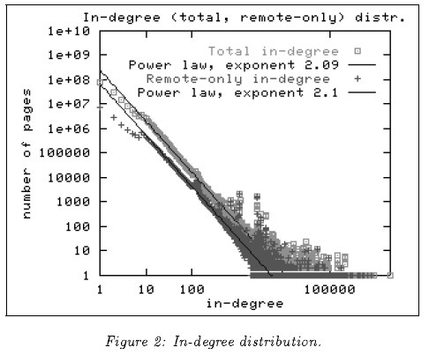
The Histogram of the Web
Late 1990’s
200M Webpages
Exponential ?
Zipf ?

Slide 11
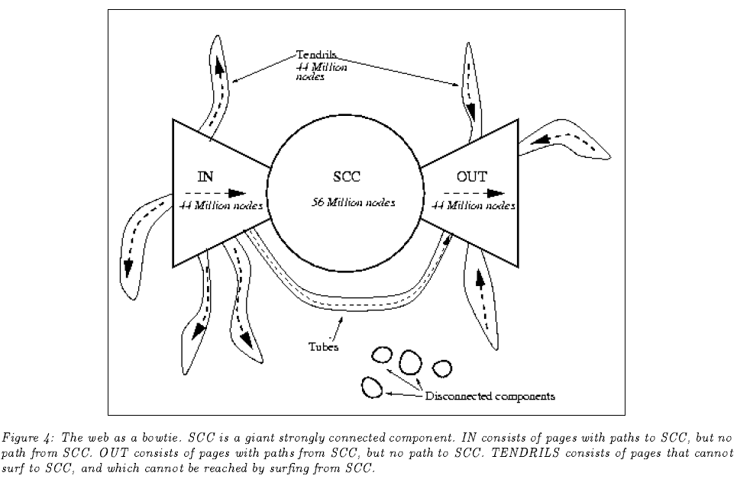
The Bowtie Structure of the Web

Slide 12
Review: Parallel Execution in Cluster
Data is typically a file in the Google File System
HDFS for Hadoop
File system partitions file into chunks
Each chunk is replicated on k (typically 3) machines
Each machine can run a few map and reduce tasks simultaneously
Each map task consumes one chunk
Can adjust how much data goes into each map task using “splits”
Scheduler tries to schedule map task where its input data is located
Map output is partitioned across reducers
Map output is also written locally to disk
Number of reduce tasks is configurable
System shuffles data between map and reduce tasks
Reducers sort-merge data before consuming it

Slide 13
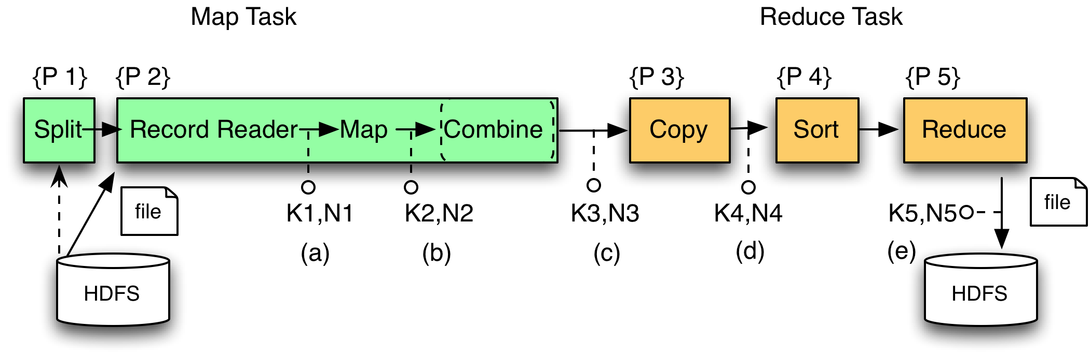
MapReduce Phases
`
Local storage

Slide 14
MapReduce Illustrated
Romeo, Romeo, wherefore art thou Romeo?
What, art thou hurt?
map
map
reduce
reduce

Slide 15
MapReduce Illustrated
Romeo, Romeo, wherefore art thou Romeo?
What, art thou hurt?
Romeo, 1
Romeo, 1
wherefore, 1
art, 1
thou, 1
Romeo, 1
map
map
What, 1
art, 1
thou, 1
hurt, 1
reduce
reduce

Slide 16
MapReduce Illustrated
Romeo, Romeo, wherefore art thou Romeo?
What, art thou hurt?
Romeo, 1
Romeo, 1
wherefore, 1
art, 1
thou, 1
Romeo, 1
map
map
What, 1
art, 1
thou, 1
hurt, 1
art, (1, 1)
hurt (1),
thou (1, 1)
reduce
reduce
Romeo, (1, 1, 1)
wherefore, (1)
what, (1)

Slide 17
MapReduce Illustrated
Romeo, Romeo, wherefore art thou Romeo?
What, art thou hurt?
Romeo, 1
Romeo, 1
wherefore, 1
art, 1
thou, 1
Romeo, 1
map
map
What, 1
art, 1
thou, 1
hurt, 1
art, (1, 1)
hurt (1),
thou (1, 1)
reduce
reduce
Romeo, (1, 1, 1)
wherefore, (1)
what, (1)
art, 2
hurt, 1
thou, 2
Romeo, 3
wherefore, 1
what, 1

Slide 18
Making Parallelism Simple
Sequential reads = good read speeds
In large cluster failures are guaranteed; MapReduce handles retries
Good fit for batch processing applications that need to touch all your data:
data mining
model tuning
Bad fit for applications that need to find one particular record
Bad fit for applications that need to communicate between processes; oriented around independent units of work

Slide 19

What is Pig?
An engine for executing programs on top of Hadoop
It provides a language, Pig Latin, to specify these programs
An Apache open source project http://hadoop.apache.org/pig/

Slide 20
Why use Pig?
Suppose you have user data in one file, website data in another, and you need to find the top 5 most visited sites by users aged 18 - 25.
Load Users
Load Pages
Filter by age
Join on name
Group on url
Count clicks
Order by clicks
Take top 5

Slide 21
In MapReduce
170 lines of code, 4 hours to write

Slide 22
In Pig Latin
Users = load ‘users’ as (name, age); Fltrd = filter Users by age >= 18 and age <= 25; Pages = load ‘pages’ as (user, url); Jnd = join Fltrd by name, Pages by user; Grpd = group Jnd by url; Smmd = foreach Grpd generate group, COUNT(Jnd) as clicks; Srtd = order Smmd by clicks desc; Top5 = limit Srtd 5; store Top5 into ‘top5sites’;
9 lines of code, 15 minutes to write

Slide 23
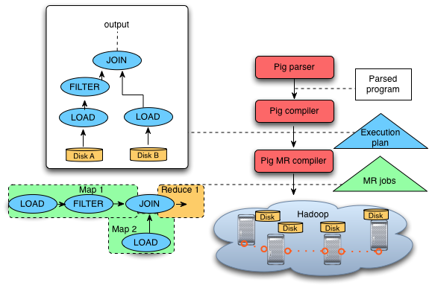
Pig System Overview
A = LOAD 'file1' AS (sid,pid,mass,px:double);
B = LOAD 'file2' AS (sid,pid,mass,px:double);
C = FILTER A BY px < 1.0;
D = JOIN C BY sid,
B BY sid;
STORE g INTO 'output.txt';
Pig Latin
program
Ensemble of MapReduce jobs

Slide 24
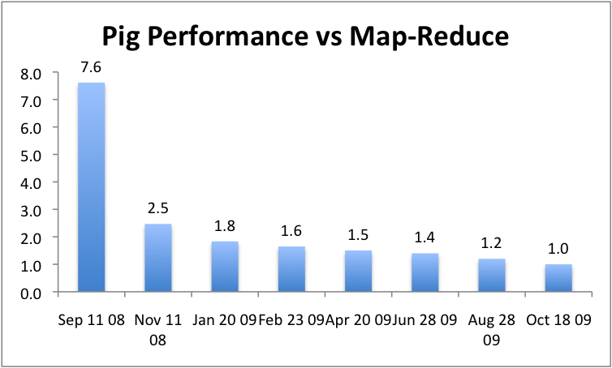
But can it fly?

