Slide 1
Pig: High-level Procedural Language over MapReduce

Slide 2
Matrix Addition
SELECT A.row, A.column, A.value + B.value
FROM A, B
WHERE A.row = B.row
AND A.column = B.column
SELECT A.row, A.column, A.value + B.value
FROM A INNER JOIN B ON (
A.row = B.row
AND A.column = B.column
)

Slide 3
CREATE VIEW totalNumOfDocuments AS
SELECT count(frequency.docid) as count
FROM frequency
SELECT term_id f.term, docid f.docid, f.count * log(N.count / (
SELECT count(docid)
FROM frequency f1
WHERE f.term = f1.term)
)
FROM frequency f, totalNumOfDocument as N;

Slide 4
CREATE VIEW termdocs as
SELECT term, count(docid) as termdocs
FROM frequency
GROUP BY term;
CREATE VIEW totaldocs as
SELECT count(distinct docid) as countalldocs
FROM frequency;
SELECT a.term, a.docid, (
a.count * log(b.termdocs /
c.countalldocs)
) as tfidf
FROM frequency a, termdocs b, totaldocs c
WHERE a.docid = b.docid
AND a.term = b.term;

Slide 5
set @TotalNumberOfDocuments = (select COUNT(distinct doc_id) from frequency)
declare @DocumentCounts table
( term_id varchar(max),
document_count int)
-- get the number of documents containing each term
insert into @DocumentCounts (term_id,document_count)
select term_id,COUNT(distinct doc_id)
from DATASCI250.dbo.frequency
group by term_id
-- Then calculate the TF-IDF, note that the below uses the Natural LOG
select doc_id,f.term_id,frequency * LOG(CAST(@TotalNumberOfDocuments as Decimal(18,4))/CAST(Document_count as Decimal(18,4))) as TF_IDF
from frequency f
inner join @DocumentCounts d on f.term_id = d.term_id

Slide 6
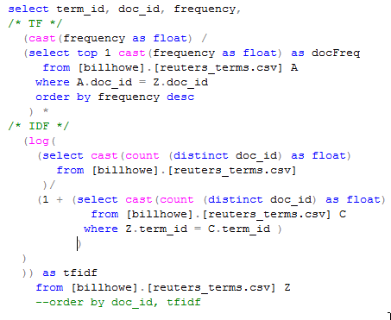
Assignment 2 Review

Slide 7
Reflection
Why did we do this exercise?

Slide 8
From the first lecture
What is Data Science about?
1) Preparing data for analysis
(wrangling, cleaning, munging, transforming, inegrating, …)
2) Running some analysis (often a statistical model)
3) Interpreting the results and making decisions

Slide 9
Key challenges for Data Preparation
Data can be very large (Volume)
Data can be very heterogeneous and weakly structured (Variety)
Data may be coming in faster than you can handle it (Velocity)

Slide 10
For Volume
Key idea: use abstractions that allow scalable processing
Relational algebra and SQL
(not necessarily just databases)
MapReduce
Today: Pig

Slide 11
For Variety
Key idea: we want to know how to work with a variety of data types
Matrices
Relations
Graphs (some today)
Text
Images? (maybe)
Key challenges for 2):
Selecting the model, running the model.
Later in this class, we will learn a handful of key "go to" techniques.
We will already know how to implement them in the abstractions above.
Key challenges for 3):
Communicating the results of a "black box" model.
Here, we will consider visualization techniques.

Slide 12
For Velocity
We won’t discuss this much in this class

Slide 13
Key Challenges for Running Analyses
Selecting the model
We will learn a toolbox of core techniques.
clustering (k-means)
optimization (forms of regression)
dimension reduction (multidimensional scaling)
Running the model efficiently
We will already know how to implement these models in existing systems
RA/SQL, MapReduce
We may have time to cover some new approaches (GraphLab)
We will already know how to implement them in the abstractions above.
Key challenges for 3):
Communicating the results of a "black box" model.
Here, we will consider visualization techniques.

Slide 14
Key Challenges for Interpreting Results
Interpreting the results (convincing yourself)
Communicating the results (convincing others)
We will focus on visualization

Slide 15
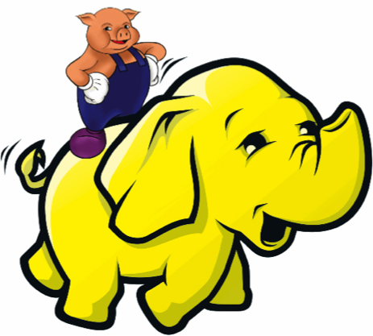
What is Pig?
An engine for executing programs on top of Hadoop
It provides a language, Pig Latin, to specify these programs
An Apache open source project http://pig.apache.org/

Slide 16
Why use Pig?
Suppose you have user data in one file, website data in another, and you need to find the top 5 most visited sites by users aged 18 - 25.
Load Users
Load Pages
Filter by age
Join on name
Group on url
Count clicks
Order by clicks
Take top 5

Slide 17
In MapReduce
170 lines of code, 4 hours to write

Slide 18
In Pig Latin
Users = load ‘users’ as (name, age); Fltrd = filter Users by age >= 18 and age <= 25; Pages = load ‘pages’ as (user, url); Jnd = join Fltrd by name, Pages by user; Grpd = group Jnd by url; Smmd = foreach Grpd generate group, COUNT(Jnd) as clicks; Srtd = order Smmd by clicks desc; Top5 = limit Srtd 5; store Top5 into ‘top5sites’;
9 lines of code, 15 minutes to write

Slide 19
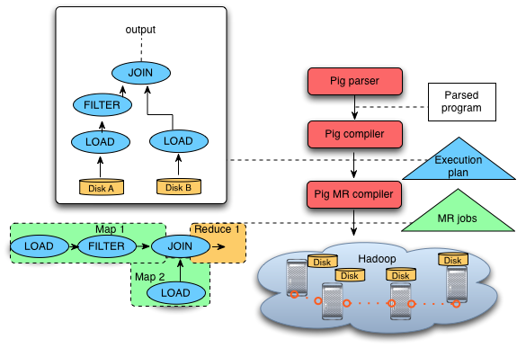
Pig System Overview
A = LOAD 'file1' AS (sid,pid,mass,px:double);
B = LOAD 'file2' AS (sid,pid,mass,px:double);
C = FILTER A BY px < 1.0;
D = JOIN C BY sid,
B BY sid;
STORE g INTO 'output.txt';
Pig Latin
program
Ensemble of MapReduce jobs

Slide 20
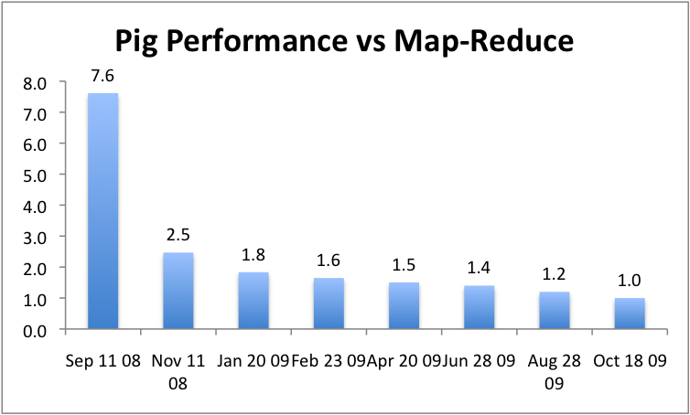
But can it fly?

Slide 21
Data Model
 Atom - simple atomic value (ie: number or string)  Tuple
 Bag  Map
slide src: Oliver Kennedy, U of Buffalo

Slide 22
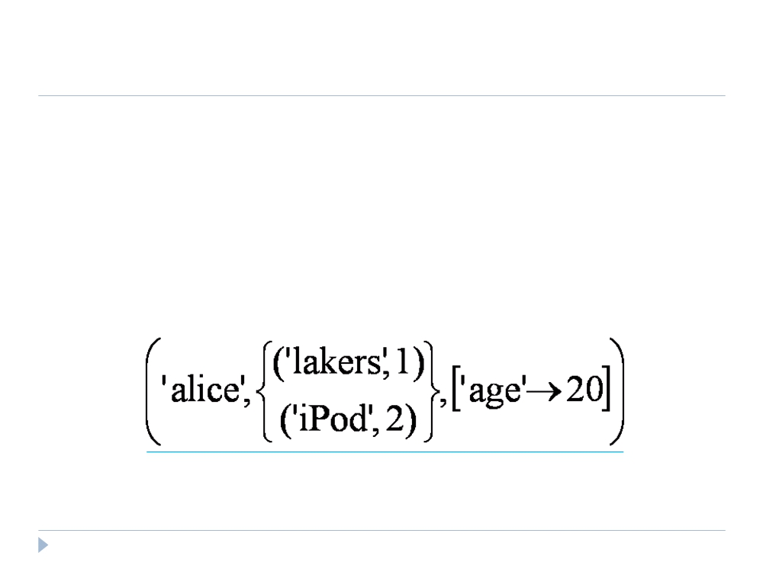
Data Model
 Atom
 Tuple - sequence of fields; each field any type  Bag
 Map
slide src: Oliver Kennedy, U of Buffalo

Slide 23
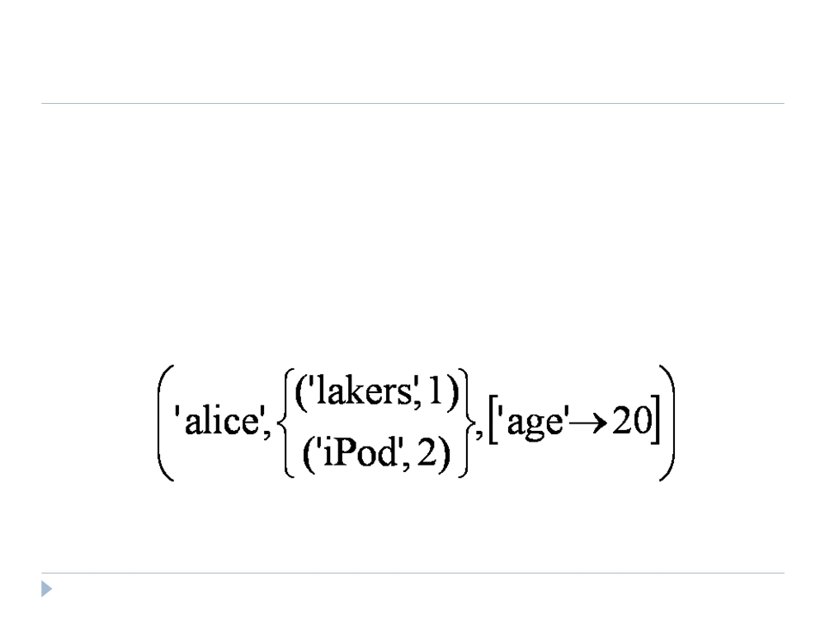
Data Model
 Atom
 Tuple
 Bag - collection of tuples
 Duplicates possible
 Tuples in a bag can have different field lengths and field types  Map
slide src: Oliver Kennedy, U of Buffalo

Slide 24
Data Model
 Atom
 Tuple  Bag
 Map - collection of key-value pairs
 Key is an atom; value can be any type
slide src: Oliver Kennedy, U of Buffalo

Slide 25

Speaking Pig Latin
 LOAD
 Input is assumed to be a bag (sequence of tuples)  Can specify a deserializer with “USING‟  Can provide a schema with “AS‟
newBag = LOAD ‘filename’ <USING functionName() >
<AS (fieldName1, fieldName2,…)>;
Queries = LOAD ‘query_log.txt’ USING myLoad()
AS (userID,queryString, timeStamp)
slide src: Oliver Kennedy, U of Buffalo

Slide 26
Speaking Pig Latin
 FOREACH
 Apply some processing to each tuple in a bag  Each field can be:
 A fieldname of the bag  A constant
 A simple expression (ie: f1+f2)
 A predefined function (ie: SUM, AVG, COUNT, FLATTEN)  A UDF (ie: sumTaxes(gst, pst) )
newBag =
FOREACH bagName
GENERATE field1, field2, …;
slide src: Oliver Kennedy, U of Buffalo

Slide 27
Speaking Pig Latin
 FILTER
 Select a subset of the tuples in a bag
newBag = FILTER bagName BY expression ;
 Expression uses simple comparison operators (==, !=, <, >, …) and Logical connectors (AND, NOT, OR)
some_apples =
FILTER apples BY colour != ‘red’;
 Can use UDFs
some_apples =
FILTER apples BY NOT isRed(colour);
slide src: Oliver Kennedy, U of Buffalo

Slide 28
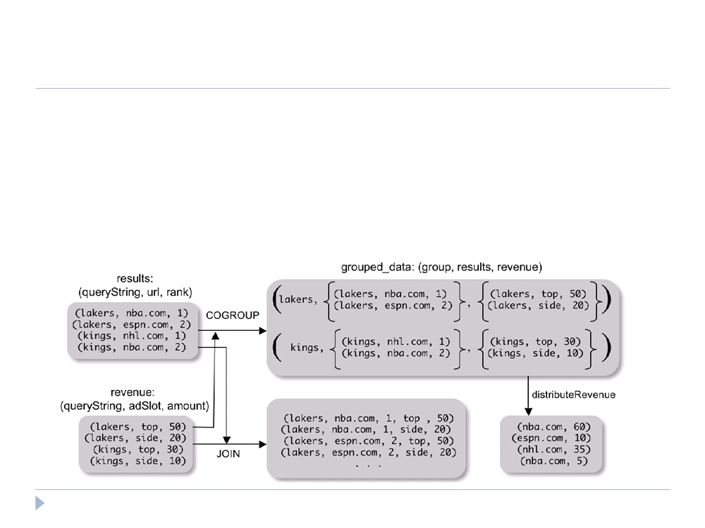
Speaking Pig Latin
 COGROUP
 Group two datasets together by a common attribute  Groups data into nested bags
grouped_data = COGROUP results BY queryString, revenue BY queryString;
slide src: Oliver Kennedy, U of Buffalo

Slide 29
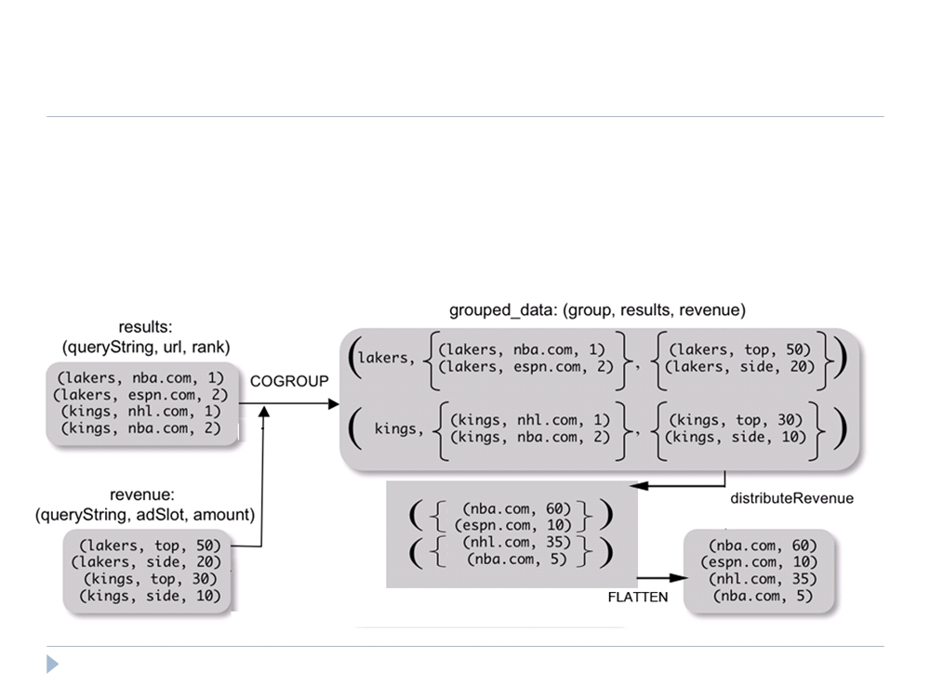
Speaking Pig Latin
 Why COGROUP and not JOIN?
url_revenues =
FOREACH grouped_data GENERATE
FLATTEN(distributeRev(results, revenue));
slide src: Oliver Kennedy, U of Buffalo

Slide 30
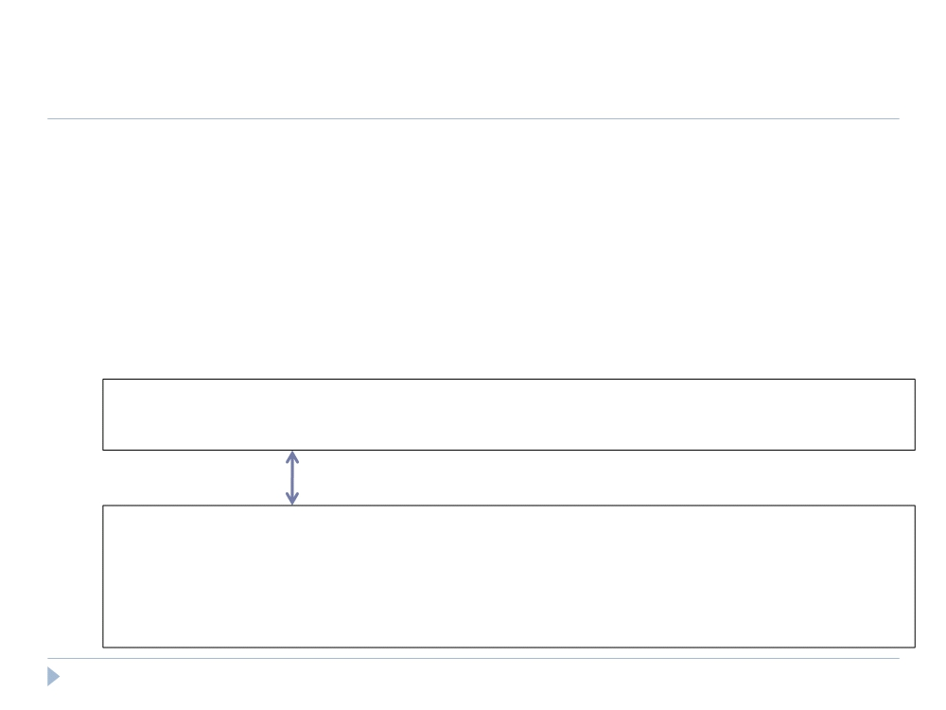
Speaking Pig Latin
 Why COGROUP and not JOIN?
 May want to process nested bags of tuples before taking the cross product.
 Keeps to the goal of a single high-level data transformation per pig-latin statement.
 However, JOIN keyword is still available:
JOIN results BY queryString, revenue BY queryString;
Equivalent
temp = COGROUP results BY queryString, revenue BY queryString;
join_result = FOREACH temp GENERATE
FLATTEN(results), FLATTEN(revenue);
slide src: Oliver Kennedy, U of Buffalo

Slide 31
Speaking Pig Latin
 STORE (& DUMP)
 Output data to a file (or screen)
STORE bagName INTO ‘filename’ <USING deserializer ()>;
 Other Commands (incomplete)
 UNION - return the union of two or more bags
 CROSS - take the cross product of two or more bags  ORDER - order tuples by a specified field(s)  DISTINCT - eliminate duplicate tuples in a bag  LIMIT - Limit results to a subset
23

Slide 32
Compilation
 Pig system does two tasks:
 Builds a Logical Plan from a Pig Latin script
 Supports execution platform independence
 No processing of data performed at this stage
 Compiles the Logical Plan to a Physical Plan and Executes
 Convert the Logical Plan into a series of Map-Reduce statements to be executed (in this case) by Hadoop Map-Reduce
24

Slide 33
Compilation
 Building a Logical Plan
 Verify input files and bags referred to are valid  Create a logical plan for each bag(variable) defined
25

Slide 34

Compilation
 Building a Logical Plan Example
A = LOAD ‘user.dat’ AS (name, age, city);
Load(user.dat)
B = GROUP A BY city;
C = FOREACH B GENERATE group AS city, COUNT(A);
D = FILTER C BY city IS ‘kitchener’ OR city IS ‘waterloo’;
STORE D INTO ‘local_user_count.dat’;
26

Slide 35
Compilation
 Building a Logical Plan Example
A = LOAD ‘user.dat’ AS (name, age, city);
Load(user.dat)
B = GROUP A BY city;
C = FOREACH B GENERATE group AS city, COUNT(A);
D = FILTER C BY city IS ‘kitchener’ OR city IS ‘waterloo’;
STORE D INTO ‘local_user_count.dat’;
26

Slide 36
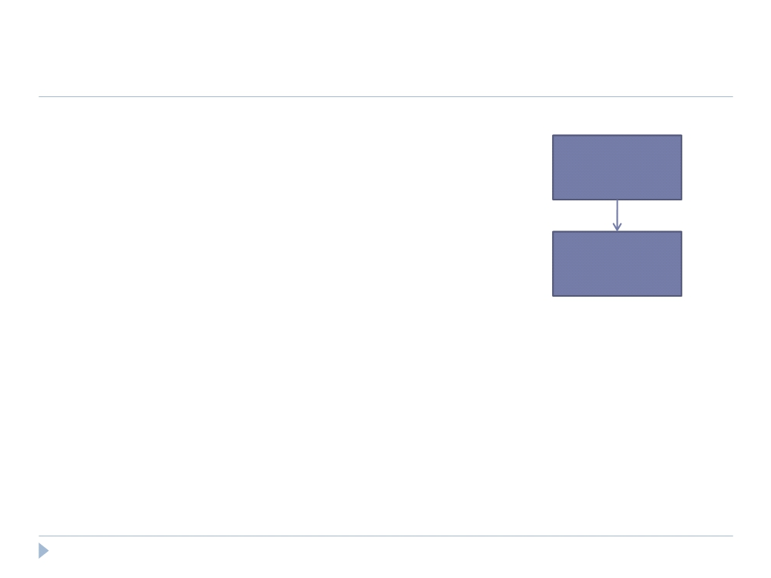
Compilation
 Building a Logical Plan Example
A = LOAD ‘user.dat’ AS (name, age, city);
Load(user.dat)
B = GROUP A BY city;
C = FOREACH B GENERATE group AS city, COUNT(A);
D = FILTER C BY city IS ‘kitchener’
Group
OR city IS ‘waterloo’;
STORE D INTO ‘local_user_count.dat’;
27

Slide 37
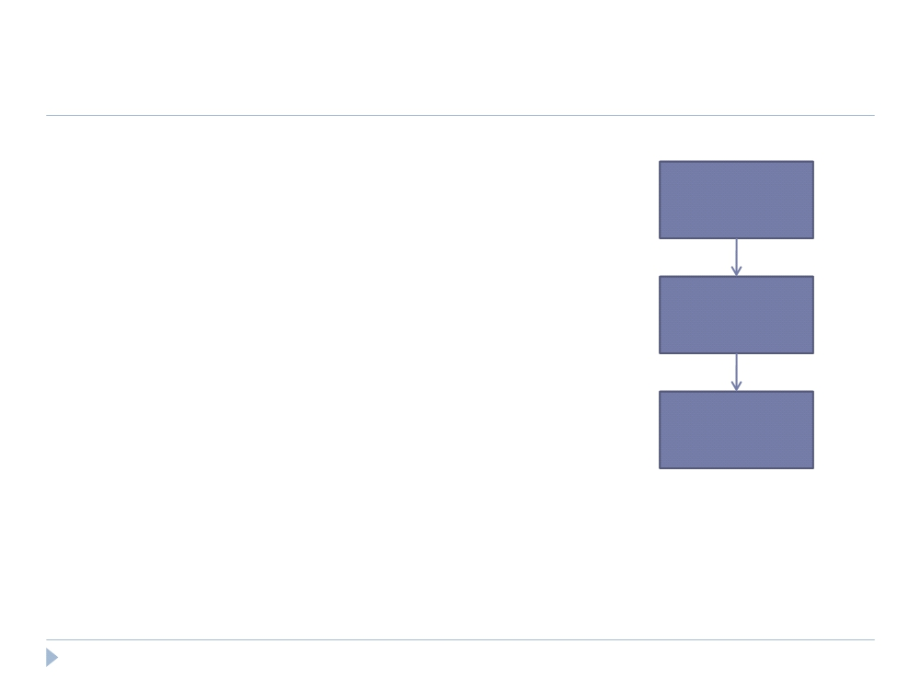
Compilation
 Building a Logical Plan Example
A = LOAD ‘user.dat’ AS (name, age, city);
Load(user.dat)
B = GROUP A BY city;
C = FOREACH B GENERATE group AS city, COUNT(A);
D = FILTER C BY city IS ‘kitchener’
Group
OR city IS ‘waterloo’;
STORE D INTO ‘local_user_count.dat’;
Foreach
28

Slide 38
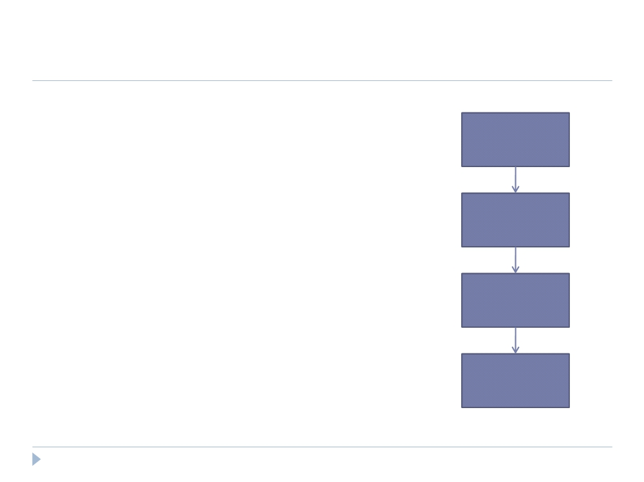
Compilation
 Building a Logical Plan Example
A = LOAD ‘user.dat’ AS (name, age, city);
Load(user.dat)
B = GROUP A BY city;
C = FOREACH B GENERATE group AS city, COUNT(A);
D = FILTER C BY city IS ‘kitchener’
Group
OR city IS ‘waterloo’;
STORE D INTO ‘local_user_count.dat’;
Foreach
Filter
29

Slide 39
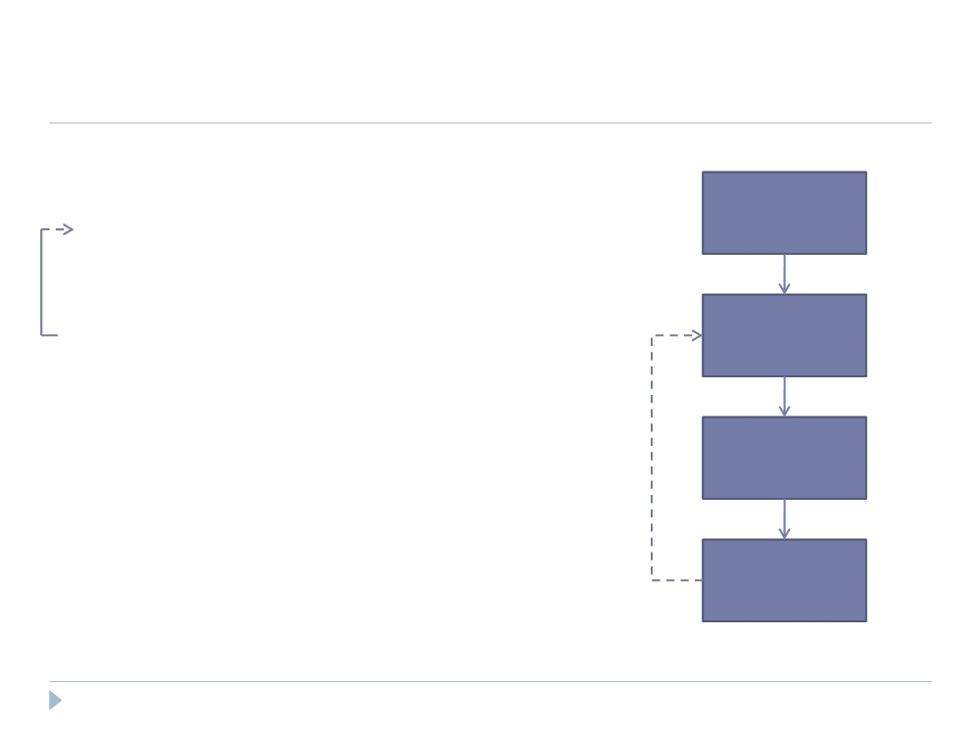
Compilation
 Building a Logical Plan Example
A = LOAD ‘user.dat’ AS (name, age, city);
Load(user.dat)
B = GROUP A BY city;
C = FOREACH B GENERATE group AS city, COUNT(A);
D = FILTER C BY city IS ‘kitchener’
Filter
OR city IS ‘waterloo’;
STORE D INTO ‘local_user_count.dat’;
Group
Foreach
30

Slide 40
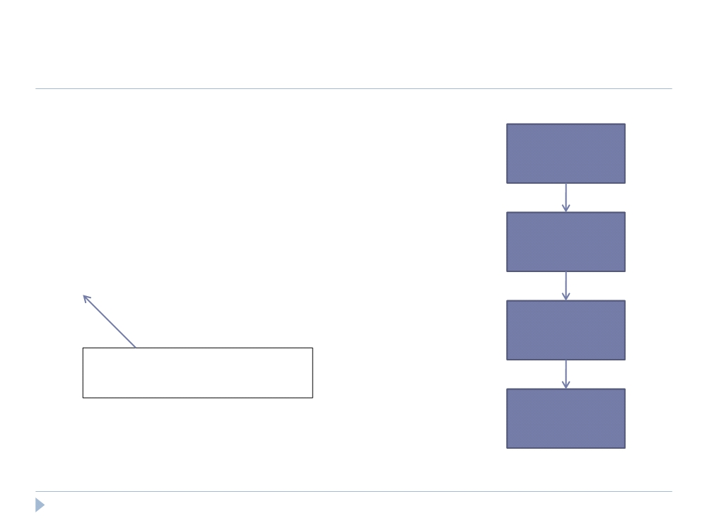
Compilation
 Building a Physical Plan
A = LOAD ‘user.dat’ AS (name, age, city);
Load(user.dat)
B = GROUP A BY city;
C = FOREACH B GENERATE group AS city, COUNT(A);
D = FILTER C BY city IS ‘kitchener’
Filter
OR city IS ‘waterloo’;
STORE D INTO ‘local_user_count.dat’;
Group
Only happens when output is specified by STORE or DUMP
Foreach
32

Slide 41
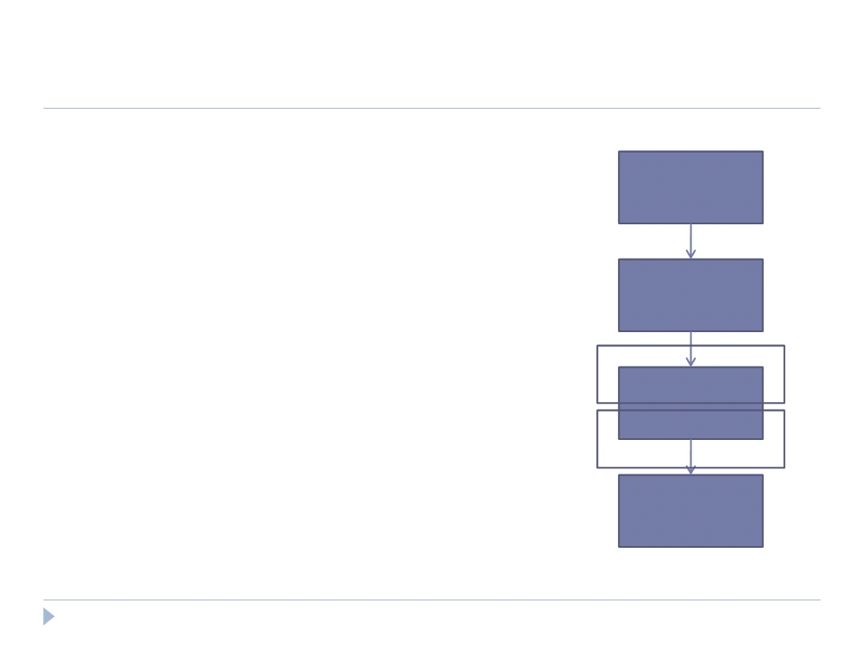
Compilation
 Building a Physical Plan
 Step 1: Create a map-reduce job for each COGROUP
Load(user.dat)
Filter
Map
Group
Reduce
Foreach
33

Slide 42
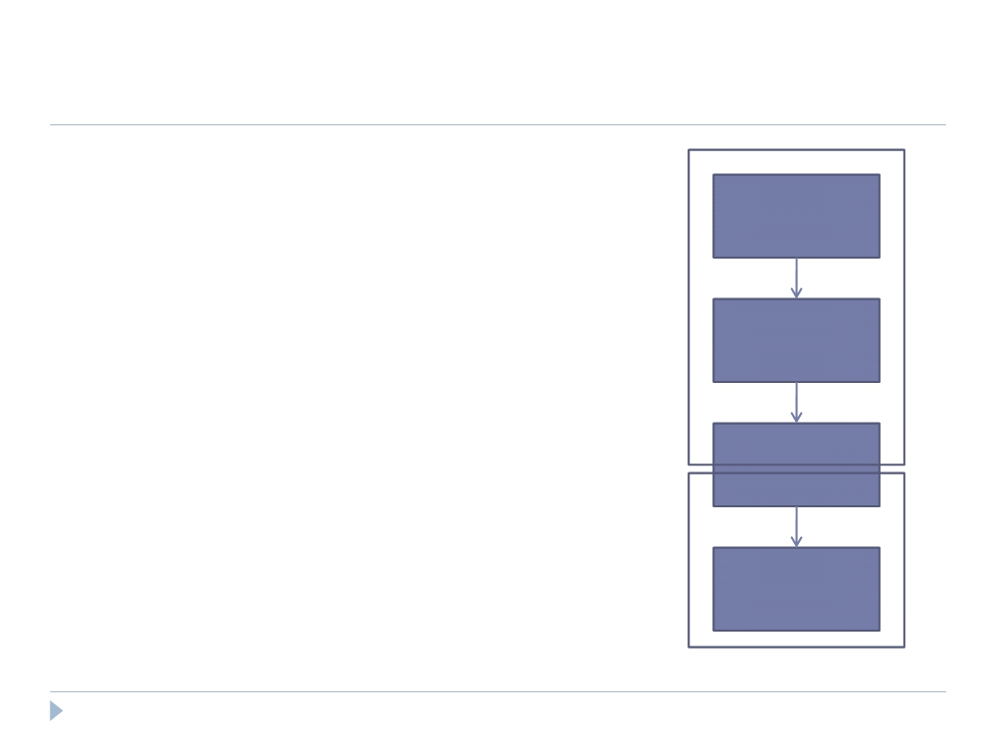
Compilation
 Building a Physical Plan
 Step 1: Create a map-reduce job for each COGROUP
Load(user.dat)
 Step 2: Push other commands into the map and reduce functions where Map
Filter
possible
 May be the case certain commands
Group
require their own map-reduce
job (ie: ORDER needs separate map-
Reduce
reduce jobs)
Foreach
34

