Slide 1
External Iteration Optimization of Recursive Queries Internal Iteration
Iterative Algorithms
Notes:
In this unit I’m going to build some theory for map-reduce algorithms. This theory will eventually lead us to some lower bounds, and that in turn lets us assert that particular algorithms are as efficient as a map-reduce algorithm for a problem can be.
There are several ingredients to the theory. First, we need the notion of reducer size – the maximum amount of data that a reducer can have as input. We also need the notion of replication rate – the average number of key-value pairs generated by a mapper on one input. One goal is to prove lower bounds on the replication rate as a function of reducer size. That is, the smaller the reducer size, the bigger the replication rate.
Another essential ingredient to the theory is the mapping schema – a description of how outputs for a problem relate to inputs. We characterize a problem by its mapping schema, and we use properties of that schema to put an upper bound on how many outputs can be covered by one reducer with a given reducer size. That in turn lets us get lower bounds on replication rate as a function of the reducer size.

Slide 2
Why Iterative Programs?
Graph Analytics
Recursive Relational Queries
Clustering
k-means
Optimization
SGD, EM, …
Bottom line: Analytics implies iteration

Slide 3
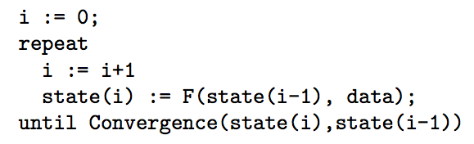
Every Iterative Analytics Program

Slide 4
Four ways to implement iteration
Use an external driver program (baseline)
External Iteration
Change the algorithm to avoid iteration
No iteration
Tweak the system to better support iteration
Internal iteration
Reason algebraically
All of the above

Slide 5
Example 1: PageRank
Rank Table R₀
url | rank
www.a.com | 1.0
www.b.com | 1.0
www.c.com | 1.0
www.d.com | 1.0
www.e.com | 1.0
Edge Table E
R_{i+1}
url_src | url_dest
www.a.com | www.b.com
www.a.com | www.c.com
www.c.com | www.a.com
www.e.com | www.c.com
www.d.com | www.b.com
www.c.com | www.e.com
www.e.com | www.c.om
www.a.com | www.d.com
π(url_dest, γ_{url_dest}SUM(rank))
R_{i}.rank = R_{i}.rank/γ_{url}COUNT(url_dest)
Rank Table R₃
url | rank
www.a.com | 2.13
www.b.com | 3.89
www.c.com | 2.60
www.d.com | 2.60
www.e.com | 2.13
R_{i}.url = L.url_src
R_{i}
L

Slide 6
Using an External Driver
Join & compute rank
Aggregate
fixpoint evaluation
rank_{i}
M
r
M
r
M
r
edge₀
M
r
M
r
M
r
edge₁
M
i=i+1
Converged?
Client
done

Slide 7
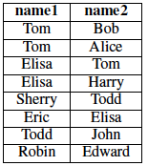
Example 2: TC / Breadth-first search
Friend
Find all transitive friends of Eric
R₀
{Eric, Eric}
R₁
{Eric, Elisa}
R₂
{Eric, Tom
Eric, Harry}
R₃
{}
(semi-naïve evaluation)

Slide 8
TC/ Breadth-first search in MapReduce
(compute next generation of friends)
Join
(remove the ones we’ve already seen)
Dupe-elim
result_{i}
M
r
M
r
edge₀
M
r
M
r
edge₁
M
Anything new?
i=i+1
Client
done

Slide 9
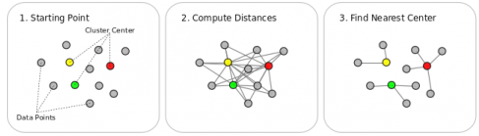
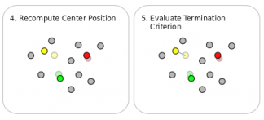
Example 3: k-means
https://stratosphere.eu/wiki/doku.php/wiki:kmeansexample

Slide 10
Example 3: k-means
k_{i}
= k centroids at iteration i
k_{i}
P0
M
r
k_{i}
P1
M
k_{i+1}
r
k_{i}
P2
M
k_{i} - k_{i+1} < threshold?
Client
i=i+1
done

Slide 11
What’s the problem?
ranks_{i}
m
r
M
r
M
r
edge₀
m
r
M
r
M
r
edge₁
3.
m
2.
1.
L is loop invariant, but
L is loaded on each iteration
L is shuffled on each iteration
Fixpoint evaluated as a separate MapReduce job per iteration
plus

Slide 12
What’s the problem?
(compute next generation of friends)
Join
(remove the ones we’ve already seen)
Dupe-elim
result_{i}
M
r
M
r
edge₀
M
r
M
r
edge₁
M
2.
1.
Friend is loop invariant, but
Friend is loaded on each iteration
Friend is shuffled on each iteration

Slide 13
What’s the problem?
k_{i}
k_{i}
= k centroids at iteration i
P0
M
r
k_{i}
P1
M
k_{i+1}
r
k_{i}
P2
M
1.
k_{i} - k_{i+1} < threshold?
Client
i=i+1
done
P is loop invariant, but
P is loaded on each iteration
Notes:
asynchronous communication
1) engineering issue: client involved
2) loop invariant
3) bulk synchrous
4)

Slide 14
Method 2: Change the Algorithm

Slide 15
Method 2: Change the Algorithm
Jimmy Lin’s hypothesis [SIGMOD 12, ARXIV tech report]
Iteration can be eliminated in most cases
Ex: stochastic gradient descent instead of batch gradient descent
Consider influence from each training example independently, in parallel
HogWild [Recht, Re, Wright, Niu NIPS 2011]
Parallelized Stochastic Gradient Descent [Zinkevich et. al 2010]
Ex: Approximate graph algorithms
Ex: Streaming / One-pass k-means
General form of these tricks unknown

Slide 16
Key Idea
Program still converges, even if F does not operate on the whole dataset

Slide 17
Method 3: Tweak the System

Slide 18
Method 3: Tweak the System: Inter-iteration caching
Loop body
M
…
r
M
r
M
Reducer output cache (RO)
Reducer input cache (RI)
Mapper output cache (MO)
Mapper input cache (MI)

Slide 19
Most important: Cache Loop-Invariant Data
Iteration i = 0: Load a distributed cache
Iteration i > 0:
Join
Difference
ΔA_{i-1}
map
reduce
map
R⁽⁰⁾
reduce
map
reduce
map
R⁽⁰⁾
R⁽¹⁾
A_{i}⁽⁰⁾
map
R⁽¹⁾
map
reduce
A_{i}⁽¹⁾
map
Notes:
Instead of shuffling the invariant relation on every iteration, load it into a cache on iteration 0, then access it on iteration I > 0

Slide 20
Join
Difference
Caching Loop-Invariant Data
ΔA_{i-1}
map
reduce
map
R⁽⁰⁾
map
reduce
map
reduce
R⁽¹⁾
map
A_{i}⁽⁰⁾
map
reduce
A_{i}⁽¹⁾
map
failure
First iteration is slow, as the invariant graph is shuffled and cached
23X
Notes:
Four points to make:
0) This is the time for *join only*, not the overall iteration time
1) First iteration is slower, as the cache is filled
2) each iteration is about 23X faster by joining against cached results.
3) The gaps are failures, which are a reality at this scale. Recovery proceeded as usual.
HaLoop showed similar, but did not evaluate complete datalog queries.

Slide 21
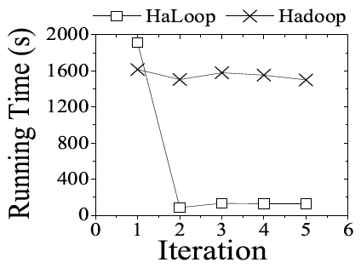
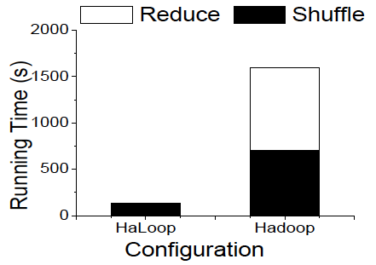
Join & compute rank
Aggregate
fixpoint evaluation
R_{i}
M
r
M
r
M
r
L-split0
M
r
M
r
M
r
L-split1
M
Total

Slide 22
Schimmy trick
Lin and Schatz 2010
HaLoop reducer input cache in vanilla MapReduce
Reducer writes sorted graph data directly to HDFS, then reads it on subsequent iterations
Implements a sort-merge join on sorted input
Not strictly MR, since it operates on HDFS directly

Slide 23
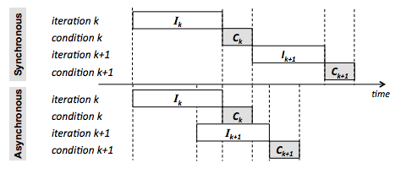
Asynchronous Iteration
iHadoop (Elnikety et al.)
Reducer early start: start collecting and shuffling mapper outputs before all tasks finish (not a new idea)
Stream reduce -> map: Map phase of iteration k+1 can read output of reduce phase of iteration k as it is written
Concurrent termination check

Slide 24
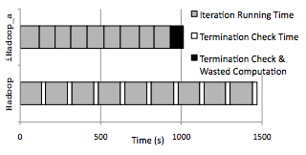
Asynchronous Iteration

Slide 25
Optimization: Priorities
Zhang et al. SOCC 2011
http://code.google.com/p/priter/
Key idea: For iterative jobs, some tasks help the algorithm converge faster than others
Assign these tasks a higher priority, make the others wait
Like stochastic gradient descent, but choose a set of variables instead of just one
Program still converges, even if F does not operate on the whole dataset

Slide 26
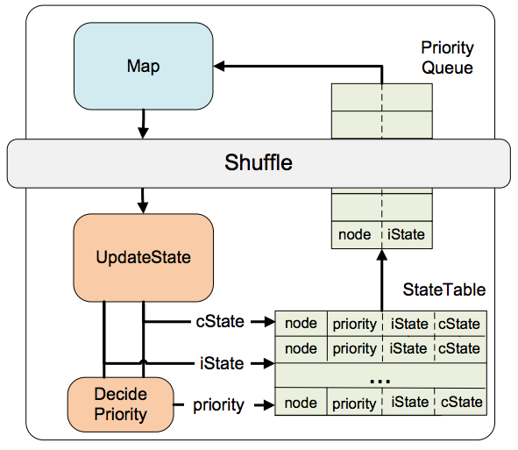
Prioritized Execution
Zhang et al. SOCC 2011
http://code.google.com/p/priter/

Slide 27
Method 4: Reason Algebraically

Slide 28
Method 4: Generalize and Optimize
Add an abstraction layer supporting iteration
Specialize MapReduce for these semantics
Reason about the program algebraically

Slide 29

Why A Language Level?
Observation: MapReduce has proven successful as a common runtime for non-recursive declarative languages
HIVE (SQL)
Pig (RA with nested types)
Observation: Status quo is to roll your own loops
Graphs, clustering, mining, recursive queries
iteration managed by external script
Thesis: With minimal extensions, we can provide an efficient common runtime for recursive languages
Map, Reduce, Fixpoint

Slide 30
Datalog: Relational Algebra + Recursion
Example: Find all friends of George:
Ans(X) :- Friend('George', X)
Example: Find everyone in George’s social network
FriendOfFriend(X,Y) :- Friend(X, Y)
FriendOfFriend(X,Y) :- Friend(X,Y), FriendOfFriend(Y,Z)
Ans(X) :- FriendOfFriend('George', X)
Notes:
Shortest path, connected components,

Slide 31
Variants
Hyracks: Compile alternative programming models to Datalog and optimize
e.g., Pregel
Have users express Datalog directly and optimize

Slide 32




Generic Graph Operations
Transitive Closure
Strongly Connected Components
Shortest Path
reachable(X,Y) :- edge(X,Y)
reachable(X,Z) :- edge(X,Y), reachable(Y,Z)
% Find the strongly connected pairs of nodes
connected(X,Y) :- reachable(X,Y), reachable(Y,X).
% Label each connected component
component(max(X),Y) :- connected(X,Y).
[Abiteboul, Kanellakis 90]

Slide 33
Example: Aggregation with Inference
Find all cases where a company C1 owns >50% of the share in a company C2.
The relationship owns(C1, C2, S) indicates that company C1 directly owns S% of C2.
A
owns 10%
owns 10%
bought
bought
B
bought(Parent, Subsid) :-
owns(Parent, Subsid, Percent)
C
control 50%
bought
control(Parent, Subsid, sum(S)) : -
bought(Parent, Intermediary),
owns(Intermediary, Subsid, S)
owns 20%
owns 30%
bought(Parent, Subsid) :-
control(Parent, Subsid, S),
S > 50
bought(A,B)
bought(A,C)
bought(B,C)
bought(B,D)
bought(A,D)
bought
bought
D

Slide 34
Review: Algebraic Optimization
N = ((4*2)+((4*3)+0))/1
Algebraic Laws:
1. (+) identity: x+0 = x
2. (/) identity: x/1 = x
3. (*) distributes: (n*x+n*y) = n*(x+y)
4. (*) commutes: x*y = y*x
Apply rules 1, 3, 4, 2: N = (2+3)*4
two operations instead of five, no division operator
Same idea works with very large tables / graphs, but the payoff is much higher

Slide 35
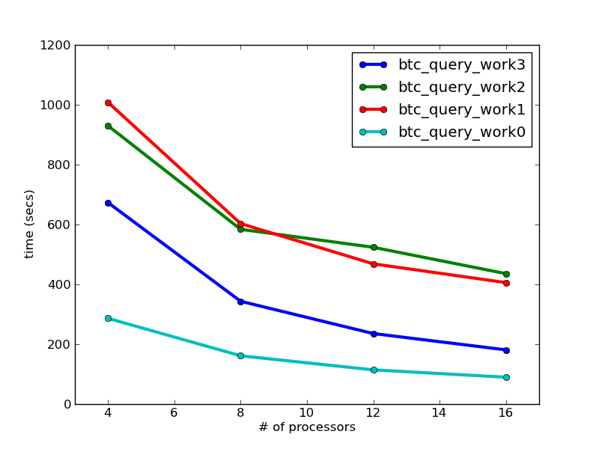
Review: Logical Optimization Matters
BTC 2010 Dataset
3B quads
623 GB processed
Notes:
btc_query_work.cc -- BTC query on the BTC2010 data set. Hash two of the
selections and scan for the last. Create an array with
the join result. Each step is a scan for a count to build
a data structure followed by a scan to fill the data
structure.
?a foaf:knows ?b .
?b foaf:holdsAccount ?c .
?c foaf:accountServiceHomepage ?d .
btc_query_work0 (case 0, define SX_H1Y_H2Z):
- Hash foaf:holdsAccount and foaf:accountServiceHomepage
- Scan for foaf:knows. Search foaf:holdsAccount hashtable
first.
btc_query_work1 (case 1, define H1X_SY_H2Z_0):
- Hash foaf:knows and foaf:accountServiceHomepage
- Scan for foaf:holdsAccount. Search foaf:knows hashtable
first.
btc_query_work2 (case 2, define H1X_SY_H2Z_1):
- Hash foaf:knows and foaf:accountServiceHomepage
- Scan for foaf:holdsAccount. Search
foaf:accountServiceHomepage hashtable first.
btc_query_work3 (case 3, define H1X_H2Y_SZ):
- Hash foaf:knows and foaf:holdsAccount
- Scan for foaf:accountServiceHomepage. Search
foaf:knows hashtable first.

Slide 36
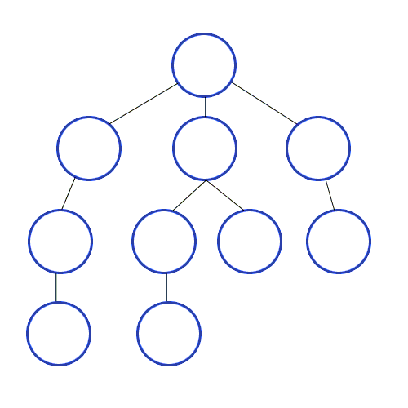
Evaluation of Recursive Programs
Reachability from a given node
A(y) :- Edge(‘w’, y)
A(y) :- A(x), Edge(x,y)
step 0: all nodes connected to ‘w’
w
step 1: for each node in A, find neighbors
step 2: for each node in A, find neighbors

Slide 37
Example: Reachability
A(y) :- R(1234, b, y)
A(y) :- A(z), R(z,b,y)
Breadth first search; find all nodes connected to node 1234
Dataset: Billion Triple Challenge 2010, 680GB, ~2 billion nodes

Slide 38
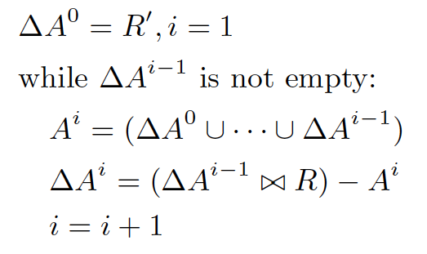
Iterative queries in MR = just two expensive tasks
Union is just concatenation of disjoint files; implicit in MR
Join
Dupe-elim
Notes:
This should be easy to understand for the Datalog crowd
Two points to make:
1) Join and Dupe-Elim are the only large-scale/parallel/expensive tasks
2) Union is just concatenation of disjoint files, which is implicit in MR since all datasets span multiple files.
Breadh first search

Slide 39
How does the Join work?
(y,z1)
(y, z2)
y
(x,y)
(y, z3)
x
Map phase:
Reduce phase:
join to construct 2-paths:
hash (x,y) on y
hash (y,z1) on y
hash (y,z2) on y
hash (y,z3) on y
(x,y,z1)
(x,y,z2)
(x,y,z3)
Notes:
“left” edges are hashed on the object, “right” edges are hashed on the subject.
The has value determines which server will process them.
Each combination of “left” and “right” edges correspond to one join tuple in the output (in this case, a 2path)

Slide 40
In MapReduce
(compute next generation of nodes)
(remove the ones we’ve already seen)
Join
Difference
ΔA_{i-1}
map
reduce
map
R⁽⁰⁾
map
reduce
reduce
map
R⁽¹⁾
map
A_{i}⁽⁰⁾
map
reduce
A_{i}⁽¹⁾
map
Anything new?
i=i+1
Client
done

Slide 41
What’s the problem?
Bu, Howe, Balazinska, Ernst VLDB10, VLDBJ12
Shaw, Howe, Koutris Datalog12
Join
Difference
ΔA_{i-1}
map
reduce
map
R⁽⁰⁾
map
reduce
reduce
map
R⁽¹⁾
map
A_{i}⁽⁰⁾
map
reduce
(a)
(b)
A_{i}⁽¹⁾
map
(a) R is loop invariant, but gets loaded and shuffled on each iteration
(b) A_{i} grows slowly and monotonically, but is loaded and shuffled on each iteration. HaLoop’s Reducer Input Cache addressed (a), but did not support the append semantics needed for (b).

Slide 42
First optimization: Cache Loop-Invariant Data
Iteration i = 0: Load a distributed cache
Iteration i > 0:
Join
Difference
ΔA_{i-1}
map
reduce
map
R⁽⁰⁾
reduce
map
reduce
map
R⁽⁰⁾
R⁽¹⁾
A_{i}⁽⁰⁾
map
R⁽¹⁾
map
reduce
A_{i}⁽¹⁾
map
Notes:
Instead of shuffling the invariant relation on every iteration, load it into a cache on iteration 0, then access it on iteration I > 0

Slide 43
Join
Difference
Caching Loop-Invariant Data
ΔA_{i-1}
map
reduce
map
R⁽⁰⁾
map
reduce
map
reduce
R⁽¹⁾
map
A_{i}⁽⁰⁾
map
reduce
A_{i}⁽¹⁾
map
failure
First iteration is slow, as the invariant graph is shuffled and cached
23X
Notes:
Four points to make:
0) This is the time for *join only*, not the overall iteration time
1) First iteration is slower, as the cache is filled
2) each iteration is about 23X faster by joining against cached results.
3) The gaps are failures, which are a reality at this scale. Recovery proceeded as usual.
HaLoop showed similar, but did not evaluate complete datalog queries.

Slide 44
Cost of Join vs. Dupe-elim
time (s)
iteration #
Notes:
Just showing the relative cost of the join vs. the dupe-elim with the join cache in place.
May not want to dwell on this; there are some other optimizations
Point to make: the cost is no longer dominated by the join.
The slight upward slope is due to the cost of checking duplicates against an ever-growing result set.

Slide 45
Second Optimization: Specialize Cache for Datalog Semantics
Join
Difference
ΔA_{i-1}
map
reduce
map
R⁽⁰⁾
map
reduce
map
reduce
R⁽¹⁾
map
A_{i}⁽⁰⁾
map
reduce
A_{i}⁽¹⁾
map
MapReduce semantics require that all keys from the cache be extracted and passed to reducers.
But we only care about keys that join.
join keys arriving from mappers
Reducer for Join
all tuples from cache

Slide 46
Specialization for Equijoin
Join
Difference
ΔA_{i-1}
map
reduce
map
R⁽⁰⁾
map
reduce
map
reduce
R⁽¹⁾
map
A_{i}⁽⁰⁾
map
reduce
A_{i}⁽¹⁾
map
Index the cache, and only extract keys that join
Reducer for Join
join keys arriving from mappers
keys that join
indexed cache lookup

Slide 47
Join
Difference
Effect of equijoin specialization
ΔA_{i-1}
map
reduce
map
R⁽⁰⁾
map
reduce
map
reduce
R⁽¹⁾
map
A_{i}⁽⁰⁾
map
reduce
A_{i}⁽¹⁾
map
Failure occurred
total time for loop body (s)
~20%
Notes:
Two points to make:
1) 20% speedup on the overall iteration time from this specialization. This optimization violates MapReduce semantics, but is safe given our target lanaguage of datalog.
2) The outliers represent failures, which is a reality of dealing with large-scale data, and is a key reason why HaLoop is popular.

Slide 48
Third Optimization: Extend Cache to Support Duplicate Elimination
Join
Difference
ΔA_{i-1}
map
reduce
map
R⁽⁰⁾
map
reduce
map
reduce
R⁽¹⁾
map
A_{i}⁽⁰⁾
map
reduce
A_{i}⁽¹⁾
map
The accumulated result is not loop-invariant, but it changes relatively slowly, and is needed on every iteration to check for duplicates.
Extend the cache to support append, and we can use it for Dupe-Elim as well.
Reducer for Dupe-elim
tuples arriving from mappers
unique keys
indexed cache lookup, with new tuples inserted
Notes:
The accumulated result is not loop-invariant, but it changes relatively slowly, and is needed on every iteration to check for duplicates.
Extend the cache to support append, and we can use it for Dupe-Elim as well.

Slide 49
Effect of Diff Cache
Failures may be more likely due to extra network traffic
total time for loop body (s)
~20% overall
improvement
Notes:
The diff cache works
Maybe ignore the failure comment, but just in case a question arises about why failures appear to be more common without the cache.
The answer: we’re not sure, but we know more data is being transferred over the network without the cache.

Slide 50
Overall
(a) no optimizations
(b) HaLoop
(c) all
optimizations
(d) raw Hadoop
overhead

Slide 51
Endgame Problem [Afrati 10]

Slide 52
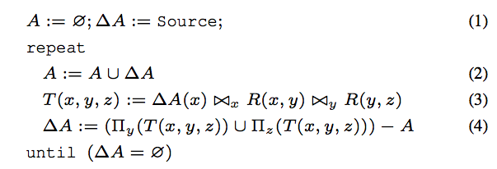
Optimization: Loop unrolling
Run two joins for every dupe-elim

Slide 53
Example Optimization: Loop unrolling
Reachability from a given node
A(y) :- Edge(‘w’, y)
A(y) :- A(x), Edge(x,y), Edge(x,y)
w
step 0: all nodes connected to ‘w’
step 1: for each node in A, find neighbors
Run two joins for every dupe-elim

Slide 54
Optimization: Dynamic re-optimization
Change strategies midstream
In the dense region, minimize duplicates
In the sparse region, minimize communication

Slide 55
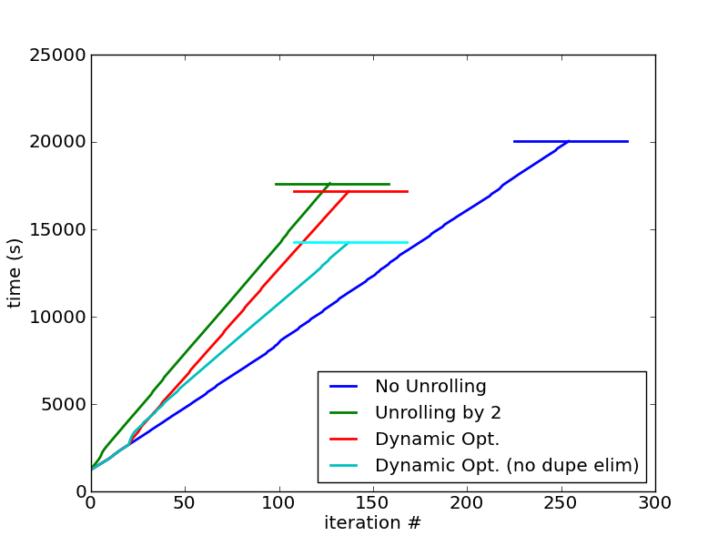
half the iterations, but each is more expensive
change strategies

Slide 56
Optimization: Path Doubling
S(x,z) :- R(x,y), R(y,z)
A(1234)
A(y) :- R(1234, y)
A(y) :- A(x), S(x, y)
Materialize all paths of two hops and use that
Half the iterations, up to N² the data

Slide 57
Optimization: Graph Consolidation
// initialize
A(1234)
A(y) :- R(1234, y)
// do this for N iterations…
A(y) :- A(x), S(x, y)
// subtract edges you’ve already seen
S(x,y) :- R(x,y), -A(y), -A(x)
// Apply path doubling
SD(x,z) :- S(x,y), S(y,z)
// do this for iterations > N
A(y) :- A(x), SD(x,y)

Slide 58
BACKUP

Slide 59
Related Work: Twister [Ekanayake HPDC 2010]
Redesigned evaluation engine using pub/sub
Termination condition evaluated by main()
13. while(!complete){
14. monitor = driver.runMapReduceBCast(cData);
15. monitor.monitorTillCompletion();
16. DoubleVectorData newCData = ((KMeansCombiner) driver
.getCurrentCombiner()).getResults();
17. totalError = getError(cData, newCData);
18. cData = newCData;
19. if (totalError < THRESHOLD) {
20. complete = true;
21. break;
22. }
23. }
O(k)
Notes:
Programming Model

Slide 60
In Detail: PageRank (Twister)
while (!complete) {
// start the pagerank map reduce process
monitor = driver.runMapReduceBCast(new
BytesValue(tmpCompressedDvd.getBytes()));
monitor.monitorTillCompletion();
// get the result of process
newCompressedDvd = ((PageRankCombiner)
driver.getCurrentCombiner()).getResults();
// decompress the compressed pagerank values
newDvd = decompress(newCompressedDvd);
tmpDvd = decompress(tmpCompressedDvd);
totalError = getError(tmpDvd, newDvd);
// get the difference between new and old pagerank values
if (totalError < tolerance) {
complete = true;
}
tmpCompressedDvd = newCompressedDvd;
}
run MR
O(N) in the size of the graph
term. cond.

Slide 61
Related Work: Spark [Zaharia HotCloud 2010]
Reduction output collected at driver program
“…does not currently support a grouped reduce operation as in MapReduce”
val spark = new SparkContext(<Mesos master>)
var count = spark.accumulator(0)
for (i <- spark.parallelize(1 to 10000, 10)) {
val x = Math.random * 2 - 1
val y = Math.random * 2 - 1
if (x*x + y*y < 1) count += 1
}
println("Pi is roughly " + 4 * count.value / 10000.0)
all output sent to driver.
Notes:
Programming Model

Slide 62
Related Work: Pregel [Malewicz PODC 2009]
Graphs only
clustering: k-means, canopy, DBScan
Assumes each vertex has access to outgoing edges
So an edge representation …
…requires offline preprocessing
perhaps using MapReduce
Edge(from, to)

Slide 63
Related Work: Piccolo [Power OSDI 2010]
Partitioned table data model, with user-defined partitioning
Programming model:
message-passing with global synchronization barriers
User can give locality hints
Worth exploring a direct comparison
GroupTables(curr, next, graph)

Slide 64
Related Work: BOOM [c.f. Alvaro EuroSys 10]
Distributed computing based on Overlog (Datalog + temporal logic + more)
Recursion supported naturally
app: API-compliant implementation of MR
Worth exploring a direct comparison

Slide 65
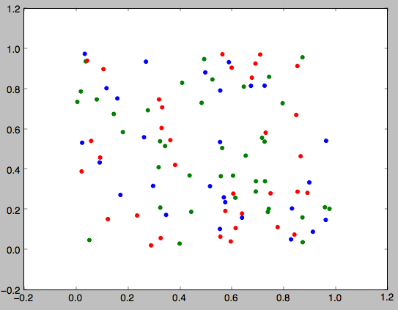
Prioritization Intuition

Slide 66
Prioritized Execution
PrIter (Zhang et al)
Map
(Shuffle)
Reduce

Slide 67
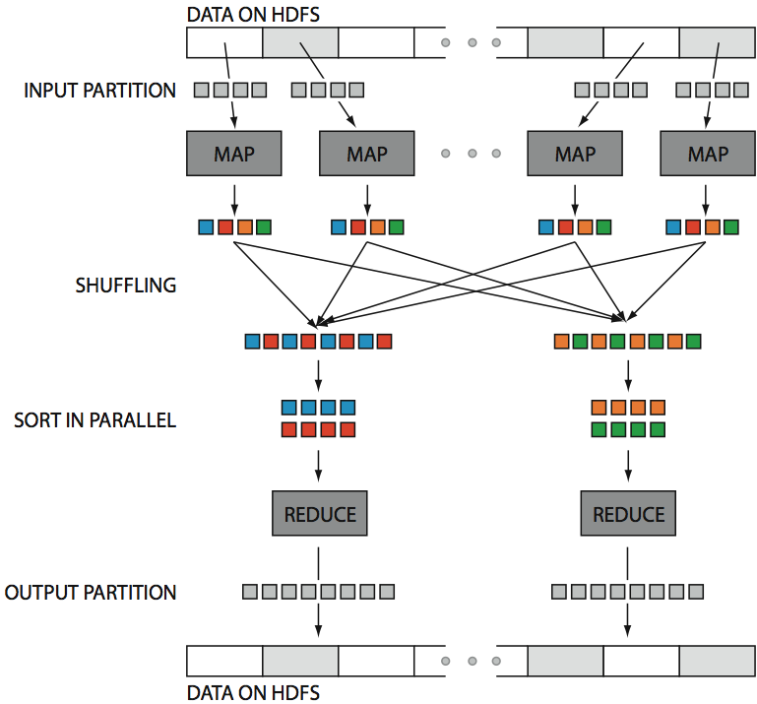
Hadoop in
One Slide
src: Huy Vo, NYU Poly

Slide 68
RI: Reducer Input Cache
Provides:
Access to loop invariant data without map/shuffle
Used By:
Reducer function
Assumes:
Mapper output for a given table constant across iterations
Static partitioning (implies: no new nodes)
PageRank
Avoid shuffling the network at every step
Transitive Closure
Avoid shuffling the graph at every step
K-means
No help
…

Slide 69
RO: Reducer Output Cache
Provides:
Distributed access to output of previous iterations
Used By:
Fixpoint evaluation
Assumes:
Partitioning constant across iterations
Reducer output key functionally determines Reducer input key
PageRank
Allows distributed fixpoint evaluation
Obviates extra MapReduce job
Transitive Closure
No help
K-means
No help
…

Slide 70
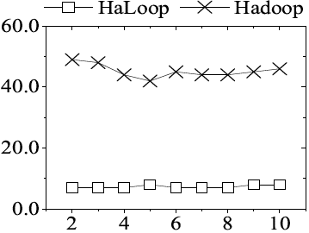
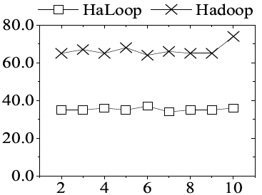
Reducer Output Cache Benefit
Fixpoint evaluation (s)
Iteration #
Iteration #
Livejournal dataset
50 EC2 small instances
Freebase dataset
90 EC2 small instances

