Slide 1
Ad Targeting – Bank Division
LOL Inc.
Focused on Real Estate
And
Banks Industries

Slide 2
Statistics
10% more like to be male
Renters Total Household Income $50,330
Owners Total Household Income $92462

Slide 3
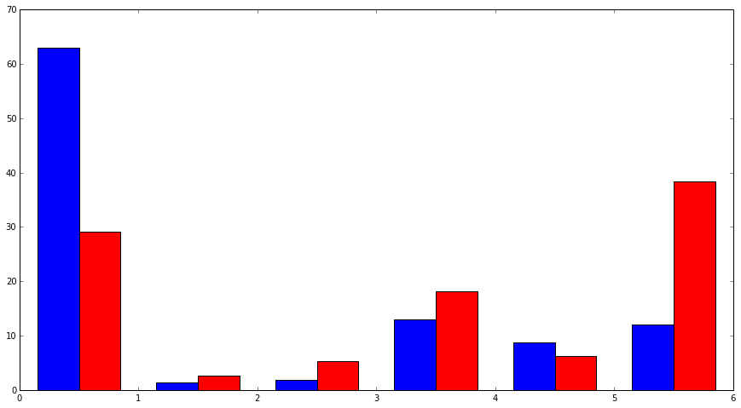
Marital Status
Married
Single
Red is Renters, Blue is Owners

