Slide 1
ASP.Net web api 2
And a little bit of angular 1, bootstrap and jquery

Slide 2
Prerequisite
SOLID PRINCIPLES
S – SINGLE RESPONSIBILITY PRINCIPLE (Model classes, Logical classes)
O – OPEN CLOSED PRINCIPLE (Extension classes)
L – LISKOV SUBSTITUTION PRINCIPLE ( Interface injection via Ninject )
I – INTERFACE SEGREGATION PRINCIPLE ( Multiple interfaces > Super Interface )
D – DEPENDENCY INVERSION ( Direct instantiate vs Dependency Inversion)

Slide 3
Prerequisite
MVC
MODEL ( Classes with properties)
VIEW ( Classes with User Interface )
CONTROLLER ( Classes with logic )
Demo Solution Repo:
https://github.com/bkferareza/ProjectSpiderman.git

Slide 4
Asp.net mvc vs asp.net web api vs asp.net web forms
In ASP.Net MVC – the MVC’s Controller decides what should be the View - i.e., the controller decides what the user should “see” (based on the current scenario or context), when they make a request.
In ASP.Net Web Forms, the ASPX pages decides what the user should “see” when they make a request.
But in Web API, there is no control/power to any of the Web API’s features to decide what the user should “see” when they make a request, Web API is NOT a technology tied up with websites only. It can be used for multiple purposes – not only websites. So it doesn't know the meaning of rendering

Slide 5
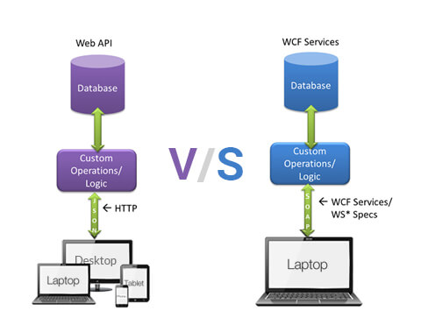
Web api vs web service
WCF Services use SOAP
WEB API use JSON and JSON is really easy to render in any device.

Slide 6
Angularjs 1.7 framework
WHY? HTML is great for declaring static documents, but it falters when we try to use it for declaring dynamic views in web-applications. AngularJS lets you extend HTML vocabulary for your application. The resulting environment is extraordinarily expressive, readable, and quick to develop.

Slide 7
jquery
jQuery is a fast, small, and feature-rich JavaScript library. It makes things like HTML document traversal and manipulation, event handling, animation, and Ajax much simpler with an easy-to-use API that works across a multitude of browsers. With a combination of versatility and extensibility, jQuery has changed the way that millions of people write JavaScript.

Slide 8
bootstrap
Build responsive, mobile-first projects on the web with the world's most popular front-end component library.

