Slide 1
Front End Engineering-I Project
Team Details:
Bhavya Kakkar [Leader]
2410993144
Aditya
2410993100
Akash Sharma
2410993102
Bhavya Singla
2410993146
Faculty Coordinator:
Ratan Lal Gupta
:
Chitkara University Institute of Engineering and Technology,
Chitkara University, Punjab

Slide 2
Table of Contents
Title
Introduction
Problem Statement
Technical Details
Key Features
Project Highlights
Bonus Feature
Conclusion
References/Links used

Slide 3
Title
DOCCURE – Healthcare Booking Appointment System
This presentation showcases the development and implementation of "Doccure“, a web-based healthcare booking appointment system built using the Django framework in Python.
The primary goal of this project is to streamline the process of booking medical appointments by providing an efficient, user-friendly, and automated system for patients, doctors, and administrators.

Slide 4
Introduction
Overview of project:
In today’s fast-paced world, healthcare accessibility is a crucial aspect of patient well-being. Traditional methods of booking doctor appointments are often inefficient, time-consuming, and prone to errors.
Objective of System:
"Doccure" is designed to address these issues by offering a seamless appointment booking experience. The system enables patients to find doctors, schedule appointments. Doctors can efficiently manage their schedules, while administrators oversee the entire system’s functioning.

Slide 5
Problem Statement
Long Wait Times: Patients often experience extended waiting periods due to inefficient appointment scheduling and high demand for doctors.
Scheduling Conflicts – Manual appointment management leads to overlapping bookings and scheduling errors, causing inconvenience for both patients and doctors.
Lack of Real-Time Availability Updates – Patients struggle to find available doctors as traditional systems do not provide real-time status updates.
Difficulty in Maintaining Medical Records – Paper-based or outdated digital record-keeping makes it hard to access patient history quickly and accurately.

Slide 6
Key Features
The "Doccure" system is divided into three main modules:
Patient App:
Patients can register, log in, browse doctors based on specialty and location, book appointments, and view their medical history. They receive real-time notifications about their bookings and prescriptions.
Doctor App:
Doctors have dedicated profiles where they can set their availability, accept or decline appointments, and access patient reports. They can also generate prescriptions and provide follow-up recommendations.

Slide 7
Key Features
Site Administration:
The administrator dashboard allows for efficient system management, including user registration approvals, monitoring appointment trends, and generating reports. The admin ensures that the platform runs smoothly and addresses any technical issues.
User Authentication App:
The User Authentication allows Management and User both to access the App easily, including Signing In and Signing Up
App is also with Google Authentication.

Slide 8
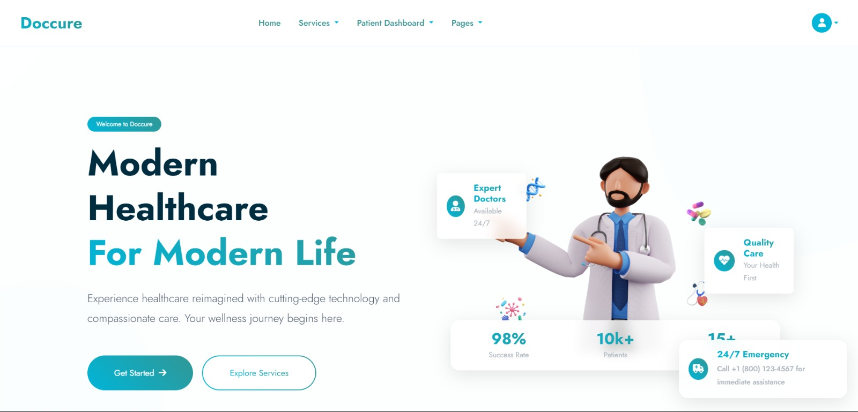
Project Highlights
LANDING PAGE: The landing page of “Doccure” provides a seamless experience for users to search for doctors, clinics, and hospitals based on location and specialty. With a clean interface and intuitive search functionality, it ensures effortless appointment booking for patients.

Slide 9
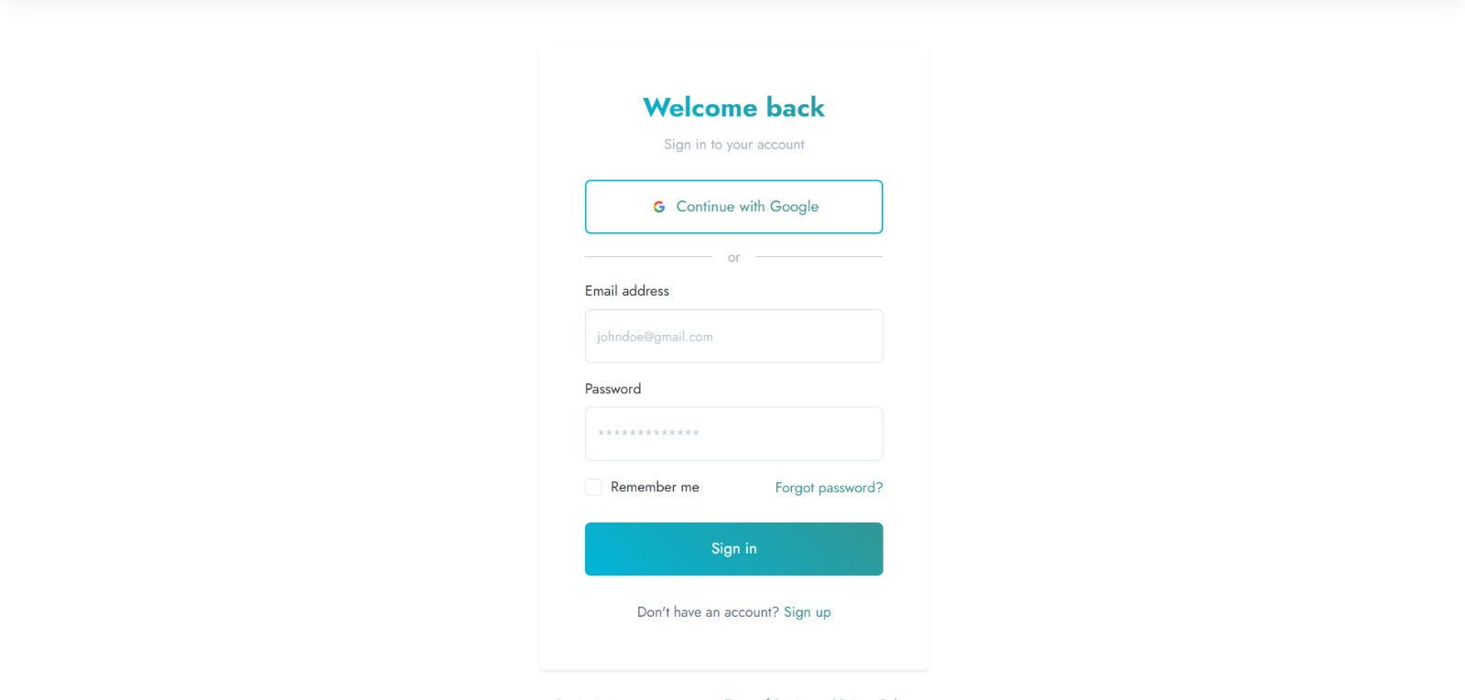
Project Highlights
LOGIN PAGE: The “Doccure” login page provides a secure and user-friendly interface for doctors, patients, and admins to access their accounts. With role-based authentication, users can seamlessly log in and manage appointments, patient records, and administrative tasks efficiently.

Slide 10
Bonus Feature(optional)
Pagination for Doctor Listings and Appointment Histories: Enhances user experience by dividing large datasets into manageable pages, ensuring faster load times and easier navigation through doctor listings and past appointments.
Infinite Scrolling on Doctor Search Results or Appointment Lists: Provides a seamless browsing experience by dynamically loading more doctors or appointments as the user scrolls, eliminating the need for manual pagination and enhancing accessibility.

Slide 11
Conclusion
The Doccure Healthcare Booking System revolutionizes the way patients connect with healthcare providers by offering a seamless, efficient, and user-friendly appointment scheduling platform. By leveraging Django and modern web technologies, it addresses key challenges such as long wait times, scheduling conflicts, and administrative burdens. With features like real-time availability updates, secure authentication, and enhanced user experience elements such as pagination and infinite scrolling, Doccure ensures a hassle-free healthcare journey for both patients and medical professionals.

Slide 12
References/Links used
GitHub Repository – Source code and documentation for Django-based healthcare appointment systems. 🔗 https://github.com
These references were instrumental in building, refining, and optimizing the Doccure Healthcare Booking System.

Slide 13


