Slide 1



From detection to high-level reconstruction
A statistical view on gamma-ray sources
2025.11.03, Č Astronomy Data School
Jonathan Biteau

Slide 2
I. Gamma-ray astronomy as a counting experiment
Concepts: DL3-DL4-DL5, forward-folding, binomial / Poisson / Gauss, PMF / PDF / CDF / SF
II. Statistical inference
Concepts: Bayesian & frequentist, marginalizing & profiling, parameter estimation, (saturated) deviance
III. Model selection
Concepts: goodness of fit, residuals & pulls, under-/over-fitting, local & global p-values (trial factors / look-elsewhere), likelihood ratio test, significance level, Li & Ma
IV. Dealing with uncertainties
Concepts: covariance, decorrelation energy, bowtie, systematic uncertainties, bracketing / marginalizing
V. Outro
More… if we have time

Slide 3
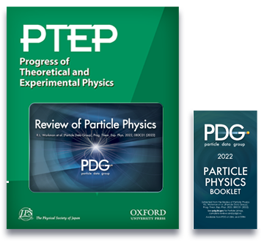
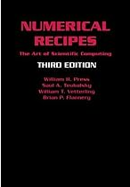
[G. Cowan+ ‘24]
[W. H. Press+ ‘07]
Chap. 39 - Probability
Chap. 40 - Statistics
Chap. 14 - Statistical Description of Data
Chap. 15 - Modeling of Data

Slide 4
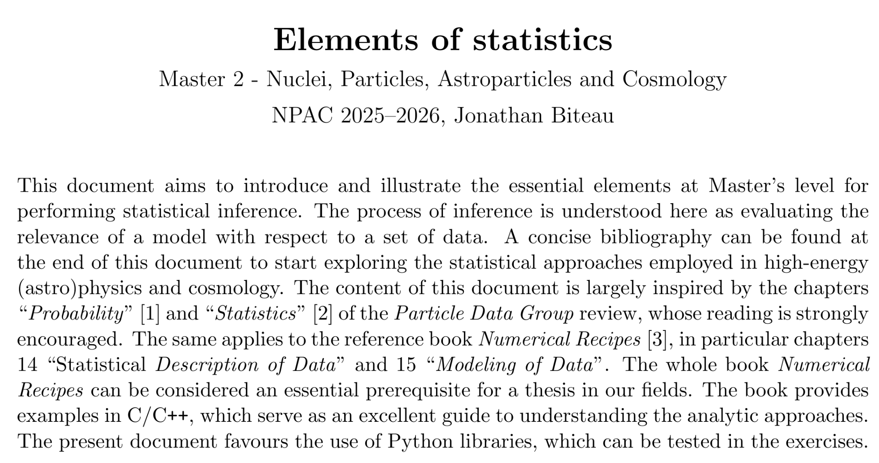
Lesson adapted from my Master 2 notes, available at this link

Slide 5
I. Gamma-ray astronomy as a counting experiment
Concepts: DL3-DL4-DL5, forward-folding, binomial / Poisson / Gauss, PMF / PDF / CDF / SF
II. Statistical inference
Concepts: Bayesian & frequentist, marginalizing & profiling, parameter estimation, (saturated) deviance
III. Model selection
Concepts: goodness of fit, residuals & pulls, under-/over-fitting, local & global p-values (trial factors / look-elsewhere), likelihood ratio test, significance level, Li & Ma
IV. Dealing with uncertainties
Concepts: covariance, decorrelation energy, bowtie, systematic uncertainties, bracketing / marginalizing
V. Outro
More… if we have time

Slide 6
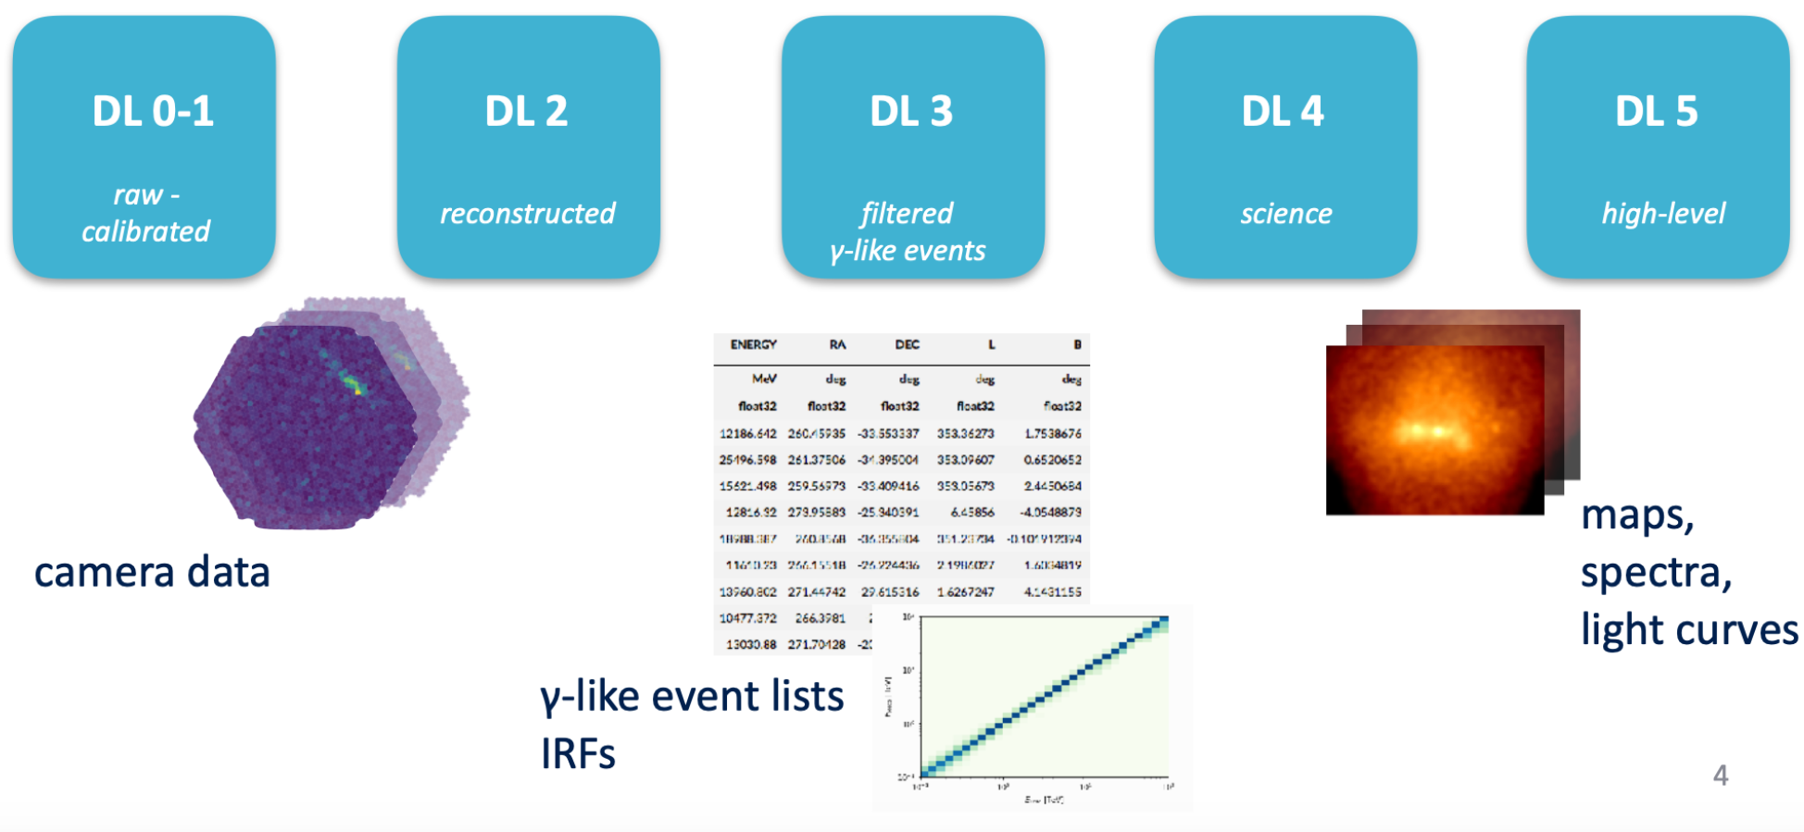
Gamma-ray astronomy as a counting experiment
[GammaPy team, CTAO School 2024]
‹#›

Slide 7
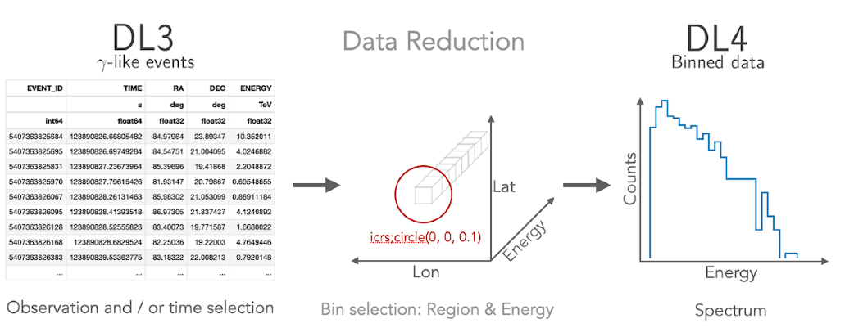
Gamma-ray astronomy as a counting experiment
[GammaPy team, CTAO School 2024]
‹#›

Slide 8
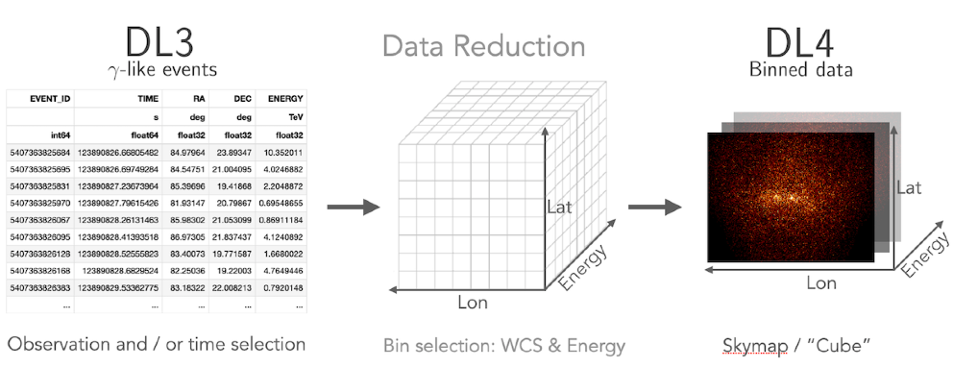
Gamma-ray astronomy as a counting experiment
[GammaPy team, CTAO School 2024]
‹#›

Slide 9
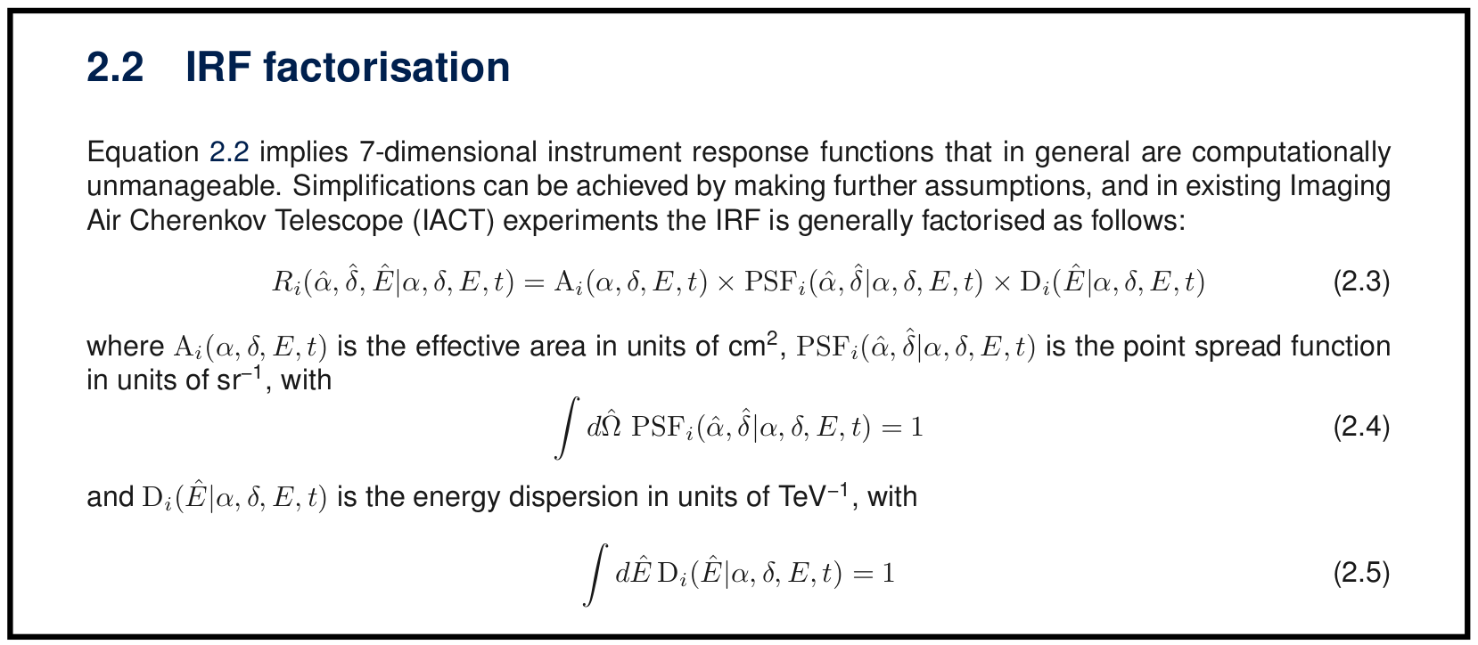
Gamma-ray astronomy as a counting experiment
[CTAO Doc]
Forward folding
Convolve true emission (i.e. model as a function of true energy, direction…)
with transfer matrix (Instrument Response Function linking true and observed quantities)
to enable a comparison to data in the observed space
‹#›

Slide 10
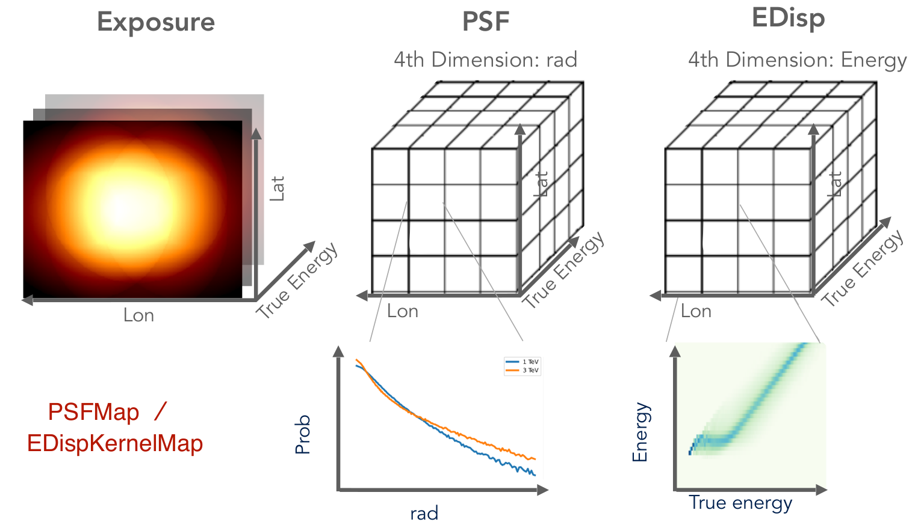
Gamma-ray astronomy as a counting experiment
[CTAO Doc]
Forward folding
Convolve true emission (i.e. model as a function of true energy, direction…)
with transfer matrix (Instrument Response Function linking true and observed quantities)
to enable a comparison to data in the observed space
[GammaPy team, CTAO School 2024]
‹#›

Slide 11
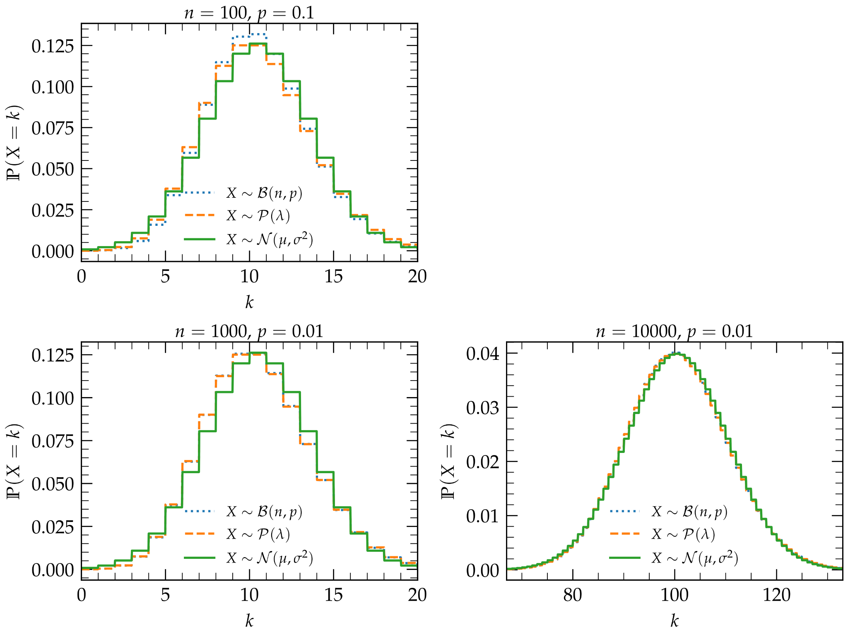
Gamma-ray astronomy as a counting experiment
When Bernoulli meets Poisson and Gauss
‹#›

Slide 12
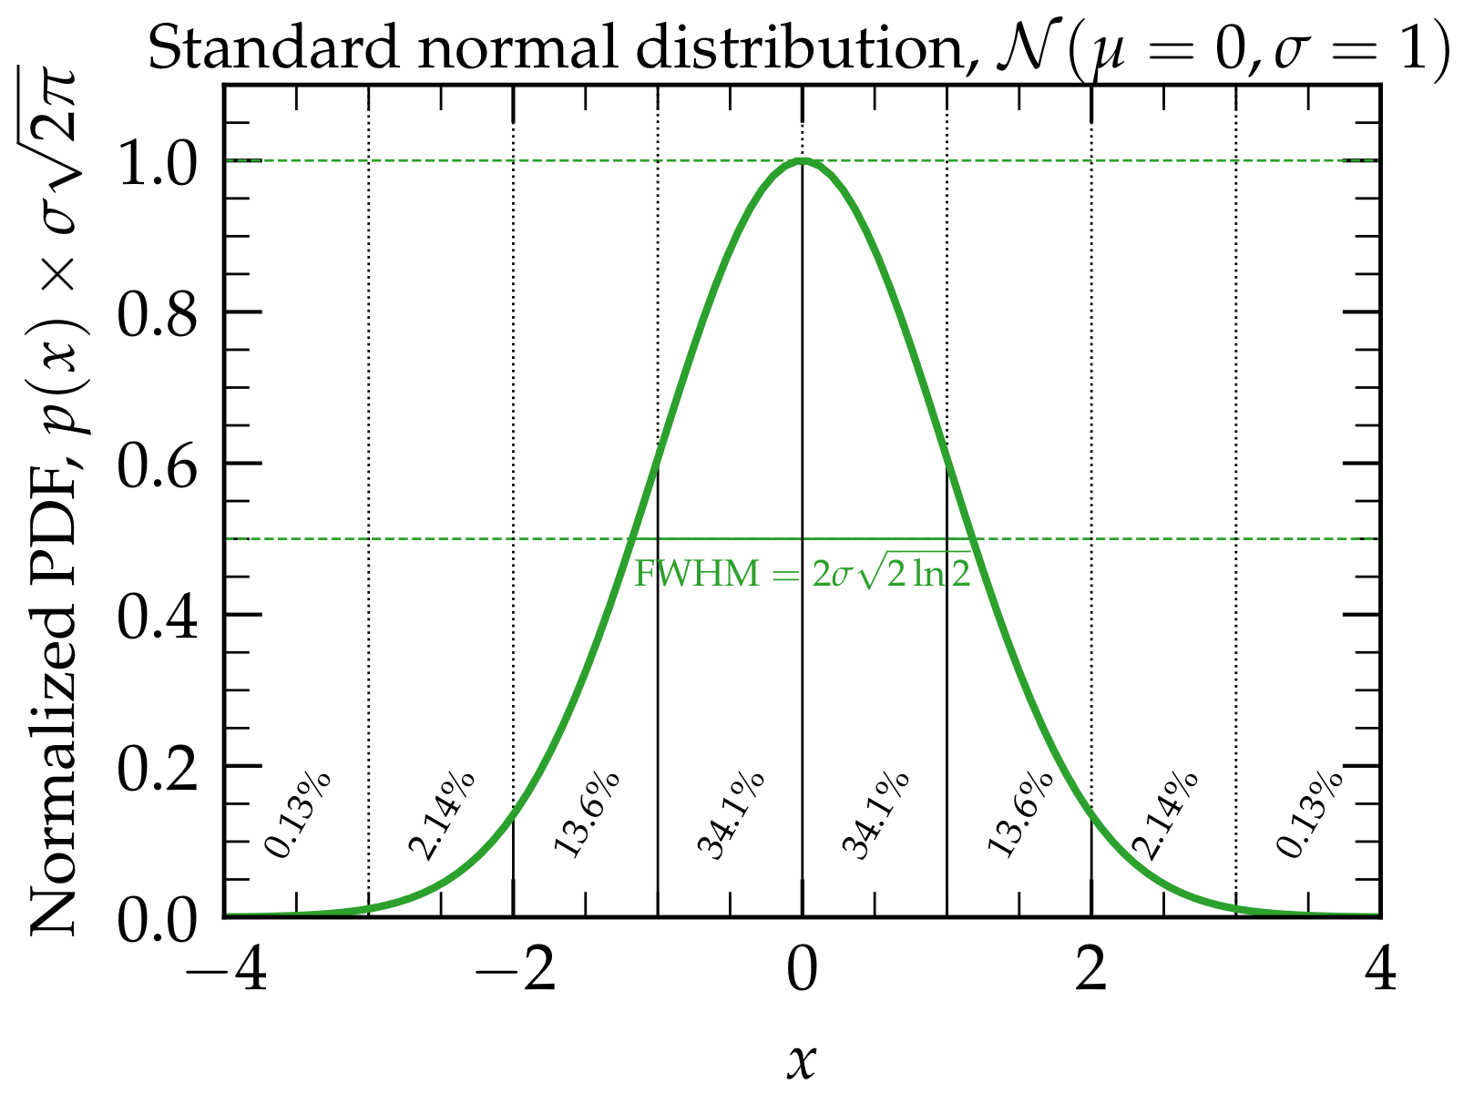
Gamma-ray astronomy as a counting experiment
From Gauss PMF to Gauss PDF
‹#›

Slide 13
I. Gamma-ray astronomy as a counting experiment
Concepts: DL3-DL4-DL5, forward-folding, binomial / Poisson / Gauss, PMF / PDF / CDF / SF
II. Statistical inference
Concepts: Bayesian & frequentist, marginalizing & profiling, parameter estimation, (saturated) deviance
III. Model selection
Concepts: goodness of fit, residuals & pulls, under-/over-fitting, local & global p-values (trial factors / look-elsewhere), likelihood ratio test, significance level, Li & Ma
IV. Dealing with uncertainties
Concepts: covariance, decorrelation energy, bowtie, systematic uncertainties, bracketing / marginalizing
V. Outro
More… if we have time

Slide 14
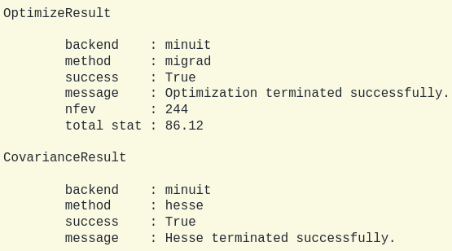
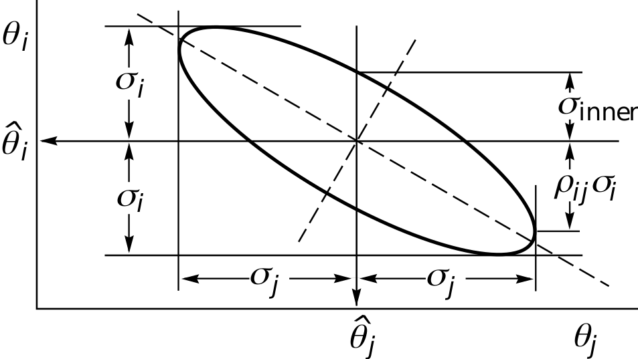
Statistical inference
Hessian and covariance matrix
[GammaPy team]
[G. Cowan+ ‘24]
‹#›

Slide 15
I. Gamma-ray astronomy as a counting experiment
Concepts: DL3-DL4-DL5, forward-folding, binomial / Poisson / Gauss, PMF / PDF / CDF / SF
II. Statistical inference
Concepts: Bayesian & frequentist, marginalizing & profiling, parameter estimation, (saturated) deviance
III. Model selection
Concepts: goodness of fit, residuals & pulls, under-/over-fitting, local & global p-values (trial factors / look-elsewhere), likelihood ratio test, significance level, Li & Ma
IV. Dealing with uncertainties
Concepts: covariance, decorrelation energy, bowtie, systematic uncertainties, bracketing / marginalizing
V. Outro
More… if we have time

Slide 16
I. Gamma-ray astronomy as a counting experiment
Concepts: DL3-DL4-DL5, forward-folding, binomial / Poisson / Gauss, PMF / PDF / CDF / SF
II. Statistical inference
Concepts: Bayesian & frequentist, marginalizing & profiling, parameter estimation, (saturated) deviance
III. Model selection
Concepts: goodness of fit, residuals & pulls, under-/over-fitting, local & global p-values (trial factors / look-elsewhere), likelihood ratio test, significance level, Li & Ma
IV. Dealing with uncertainties
Concepts: covariance, decorrelation energy, bowtie, systematic uncertainties, bracketing / marginalizing
V. Outro
More… if we have time

Slide 17
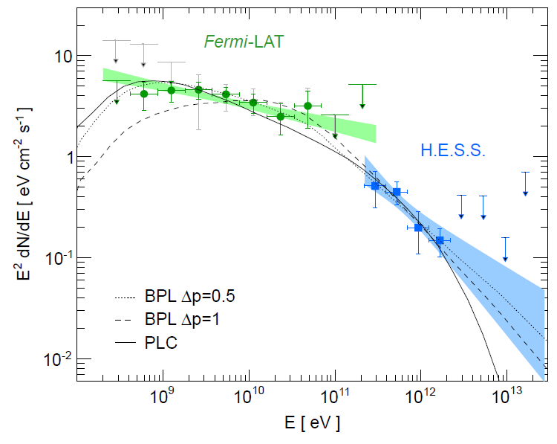
Dealing with uncertainties
Bowtie / butterfly
[H.E.S.S. Collab.+ ‘14]
‹#›

Slide 18
I. Gamma-ray astronomy as a counting experiment
Concepts: DL3-DL4-DL5, forward-folding, binomial / Poisson / Gauss, PMF / PDF / CDF / SF
II. Statistical inference
Concepts: Bayesian & frequentist, marginalizing & profiling, parameter estimation, (saturated) deviance
III. Model selection
Concepts: goodness of fit, residuals & pulls, under-/over-fitting, local & global p-values (trial factors / look-elsewhere), likelihood ratio test, significance level, Li & Ma
IV. Dealing with uncertainties
Concepts: covariance, decorrelation energy, bowtie, systematic uncertainties, bracketing / marginalizing
V. Outro
More… if we have time

