Slide 1
Adaptive Routing for Saving Energy of Random shortcut Networks using Deep Reinforcement Learning
Nguyen Tien Thanh

Slide 2
Abstract
Random shortcut network has better scalability, smaller diameter and lower latency when compared to regular network topologies. But this topology still has question about saving its energy, both at simulation and prototype. In this proposal, I propose a deep reinforcement learning for routing optimization approach. This routing approach chooses subset of network to stay active and then turns off redundant links and ports. I hope my proposal not only saves up to 50% of network energy but also minimizes network delay, maximizes fault tolerant ability and therefore justifies using random shortcut topology.

Slide 3

Introduction (1)
Random shortcut network has better scalability, smaller diameter, lower latency when compared to regular network topologies [5].
But it has question about saving energy, both at simulation and prototype.
Network devices consume up to 15% of data center’s energy [1].

Slide 4
Introduction (2)
IEEE Energy Efficient Ethernet standard (IEEE 802.3az) proposes power-saving mechanism by turning on/off links in a few microseconds [6]
Given the recent advancement of IEEE 802.3az, a question arises how to choose a subset of network that can still route data to all nodes.
Many approaches concentrate on saving energy of torus [2], Fat Tree [3] or both of them [4] by turning off redundant links and ports.
Finding optimal traffic routing solution (that satisfies traffic constraints) is a NP-complete problem [3]

Slide 5
Content
Introduction
Background
  NP-Complete and formal method
  Software Defined Network
  Machine learning
Problem
Related Work
Conclusion

Slide 6

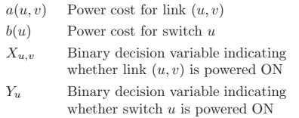
2. Background
2.1 NP-complete and formal method
Heller [3] modelled total network energy consumption:
(1)
Minimizing (1) while satisfying all traffic constraints is NP-complete problem.
Authors proposed a formal method in order to produce solutions closest to optimal but this method has complexity O(n^{3.5}).
Authors then proposed two heuristic methods with complexities O(n²) and O(n) respectively.

Slide 7
2. Background (2)
2.1 NP-complete and formal method
Heller [3] modelled total network energy consumption:
(1)
Authors proposed a formal method (based on linear optimization solvers like GLPK and CPLEX) to produce solutions closest to optimal but this method has complexity O(n^{3.5}).
Authors then proposed two heuristic methods with complexities O(n²) and O(n) respectively.
Notes:
Minimizing (1) while satisfying all traffic constraints is NP-complete problem.

Slide 8
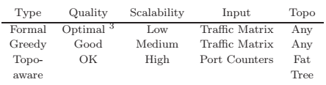
2.1 NP-complete and formal method

Slide 9
2.1 NP-complete and formal method (2)
But authors mention nothing about discrepancy of network energy consumptions between two heuristic methods and formal method.
Keep in mind that the formal method is not the best solution, authors claim that this method has bounded percentage from optimal, configured to 10% [3]

Slide 10
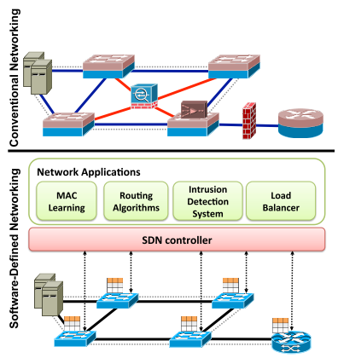
2.2. Software Defined Network
SDN is the hardware independent next generation networking paradigm in which networking device from any vendors could be controlled through SDN.
The openness, feasibility and programmability of SDN reduces the complexity to implement energy efficiency approaches in both hardware and software [7].
In my opinion, SDN is the best solution for building simulator and prototype of energy-aware routing in data center networks.

Slide 11
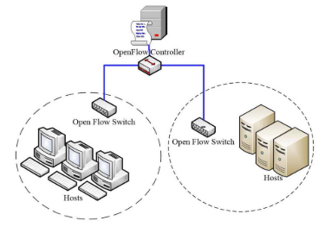
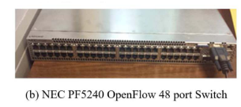
2.2. Software Defined Network (2)
ElasticTree uses NOX, OpenFlow for its controller and Southbound API respectively. [3]

Slide 12

2.2. Machine Learning
ElasticTree solves saving energy consumption, but it has limitation [7]:
Many factors affect routing performance in a complex way, leading to the need of sophisticated scheme that makes correct trade-offs.
An approach uses Deep Reinforcement Learning (DRL) to minimize network delay and authors find out that DRL has advantages over traditional heuristic and linear/convex optimization techniques [8]

Slide 13
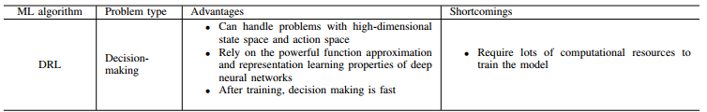
2.2. Machine Learning (2)
In a survey [9], authors also find advantages and shortcoming of DRL, comparing with other ML algorithms.

Slide 14
3. Problem
My proposal:
A deep reinforcement learning for adaptive routing in random shortcut network. This routing addresses at the same time three factors:
  Minimizing energy consumption by choosing a subset of network and then turning off idle links and ports.
  Minimizing network delay
  Maximizing fault tolerant ability

Slide 15
4. Related work
Energy saving by turning on/off links and ports in itself is not new [2, 3, 4] but they concentrate on fat tree or torus. Random shortcut topology still is out of action.
Some solutions try to save energy consumption like rate adaption [10] and energy proportional [11], but current networking devices are far from satisfying their assumptions [12].
Recent trends is the use of ML techniques for the control and operation of the network and in this area, RL techniques tackle routing optimization. A version of RL, DRL shows promising performance in scale-free network [8] but authors focus on only network delay.
An approach also uses RL for energy-aware routing, but it concentrates on wireless network [13].

Slide 16
5. Conclusion (1)
Random shortcut network has better scalability, smaller diameter and lower latency when compared to regular network topologies. But it still lacks a saving energy solution as this topology is applied to data center networks.
I am going to use adaptive routing to maximize numbers of idle ports and links and then power them off. I believe that using a subset of network will reduce energy consumption. I expect a deep reinforcement learning to give an acceptable routing for this NP-complete problem.

Slide 17
5. Conclusion (2)
I hope my proposal not only saves up to 50% of network energy but also minimizes network delay, maximizes fault tolerant ability and therefore justifies using random shortcut topology.
In future work, a deep reinforcement learning could work better than other classic techniques for prediction as scaling nodes of DCN.

Slide 18
References
[1] A. Greenberg, et al. The Cost of a Cloud: Research Problems in Data Center Networks. In ACM SIGCOMM CCR, January 2009.
[2] Andújar, F. J et al. Energy efficient torus networks with on/off links. Journal of Parallel and Distributed Computing, March 2019.
[3] Heller, Brandon, et al. Elastictree: Saving energy in data center networks. Nsdi. Vol. 10. April, 2010.
[4] Andújar, Franciso J., et al. "POWAR: Power-Aware Routing in HPC Networks with On/Off Links." ACM Transactions on Architecture and Code Optimization (TACO) 15.4 (2019): 61.
[5] Koibuchi, Michihiro, et al. "A case for random shortcut topologies for HPC interconnects." 2012 39th Annual International Symposium on Computer Architecture (ISCA). IEEE, June, 2012.
[6] Reviriego, Pedro, et al. "Performance evaluation of energy efficient ethernet." IEEE Communications Letters, September, 2009: 697-699.

Slide 19
References
[7] Rawat DB, Reddy SR. Software defined networking architecture, security and energy efficiency: A survey. IEEE Communications Surveys & Tutorials. January, 2017
[8] Stampa G, et al. A deep-reinforcement learning approach for software-defined networking routing optimization. arXiv preprint arXiv:1709.07080. September, 2017.
[9] Xie J, et al. A survey of machine learning techniques applied to software defined networking (SDN): Research issues and challenges. IEEE Communications Surveys & Tutorials. August, 2018.
[10] Aroca J.A, Structural issues and energy efficiency in data centers , PhD thesis, February, 2015
[11] Abts, Dennis, et al. "Energy proportional datacenter networks." ACM SIGARCH Computer Architecture News 38.3, January, 2010: 338-347.
[12] Dayarathna M, et al. Data center energy consumption modeling: A survey. IEEE Communications Surveys & Tutorials. January, 2016 :732-794.

Slide 20
References
[13] Wang P, Wang T. Adaptive routing for sensor networks using reinforcement learning. In The Sixth IEEE International Conference on Computer and Information Technology (CIT'06) 2006 Sep 20 (pp. 219-219). IEEE.

Slide 21
Thank you

