Slide 1
Multiple Lux Measurement
Brian Medrano Kiaer
kiaer@unlv.nevada.edu
Justine Jeryll Macato
macatoj@unlv.nevada.edu

Slide 2
AIM & ACCOMPLISHMENT
AIM:
To interface with the TSL2591 lux sensors and send their data to a receiver ATmega328P using the NRF24L01.
ACCOMPLISHMENT
Interface with oneTSL2591 lux sensor using I2C
Interface with the TCA9548A 1-to-8 mux to allow reading from two TSL2591 lux sensors
Send data through NRF24L01 to receiver ATmega328P

Slide 3
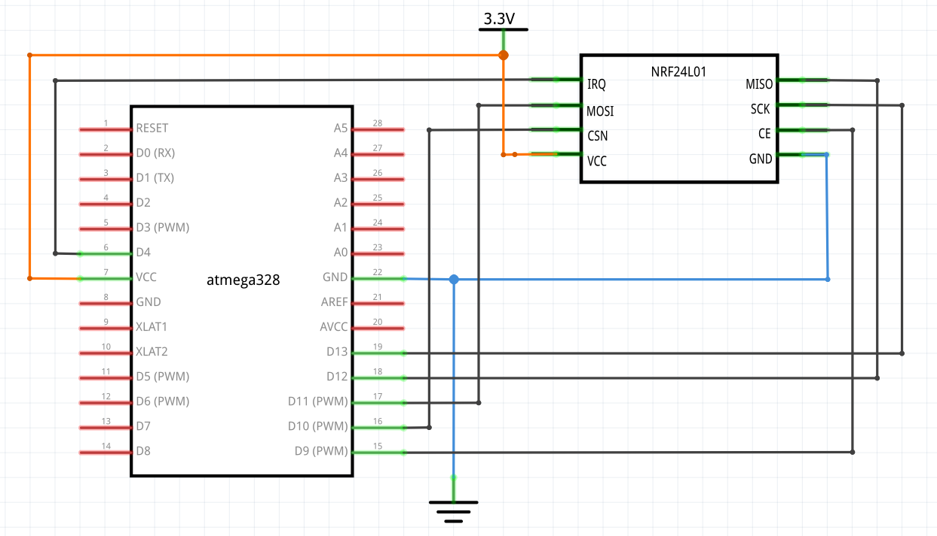
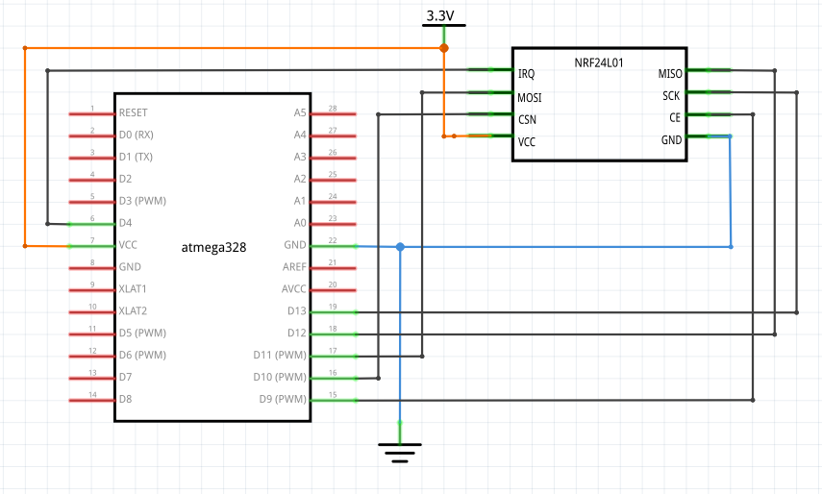
SCHEMATICS – Receiver

Slide 4
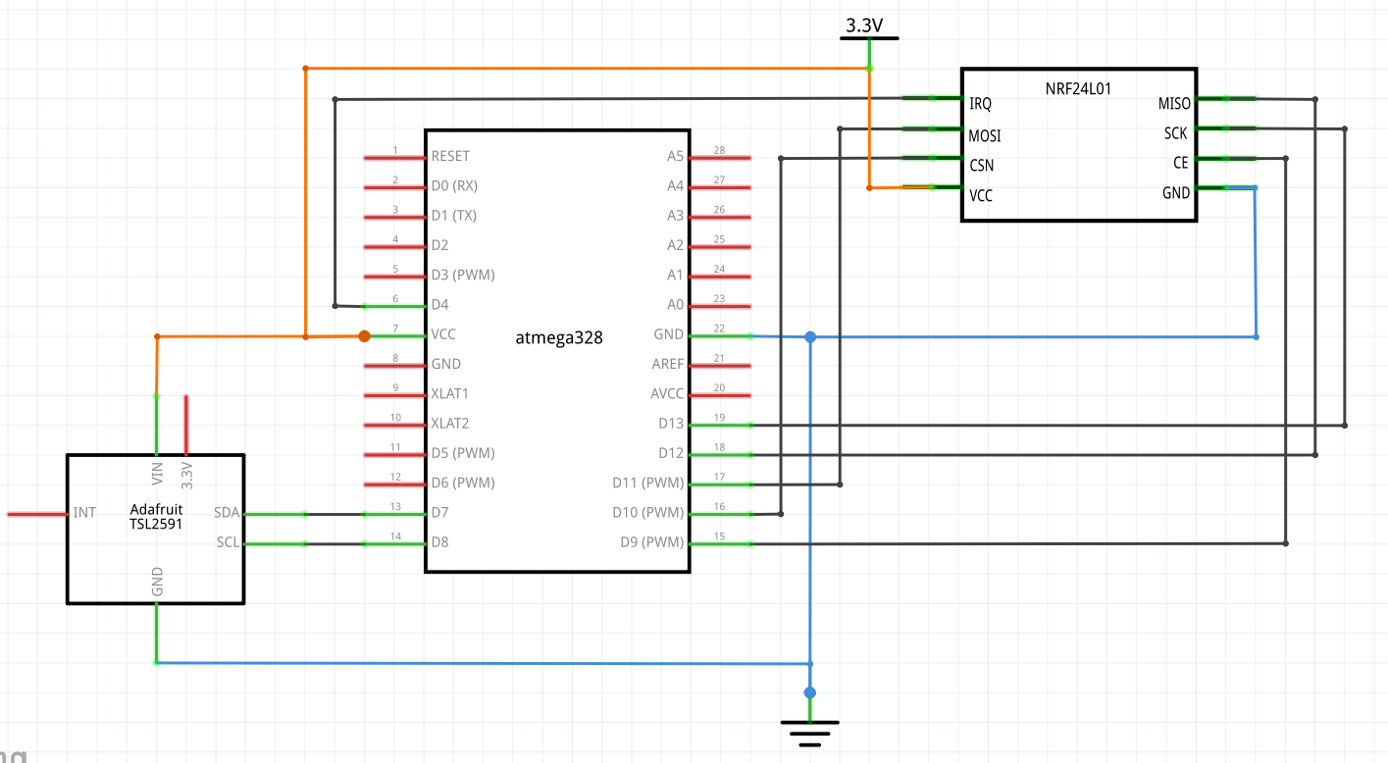
SCHEMATICS – Transmitter 1

Slide 5
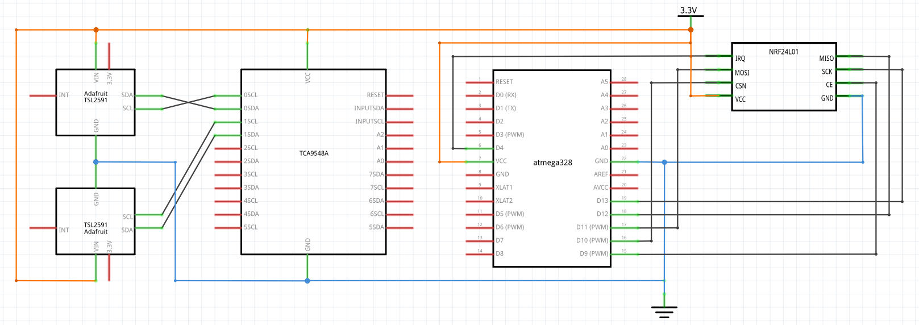
SCHEMATICS – Transmitter 2

Slide 6
DESIGN STAGES
Components
ATmega328P
TSL2591
NRF24L01
TCA9548A
Interfaces
ATmega328P – NRF24L01 using SPI
ATmega328P – TSL2591 using I2C – Address (0x29)
ATmega328P – TCA9548A using I2C – Address (0x70)

Slide 7
CODE DEVELOPMENT – I didn’t do picture thing
Initialization
Code was made to be used with I2C and SPI communications
NRF24L01 libraries were from antoineleclair’s GitHub repository
I2c_master libraries were from g4lvanix’s GitHub repository
Data Collection
TSL2591 data is collected using I2C on Transmitter 1
Two TSL2591’s data are collected through a TCA9548A using I2C on Transmitter 2
Networking/Visualization
Lux data is displayed on Data Visualizer using USART before transmission
Receiver displays all three lux data on Data Visualizer using USART

Slide 8
DEMO SNAPSHOT/VIDEO
https://youtu.be/rgk-amaNQww
Transmitter 1 with Data Visualizer
https://youtu.be/8t0dfonB40g
Transmitter 1 to Receiver with Data Visualizer
https://youtu.be/tPPbm4_hpYk
Transmitter 1 and 2 to Receiver with Data Visualizer
https://youtu.be/eug3BW66-UY
All three nodes one breadboard and computer

Slide 9
Group Projects
Student Name: Brian Medrano Kiaer
Task Completed:
Wrote and debugged the code for each Task.
Implemented multiple Transmitter Nodes to 1 Receiver Node
Several testing with hardware implementation
Wrote half of the Final Report
Wrote a portion of the Final Presentation
Contribution % towards the project:
Coding (%): 90%
Implementation (%): 50%
Testing/Demo (%): 50%
Documentation (%): 50%
Presentation (%): 10%

Slide 10
Group Projects
Student Name: Justine Jeryll Macato
Task Completed:
Assisted with code creation
Implemented Transmitter 1 and 2 with the Receiver
Tested that the Transmitters are sending and the Receiver is receiving
Wrote the other half of the Final Report
Presented half of the presentation
Contribution % towards the project:
Coding (%): 10%
Implementation (%): 50%
Testing/Demo (%): 50%
Documentation (%): 50%
Presentation (%): 90%

