Slide 1

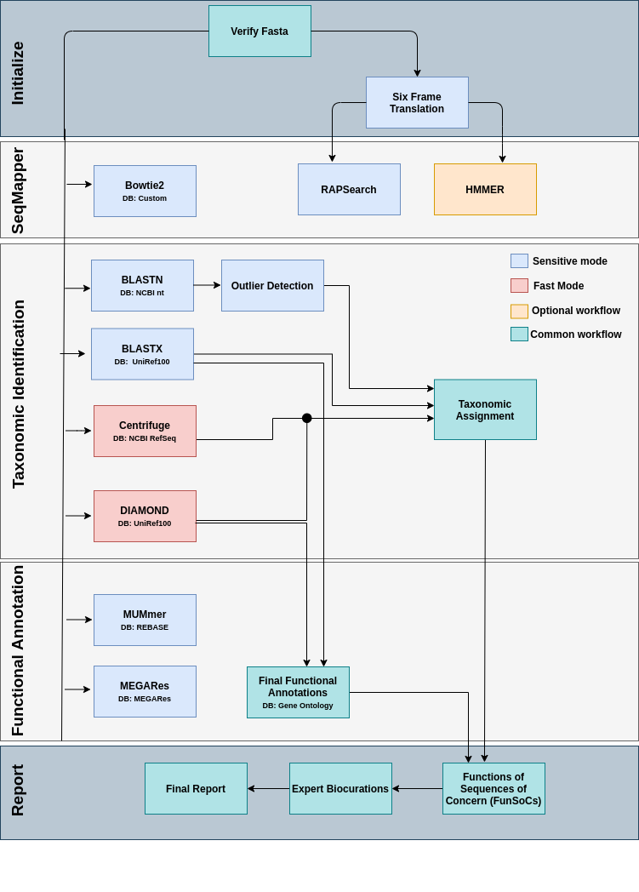
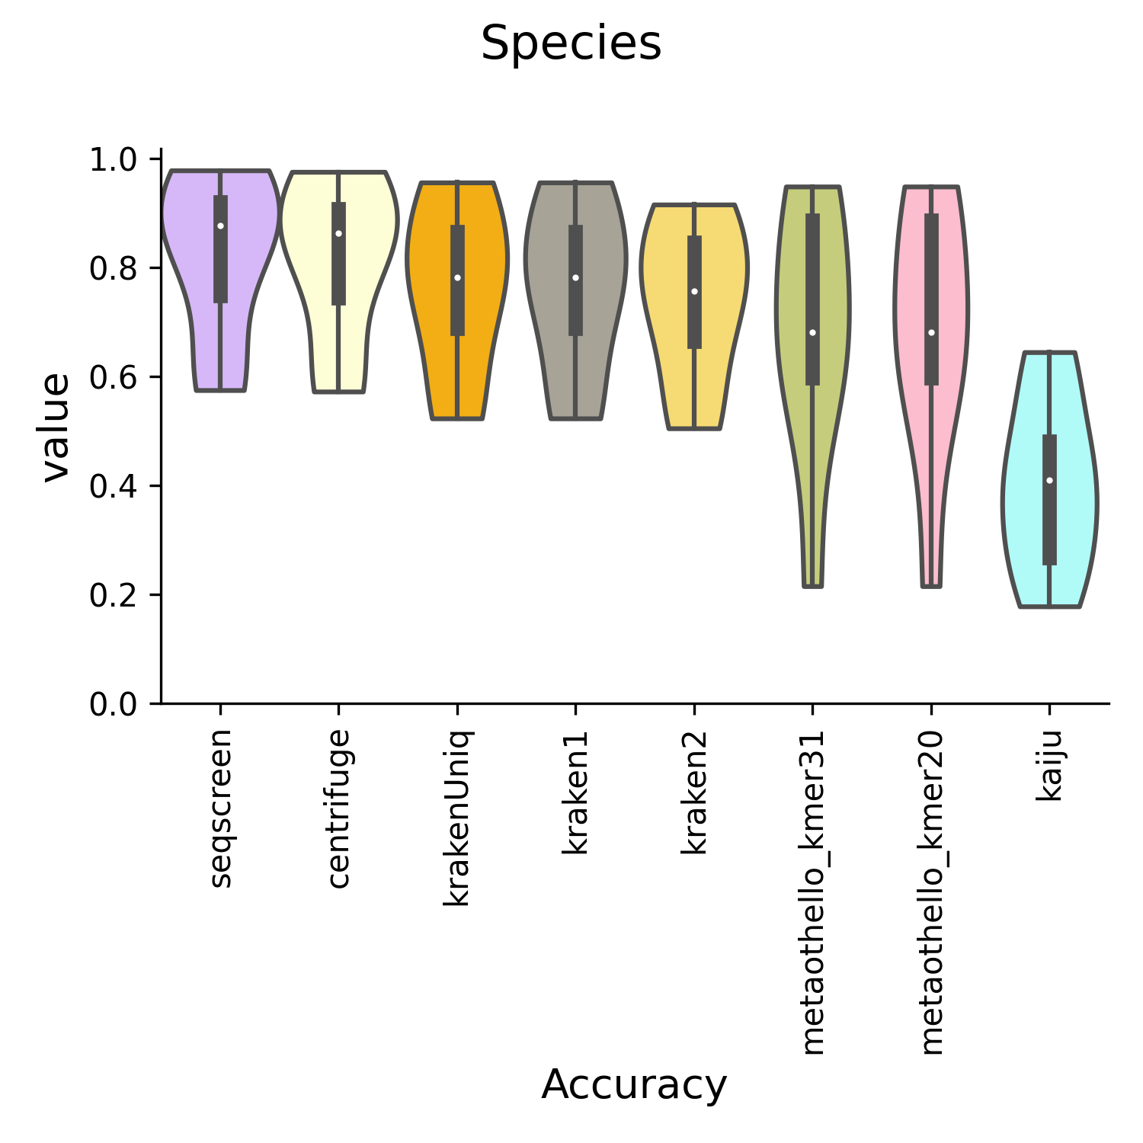
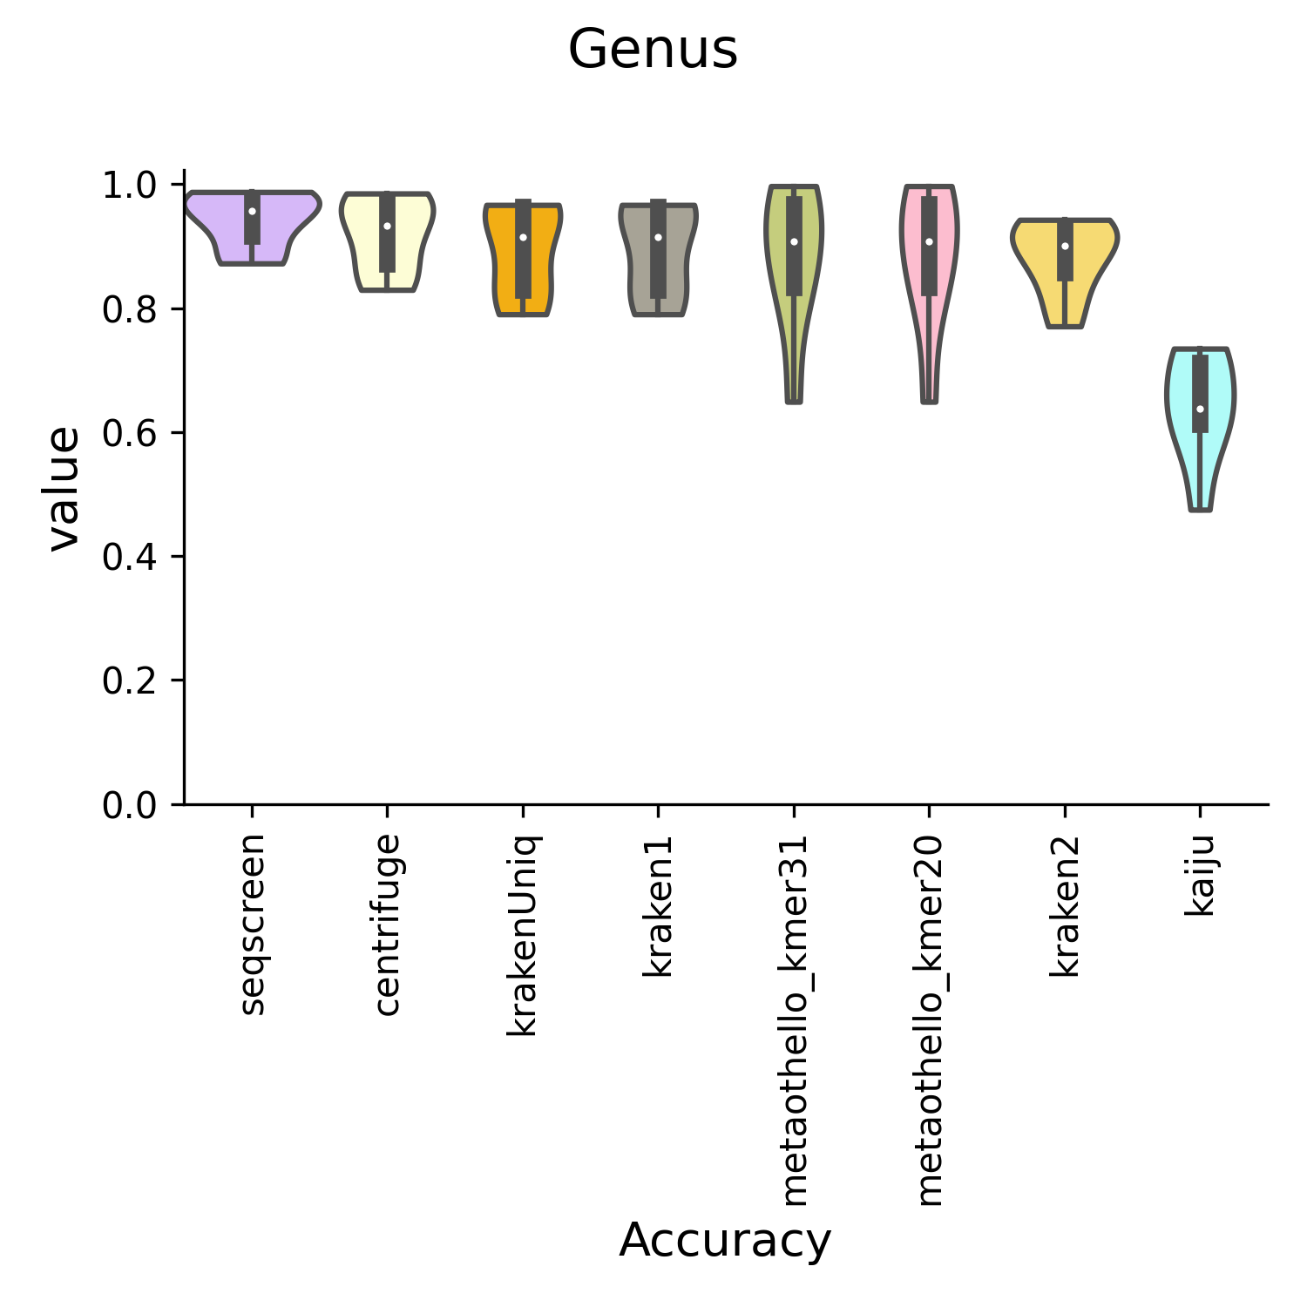
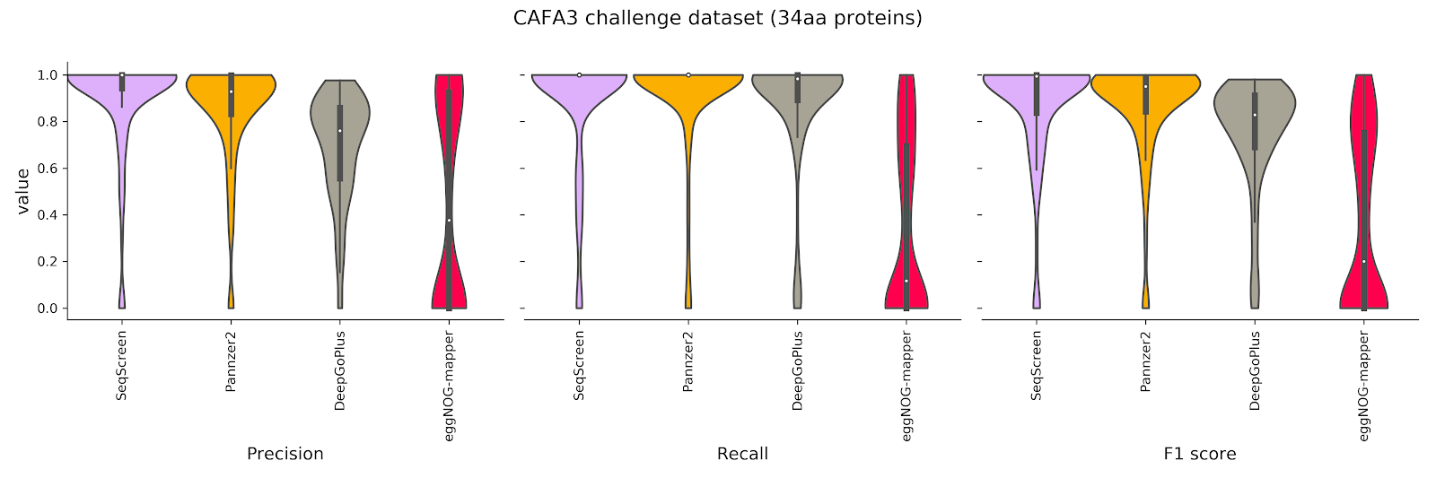
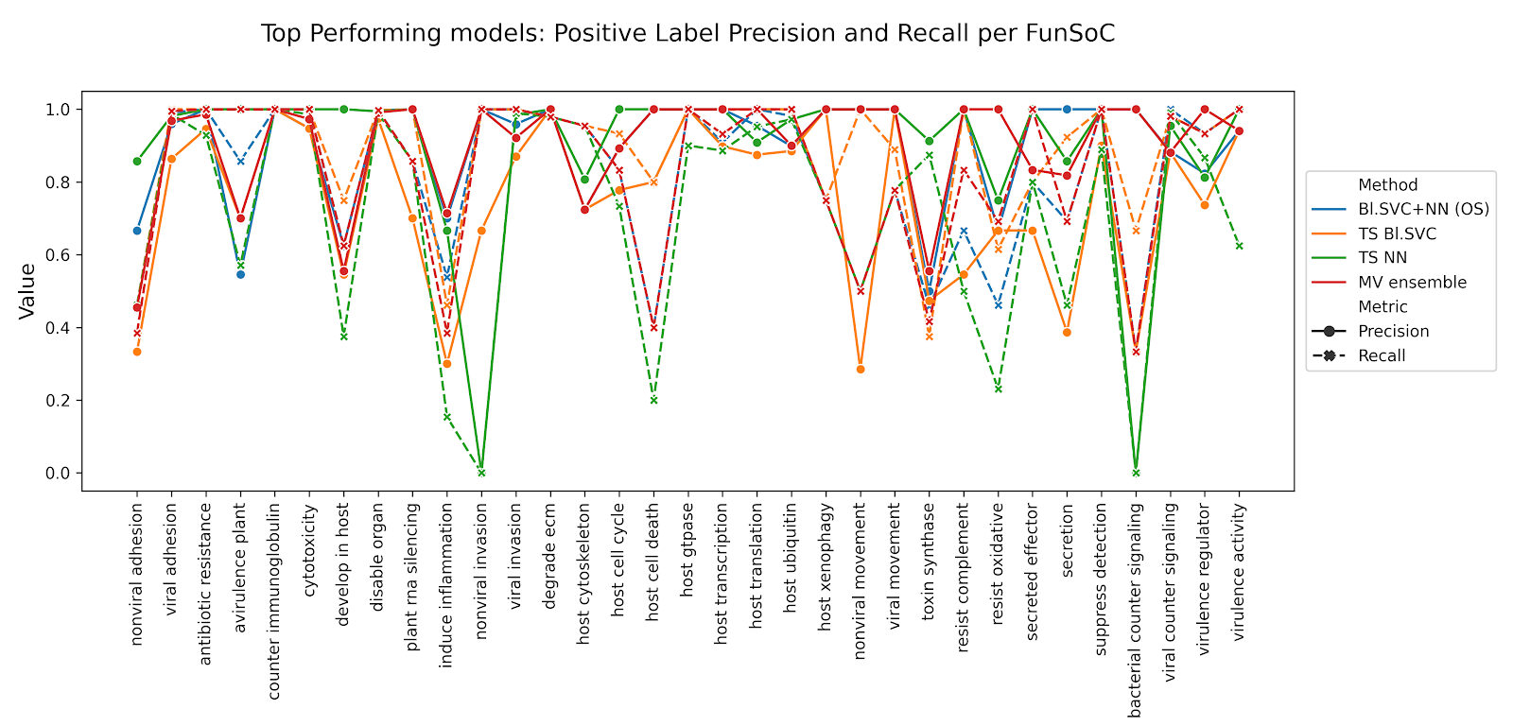
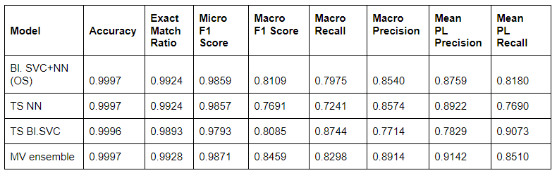
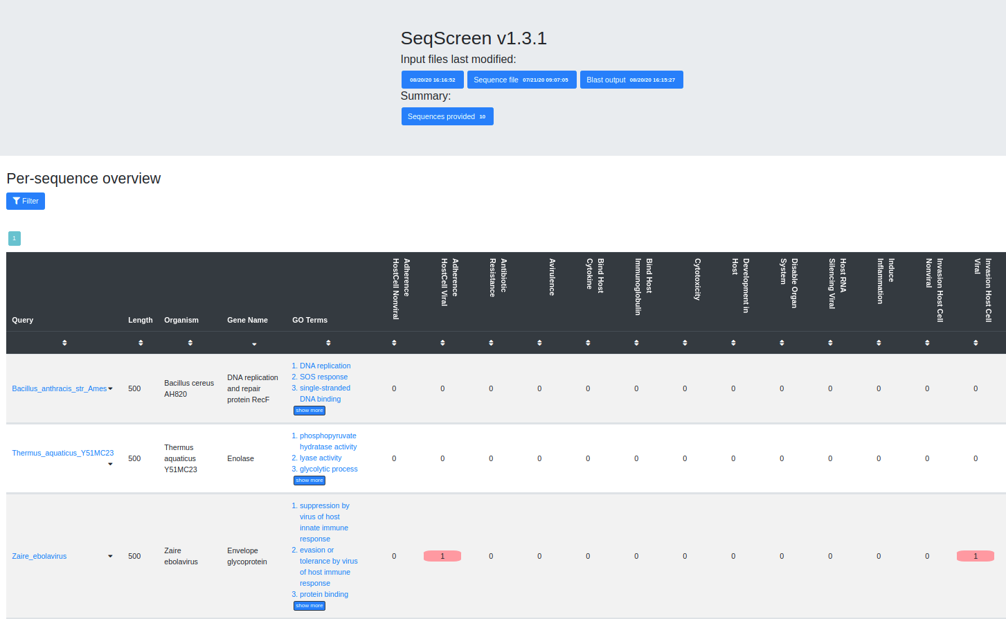
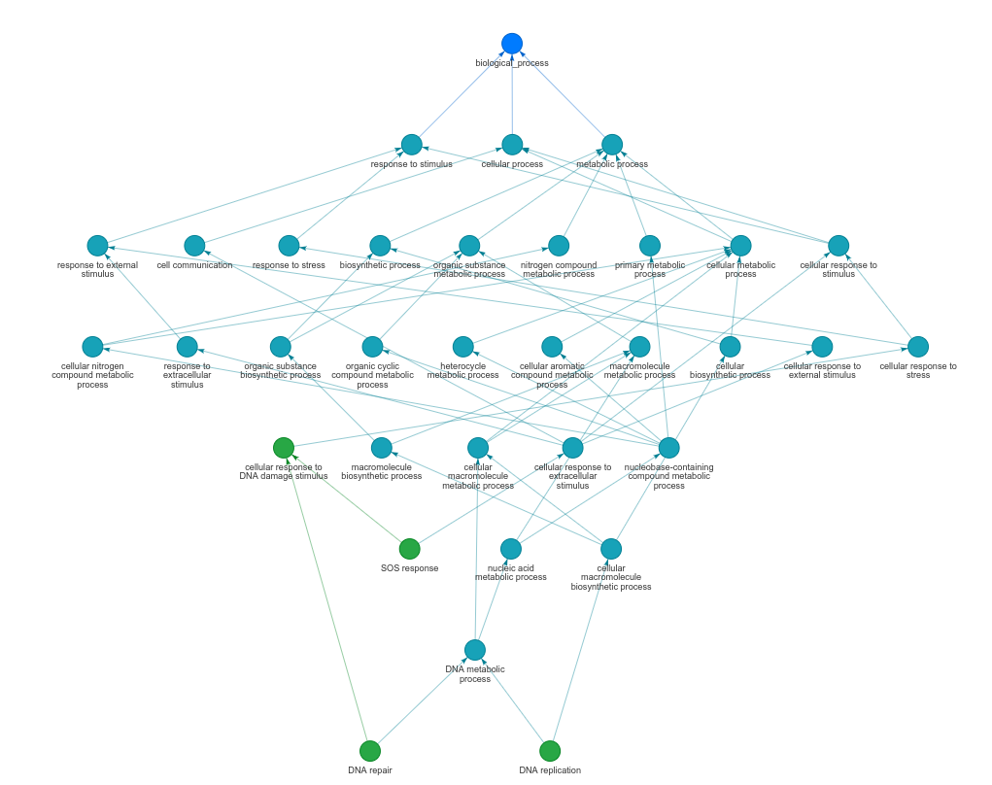
SeqScreen: comprehensive taxonomic and functional screening of pathogenic sequences
B. Kille¹, A. Balaji¹, Z. Qian¹, D. Albin¹, G. Godbold², A. Kappell³, M. Diep⁴, R. Elworth¹, S. Segarra¹, K. Ternus³, T. Treangen¹
¹Rice University, Houston, TX, ²Signature Science, Arlington, VA, ³Signature Science, Austin, TX. ⁴Fraunhofer, Riverdale Park, MD
Rice University, Houston, Texas, USA-77005
Email: blk6@rice.edu
Abstract
Pipeline
Results
Accurate and sensitive functional and taxonomic characterization of short sequences is an open challenge for many of the current techniques and ontology-based tools. To address this need, we have developed a novel software tool, SeqScreen, that can accurately and sensitively annotate individual protein coding sequences as short as 50 nucleotides. Using ontology features and text-based keywords from existing databases, SeqScreen then uses a combination of ML algorithms to associate a customized set of 33 human-curated Functions of Sequences of Concern (FunSoCs) with UniProt IDs.
Figure 3 (left): Taxonomic classifier performance. Species and Genus level accuracy for taxonomic benchmarking. (Below): Functional annotation performance. Functional annotation results on 250 proteins obtained from CAFA 1 and 3.
Methods
Fast mode uses DIAMOND and Centrifuge for aligning to amino acid and nucleotide databases while sensitive mode uses BlastX as well as BlastN with outlier detection.
For our amino acid databases we use a reduced version of the UniRef100 database which only contains proteins with high scoring annotations.
FunSoC prediction uses a majority-vote ensemble classifier, consisting of both neural networks and support vector classifiers.
The training data for FunSoC prediction consists of 50,000 manually classified proteins.
To produce explainable results, we used feature selection or two-step modular approaches that aided the interpretability of the models.
Figure 4 (above): Model prediction performance on individual FunSoCs. The models we consider are Balanced SVC (Feature Selection) + Neural Network Classification using Oversampling (Bl. SVC+NN (OS)), Two Stage Detection + Classification Neural Networks (TS NN), Two Stage Detection + Classification Balanced Support Vector Classifier (TS Bl. SVC), and the Majority Vote Ensemble Classifier (MV ensemble).
Figure 1: SeqScreen Pipeline. In addition to the taxonomic classification and functional annotation steps, SeqScreen provides a means of running other popular tools like Bowtie2, HMMER, MUMmer, MEGARes against custom databases.
Figure 5: Overall FunSoC classifier performance.
Interactive Output
Conclusion
References
SeqScreen has better precision on annotating short sequences with GO-terms, comparable performance at species-level classification, and better performance at genus-level classification compared to state-of-the-art tools. ​
Our ML model is capable of learning the underlying GO term annotations and keywords associated with 33 FunSoCs and achieves a micro F1 score of 0.987 and a macro F1 score of 0.8459 when predicting protein FunSoCs
1. Buchfink, B., Xie, C. & Huson, D. H. Fast and sensitive protein alignment using DIAMOND. Nat. Methods 12, 59–60 (2015).
2. Kim, D., Song, L., Breitwieser, F. P. & Salzberg, S. L. Centrifuge: rapid and sensitive classification of metagenomic sequences. Genome Res. 26, 1721–1729 (2016).
3. Camacho, C., Coulouris, G., Avagyan, V., Ma, N., Papadopoulos, J., Bealer, K., & Madden, T. L. (2009). BLAST+: architecture and applications. BMC bioinformatics, 10(1), 421.
4. Shah, N., Altschul, S. F., & Pop, M. (2018). Outlier detection in BLAST hits. Algorithms for Molecular Biology, 13(1), 1-9.
5. Suzek, B. E., Huang, H., McGarvey, P., Mazumder, R. & Wu, C. H. UniRef: comprehensive and non-redundant UniProt reference clusters. Bioinformatics vol. 23 1282–1288 (2007).
Figure 2 (left): Interactive HTML results explorer. This is an interactive page that outputs each query sequence with the predicted taxonomy, GO terms, and FunSoCs. (Right): Interactive HTML GO term explorer. This is an interactive page that allows users to examine the GO networks associated with input sequences. The network consists of all ancestors of any predicted GO term.
Acknowledgements
All of the co-authors were either fully or partially supported by the FunGCAT program from the Office of the Director of National Intelligence (ODNI), Intelligence Advanced Research Projects Activity (IARPA), via the Army Research Office (ARO) under Federal Award No. W911NF-17-2-0089

Slide 2
Motivation
Advancements in synthetic biology techniques has bought new biosecurity challenges to the fore.
Examples include template free synthesis of Poliovirus cDNA (Cello et al, 2002) and Spanish Flu virus (Tumpey et al, 2005)
Diversity of naturally evolving and emerging markers make pathogen detection challenging (Natl. Acad. Sci., 2019) .
Stress response genes in virulence, pathogenic sequences in commensals, and interplay of genes producing pathogenic effects.
Accurate functional, taxonomic characterization of short sequences is an open challenge for current techniques and ontology-based tools.

Slide 3
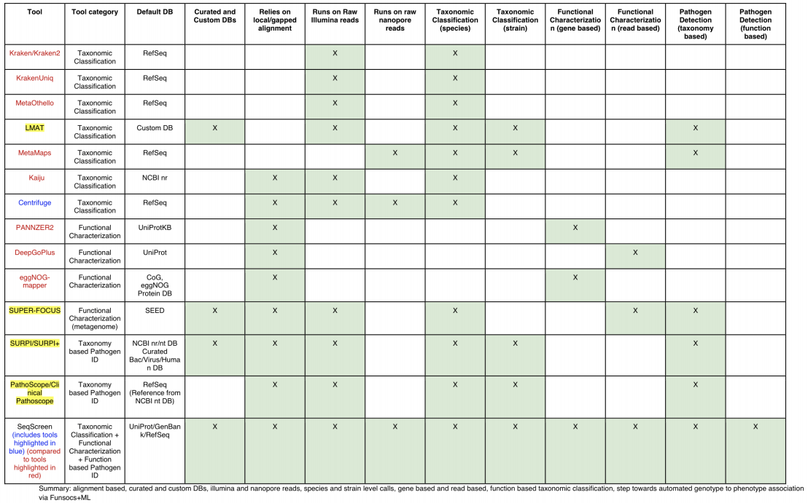
Motivation

Slide 4
Methods (Pipeline)
Fast mode uses DIAMOND and Centrifuge for aligning to amino acid and nucleotide databases while sensitive mode uses BlastX as well as BlastN with outlier detection.
FunSoC prediction uses a majority-vote ensemble classifier, consisting of both neural networks and support vector classifiers.
The SeqScreen pipeline offers auxiliary modules for user convenience like HMMER and Bowtie2.

Slide 5
Methods (FunSoCs)
FunSoCs are biocurator-defined annotations for proteins.
Indicate pathogenicity features.
Abstraction underlying pathogenicity.
Examples: “degrade_ecm,” “antibiotic resistance”, and“cytotoxicity”.
Currently there are 33 FunSoC annotations incorporated in SeqScreen.
Utilizes a lookup table to assign FunSoCs created through training ML models on Swiss-Prot and TrEMBL (30 million proteins).
Biocurators initially provided a list of 16806 proteins as a training set.
induce-inflammation (255), viral_invasion(5703), counter_immunoglobulin (28).
We train 3 separate models on each of the 33 FunSoCs and use the majority vote among the 3 as the classification.
Detection + neural network
Detection + SVC
Binary SVC feature detection + neural network

Slide 6
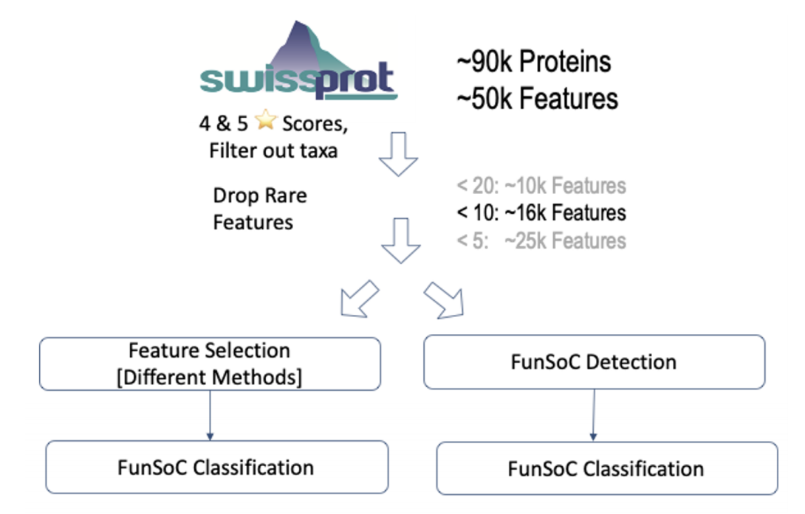
Methods (Database and Training Data)
For our amino acid databases we use a reduced version of the UniRef100 database which only contains proteins with high scoring annotations.
The training data for FunSoC prediction consists of 50,000 manually classified proteins which contained roughly 16k unique features.

Slide 7
Methods (Output Explorer)

Slide 8
Methods (Output Explorer)

Slide 9
Results (Taxanomic and Functional)
In taxonomic classification, SeqScreen matches the performance of all state-of-the-art tools
SeqScreen showed high levels of precision among all benchmarking tools in functional annotation

Slide 10
Results (FunSoCs)
Some FunSoCs prove to be much more difficult to classify than others
The Majority Vote (MV) ensemble classifier offers the best balance between precision and recall
Figure: Model prediction performance. The models we consider are Balanced SVC (Feature Selection) + Neural Network Classification using Oversampling (Bl. SVC+NN (OS)), Two Stage Detection + Classification Neural Networks (TS NN), Two Stage Detection + Classification Balanced Support Vector Classifier (TS Bl. SVC), and the Majority Vote Ensemble Classifier (MV ensemble).

Slide 11
Conclusions
SeqScreen has better precision on annotating short sequences with GO-terms, comparable performance at species-level classification, and better performance at genus-level classification compared to state-of-the-art tools. ​
Our ML model is capable of learning the underlying GO term annotations and keywords associated with 33 FunSoCs and achieves a micro F1 score of 0.987 and a macro F1 score of 0.8459 when predicting protein FunSoCs

Slide 12
Acknowledgements
This software is the culmination of many teams, thank you to the Treangen lab, Krista Ternus and Signature Science, and Madeline Diep and Fraunhofer
All of the co-authors were either fully or partially supported by the FunGCAT program from the Office of the Director of National Intelligence (ODNI), Intelligence Advanced Research Projects Activity (IARPA), via the Army Research Office (ARO) under Federal Award No. W911NF-17-2-0089

