Slide 1
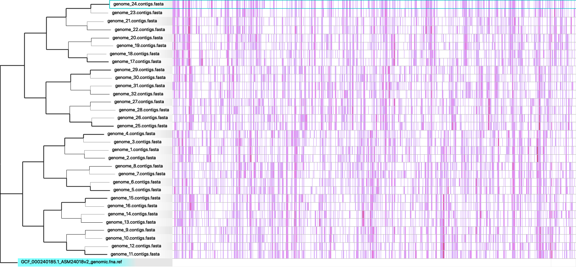
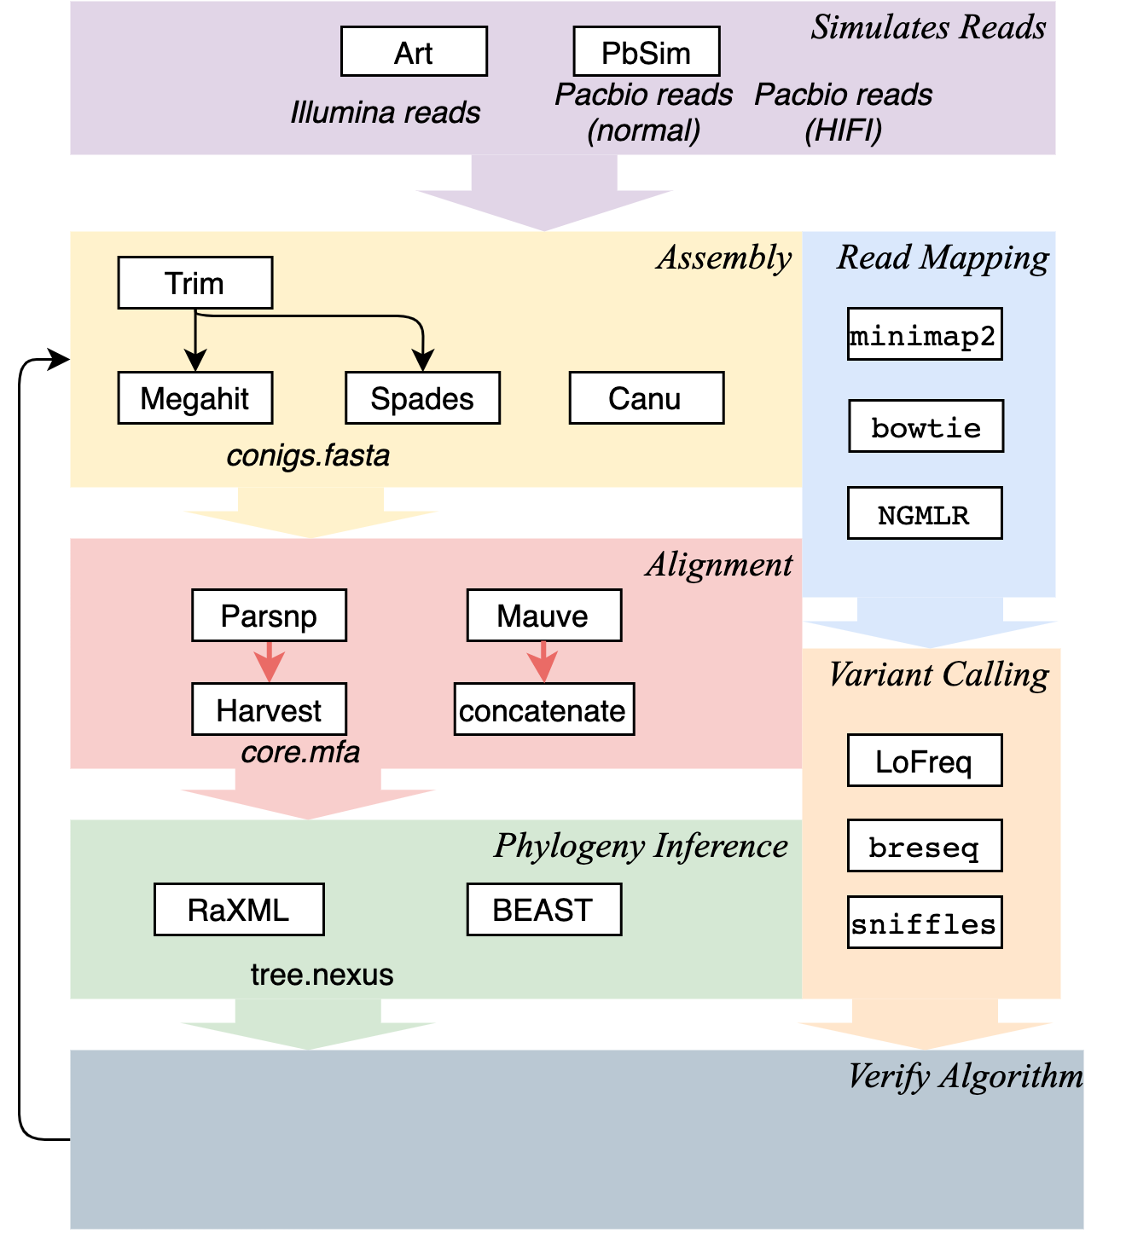
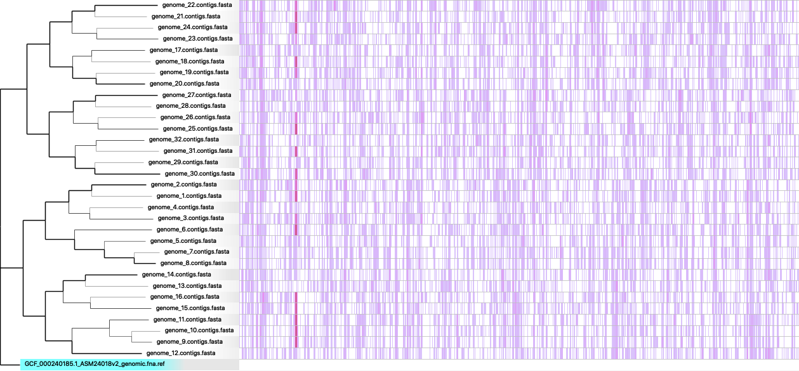
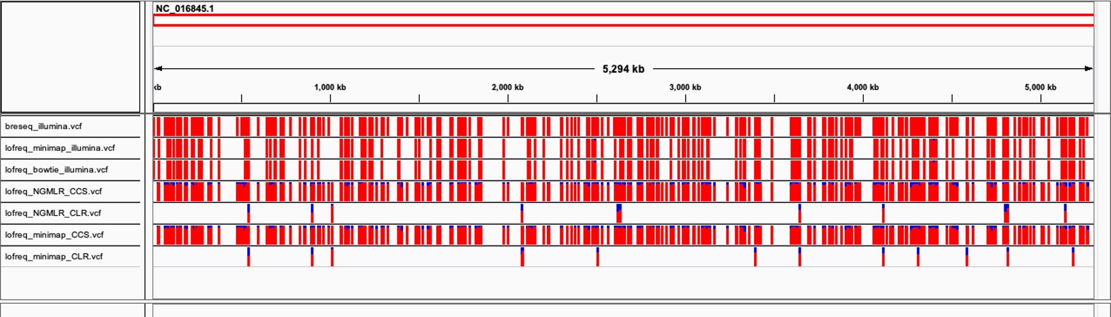
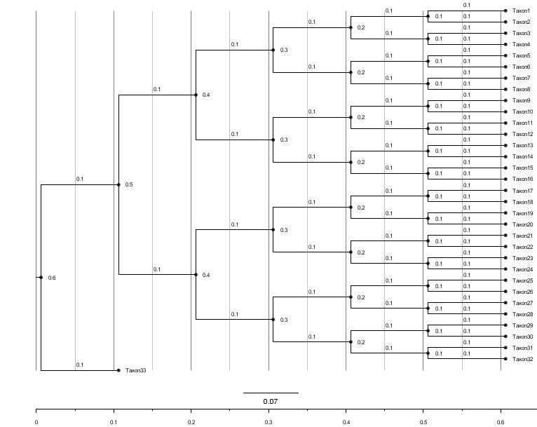
VariPhyer: A Modular Computational Platform for Verifying Microbial Phylogenetic Variant Analyses
C.Liao¹, D.Albin¹, B.Kille¹, Y.Liu¹, Y.Fu¹, M.Nute¹, R.A.L.Elworth¹, T.Treangen^{1*}
¹Rice University, Department of Computer Science, 6100 Main St., Houston, TX 77005-1827
INTRODUCTION
RESULTS
DifferentPhylogeneticInfo | 0
PhylogeneticInfoDistance | 0
JaccardRobinsonFoulds | 0
PathDist | 0
RobinsonFoulds | 0
Since March 2019, a large number of SARS-Cov-2 pandemic evolutionary phylogeny inference results have been published in a manner of high frequency and under time pressure [1]. Shared genomic variants of the pathogen have been widely used for inferring transmission routes of infectious disease outbreaks and for detecting the origin of a pathogen [2]. The inference of phylogenies on whole genomes of pathogens is critical for studying the epidemiology of communicable diseases [3]. During genome analysis, which workflow to choose and which results to trust is a fundamental question. Running a pipeline with simulated data not only can test the hypothesis but also can find the best practices in terms of tools and sequencing methods.
(a)
OBJECTIVES
Despite the wide range of existing workflow choices, a huge amount of effort is still required for an expert to study the detailed parameter settings and selection of tools for their target biological question. As many tools addressing similar questions continue to emerge, benchmarking each tool for different methodologies is becoming a common step in sequencing data analysis. A reproducible and accurate genomics analysis pipeline, with best practices in phylogeny inference and variant calling detection, is an urgent need. As can be seen from Figure 1, both the sequencing methods and pipeline selection can affect the variant calling results, so an assessment algorithm with a baseline is critical for variant calling analysis.
DifferentPhylogeneticInfo | 286.22
PhylogeneticInfoDistance | 286.22
JaccardRobinsonFoulds | 19.31
PathDist | 54.99
RobinsonFoulds | 32
(b)
breseqIllumina.vcf,
lofreqMinimapIllumina.vcf,
lofreqBowtieIllumina.vcf,
lofreqNGMLRCCS.vcf,
lofreqNGMLRCLR.vcf,
lofreqMinimapCCS.vcf, lofreqMinimapCLR.vcf.
Figure 4. 33-way genome alignment and phylogeny as visualized by Gingr [4]. (a) is the .ggr and .tree file of the Canu Parsnp pipeline, (b) is from the Spades Parsnp pipeline. Branch lengths from the Canu Parsnp pipeline are more accurate compared to the Spades Parsnp pipeline.
Figure 1. Comparison of the results of different variant calling pipelines for the same genome. Each red vertical bar is one allele for that position, the ratio of red to blue is the allele frequency compared to the reference base.
Robinson Foulds Distance (RFD) Metric on tree topologies and branch lengths
Compare the RFD of the final phylogeny with the ground truth
CONCLUSIONS
This project implemented an integrated genomic analysis pipeline with an evaluation function. The hypothesis has been tested by showing most output phylogenies are consistent with the designed tree. All the programs have been benchmarked by the designed tree with the given species. The results show our pipeline is efficient and accurate in genomic analysis and evaluation.
METHODS
Figure 2. VariPhyer workflow. VariPhyer steps include: Simulate Reads, Assemble Genomes, Genome Alignment, Phylogenetic Inference, Read Mapping, and Variant Calling steps.
We propose a benchmarking pipeline, VariPhyer, which is an end-to-end, comprehensive framework for microbial benchmarking of phylogenetic inference and variant calling from short reads, long reads, and assembled genomes with best practices.
Our hypothesis is the output phylogeny and variant calling should be close to the ground truth if there is no error in the pipeline.
It was implemented in Nextflow with 32 software packages and 44 processes and uses designed variants and evolutionary relationships as ground truth.
It simulates the pre-designed phylogeny and variants into the given genome, then uses the selected pipeline and evaluation matrix to compare the difference in terms of tree comparison and variant calling accuracy.
Figure 3. The ground truth tree and the associated genomes.
•A balanced binary tree of 32 leaf taxa with a root of the original reference.
•A medium mutation rate of 0.00001 mutations per base per branch is introduced with the HKY substitution model.
•A test dataset is simulated with Seq-gen and the Klebsiella Pneumoniae reference downloaded from NCBI RefSeq.
REFERENCES
[1] Javier A. Jaimes, Nicole M. André, Joshua S. Chappie, Jean K. Millet, and Gary R. Whittaker. Phylogenetic Analysis and Structural Modeling of SARS-CoV-2 Spike Protein Reveals an Evolutionary Distinct and Proteolytically Sensitive Activation Loop. Journal of Molecular Biology, 2020.
[2] Colin J. Worby, Marc Lipsitch, and William P. Hanage. Shared Genomic Variants: Identification of Transmission Routes Using Pathogen Deep-Sequence Data. American Journal of Epidemiology, 186(10):1209–1216, 2017.
[3] Hong Guohu, Guan Qing, and Mao Qing. Spread dynamics of SARS-CoV-2 epidemic in China: a phylogenetic analysis. medRxiv, 2020.
[4] Todd J Treangen, Brian D Ondov, Sergey Koren, and Adam M Phillippy. The harvest suite for rapid core-genome alignment and visualization of thousands of intraspecific microbial genomes. Genome biology, 15(11):524, 2014.
SOURCE CODE
Gitlab: https://gitlab.com/treangenlab/variphyer
Email: cl117@rice.edu

