Slide 1
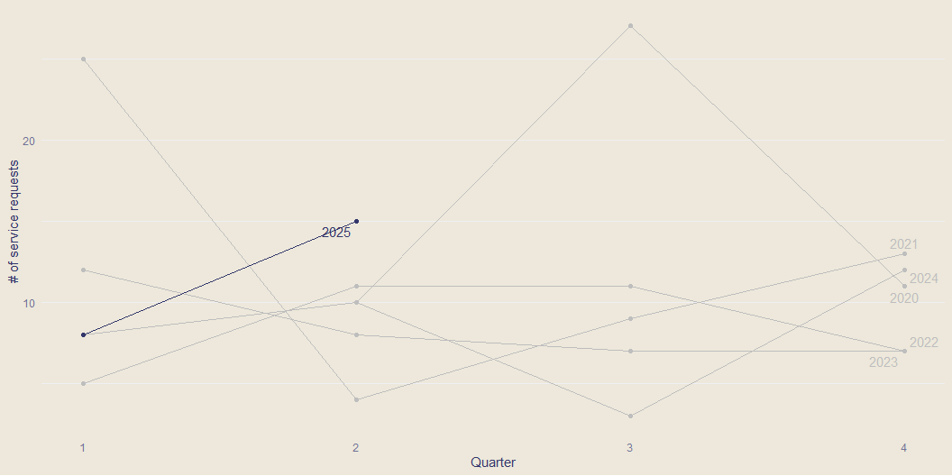
Number of service requests per fiscal year and quarter

Slide 2
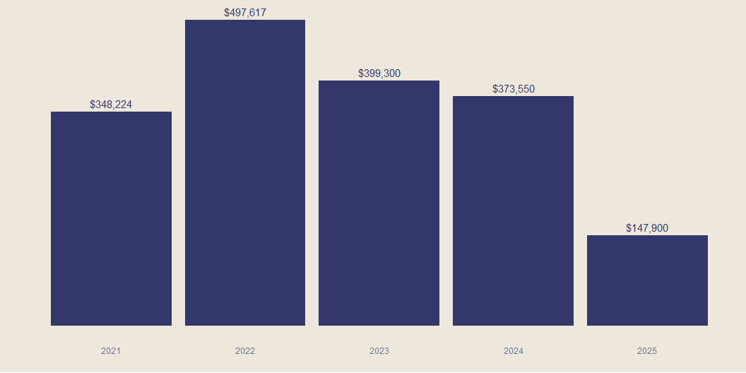
Fees committed per fiscal year

Slide 3
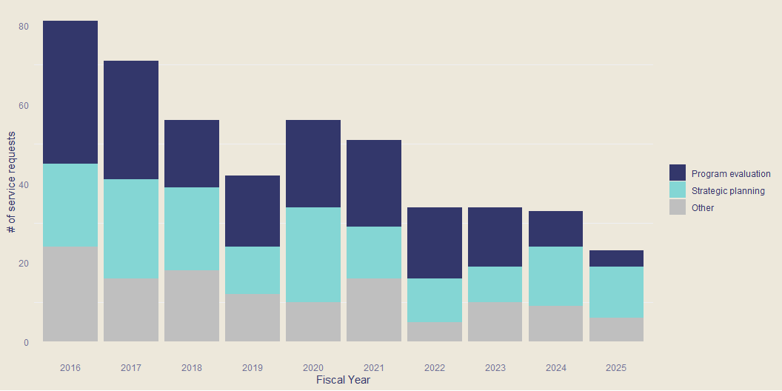
Number of service requests per fiscal year by type

Slide 4
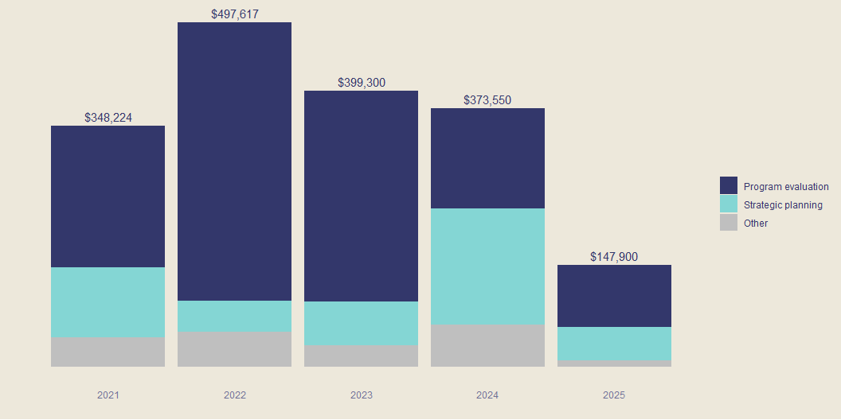
Fees committed per fiscal by type of project

Slide 5
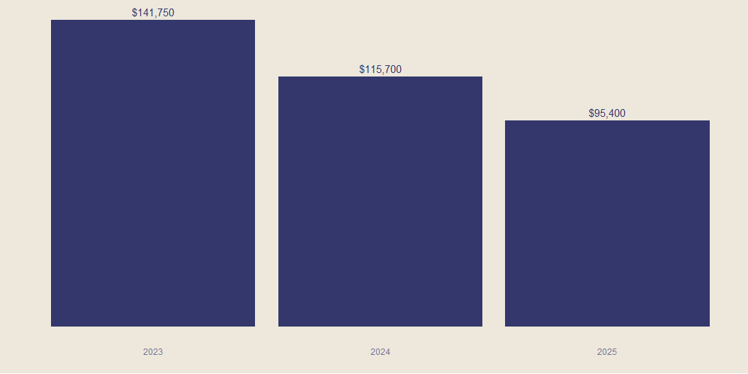
Total fees committed in first two quarters of fiscal

Slide 6
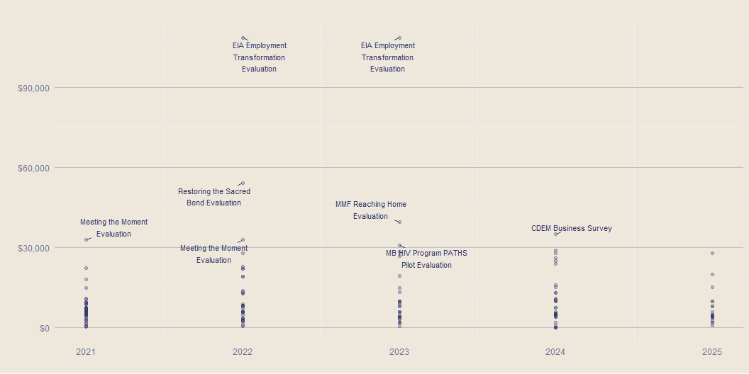
Fees paid by project per fiscal
The labeled points are fees over $30,000

Slide 7
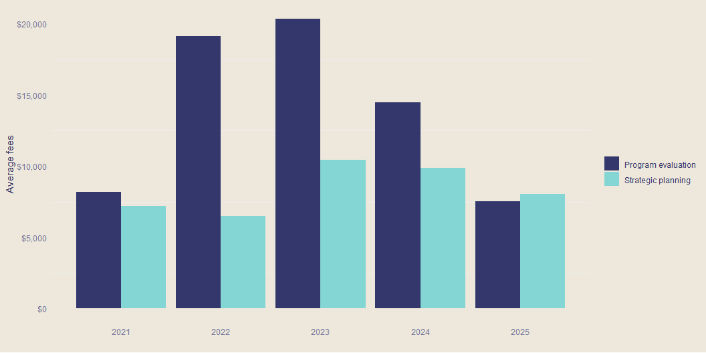
Average fees per fiscal by service type

