Slide 1
Updated October 23, 2025 N = 127 surveys were completed between October 21 and 29, 2025.

Slide 2
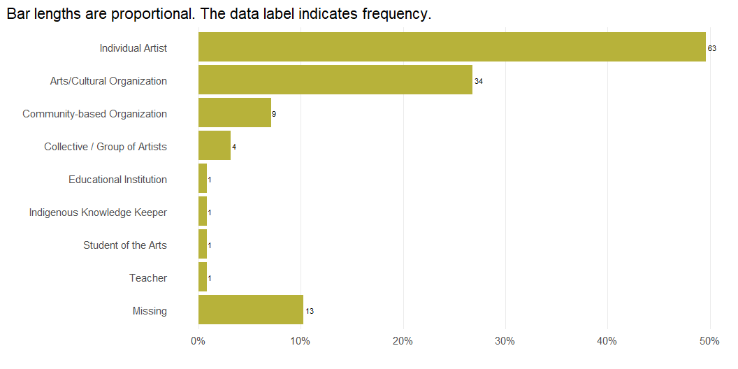
Survey Respondents by Role

Slide 3
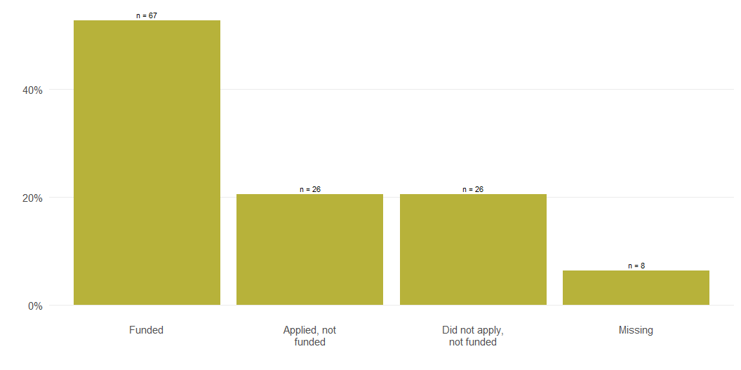
Survey Respondents by Funding Status

Slide 4
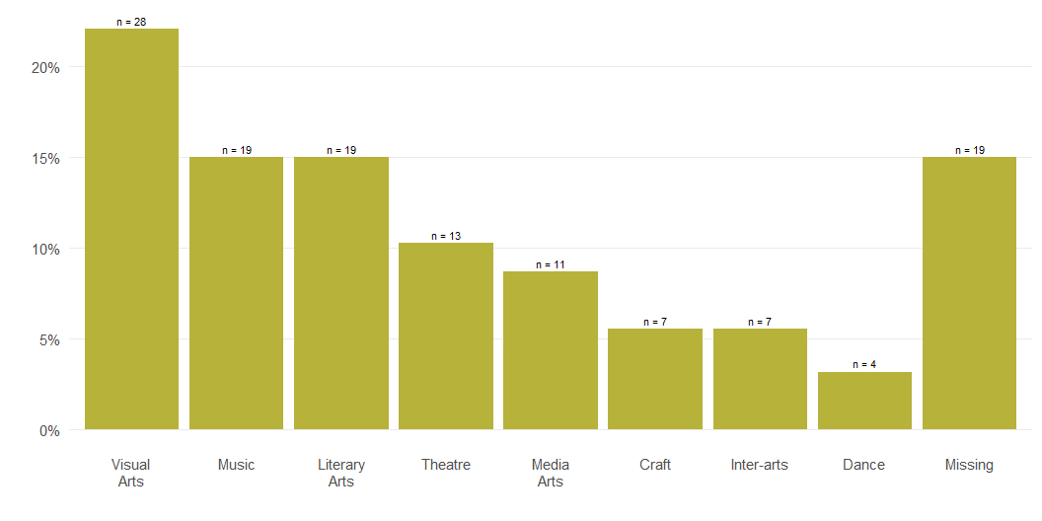
Primary Area of Artistic or Organizational Focus

Slide 5
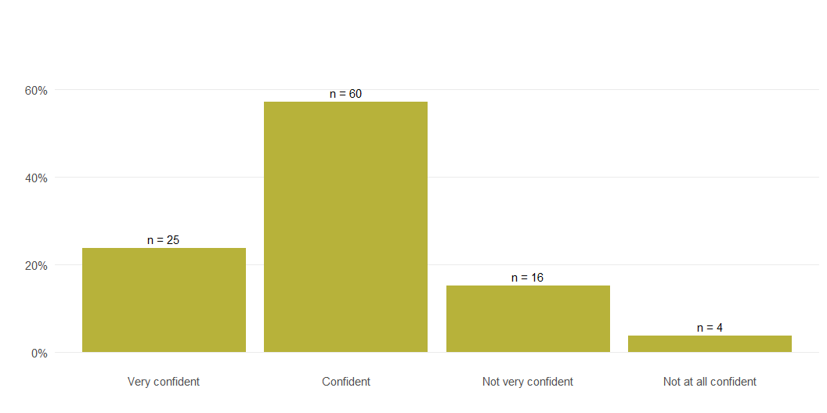
Confidence in MAC’s Ability to Fulfill Its Purpose

Slide 6
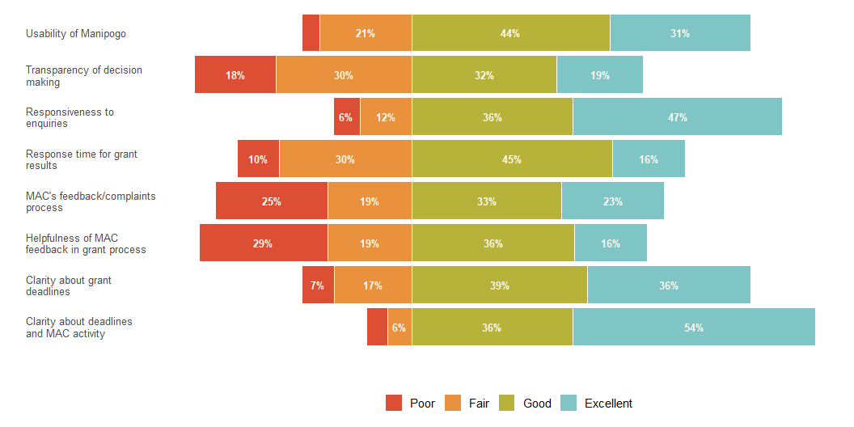
Feedback on MAC’s Process and Services

