Slide 1
Updated October 24, 2025 N = 129

Slide 2
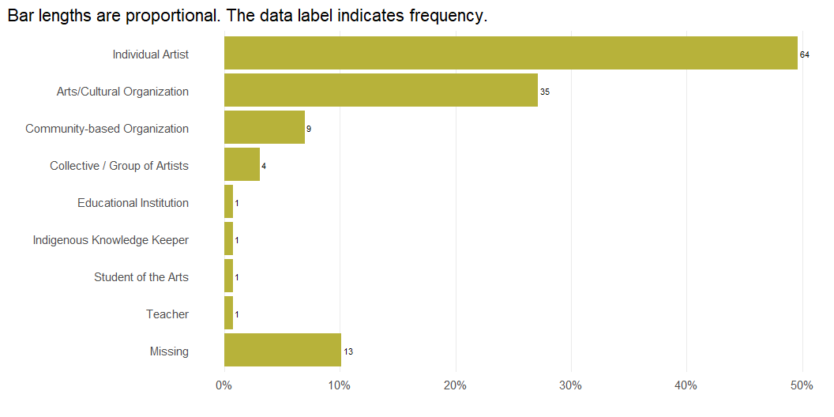
Survey Respondents by Role

Slide 3
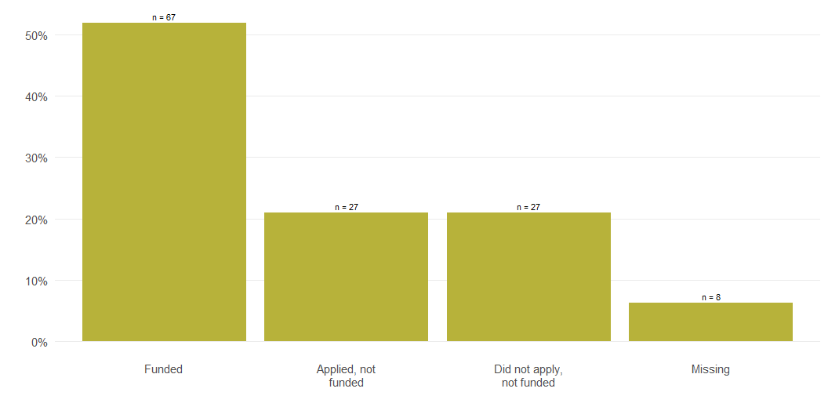
Survey Respondents by Funding Status

Slide 4
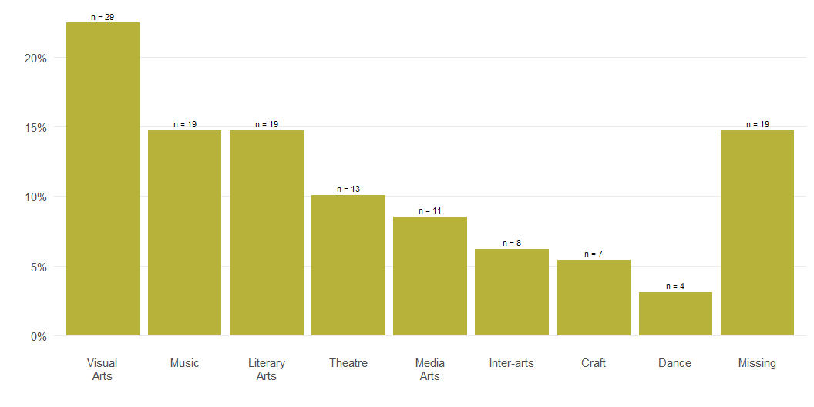
Primary Area of Artistic or Organizational Focus

Slide 5
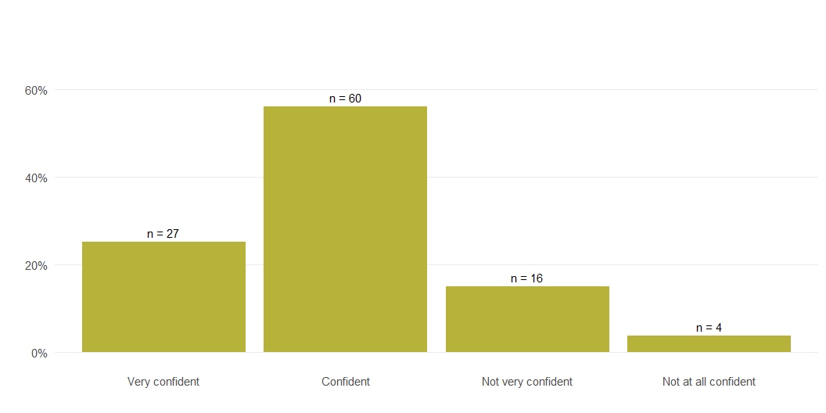
Confidence in MAC’s Ability to Fulfill Its Purpose

Slide 6
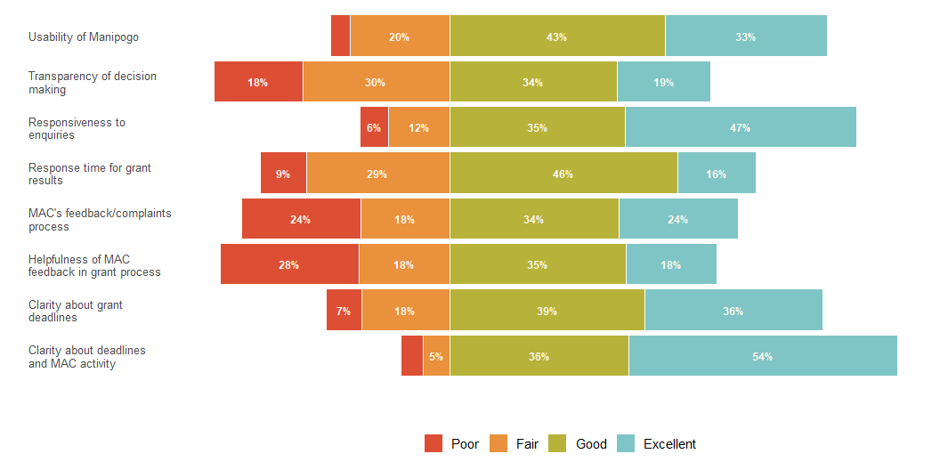
Feedback on MAC’s Process and Services

Slide 7
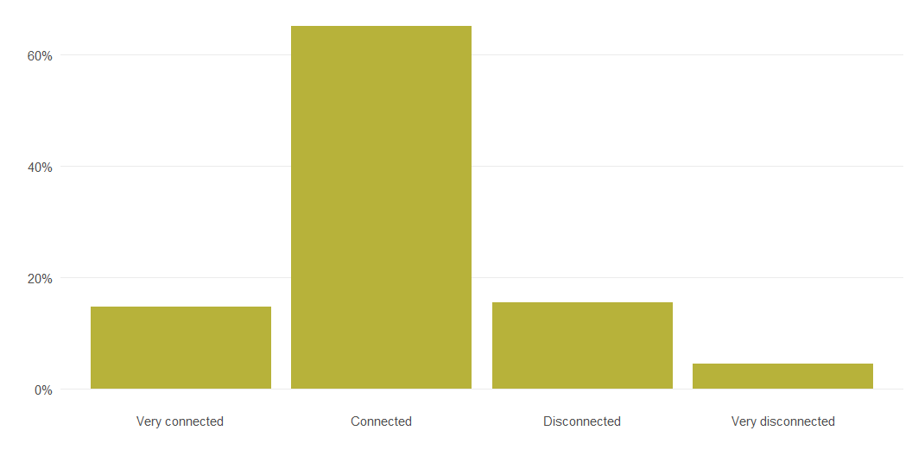
MAC’s Connection to Arts & Cultural Community’s Needs and Realities

Slide 8
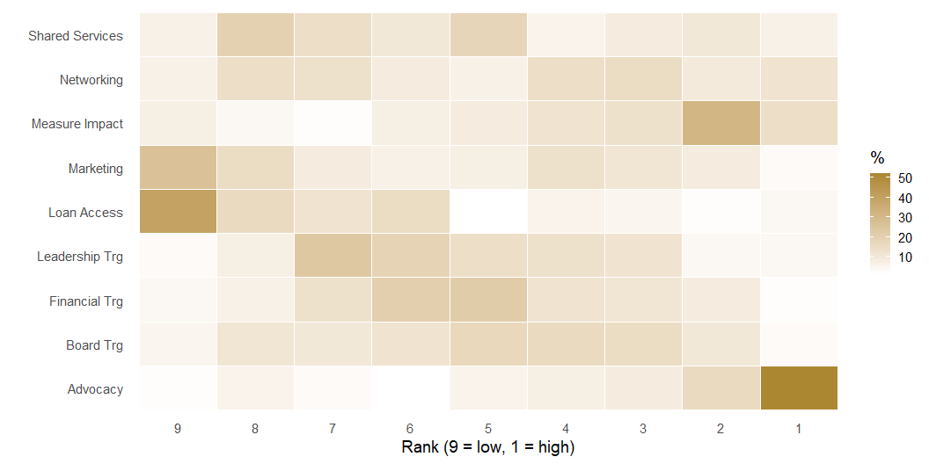
Rank Distribution of Areas Needing Enhacement
Each row in the grid represents an item on the the list. Each column represents a rank starting from the lowest rank (9) to the highest rank (1) on the right. The colour of the square represents the proportion of people assigning the corresponding rank to each item. The darker the colour, the higher the proportion of respondents assigning that rank.

