Slide 1


Ballari Institute Of Technology And Management
(Recognized by Govt. of Karnataka, approved by AICTE, New Delhi
Autonomous Institute under Visvesvaraya Technological University, Belagavi)
"JnanaGangotri" Campus, No.873/2, Ballari-Hosapete Road, Allipur,
Ballari-583 104 (Karnataka) (India)
Ph: 08392 – 237100 / 237190, Fax: 08392 – 237197
Department of Artificial Intelligence & Machine Learning
A Mini Project Presentation
on
SMS Application
Presented By
ABDUL MUSAWWIR S 3BR21AI004
B KIRAN 3BR21AI013
B PAVAN KUMAR 3BR21AI014
B KIRAN KUMAR 3BR21AI020
Mini project Guide
Dr. Hemavathi Purad
Associate professor
Dept. of AIML
Dr. B.M Vidyavathi
Head of the Department
Dept. of AIML

Slide 2
Contents
Introduction
Problem statement
Objectives
Design
Results
Summary

Slide 3
Introduction
In today's digital landscape, SMS (Short Message Service) remains a fundamental communication tool due to its simplicity, reliability, and wide accessibility. The development of an SMS application addresses the need for a straightforward solution to send text messages directly to a specified phone number.
The application focuses on delivering a streamlined user experience, enabling users to easily input the recipient's phone number, type out their message, and send it with minimal effort. By concentrating on core functionalities, this application ensures efficient and reliable text message delivery without the complexities of additional features like message receiving or database integration.

Slide 4
Problem Statement
To develop and design an SMS application that allows users to send a text message to a specific phone number based on the input provided by the user. The application focuses on creating a simple and efficient interface where users can input a phone number, type a message, and send it.

Slide 5
Objectives
Develop User Interface:
Create a user-friendly interface for inputting a phone number and a text message.
Implement a button to send the SMS.
SMS Functionality:
Ensure the application sends text messages to a predefined phone number only, as specified by the user.
Display confirmation of the sent message to the user.
Compatibility:
Ensure compatibility with a wide range of Android devices and OS versions.

Slide 6
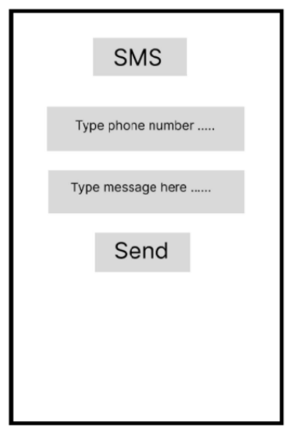
Design

Slide 7
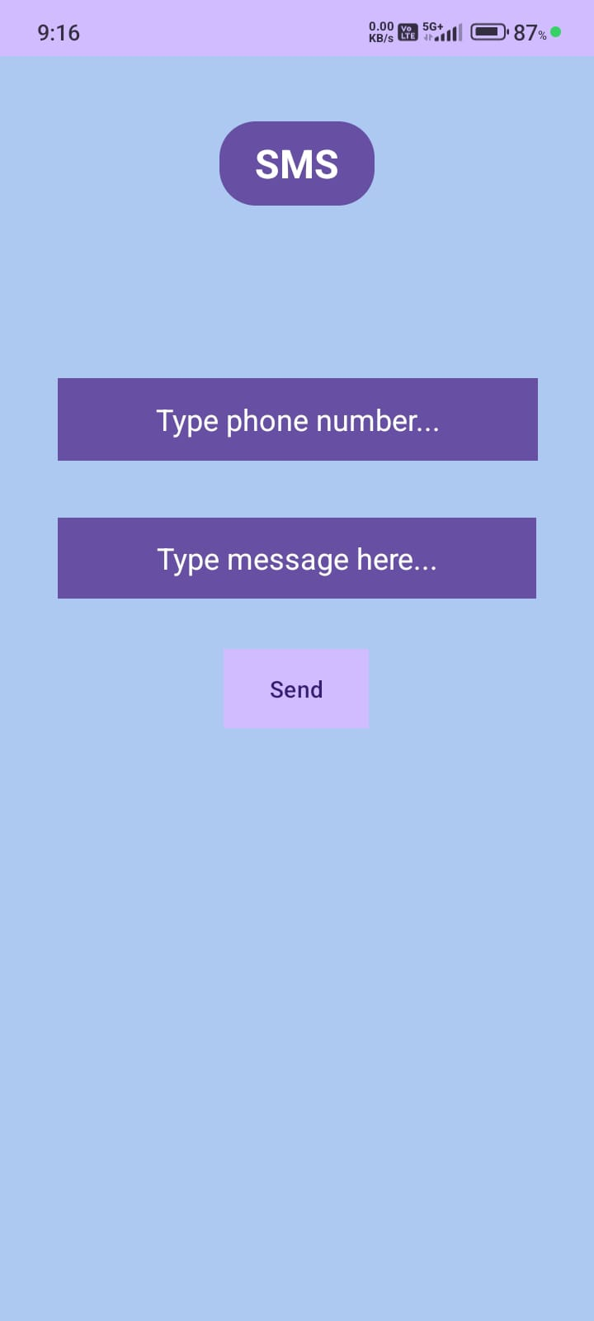
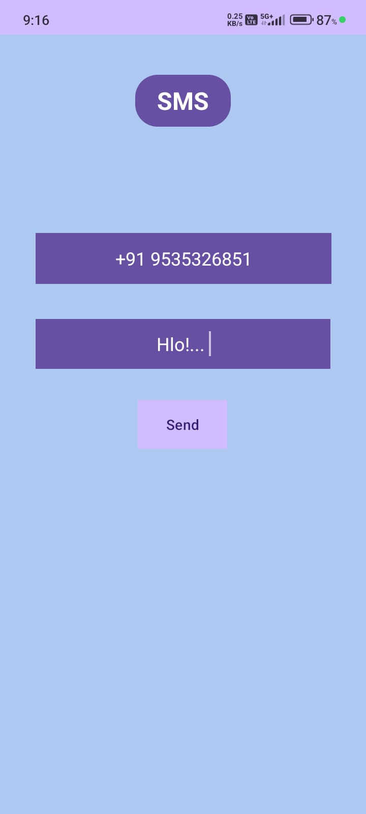
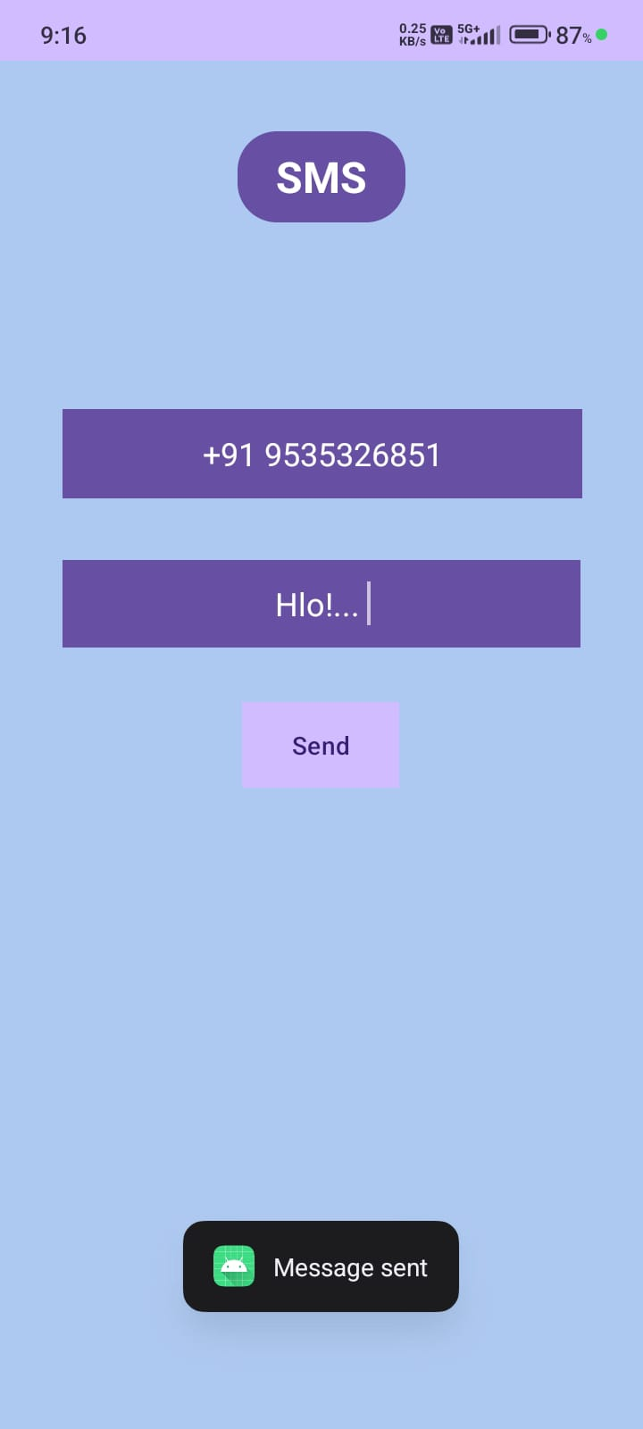
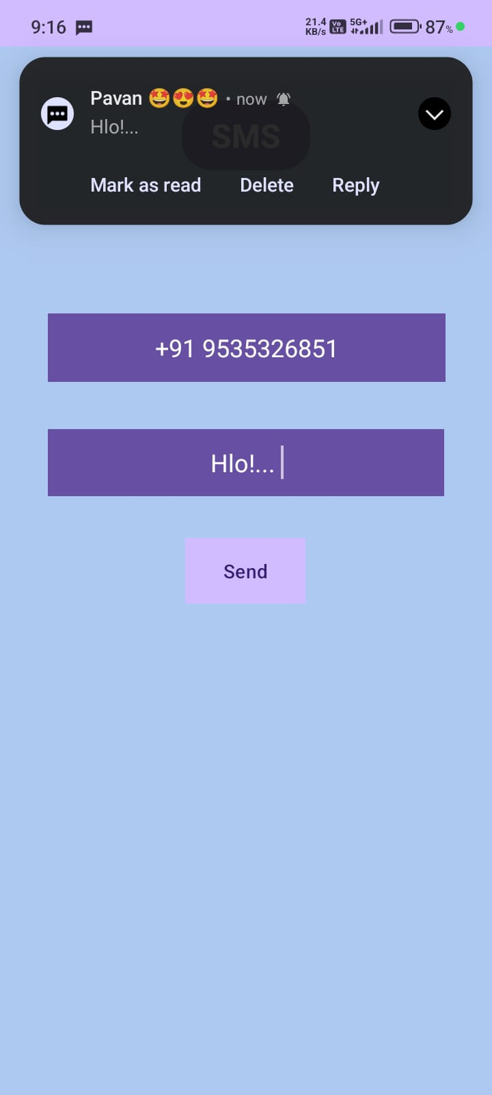
Results

Slide 8
Summary
The SMS application is designed to offer a straightforward solution for sending text messages. With a user-friendly interface, it enables users to input a phone number and message, then send the SMS with ease. The application emphasizes simplicity and efficiency, focusing solely on the core functionality of sending messages without additional features or complexities. This streamlined approach ensures that users can quickly and reliably communicate via text message.

