Slide 1
Sub grants Management System

Slide 2
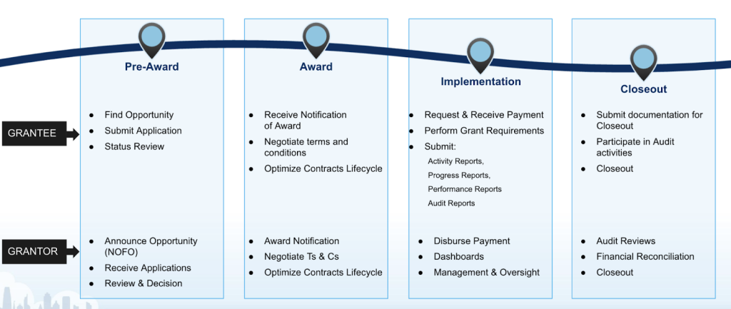
Grant MGT Cycle-1

Slide 3
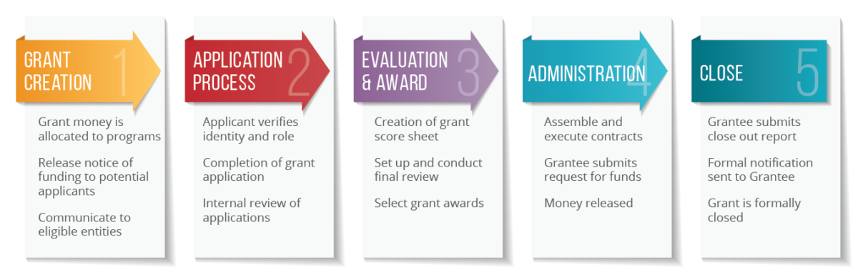
Grant MGT Cycle-2

Slide 4

WHAT DOCUMENTS DO I NEED TO UPLOAD TO GRANTS MANAGEMENT SYSTEM?
PREPARE / OPPORTUNITY
PROPOSAL / AMENDMENT
AGREEMENT / KICK - OFF
REPORT / REGULAR REVIEW
AUDITS & EVALUATIONS
CLOSE
Call for Proposals
Final Concept Note
Proposal Development Plan
Final Proposal Narrative & Budget including all donor required documents
Grant Risk Assessment
Procurement Plan
Cost share plan where applicable
HR plans
Amended documents If an amendment has been approved
Donor Contract
Approved Budget & Plan
Detailed Implementation Plan
Kick-off meeting pack including donor compliance information and any specific document information for audit requirements
Kick-off meeting action points
Final versions of all donor reports submitted to donor
Case Studies submitted to donor
Grant Correspondence (between Donor, Partners etc.)
Cost share Report
Assets Register
Documents to support committed costs/ accruals to donor
Full Final Audit reports
Final Evaluation reports
Donor/ Auditor correspondence
Final Notification of Disallowances from Donor
Partner/ Sub Recipient Audit Reports / Annual Certificates
Completed Close Out Plan
Lessons Learnt on Grant Report
Final Inventory Report
Asset / Stock Disposal Plan Agreed by Donor (if applicable)
PARTNERS
Original Partner Contract & Amendments
Partner Assessment
Contracts committee / SMT /Donor (for USAID) approval of CSOs
Partner Information
Evidence of orientation workshop-Reports
Agreed Capacity Strengthening Plan
Documentation / Approvals for items/actions requiring prior approval from donor
Minutes of Partnership Review Meetings
Correspondence with Partners
Funding notification letters to the CAOs
Verification of Site Visits
Narrative and Financial reports from partners including transaction list
Baylor-Uganda feedback on Partner Financial and Narrative Reports

