Slide 1
AP Invoice-to-Pay Governance Pilot
Finance & Accounting Domain Governance Architecture
Decision Requested: Approve a 90-day pilot
Steering Committee Review

Slide 2
Decision Requested
Approve Accounts Payable Invoice-to-Pay as a 90-day pilot to validate a reusable governance model for finance operations, analytics, AI augmentation, and future bounded agents.
Control baseline:
AP I2P Governance Package — operations control baseline
Analytics Intake and Extension Policy — Oracle-first reporting governance
AP Finance AI Governance Bundle — AI safe use and agent readiness
This pilot is not asking to automate AP with AI. It validates the governance architecture required before scaling analytics, AI, or agents into finance processes.

Slide 3
Why AP First
AP Characteristic | Governance Relevance
Control-heavy | Requires approval, payment, duplicate prevention, and exception controls
Evidence-rich | Produces audit logs, approval records, payment packets, KPI reports, and issue records
Exception-prone | Invoice holds, validation failures, duplicate risks, and unresolved items
Data-sensitive | Supplier, payment, bank, tax, and potentially PII-related data
Oracle-dependent | Disciplined use of native reporting, workflow history, and system-of-record evidence

Slide 4
Expected Pilot Value
Value Area | Expected Improvement
Control consistency | Clear owners, gates, evidence, and escalation paths
Reporting trust | Metrics tied to approved definitions, lineage, and Oracle-native sources
Reduced sprawl | Fewer unmanaged extracts, spreadsheets, and duplicate reports
Safer AI adoption | AI use cases routed through risk tiering, review, and evidence requirements
Audit readiness | Better traceability from process → report → evidence → decision
Reusable pattern | A tested model that can scale to another Finance & Accounting domain

Slide 5
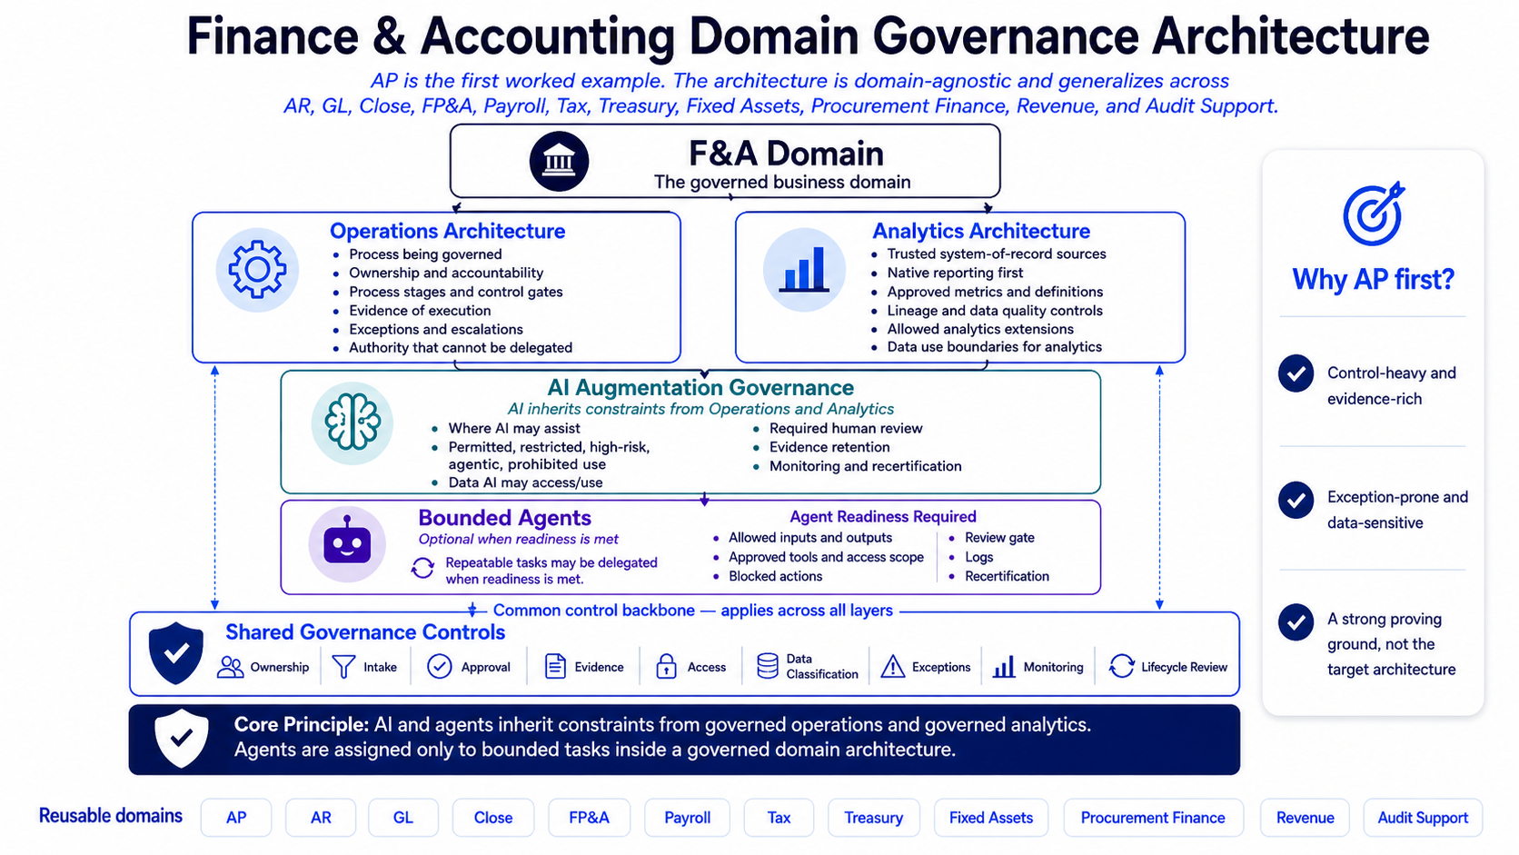
Governance Architecture — AP as the First Worked Example

Slide 6
Governance Model
Three connected governance layers — AI inherits constraints from governed operations and analytics.
A
B
C
Operations Governance
Analytics Intake & Extension
AI Governance & Agent Readiness
Controlled AP process from invoice intake through payment posting. Control points, RACI ownership, SOP steps, escalation paths, evidence artifacts, and KPI thresholds.
Oracle-first assessment before custom reports, dashboards, extracts, or recurring spreadsheets. Approved extensions require owner, lineage, quality checks, access control, retention, and change control.
Safe-use categories, AI intake, risk tiers, data handling, human accountability, evidence retention, risk/control mapping, incident handling, and agent readiness gates.

Slide 7
Pilot Scope
In Scope
AP Invoice-to-Pay governance baseline
AP control gates and evidence requirements
AP KPI definitions and metric lineage
Oracle-first analytics intake and extension review
AP AI safe-use intake, risk tiering, and control mapping
Agent readiness assessment template — AP as first worked example
Monthly governance review and issue tracking
Out of Scope (Unless Separately Approved)
Autonomous invoice approval
Payment release by AI or agent
Supplier master or supplier bank changes by AI
Control override or exception closure without human review
Unapproved public AI tools with supplier, bank, payment, tax, payroll, PII, audit, or confidential finance data
AI output as sole audit or control evidence

Slide 8
90-Day Pilot Timeline
1
2
3
4
5
6
Week 0
Kickoff
Confirm sponsor, AP process owner, scope, and review cadence
Exit: Pilot approved, owners named
Weeks 1–2
Control Setup
Confirm roles, evidence locations, access expectations, KPI baseline
Exit: Evidence & access documented
Month 1
Analytics Intake
Apply Oracle-first assessment to selected AP reporting/analytics requests
Exit: Intake decisions documented
Month 1–2
AI Use-Case Intake
Classify initial AP AI use cases, complete risk/control mapping
Exit: Use cases routed & approved/rejected
Month 2
Agent Readiness
Test readiness template on a hypothetical AP exception or evidence-prep agent
Exit: Readiness decision documented
Month 3
Review & Scale Decision
Review KPIs, evidence, issues, adoption, readiness
Exit: Go / Conditional Go / No-Go

Slide 9
Success Measures & Key Risks
Success Measures
Control clarity — Named owners, performers, reviewers, escalation paths for each AP control gate
Evidence completeness — Required evidence retained for sampled control activities
KPI trust — Metrics have documented definitions, source logic, thresholds, lineage
Analytics discipline — Native Oracle assessment completed before custom extensions approved
AI safety — Use cases classified, reviewed, routed through safe-use requirements
Scalability — Lessons learned reusable for the next Finance & Accounting domain
Key Risks & Mitigations
Governance slows throughput — Monitor on-time payment and exception aging; tune procedure without weakening controls
KPI logic not trusted — Document definitions, grain, source fields, lineage, quality checks
Users bypass intake — Communicate Oracle-first policy; require review for recurring or control-relevant outputs
Sensitive data in unsafe AI tools — Restrict to approved tools; require security/privacy review for sensitive data
AI output treated as authoritative — Require human review and source evidence before reliance
Agentic workflows exceed scope — Readiness assessment, blocked actions, logging, approval gates, recertification

Slide 10
Decision Ask
Approve a 90-day AP Invoice-to-Pay governance pilot, with:
AP I2P as the first worked example for the Finance & Accounting Domain Governance Architecture
AP I2P Governance Package as the operations control baseline
Analytics Intake & Extension Policy governing Oracle-first reporting and extension decisions
AP Finance AI Governance Bundle governing AI safe use, intake, risk/control mapping, agent readiness
Monthly governance reviews assessing evidence, KPI trust, intake discipline, AI routing, and risks
At day 90: Go / Conditional Go / No-Go recommendation, with scaling path to the next Finance & Accounting domain.

