Slide 1
Finance & Accounting Domain Governance Architecture
A reusable model for governing operations, analytics, AI augmentation, and bounded agents across F&A domains.
AP Invoice-to-Pay is the first worked example, not the target architecture.
Executive reference architecture | Version 2

Slide 2
EXECUTIVE SUMMARY
AI Governance Starts With Domain Governance
Finance & Accounting should not start by governing AI in isolation. It should start by governing the domain: the process, data, controls, evidence, and accountability that AI and agents must inherit.
Govern the work
->
Govern the analytics
->
Govern AI use
->
Bound agent activity
Problem
Architecture response
AP rationale
Decision request
AI is entering finance work before process, analytics, accountability, data boundaries, and evidence requirements are consistently defined.
Separate operations, analytics, AI augmentation, and bounded agents while applying shared governance controls across all layers.
AP is control-heavy, evidence-rich, exception-prone, and data-sensitive, making it a strong proving ground.
Adopt the architecture as the reference model and apply it first to AP before scaling to other F&A domains.
Finance & Accounting Domain Governance Architecture
V2 | 2

Slide 3
WHY NOW
AI Risk Increases When Finance Work Is Not Governed as a Domain
Risk
Governance response
Outcome
Shadow process
Domain architecture
Controlled adoption
AI output can influence finance work without clear process ownership, review gates, or evidence expectations.
Govern the process, handoffs, decisions, controls, and evidence before AI is enabled.
AI use is tied to named owners, approval paths, evidence, and monitoring.
Shadow analytics
Trusted information layer
Decision-ready outputs
AI can interpret unclear metrics, weak lineage, unmanaged extracts, or inconsistent source data.
Apply native reporting first, approved metrics, lineage, data quality, access, and data-use boundaries.
AI interprets only governed information and cannot become its own source of truth.
Finance & Accounting Domain Governance Architecture
V2 | 3

Slide 4
CORE PRINCIPLE
AI Should Inherit Authority From Governed Operations and Governed Analytics
Governed Operations
Governed Analytics
Process ownership, decision rights, control gates, exceptions, and evidence requirements.
AI Augmentation Governance
Trusted sources, native reporting first, approved metrics, lineage, quality, access, and data-use boundaries.
inherits constraints
Core principle
AI and agents inherit constraints from governed operations and governed analytics.
Agents are assigned only to bounded tasks inside a governed domain architecture.
Finance & Accounting Domain Governance Architecture
V2 | 4

Slide 5
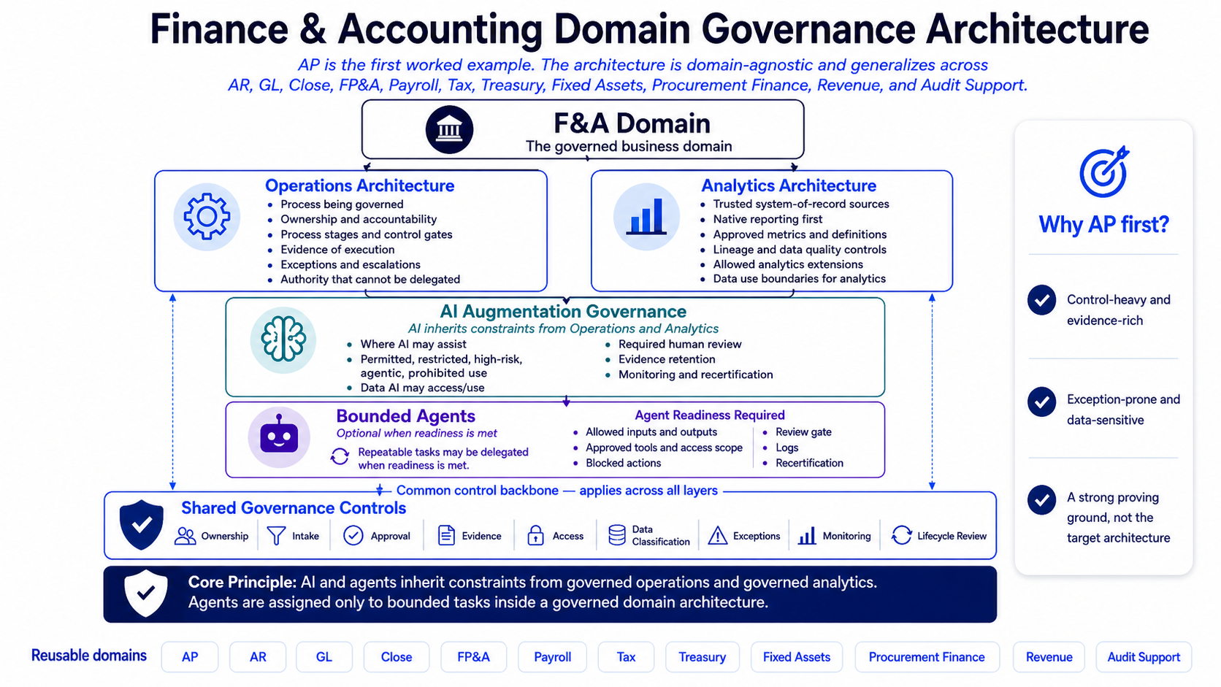
REFERENCE ARCHITECTURE
The Architecture Separates Domain Governance From AI Execution
Finance & Accounting Domain Governance Architecture
V2 | 5

Slide 6
OPERATING MODEL
Each Layer Has a Distinct Governance Job
Layer
Governance job
Primary question
F&A Domain
Defines the business context
What domain are we governing?
Operations Architecture
Defines accountable work
How is the work performed and controlled?
Analytics Architecture
Defines trusted information
What data and metrics can be trusted?
AI Augmentation Governance
Defines safe AI use
Where may AI assist under control?
Bounded Agents
Defines delegated task execution
What tasks may be assigned after readiness is proven?
Readiness logic
Operations and analytics must be sufficiently governed before AI augmentation and bounded agents can be responsibly evaluated.
Finance & Accounting Domain Governance Architecture
V2 | 6

Slide 7
OPERATIONS ARCHITECTURE
Safe AI Depends on Accountable Process Design
Process model
Ownership and decision rights
Scope, trigger, endpoint, stages, handoffs, and operating cadence.
Accountable owner, process roles, approvers, reviewers, and non-delegable authority.
Control gates and evidence
Exceptions and escalation
Control points, pass criteria, required proof, retention location, and review cadence.
Exception criteria, issue routing, risk acceptance, due dates, and escalation authority.
AP worked example
Invoice intake, validation, approval workflow, payment preparation, payment execution, and post-payment review define the AP operating backbone.
Finance & Accounting Domain Governance Architecture
V2 | 7

Slide 8
ANALYTICS ARCHITECTURE
AI Can Only Interpret Analytics That Are Trusted and Governed
Trusted sources
Native reporting first
Authoritative systems, approved datasets, source ownership, and system-of-record expectations.
Standard reports, inquiries, workflow evidence, audit logs, and seeded analytics assessed before extension.
Approved metrics and lineage
Quality, access, and data use
Definitions, formulas, grain, thresholds, source-to-output lineage, and transformation logic.
Quality checks, remediation, least privilege, extract controls, retention, and data-use boundaries.
AP worked example
Oracle-native AP reports, approval evidence, duplicate-risk metrics, payment timing, and AP KPI lineage define what AI may later explain or summarize.
Finance & Accounting Domain Governance Architecture
V2 | 8

Slide 9
AI AUGMENTATION GOVERNANCE
AI Use Should Be Classified Before It Is Enabled
Permitted
Restricted / high-risk
Prohibited
Low-risk productivity support with approved tools, no sensitive data, and human review.
Sensitive data, recurring outputs, management reporting, controls, audit evidence, or finance decisions require intake, approval, evidence, monitoring, and recertification.
Control bypass, autonomous approval/payment, unapproved disclosure, credential sharing, and unsupported accounting or tax conclusions.
Governance principle
AI should not compensate for weak process or weak analytics.
Finance & Accounting Domain Governance Architecture
V2 | 9

Slide 10
BOUNDED AGENTS
Agents Should Be Approved Only After Readiness Is Proven
Allowed agent work
Blocked agent work
Draft
Summarize
Classify
Triage
Monitor
Prepare evidence packets
Generate commentary
Route issues for human review
Approve
Post
Pay
Certify
File
Override
Externalize sensitive data
Delete records
Change supplier or bank records
Close controls without human approval
Readiness gate
Agents are not a destination. A domain may stop at policy, intake, and controlled AI use until readiness is proven.
Finance & Accounting Domain Governance Architecture
V2 | 10

Slide 11
SHARED GOVERNANCE CONTROLS
Shared Controls Create the Reusable Backbone
Ownership
Intake
Approval
Evidence
Access
Data Classification
Exceptions
Monitoring
Lifecycle Review
Who is accountable?
What is being requested?
Who authorizes use?
What proof is retained?
Who can see or use it?
What handling rules apply?
Who accepts risk?
How are issues detected?
When is it refreshed?
Shared Governance Controls
Common control backbone - applies across all layers
Finance & Accounting Domain Governance Architecture
V2 | 11

Slide 12
AP WORKED EXAMPLE
AP Is the Proving Ground, Not the Target Architecture
Control-heavy and evidence-rich
Exception-prone and data-sensitive
Transferable but not AP-specific
AP has clear stages, approvals, and audit-relevant evidence.
AP includes supplier data, payment data, tax data, holds, duplicate risk, and remediation workflows.
If the architecture works for AP, it can be adapted to domains with different process, analytics, and AI risk profiles.
AP validates the pattern because it exposes the governance questions clearly. It does not limit the architecture.
Finance & Accounting Domain Governance Architecture
V2 | 12

Slide 13
REUSABLE DOMAIN PATTERN
The Same Pattern Can Be Applied Domain by Domain
1
Define the domain
AP
AR
GL
Close
FP&A
2
Map operations
Payroll
Tax
Treasury
Fixed Assets
3
Govern analytics
Procurement Finance
Revenue
Audit Support
4
Classify AI use
5
Apply shared controls
6
Gate agent readiness
7
Retain evidence and monitor lifecycle
Reuse principle
The artifacts change by domain. The sequence, shared controls, readiness logic, and AI inheritance principle remain stable.
Finance & Accounting Domain Governance Architecture
V2 | 13

Slide 14
DECISION REQUEST
Adopt the Reference Architecture and Apply It First to AP
Decision requested
Adopt the Finance & Accounting Domain Governance Architecture as the reference model for domain governance, analytics governance, AI augmentation, and bounded agents.
Proposed first application
Use AP Invoice-to-Pay as the first worked example.
Next 30 days
Next 60-90 days
Finalize AP worked example
Confirm domain owner and control owners
Validate shared governance controls
Define AI intake and classification criteria
Identify controlled copy and evidence locations
Pilot the model
Collect feedback
Refine templates
Select next F&A domain
Prepare rollout guidance
Finance & Accounting Domain Governance Architecture
V2 | 14

