Slide 1
REFERENCE ARCHITECTURE
Finance & Accounting
Domain Governance Architecture
A reusable governance model for operations, analytics, AI augmentation, and bounded agents
Version 1.0 Draft | Finance & Accounting Team

Slide 2
THE CORE PRINCIPLE
AI and agents inherit constraints from governed operations and governed analytics.
Agents are assigned only to bounded tasks inside a governed domain architecture. They do not create their own process authority, data authority, or control evidence.
Strengthen process and analytics architecture first — AI is not a substitute for undefined operations, weak lineage, or unresolved data ownership.

Slide 3
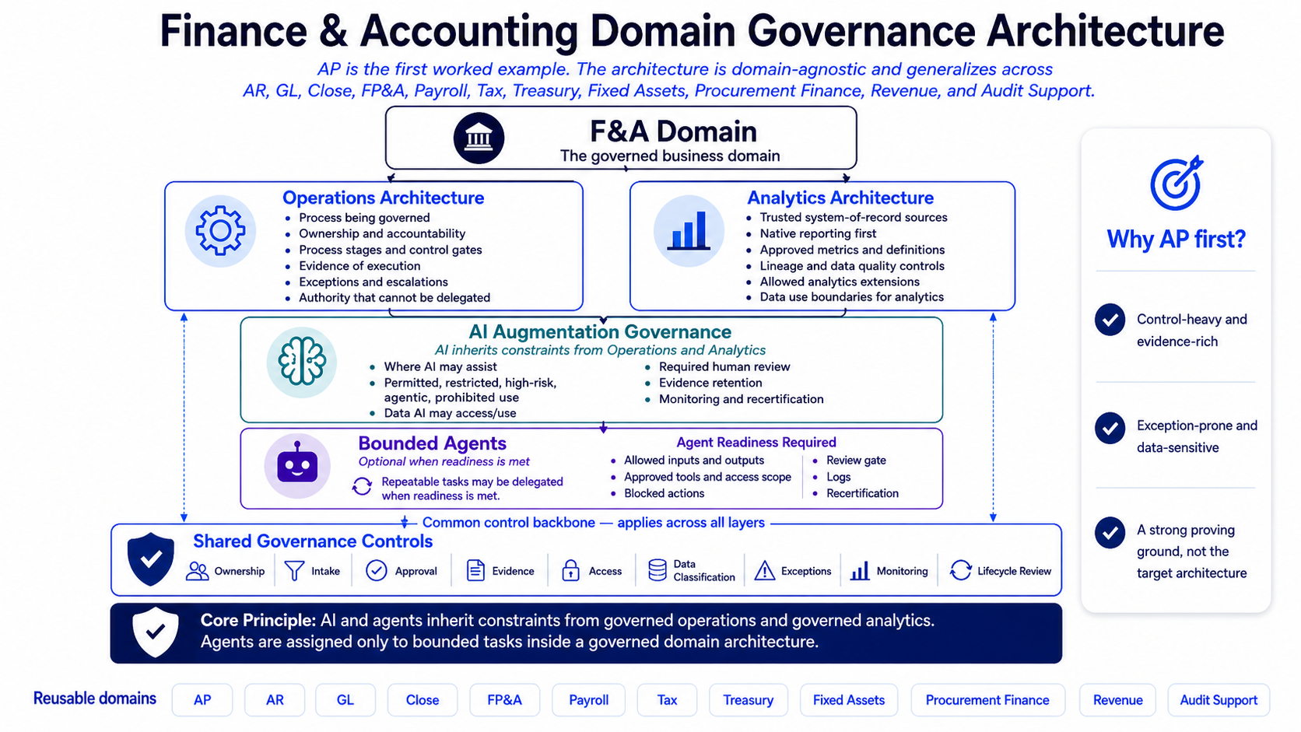
THE ARCHITECTURE AT A GLANCE
Five layers, one common control backbone

Slide 4
LAYER 1
THE FINANCE & ACCOUNTING DOMAIN
PURPOSE
DECISIONS
Business purpose and process scope
Key decisions, controls, reports, metrics, compliance
OWNERSHIP
SENSITIVITY
Accountable owner and governance sponsor
Sensitive data and restricted activities
Each domain
must define
DATA SOURCES
EVIDENCE
Systems of record and authoritative data
Documentation, evidence, and review expectations

Slide 5
OPERATIONS ARCHITECTURE
LAYER 2
WHAT IT ANSWERS
REQUIRED COMPONENTS
What process is being governed?
Who owns the process?
What are the stages, handoffs, and control gates?
What evidence proves execution?
What exceptions and escalations exist?
What authority cannot be delegated?
Process scope and out-of-scope boundaries
Process stages and trigger-to-endpoint flow
Roles, RACI, and decision rights
Control points, owners, performers, and reviewers
Exception handling, issue routing, and escalation
Evidence artifacts, retention, and review cadence
Operating metrics and governance review rhythm

Slide 6
ANALYTICS ARCHITECTURE
LAYER 3
WHAT IT ANSWERS
REQUIRED COMPONENTS
What native reporting exists first?
Which sources are authoritative?
What metrics, definitions, grain, and thresholds are approved?
What lineage and data quality controls are required?
What analytics extensions are allowed?
What data use boundaries apply?
System-of-record and native-reporting assessment
Approved metrics and business definitions
Source-to-output lineage and transformation logic
Data quality rules, thresholds, and remediation
Access, extract, sharing, and retention controls
Analytics extension intake and approval path
Change control for reports, metrics, models, dashboards

Slide 7
AI AUGMENTATION GOVERNANCE
LAYER 4
WHAT IT ANSWERS
REQUIRED COMPONENTS
Where may AI assist?
What use is permitted, restricted, high-risk, agentic, or prohibited?
What data may AI access or use?
What human review is required?
What evidence must be retained?
What monitoring and recertification are required?
AI safe-use categories
AI use-case intake and risk tiering
Data handling and disclosure rules
Human review and accountability requirements
AI risk and control mapping
Exception and incident handling
Monitoring, recertification, and change triggers

Slide 8
BOUNDED AGENTS
LAYER 5 | OPTIONAL WHEN READINESS IS MET
READINESS REQUIRES
WHAT AGENTS MAY NOT DO
Repeatable tasks defined for delegation
Allowed inputs and outputs
Approved tools and access scope
Blocked actions
Required human review gate
Logs and evidence
Recertification triggers
Approve, post, pay, or certify
File or externalize records
Override or delete controlled records
Change controlled records without explicit authorization
Act outside the bounded task definition
Substitute for required human review

Slide 9
THE COMMON CONTROL BACKBONE
SHARED GOVERNANCE CONTROLS
Ownership
Intake
Approval
Names accountable owners, stewards, reviewers, approvers
Captures business purpose, scope, risk, data, routing
Records authorized decisions, conditions, exception authority
Evidence
Access
Data Classification
Defines what proof must be retained and where
Enforces least privilege, segregation of duties, review
Defines sensitivity, handling, sharing, masking, retention
Exceptions
Monitoring
Lifecycle Review
Records rationale, risk acceptance, compensating controls
Tracks operation, adoption, control performance, incidents
Revises, recertifies, retires, refreshes when risks change

Slide 10
DOMAIN APPLICATION SEQUENCE
How to apply the architecture, in order
01
02
03
04
Define the domain and business objective
Establish or confirm Operations Architecture
Establish or confirm Analytics Architecture
Identify AI augmentation opportunities within boundaries
05
06
07
08
Classify AI use by risk tier and data sensitivity
Map AI risks to controls, evidence, ownership, monitoring
Approve bounded agents only when readiness is met
Control documentation lifecycle and recertification
Each step has readiness gates that must be met before advancing.

Slide 11
READINESS GATES
Four gates separate the phases
Each gate must be cleared before advancing to the next phase of the architecture.
01
02
03
04
Operations Readiness
Analytics Readiness
AI Augmentation Readiness
Agent Readiness
Required before advancing to analytics or AI augmentation.
Required before custom or AI-assisted analytics, or AI agents using domain data.
Required before AI use beyond low-risk productivity support.
Required before any bounded agent is approved.

Slide 12
READINESS GATE 01
OPERATIONS READINESS
DO NOT ADVANCE TO ANALYTICS OR AI AUGMENTATION UNTIL...
ALL OF THE FOLLOWING ARE TRUE
Process stages and ownership are defined
Control gates and decision rights are explicit
Evidence requirements are known
Exceptions and escalation paths exist
Authority that cannot be delegated is documented

Slide 13
READINESS GATE 02
ANALYTICS READINESS
DO NOT APPROVE CUSTOM, AI-ASSISTED, OR AGENT ANALYTICS UNTIL...
ALL OF THE FOLLOWING ARE TRUE
Native reporting has been assessed first
Source systems and authoritative data are identified
Metrics, grain, filters, and definitions are approved
Lineage and data quality controls are defined
Access, extract, sharing, and retention controls are in place

Slide 14
READINESS GATE 03
AI AUGMENTATION READINESS
DO NOT APPROVE AI USE BEYOND LOW-RISK PRODUCTIVITY UNTIL...
ALL OF THE FOLLOWING ARE TRUE
Safe-use category is assigned
Data access and use are approved
Human review is defined
Control impact is assessed
Evidence retention is defined
Monitoring and recertification expectations are set

Slide 15
READINESS GATE 04
AGENT READINESS
DO NOT APPROVE A BOUNDED AGENT UNTIL...
ALL OF THE FOLLOWING ARE TRUE
Agent purpose and scope are bounded
Inputs, outputs, tools, permissions, and blocked actions are defined
Human approval gates exist before material finance, accounting, compliance, external, or system-changing actions
Testing covers expected use, edge cases, misuse, permission limits, and recovery
Logs, monitoring, incident handling, and recertification are defined

Slide 16
FIRST WORKED EXAMPLE
Why AP is the proving ground
01
02
03
04
Control-heavy and evidence-rich
Exception-prone and data-sensitive
Clear operating gates from intake to post-payment review
Strong native reporting, lineage, and metric dependencies
AP EXPOSES AI RISK CLEARLY
Supplier, bank, and tax data sensitivity
Payment decisions and duplicate-pay risk
Approval evidence and segregation of duties
Agentic action boundaries on payment execution
Native Oracle reporting, metric definitions, and governed extensions

Slide 17
REUSABLE DOMAIN CHECKLIST
Apply to any new Finance & Accounting domain
Domain scope and objective are defined
Accountable owner, sponsor, reviewers, approvers are named
Operations Architecture is documented
Analytics Architecture is documented
Shared Governance Controls are applied
Sensitive and restricted data categories are classified
Native system and reporting capability is assessed first
Approved metrics, definitions, lineage, and quality rules are documented
AI safe-use categories and intake routing are defined
AI risk and control mapping is completed
Agent readiness is completed before any pilot
Monitoring, exceptions, incidents, and lifecycle review are defined

Slide 18
NEXT STEPS
Prove the architecture with AP.
Then extend to other domains.
DOCUMENT CONTROL
Document title Finance & Accounting Domain Governance Architecture
Version 1.0 Draft
Status Draft reference architecture
Owner Finance Governance owner — TBA
Approval authority Finance Data Governance Council
Effective date Assigned at approval
Review cadence Annual or upon material change
Worked example AP Finance AI Governance Bundle

