Slide 1
Sales Analysis
- Karthik

Slide 2
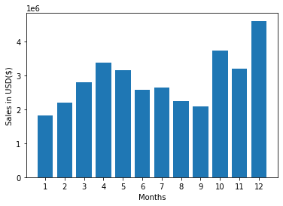
Best Month of Sales

Slide 3
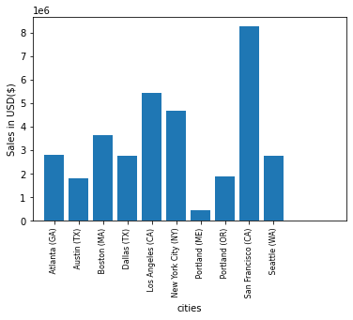
Most Sold City

Slide 4
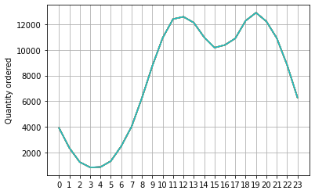
Peak Times

Slide 5
The products which are most sold together
2 items
i. iPhone, Lightning Charging Cable - 1005 times
ii. Google Phone, USB-C Charging Cable - 987 times
iii. iPhone, Wired Headphones - 447 times
3 items
i. Google Phone, USB-C Charging Cable, Wired Headphones - 87 times
ii. iPhone, Lightning Charging Cable, Wired Headphones - 62 times
iii. iPhone, Lightning Charging Cable, Apple Airpods Headphones - 47 times
4 items
i. iPhone,Lightning Charging Cable,Apple Airpods Headphones,Wired Headphones - 4 times
ii. Google Phone, USB-C Charging Cable, Bose SoundSport Headphones, Wired Headphones - 3 times
iii. Vareebadd Phone, USB-C Charging Cable, Bose SoundSport Headphones, Wired Headphones - 2times

Slide 6
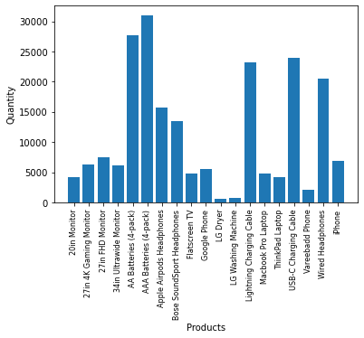
Most sold product

Slide 7
Thank You!

