Slide 1

Pentagonal Crystal System
Plausible effects of the existence of 5 fold rotational symmetry
Vivian Qiang, Billy Koech

Slide 2
Presentation Structure
Background
Point Groups of Pentagonal Crystal System
Transformation Matrices
1st rank tensor properties
2nd rank tensor properties
Applications
Notes:
b

Slide 3
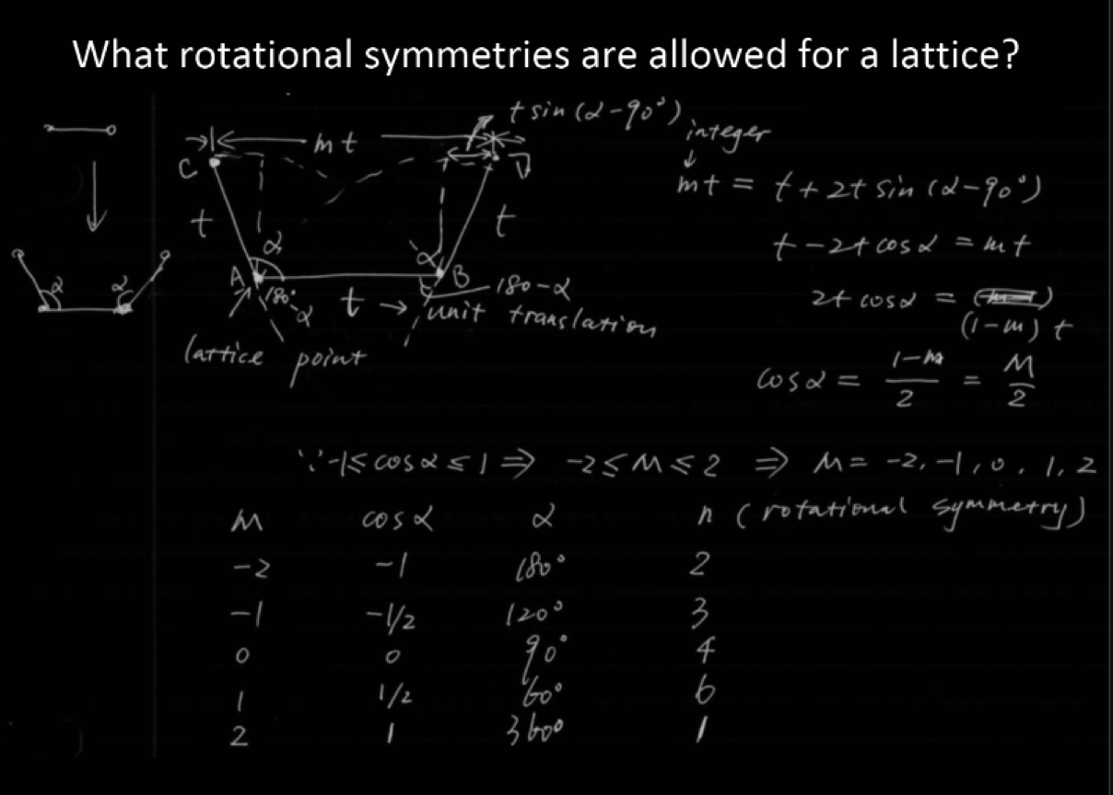
Background
Why this doesn’t work right now
Notes:
b

Slide 4
Novel Crystal System: Pentagonal
Point groups of the pentagonal crystal system:
5, 5/m, 522, 5mm
Point groups of tetragonal and hexagonal crystal systems:
4, -4, 4/m, 422, 4mm, -42m, 4/mmm
6, -6, 6/m, 622, 6mm, -6m2, 6/mmm
* Derived from observations of the pattern of point groups in the hexagonal and tetragonal crystal systems
Notes:
B introduce, v derive

Slide 5
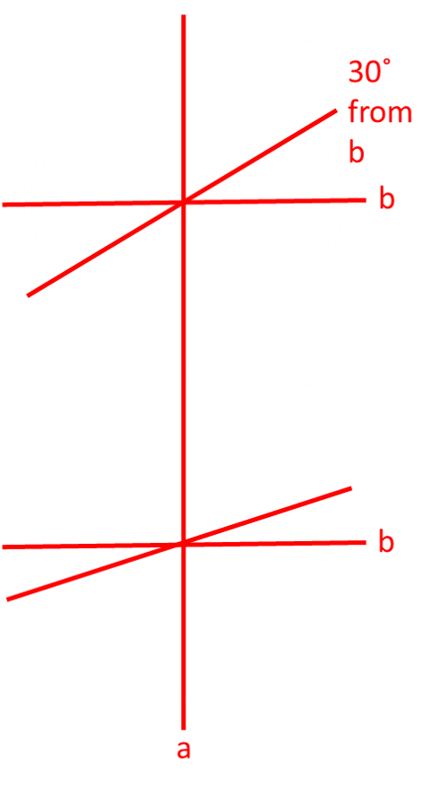
Crystal system assumptions
For tetragonal and hexagonal crystal systems:
1st notation along c axis
2nd notation along/perp a or b axis
3rd notation along/perp x degrees from a or b axis
For pentagonal crystal system:
1st notation along c axis
2nd notation along/perp a axis*
3rd notation along/perp 28 degrees from b axis
* a axis aligned with stereogram rotation edge, b is perp
28 from b
Notes:
V explain

Slide 6

Stereograms
5 5/m 522 5mm
Notes:
Billy: resemble hexagonal group

Slide 7
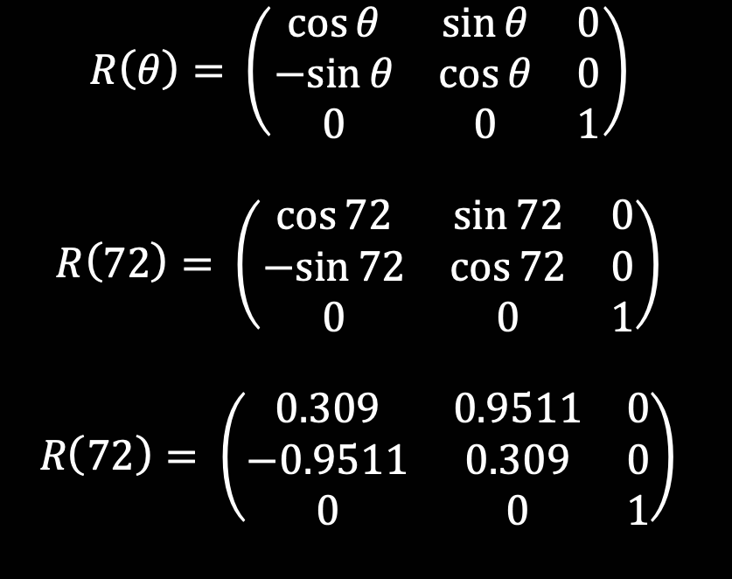
5 fold rotational symmetry matrix
Notes:
Billy. Rotational matrix from general rule

Slide 8
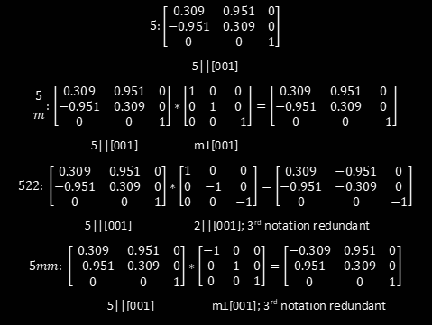
Final matrices
Notes:
Vivian

Slide 9
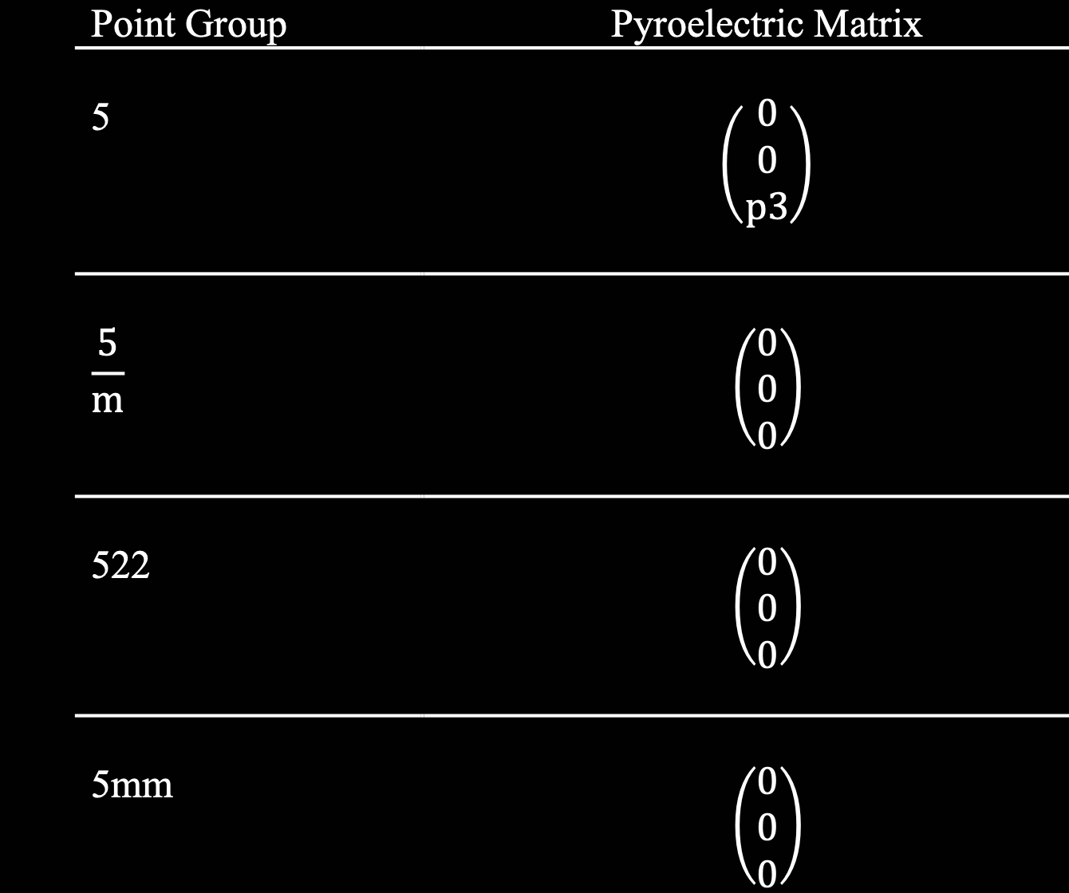
1st rank tensor property: Pyroelectricity
Derived by
Neumann’s
Principle
p’ = a.p
Notes:
b

Slide 10
1st rank tensor property: Pyroelectricity
Derived by
Neumann’s
Principle
p’ = a.p
Does not allow ferroelectricity
Does not allow ferroelectricity
Does not allow ferroelectricity
Notes:
Billy

Slide 11

1st rank tensor property: Pyromagnetism
Derived by
Neumann’s
Principle
Q’= +-|a|a.Q
Notes:
Billy

Slide 12
1st rank tensor property: Pyromagnetism
Derived by
Neumann’s
Principle
Q’= +-|a|a.Q
Does not allow pyromagnetism
Does not allow pyromagnetism
Notes:
Billy

Slide 13
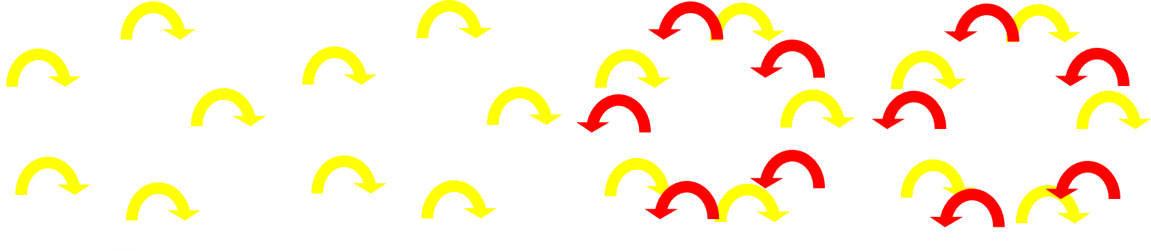
1st rank tensor property: Pyromagnetism
5 5/m 522 5mm
Ferromagnetic ferromagnetic non-ferromagnetic non-ferromagnetic
Notes:
Vivian

Slide 14
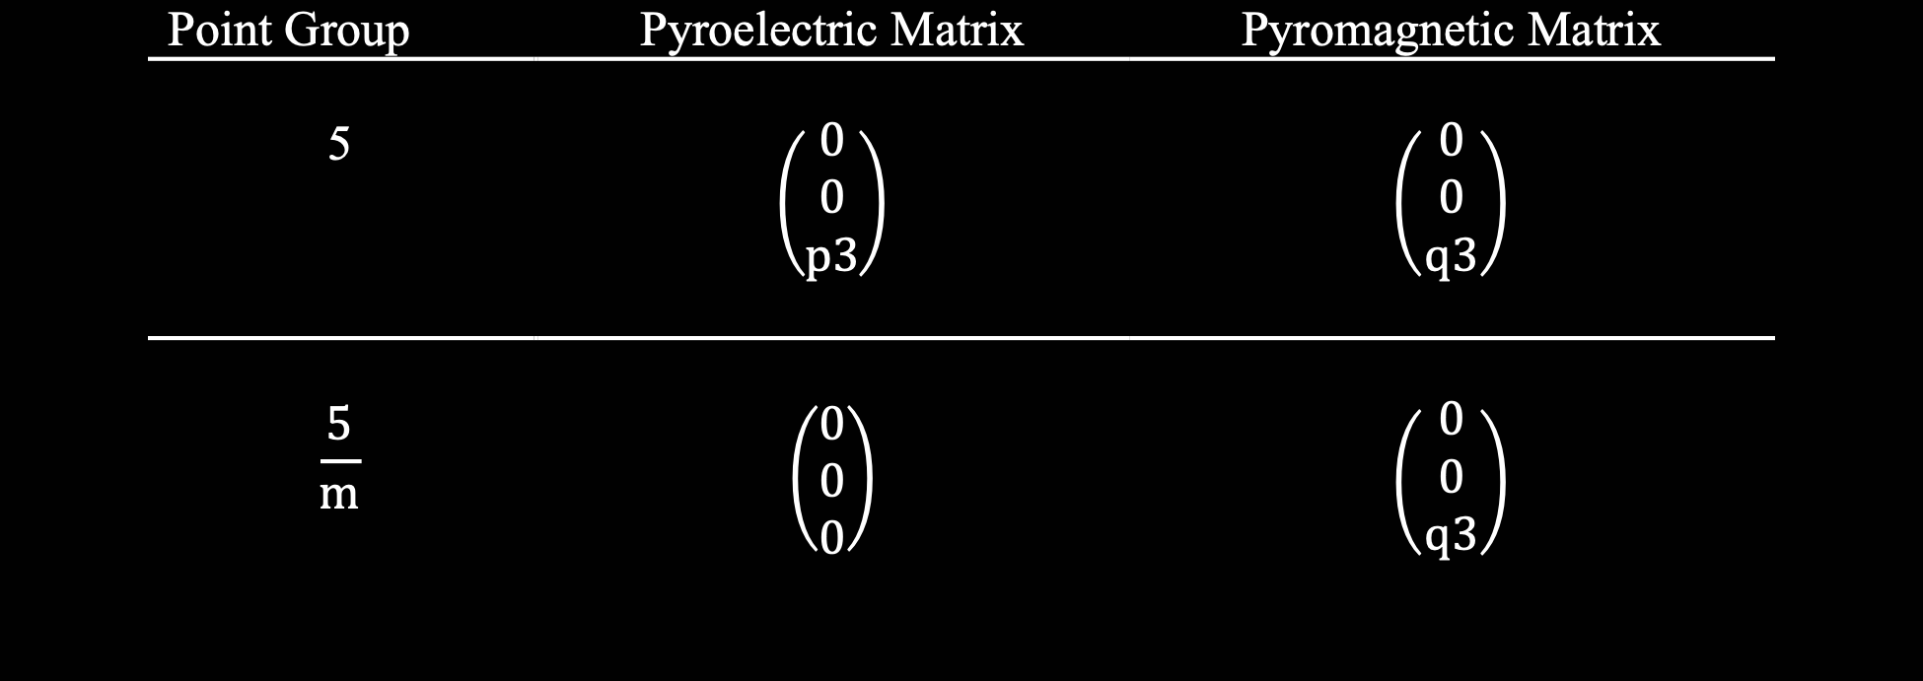
1st rank tensor properties: Observations
Same
crystallographic
direction
Notes:
Billy

Slide 15
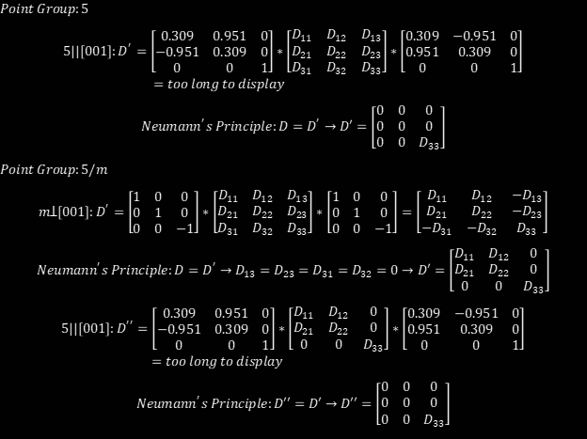
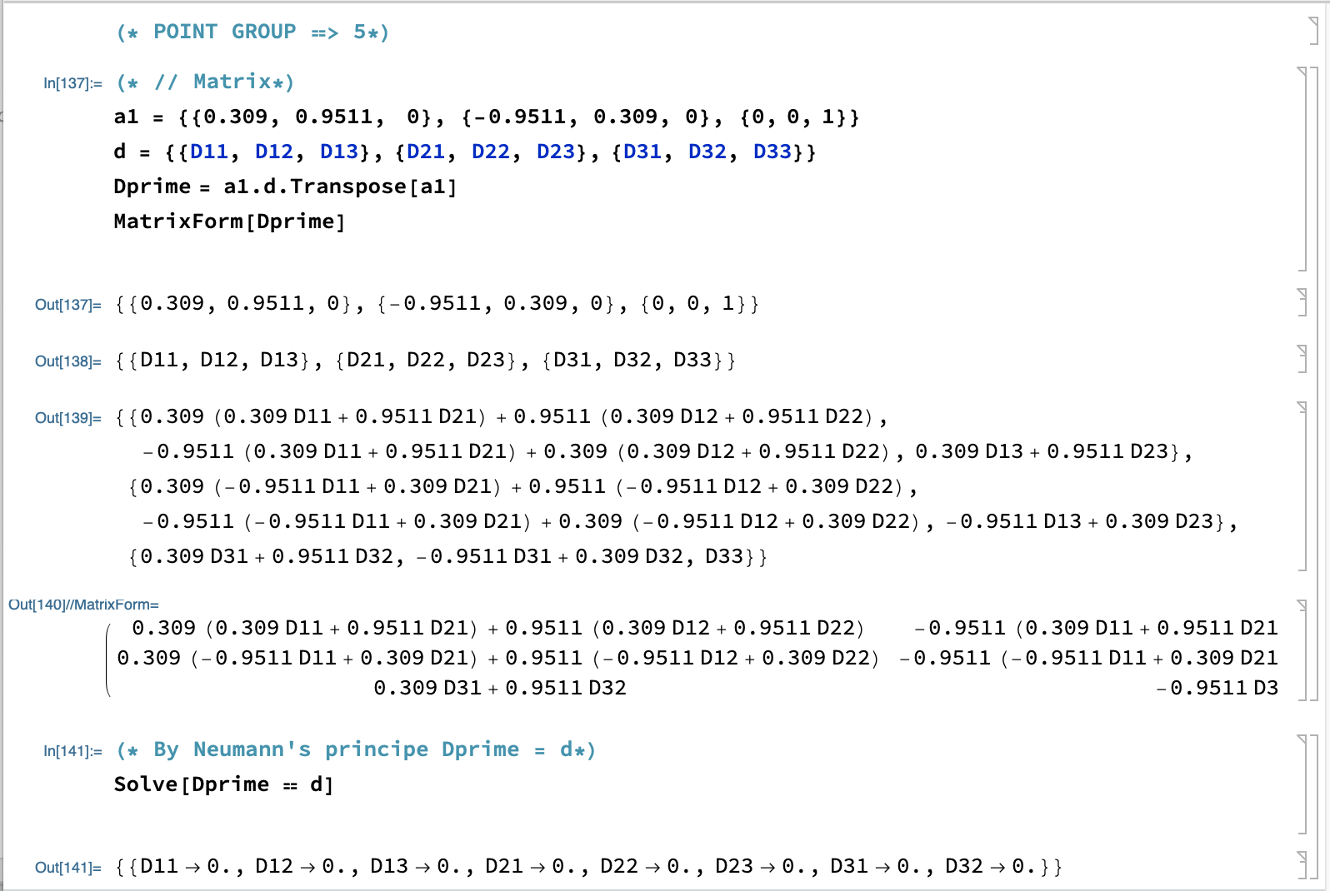
2nd rank tensor property: thermal expansion
Notes:
Vivian

Slide 16
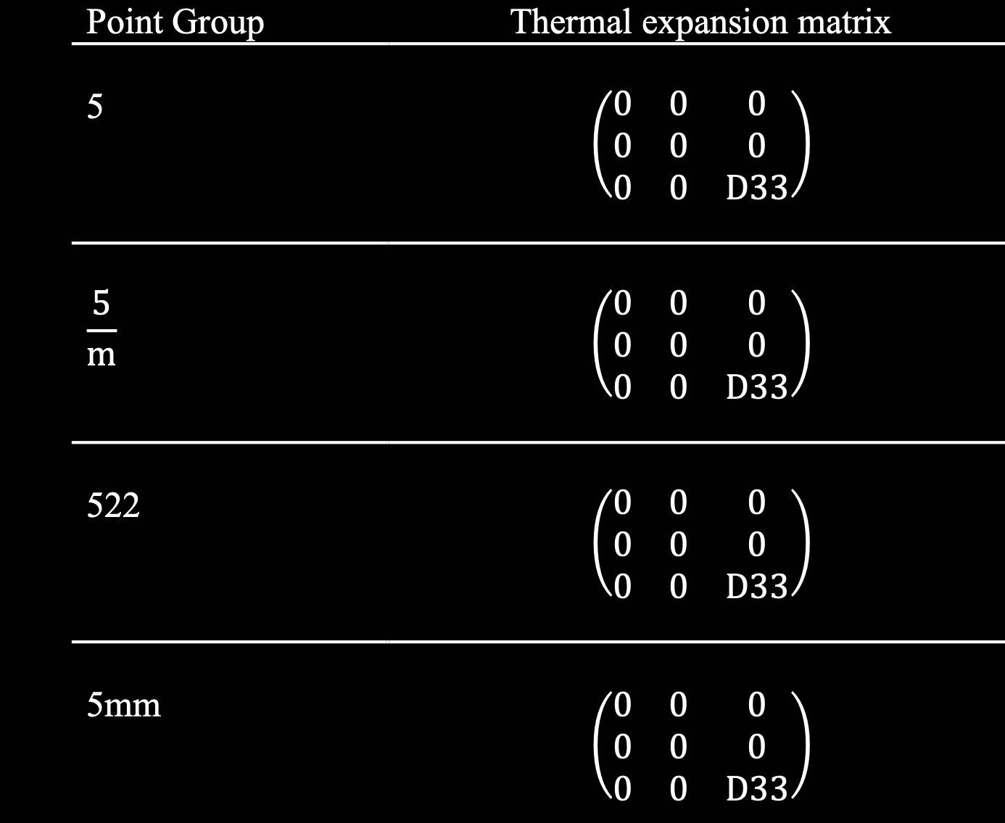
2nd rank tensor property: thermal expansion
Notes:
Vivian

Slide 17
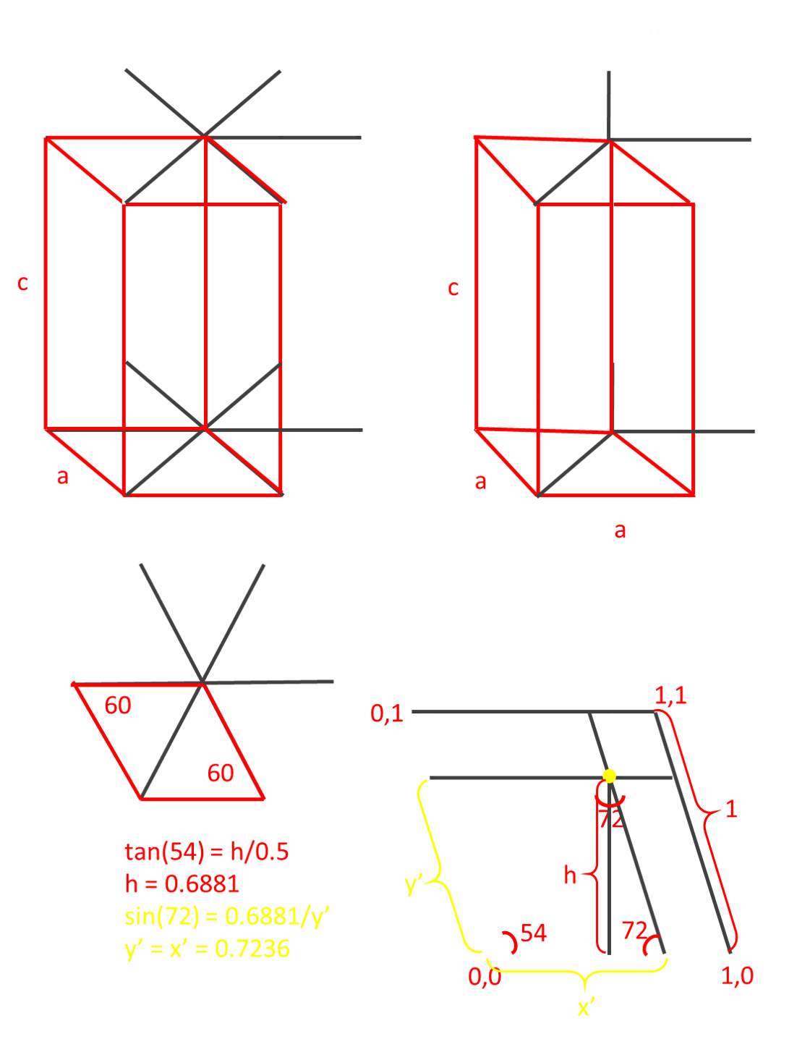
Pentagonal bravais lattice
Only Bravais lattice is ”primitive” pentagonal
Based on hexagonal, the only crystal system above 4 fold - has only primitive
Not a parallelogram base. New, different lattice
2 nonequivalent points: (0,0,0) (0.7236,0.7236,0)
Notes:
Vivian

Slide 18
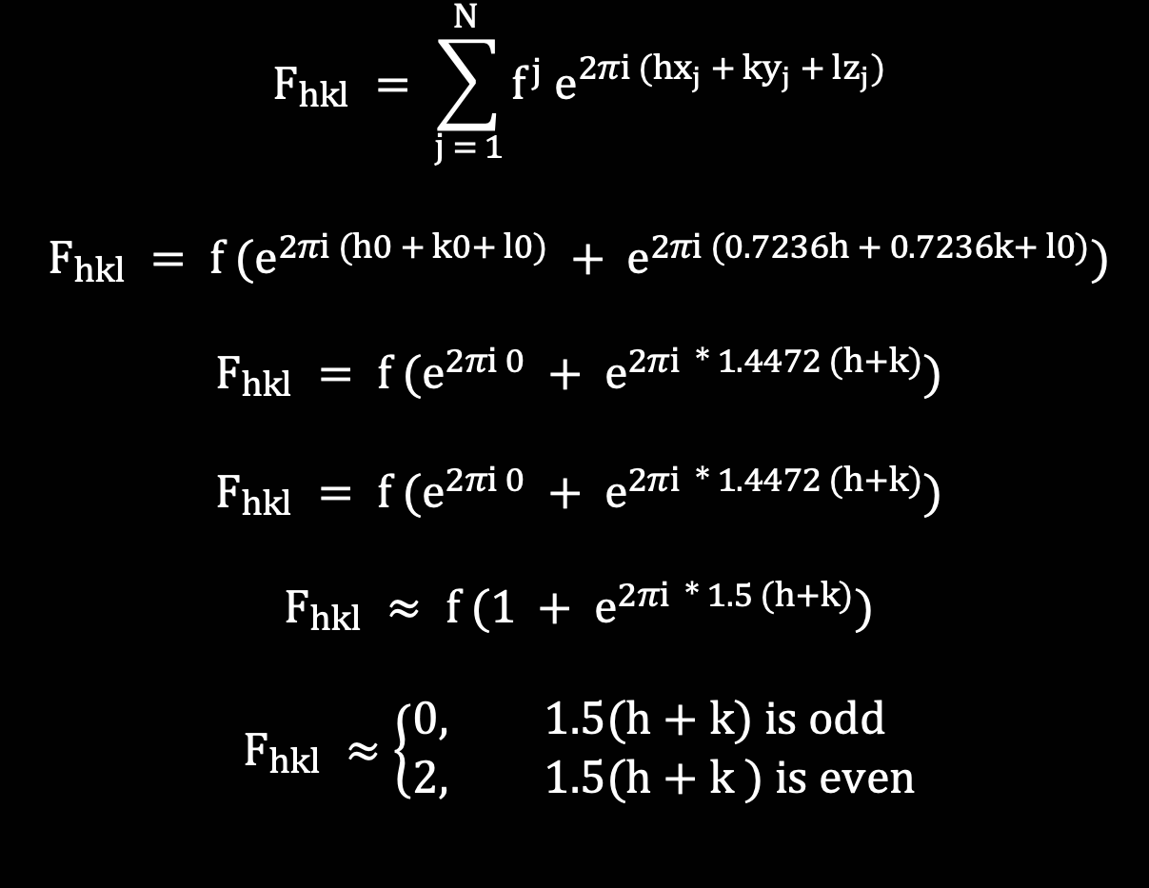
Structure factor
Notes:
Billy

Slide 19
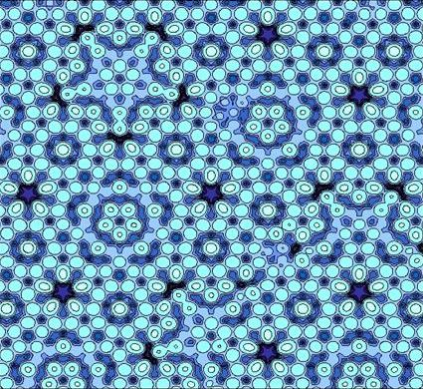
Application: Quasicrystals
Are ordered but are not periodic. Our crystal is both.
Quasicrystal properties:
High thermal, electrical resistance
Hardness and brittleness
Resistance to corrosion (low coefficient of friction)
Non-stick properties
Periodicity could solve the main challenge of Quasicrystals: brittleness
Notes:
Vivian - periodicity
Billy - properties

Slide 20
Quasicrystal areas of application
Frying pan coating to make non-stick pans
Reinforcement of steel(employs hardness and resistance to corrosion properties)
Embedding particles in plastic to make hard and low friction plastic gear like helmets and elbow guards
Notes:
Billy

Slide 21
Thank You! q u e s t i o n s ? : )
Notes:
Vivian

