Slide 1

Quick assignment for Comcast
WebApp on AWS

Slide 2
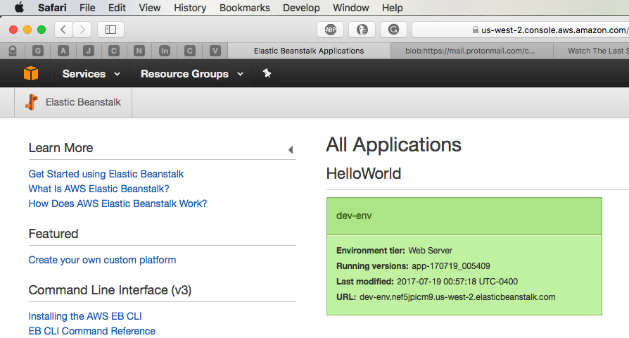
There are many ways to approach this problem, I used ElasticBeanstalk to create webapp that is secure and scalable.
I will use a combination of screenshots from AWS web GUI (picture is worth a thousand words :-)) and aws CLI since some folks are more comfortable with the command line rather than point and click. One of the first steps one needs to install awscli and eb in order to talk to aws eb…
One can accomplish that by utilizing pip (“python package management system” since I’m on MAC OS)
[mgn@home( 0:44:32)]:~$ pip install --upgrade --user awsebcli
...
[mgn@home( 0:40:23)]:~$ eb --version
EB CLI 3.10.4 (Python 2.7.1)
…
After that, we start…
I have followed a basic procedure to create an instance of dev-env
…
[mgn@home]:~$ mkdir HelloWorld
[mgn@home]:~$ cd HelloWorld
[mgn@home( 0:44:14)]:~/HelloWorld$ eb init -p PHP
[mgn@home( 0:45:22)]:~/HelloWorld$ echo "Hello World" > index.html

Slide 3
The command line will look like this…
[mgn@home( 0:54:06)]:~/HelloWorld$ eb create dev-env
Creating application version archive "app-170719_005409".
Uploading HelloWorld/app-170719_005409.zip to S3. This may take a while.
Upload Complete.
Environment details for: dev-env
Application name: HelloWorld
Region: us-west-2
Deployed Version: app-170719_005409
Environment ID: e-4a62fez5kr
Platform: arn:aws:elasticbeanstalk:us-west-2::platform/PHP 5.4 running on 64bit Amazon Linux/2.4.1
Tier: WebServer-Standard
CNAME: UNKNOWN
Updated: 2017-07-19 04:54:13.276000+00:00
Printing Status:
INFO: createEnvironment is starting.
INFO: Using elasticbeanstalk-us-west-2-396604198235 as Amazon S3 storage bucket for environment data.
INFO: Created security group named: sg-552b812f
INFO: Created load balancer named: awseb-e-4-AWSEBLoa-196M6W4C0LCTS
INFO: Environment health has transitioned to Pending. Initialization in progress (running for 12 seconds). There are no instances.
INFO: Created security group named: awseb-e-4a62fez5kr-stack-AWSEBSecurityGroup-XC6GV2S4D44I
INFO: Created Auto Scaling launch configuration named: awseb-e-4a62fez5kr-stack-AWSEBAutoScalingLaunchConfiguration-17WU03UC57FWD
INFO: Added instance [i-0ee9d5d3e3294a7fa] to your environment.
INFO: Created Auto Scaling group named: awseb-e-4a62fez5kr-stack-AWSEBAutoScalingGroup-K4B7HFJ6Q9DL
INFO: Waiting for EC2 instances to launch. This may take a few minutes.
INFO: Created Auto Scaling group policy named: arn:aws:autoscaling:us-west-2:396604198235:scalingPolicy:5e6ffa90-9eea-498e-87c5-8c6533929d3e:autoScalingGroupName/awseb-e-4a62fez5kr-stack-AWSEBAutoScalingGroup-K4B7HFJ6Q9DL:policyName/awseb-e-4a62fez5kr-stack-AWSEBAutoScalingScaleUpPolicy-NTOINW6XO1NO
INFO: Created Auto Scaling group policy named: arn:aws:autoscaling:us-west-2:396604198235:scalingPolicy:9f1ec4b9-1809-49f2-932a-449d4b157456:autoScalingGroupName/awseb-e-4a62fez5kr-stack-AWSEBAutoScalingGroup-K4B7HFJ6Q9DL:policyName/awseb-e-4a62fez5kr-stack-AWSEBAutoScalingScaleDownPolicy-1ERPCGBL3OLIR
INFO: Created CloudWatch alarm named: awseb-e-4a62fez5kr-stack-AWSEBCloudwatchAlarmHigh-1NSR0VLQEHLHV
INFO: Created CloudWatch alarm named: awseb-e-4a62fez5kr-stack-AWSEBCloudwatchAlarmLow-1VQFB92REIN7S
INFO: Environment health has transitioned from Pending to Ok. Initialization completed 10 seconds ago and took 2 minutes.
INFO: Successfully launched environment: dev-env
….
After simple Hello world in text I added recommended html code
``
<html>
<head>
<title>Hello World</title> </head>
<body>
<h1>Hello World!</h1> </body>
</html>
``
And the next side will show you the result

Slide 4
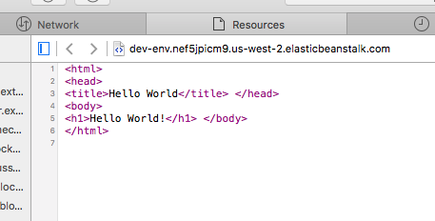

Slide 5
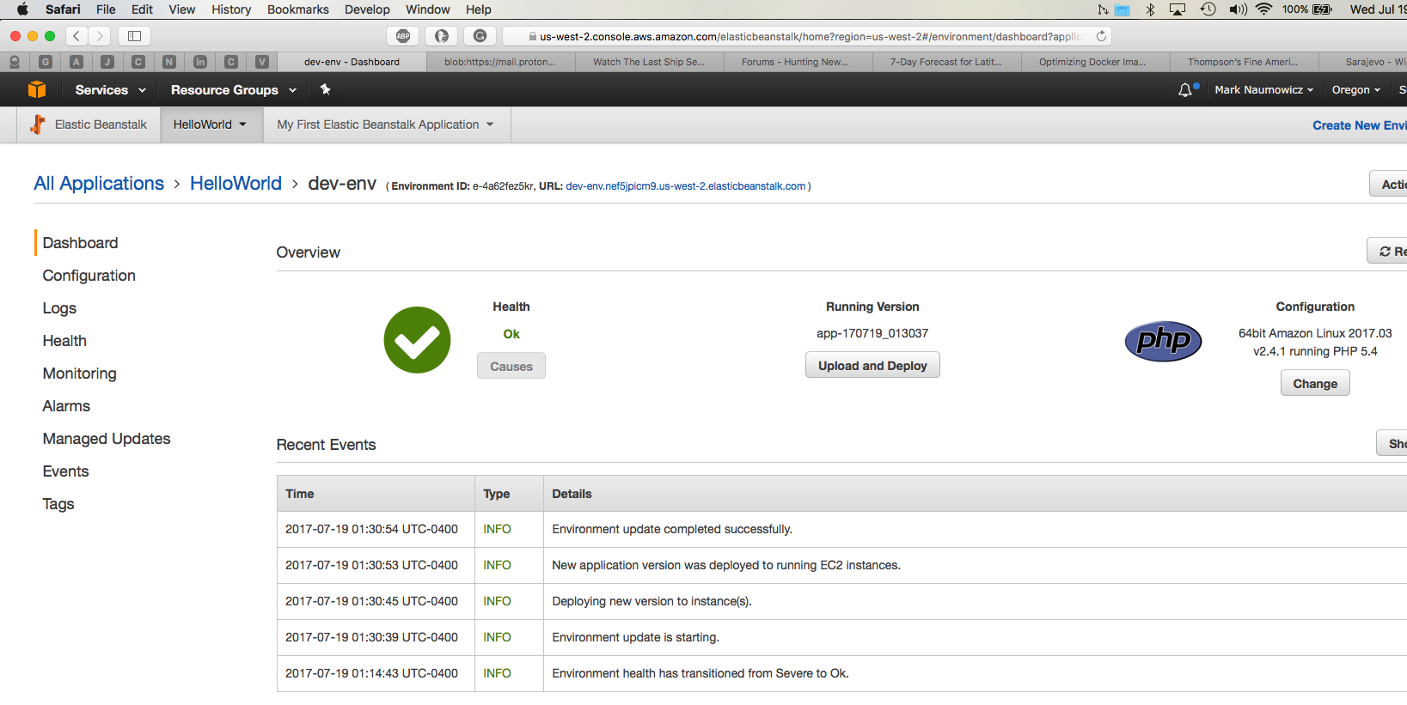
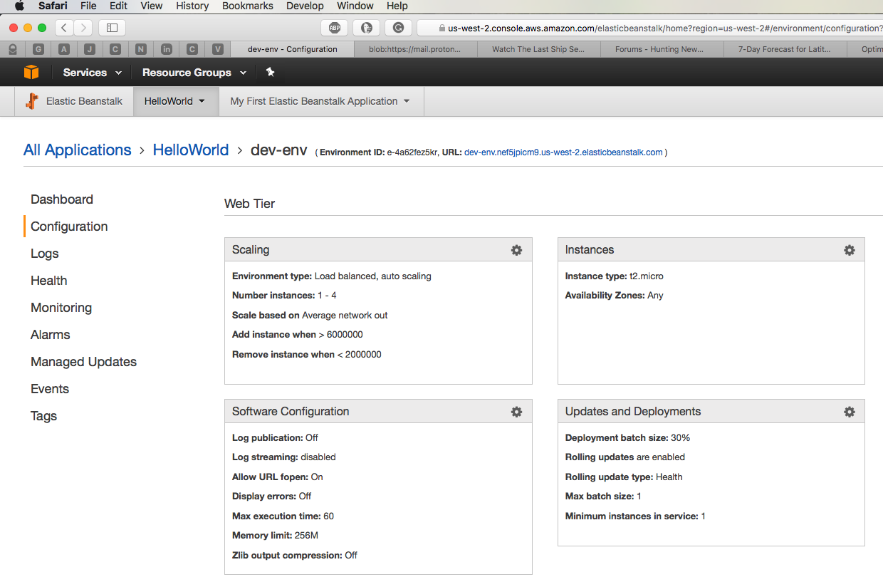
As you probably have already spotted, the instance is load balanced and set to autoscale should the load increase...

Slide 6
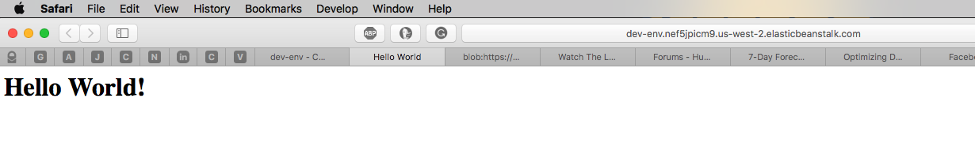
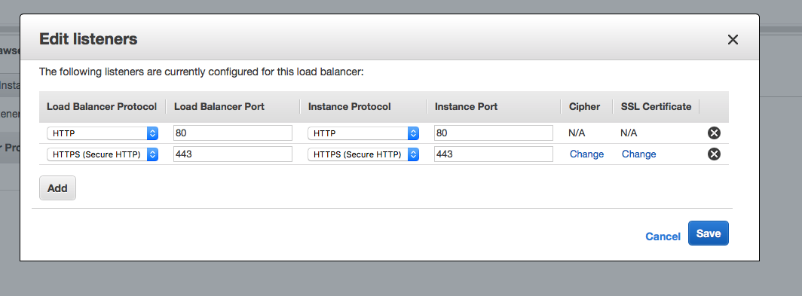
Next I need to enable port 443 on load balancer and add self signed cert I generated...

Slide 7
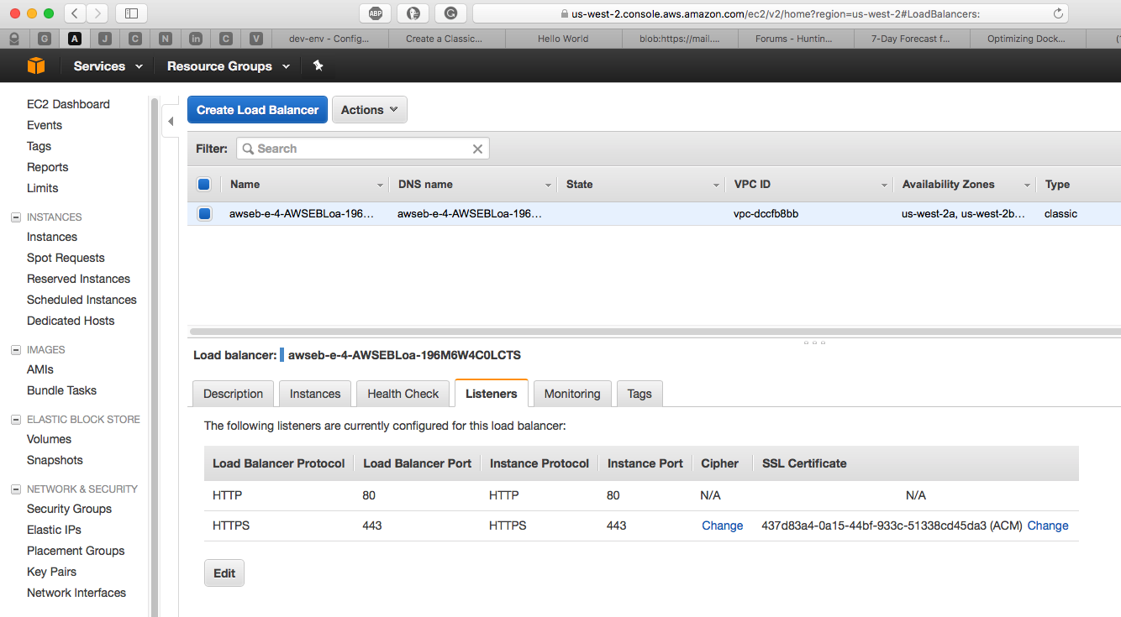
SSL cert generation involves few steps
#1 – Private key generation (e.g. openssl genrsa -des3 -out server.key 1024)
#2 – Certificate signing request generation (CSR) e.g openssl req -new -key server.key -out server.csr
#3 – The key requires a password so we will need to remove it otherwise you will have to supply it every time the web server restarts (not really practical). You can do that like this…
cp server.key server.key.org
openssl rsa -in server.key.org -out server.key
#4 – Now we can generate and self-sign the cert, just answer the questions being asked, company name, location, etc…
openssl x509 -req -days 365 -in server.csr -signkey server.key -out server.crt
… and the last step is to place it on the LB and restart the service to take effect.

Slide 8
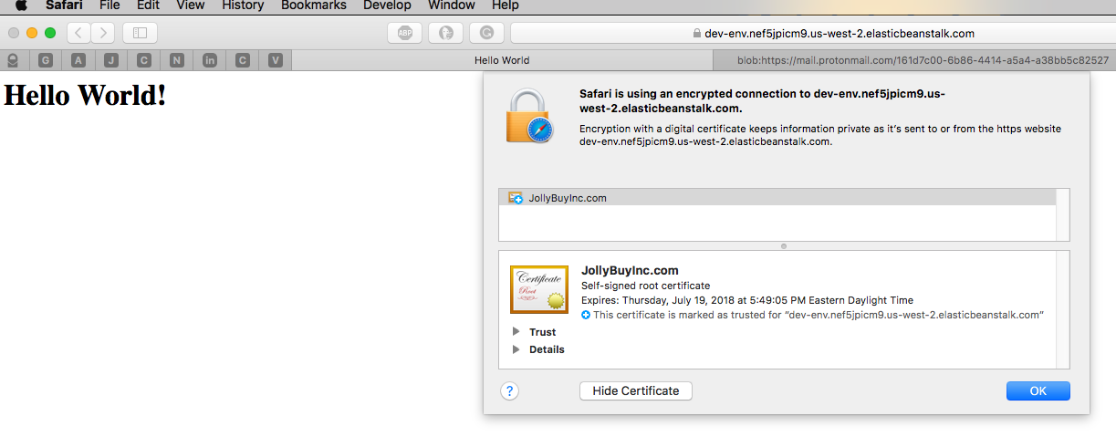
After I installed the secure certificate, we are getting the notice that the CA is not valid (that is true since I self signed it) for now I will just accept it.
But for now we have scalable and secure static page running on AWS...

Slide 9
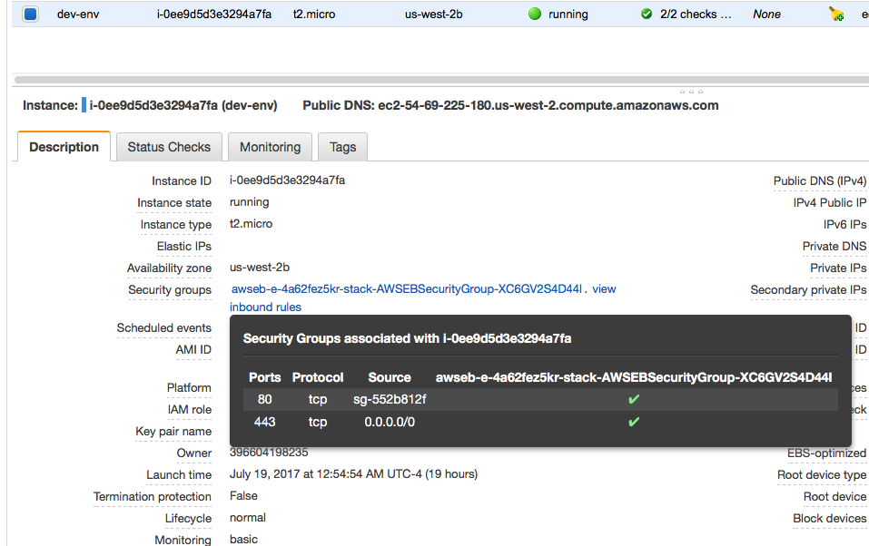
The instance is now secure and allows the traffic only on authorized ports 80 and 443 (http and https)

Slide 10
The next task was : “Develop and apply automated tests to validate the correctness of the server configuration” I’m not sure I understand this… test for what? If the configuration I provided was incorrect I would not be able to deploy the application. ElasticBeanstalk has build in checking procedures and it does check for correctness during the deployment. There is not much to check afterwards, it was already done by the system.
That’s pretty much all Folks, I will put this pitch on github and will send you a link
Thank You for the opportunity
Mark Naumowicz
mark@naumowicz.net

