Slide 1


KD-Trees
Roman Zalewski
Jonah Taylor

Slide 2
What is a KD-Tree?
K-Dimensional Tree
Based on a binary search tree
Used to multi-dimensional data
Efficiently store all dimensions at once
Used for distance
  Ray Tracing
  Collision Detection
  Machine Learning

Slide 3
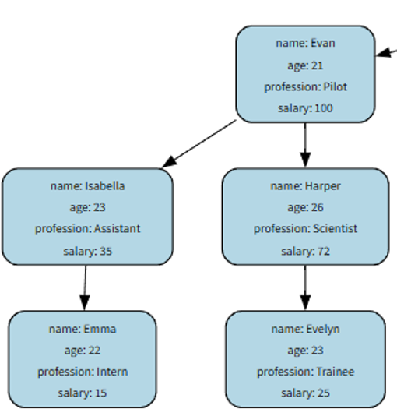
What is a KD-Tree?

Slide 4
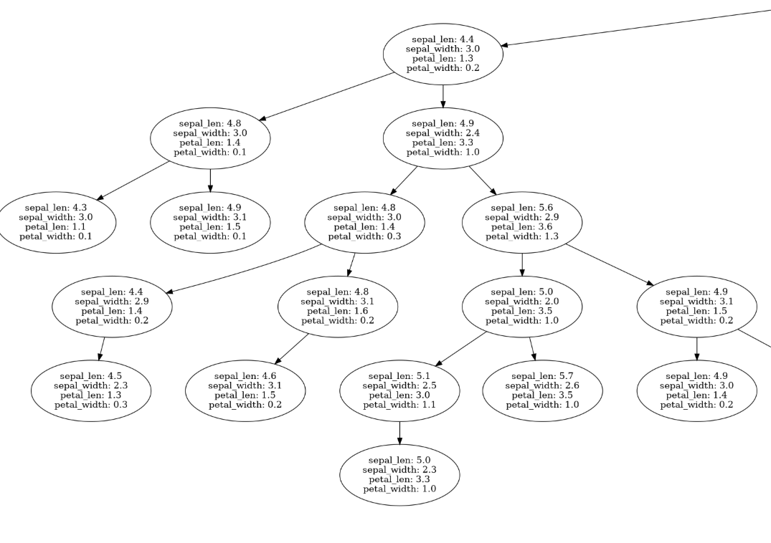
What is a KD-Tree?

Slide 5
How does it work?
Sort through a new dimension, every depth
Sort_by = dimensions % depth
Same rules as a binary search tree
2 children per parent node
More efficient if balanced

Slide 6
How can they be balanced?
AVL Balancing corrupts the properties
Must be balanced through median recursive partitioning
O(kn*logn), where k is the dimension

Slide 7
Time Complexities
Insertion – O(log n)
Balanced insertion – O(kn log n)
Search O(k log n)
Delete O(log n)+O(n) to balance

Slide 8
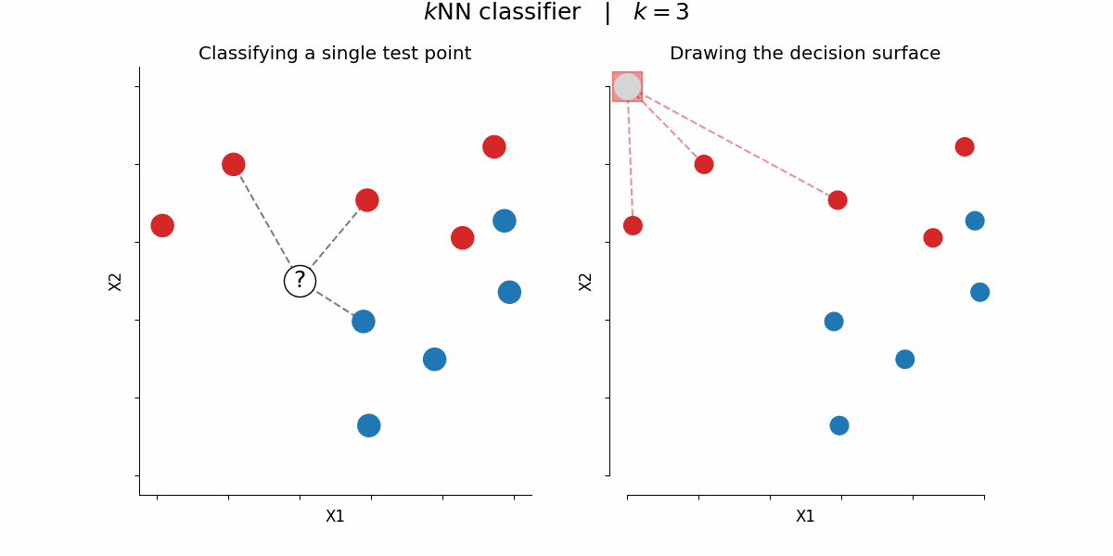
K-Nearest-Neighbor

Slide 9
Streamlit

