Slide 1
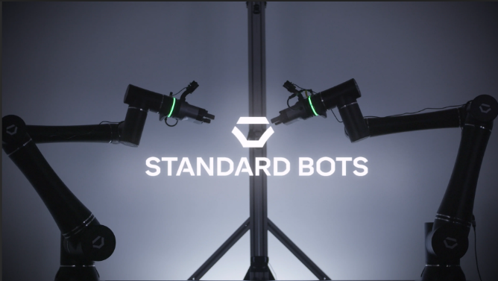


UNIVERSITY OF IDAHO – Brent knopp & kate bouse
COEUR D’ALENE
UPDATE: LAB 5 DICE DETECTION

Slide 2



PROJECT OUTLINE
Develop a dice detection system
Coordinate 1 Fanuc Robot and 1 Standard Bot
Use MQTT communication protocol
Dice detection done with OpenCV
Python Libraries

Slide 3
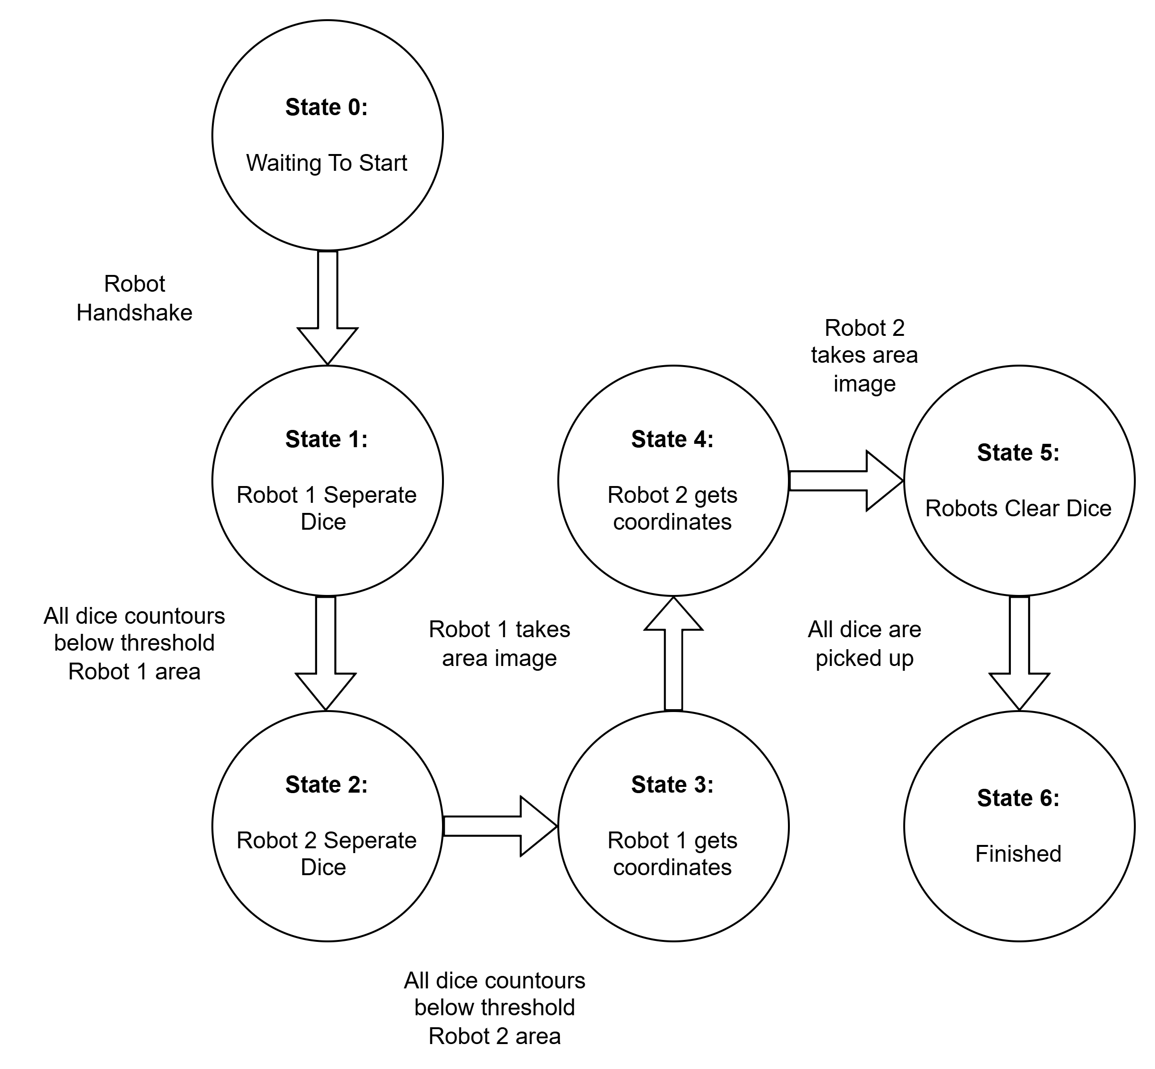
State Diagram
Must handshake with MQTT
Each robot must have both an independent state to separate dice because they use 1 camera
Each robot must have both an independent state to get coordinates because they use 1 camera
The robots do not need different states for clearing dice because the cameras are not used
State diagram

Slide 4

timeline
Project Workflow ( = done)
  Establishing MQTT Communication
  System Design
  Program Offline
  Online Programming
  Integration & Testing
  Make Video & PPT
  Documentation

Slide 5
FINISHED VIDEO

Slide 6

CHALLENGES
Firewall not allowing MQTT to work correctly. (Brent's computer's fault)
Robot position synchronization
  Random position was repeated
  No master (we implemented one)
  One-state delay (we accounted for it)
Integration of code to make one system
  Difficult to do solo
Randomize meeting position constraints by +/- 30 cm in xyz directions
  Used +/- 15 cm instead

Slide 7

Questions

