Slide 1

Ms. Pac-Man intelligent agent
Course of Artificial Intelligence
A.y. 2019/2020

Slide 2
Outline.
01 .
02.
03.
04.
Design goals and agent function
Experimental results and statistical analysis
Learning: improve the agent performance
Final considerations

Slide 3
01.
Task Environment Analysis
Definition of the problem

Slide 4



Performance - Actuators - Sensors.
Performance
Actuators
Sensors
Cumulative score
Pick a legal move given the current position
Access to the game state information

Slide 5






Environment.
Completely observable
Multiagent
Strategic
All the relevant information about the state is accessible
Other competitive agents are in the environment
The state of the environment is not deterministic
Sequential
Static
Discrete
Any action of the agent influences the next ones
No changes of the environment occur while the agent is deliberating
Time, perceptions and actions are finite

Slide 6
01.
Design goals and agent function
Purposes of the controller

Slide 7


Common goals & Specific goals.
Maximize the score
Complete levels in time
Choose the next move in up to 40msec
Choose a search algorithm to find the next action
Play efficiently versus two ghost teams
Random
Aggressive
Design and implement an agent function as general purpose as possible

Slide 8

Utility-based agent.
The utility determines the "happiness" of an action
Flexible, deal with multiple goals conflicting
Escape when in danger, eat pills when safe, eat ghosts…
Appropriate measure of satisfaction
Sophisticated utility function
Demanding
To pill or not to pill, that is the question…

Slide 9


Utility function: two macro heuristics.
Utility 0: safe environment
Utility 1: dangerous environment
Pick the action to eat pills as if adversaries do not exist.
If they are “far enough” it can be an acceptable approximation.
Utility ↔ increase the score
Pick the action to escape from ghosts or chase them.
Comes to play only if they are not “far enough”.
Utility ↔ keep Ms. Pac-Man alive

Slide 10
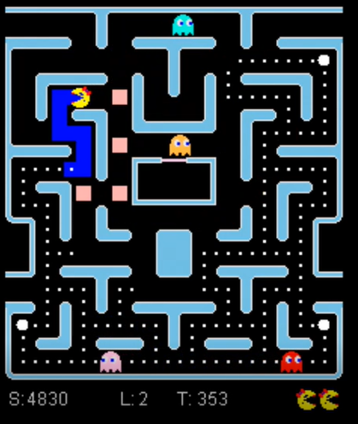
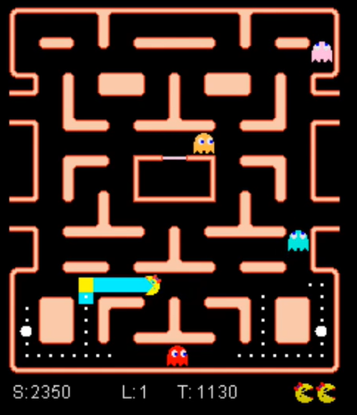
Utility function 0: use case examples.
Eat pills that are close to junctions reachable by Ms Pac-Man before than any ghost to ensure an escape way in case of danger
Check for multiple safe junctions
Check for at least a safe junction
Different “happiness” measure

Slide 11
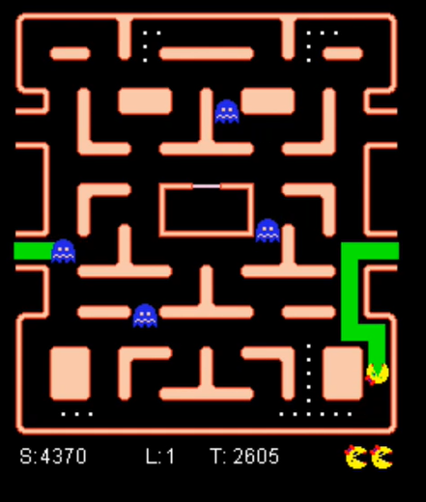
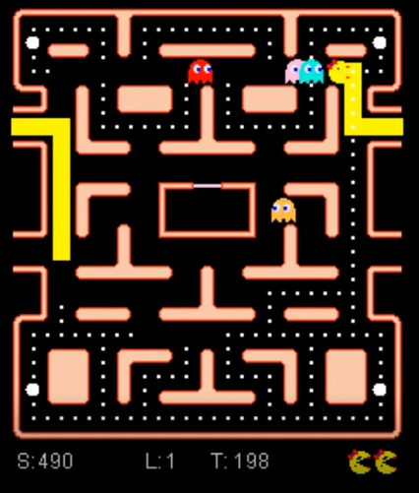
Utility function 1: use case examples.
Eat pills and power pills if safe
Eat edible ghosts, safe ≡ no other non-edible ghosts hangs around
All 4 ghosts behind ≡ Aggressive ghost team
Escape to a junction
Different “happiness” measure

Slide 12



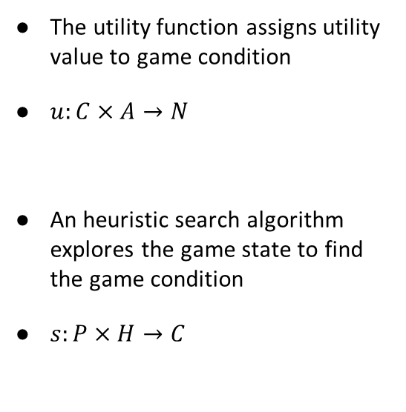
Search strategy.
Adversarial search
A* search
Greedy search
The utility function assigns utility value to game condition
$u:C×A→N$
An heuristic search algorithm explores the game state to find the game condition
$s:P×H→C$

Slide 13
02.
Experimental results
Statistical analysis of the experiments

Slide 14
Experiments setting.
Basic agent functionalities
Assess statistical properties of the system
Optimized agent with heuristics refinement
Verify quantitative improvement
Agent parameters definition
Further improvement demonstrating effectiveness of learning procedure
Exp 1
Exp 2
Exp L

Slide 15
Experiment 1.
Statistical values | Aggressive | Random | Legacy | Starter
Max score | 123620 | 68570 | 46780 | 59680
Min score | 17340 | 44420 | 5640 | 3450
Average score | 58825.9 | 58573 | 23759 | 20639.5
Std Deviation score | 27123 | 3386 | 8973 | 11276
Max level | 14 | 17 | 7 | 9
Survival % | 12 | 99 | 0 | 0
Average ghosts eaten | 66.2 | 51.8 | 31.5 | 23.8

Slide 16
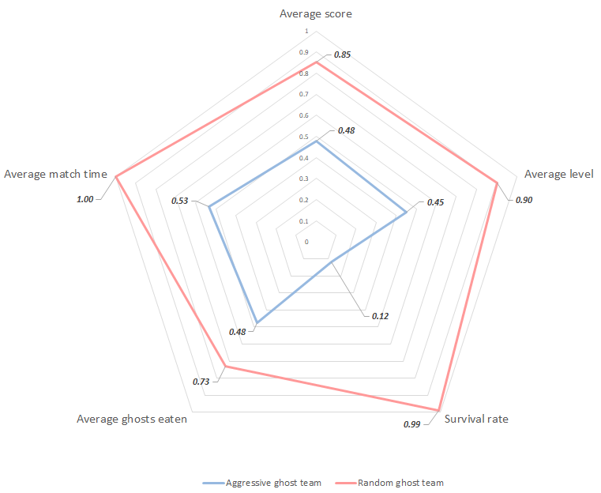
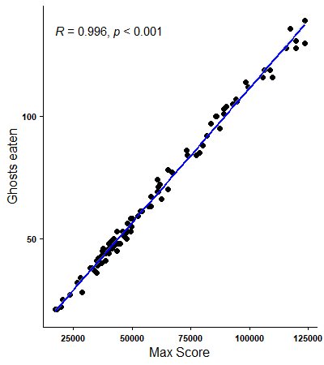
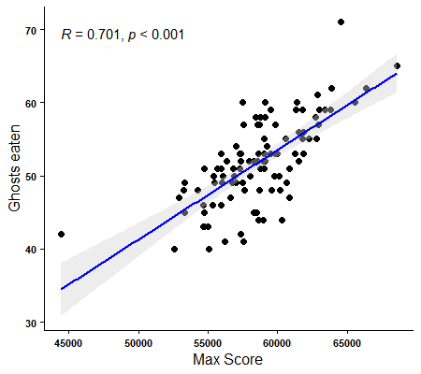
Experiment 1 – Random and Aggressive.
The score is correlated to
Match time
Ghosts eaten
Level reached
Correlation analysis

Slide 17
Experiment 2.
Statistical values | Aggressive | Random | Legacy | Starter
Max score | 131180 | 69720 | 53880 | 57680
Min score | 7800 | 37660 | 6189 | 3220
Average score | 74607.5 | 59326.9 | 24314 | 23132.5
Std Deviation score | 30688 | 3769 | 9581 | 10365.73
Max level | 13 | 17 | 8 | 10
Survival % | 22 | 99 | 0.5 | 0.5
Average ghosts eaten | 83.3 | 52 | 32.8 | 26.4

Slide 18
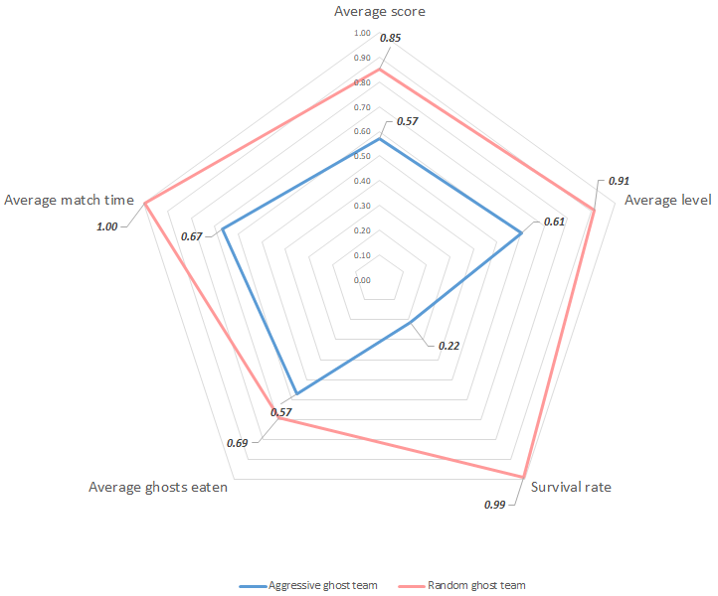
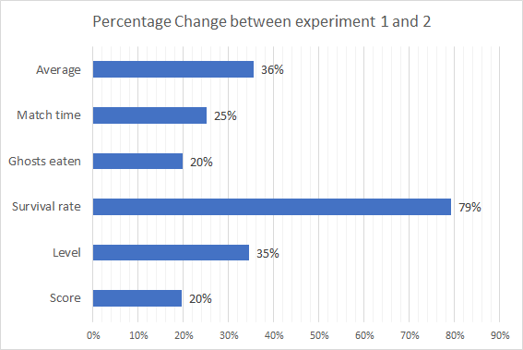
Experiment 2 – Random and Aggressive.
Enhanced strategy in eating the edible ghosts
Expected increase of the statistical values

Slide 19
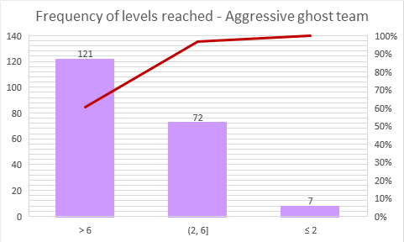
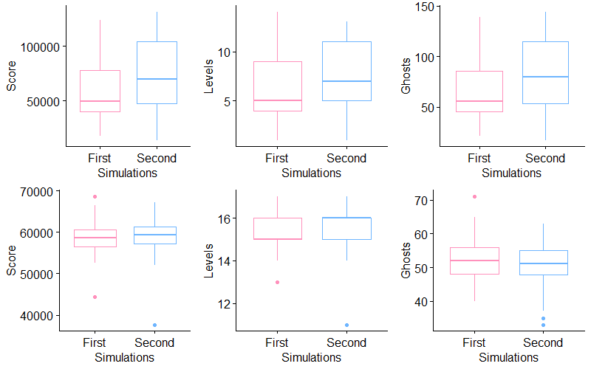
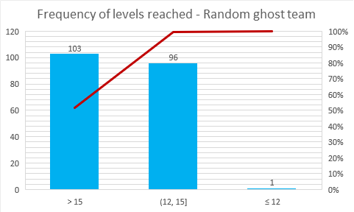
Experiment 2 – Random and Aggressive.
Aggressive ghost team (top) and Random ghost team (bottom)

Slide 20
03.
Learning
Improving the agent performance

Slide 21


Identifying hyper-parameters.
Distance hyper-parameters
Utility function hyper-parameters
Used in the heuristics applied to identify the game conditions
Can strongly influence the overall agent behavior
The agent autonomously learns which actions are "good" and which are "bad“
A given system of values could be more suitable than another to face a specific ghost team

Slide 22



Learning strategy.
Hill Climb
Stochastic Hill Climb
First Choice Hill Climb
Optimization problem
Find the hyper-parameters that maximize the score of the agent
A local search algorithm explores the parameters space to maximize the score objective function
Problem: the objective function is unknown
Computationally intensive task

Slide 23
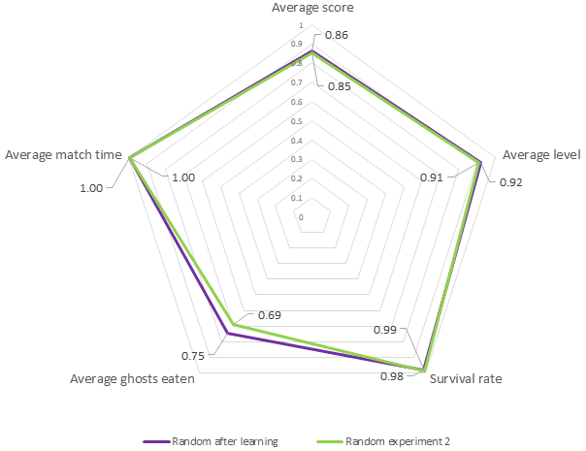
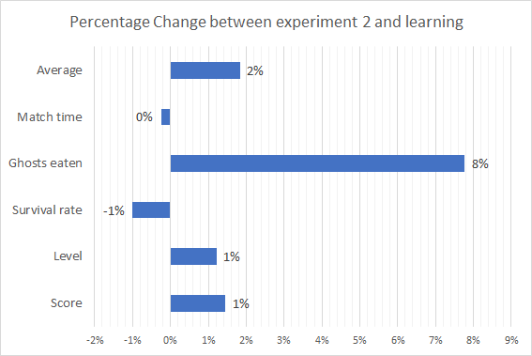
Learning experiment – Random.
Parameters tuned since ghosts are spread out
minGhostDistance, the agent could stay safe even with a lower threshold
guardDistance, the agent may dare when going towards a target
chaseDistance, it may be useful to adjust the distance value to detect if ghosts are chasing the agent

Slide 24
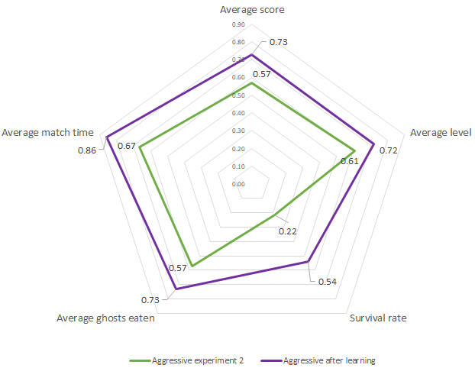
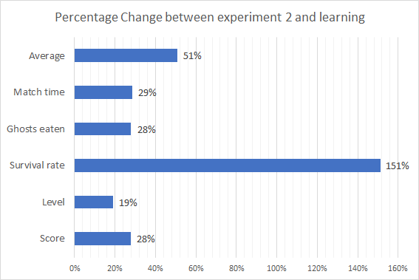
Learning experiment – Aggressive.
Parameters tuned since ghosts are clustered
minGhostDistance, the agent can be more cautious to avoid being trapped
guardDistance, prevent getting too close to ghosts when chasing a target
eatDistance, encourage the agent to eat ghosts because they are close together

Slide 25
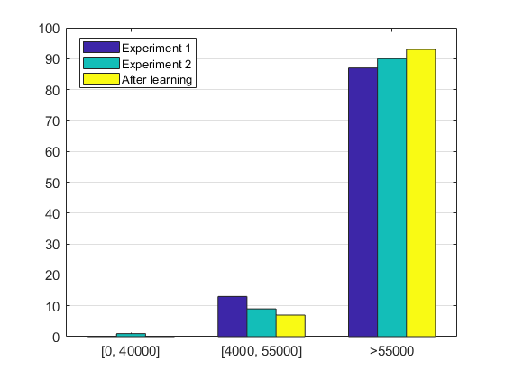
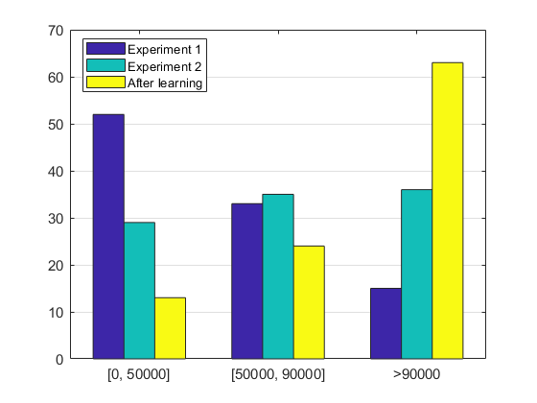
Final statistics – general look.
Vs Random
Vs Aggressive

Slide 26
04.
Conclusions

Slide 27
Final remarks.
Objective accomplished
Good game statistics with two different strategies in the same agent against Random and Aggressive ghosts
Statistical analysis lead to the right direction for the controller improvements
Matching between expected results and observed results during the experiments
Successful learning procedure

Slide 28
Final remarks.
Critical reflections
High variability vs Aggressive ghost team
Low variability vs Random ghost team
All the strategies adopted are quite conservative
Statistics vs Legacy and Starter are less than the half
Complex agent due to many hyper-parameters

Slide 29
Thanks for the attention!
Marco Carpentiero
Ilaria Gigi
0622700839
0622700809

