Slide 1
Understanding Economic Benefits of Combining Credit Scorecards
Gdansk/Edinburgh 2021
Błażej Kochański
Gdańsk University of Technology
blazej.kochanski@pg.edu.pl

Slide 2
The model
Data scientists are used to lots of data
But in some management decisions data is scarce…
This model needs just four pieces of information (2 Ginis, 1 correlation, 1 bad rate).

Slide 3
Real life example
A lender currently using application scorecard (Gini=0.45)
The credit bureau starts offering its reports and a new scorecard (Gini=0.65) to non-banking lenders.
The correlation between the two scorecards =0.4.
Default rate in the scored population = 0.1
The management has three questions:
Should we combine the new credit bureau scorecard with the application scorecard or use the former only while abandoning the latter?
If the combination is the way to go, what kind of Gini improvement should we expect?
If the combination is just a weighted linear function of the scorecards, what could the optimal weights be?

Slide 4
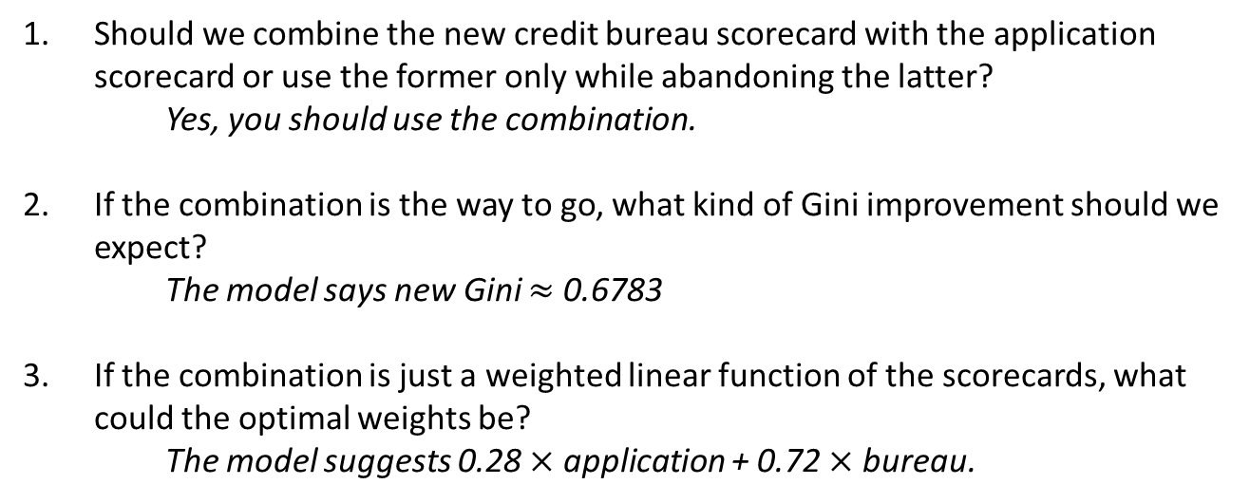
Correlation = 0.4
S₁
S₂
Gini₁ = 0.45
Gini₂ = 0.65
Bad rate = 0.1
Should we combine the new credit bureau scorecard with the application scorecard or use the former only while abandoning the latter?
Yes, you should use the combination.
If the combination is the way to go, what kind of Gini improvement should we expect?
The model says new Gini $≈$ 0.6783
If the combination is just a weighted linear function of the scorecards, what could the optimal weights be?
The model suggests 0.28 $×$ application + 0.72 $×$ bureau.

Slide 5
https://bkochanski.github.io/
Credit Scoring Calculators - links
GitHub calculators project: https://github.com/bkochanski/ScoringCalculators
Shiny app 1 - Combine Scorecards Calculator: https://blakocha.shinyapps.io/CombineScorecardsCalc/
Shiny app 2 - Better Gini Impact Calculator: https://blakocha.shinyapps.io/BetterGiniCalc/

Slide 6
Example 2
Correlation = 0.8
S₁
S₂
Gini₁ = 0.6
Gini₂ = 0.6
Bad rate = 0.08
Two banks merge. Their scorecards have Gini coefficients at the level of 0.6 both; he correlation between the scorecards is 0.8. Due to customer data protection, at this level of the process, we are not able to combine databases and build one scorecard. We have to resort to the simplified mathematical exercise instead. We would like to have an estimate of the new Gini the merged bank would have if the two banks combine their know-how, databases and modelling methods.
According to the model, assuming an 8% default rate, the new Gini is going to be around 0.63.

Slide 7
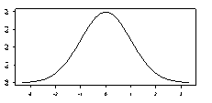



Multivariate normal
$$ρ_{B}$$
S₁
Scorecard 1
Scorecard 2
S₂
$$ρ_{1}$$
$$ρ_{2}$$
Latent Risk Variable
L

Slide 8
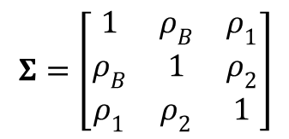
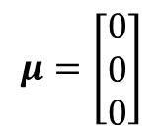
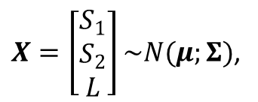
Multivariate normal
$$ρ_{B}$$
S₁
Scorecard 1
Scorecard 2
S₂
$$ρ_{1}$$
$$ρ_{2}$$
$X=\left[\begin{matrix}S_{1} \\ S_{2} \\ L\end{matrix}\right]\sim N(μ;Σ)$,
Latent Risk Variable
L
$$μ=\left[\begin{matrix}0 \\ 0 \\ 0\end{matrix}\right]$$
$$Σ=\left[\begin{matrix}1 & ρ_{B} & ρ_{1} \\ ρ_{B} & 1 & ρ_{2} \\ ρ_{1} & ρ_{2} & 1\end{matrix}\right]$$

Slide 9
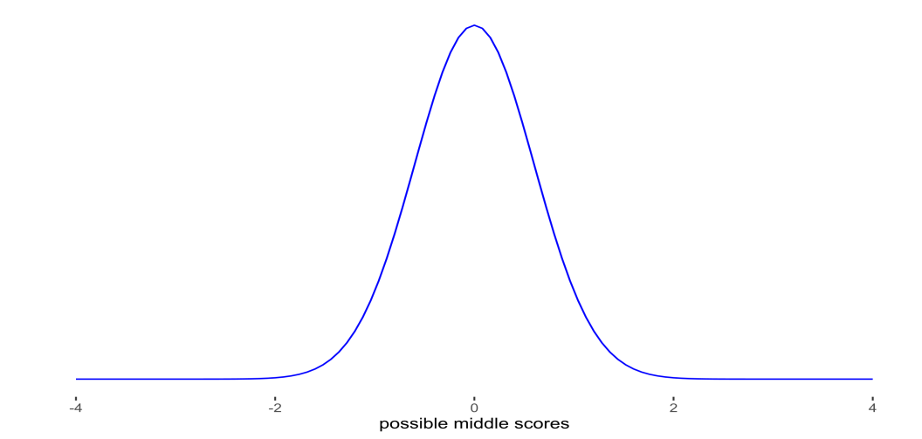
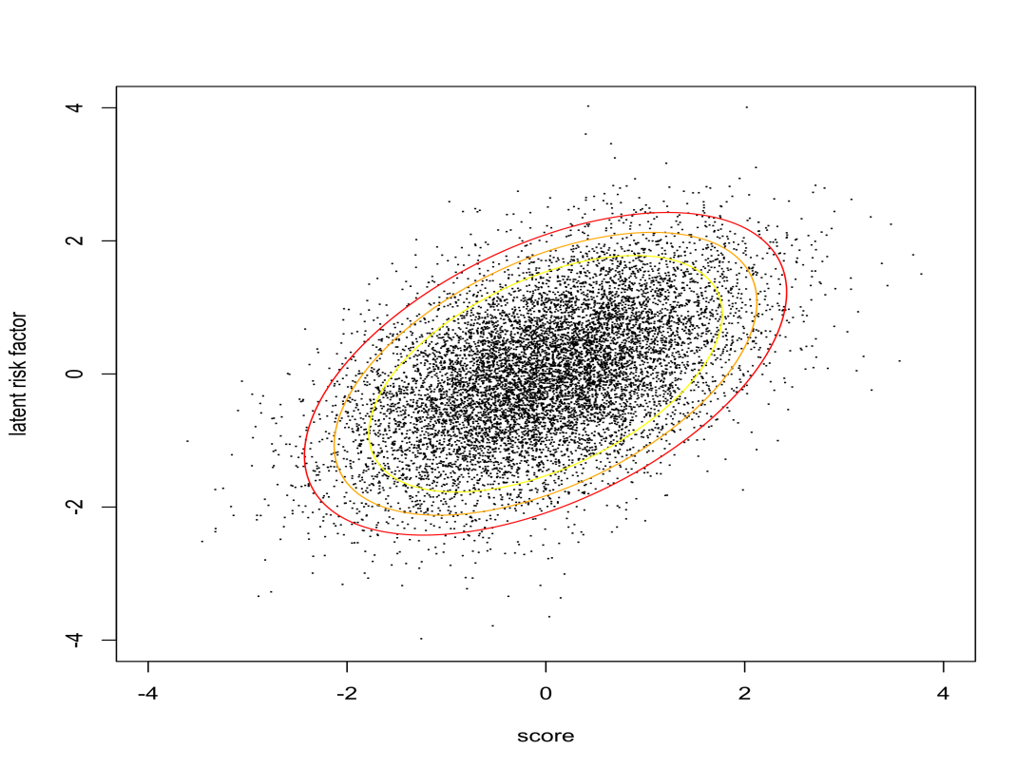
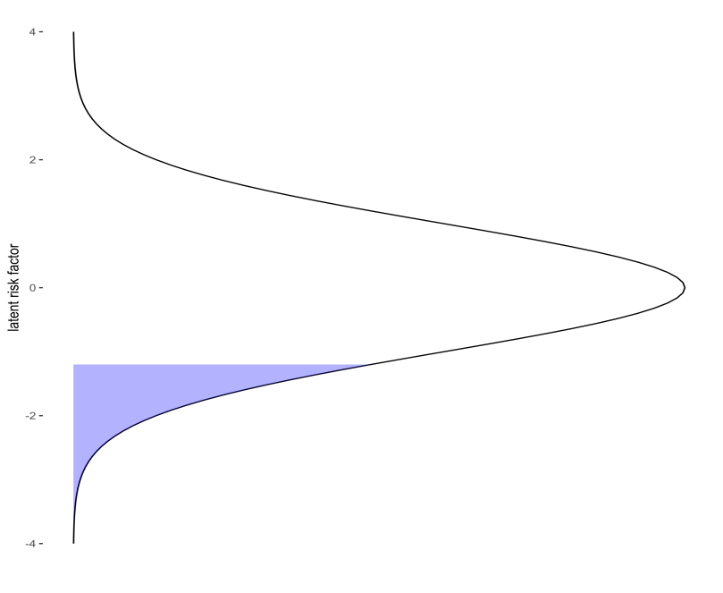
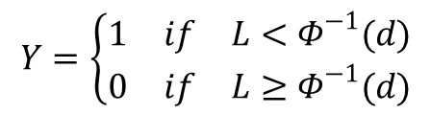
The score correlated with the latent risk variable. Latent risk variable, in turn, translates into default flag based on assumed market default rate.
$$Y=\left\{\begin{matrix}1 & if & L<Φ^{−1}(d) \\ 0 & if & L≥Φ^{−1}(d)\end{matrix}\right.$$
score
latent risk factor

Slide 10
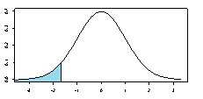

Gini <-> $ρ$
$$ρ_{B}$$
S₁
Scorecard 1
Scorecard 2
S₂
$$ρ_{1}$$
$$ρ_{2}$$
Gini₁
Gini₂
Latent Risk Variable
L
Y

Slide 11
Gini <-> $ρ$
$$ρ_{B}$$
S₁
Scorecard 1
Scorecard 2
S₂
$$ρ_{1}$$
$$ρ_{2}$$
Gini₁
Gini₂
Latent Risk Variable
L
Bad rate
Y

Slide 12

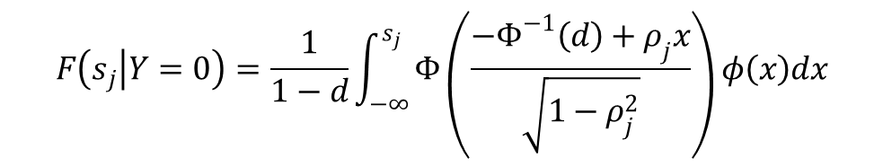
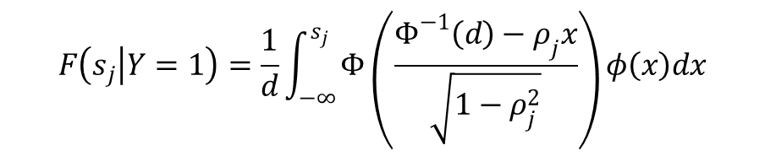


Gini <-> $ρ$
$$ρ_{1}$$
$$ρ_{2}$$
Gini₂
Gini₁
Bad rate
$$Gini_{j}=2∫F\left(s_{j} | Y=1\right)dF\left(s_{j} | Y=0\right)−1$$
$$F\left(s_{j} | Y=1\right)=\frac{1}{d}\int_{−∞}^{s_{j}}{Φ\left(\frac{Φ^{−1}\left(d\right)−ρ_{j}x}{\sqrt{1−ρ_{j}^{2}}}\right)φ\left(x\right)dx}$$
$$F\left(s_{j} | Y=0\right)=\frac{1}{1−d}\int_{−∞}^{s_{j}}{Φ\left(\frac{{−Φ}^{−1}\left(d\right)+ρ_{j}x}{\sqrt{1−ρ_{j}^{2}}}\right)φ\left(x\right)dx}$$
d is the default rate, $Φ$ is a standard normal CDF and $φ$ is the standard normal PDF, while $ρ_{j}$ is the correlation between $S_{j}$ (scorecard variable) and the latent risk variable ($L$)

Slide 13


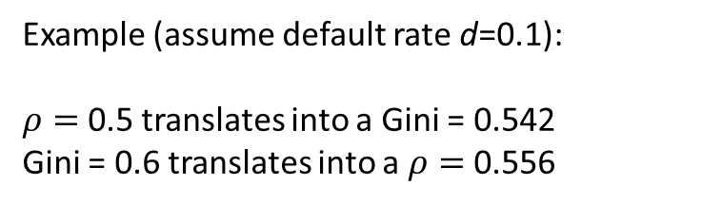
$$ρ_{1}$$
Gini₁
Numerical integration
Gini₁
$$ρ_{1}$$
Root finding with repeated numerical integration
Example (assume default rate d=0.1):
$ρ=$ 0.5 translates into a Gini = 0.542
Gini = 0.6 translates into a $ρ=$ 0.556

Slide 14


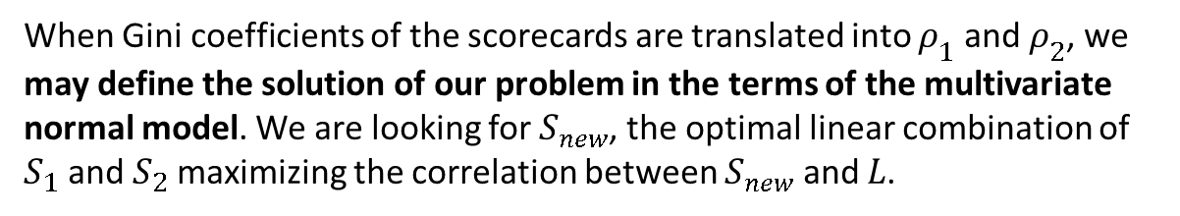



When Gini coefficients of the scorecards are translated into $ρ_{1}$ and $ρ_{2}$, we may define the solution of our problem in the terms of the multivariate normal model. We are looking for $S_{new}$, the optimal linear combination of $S_{1}$ and $S_{2}$ maximizing the correlation between $S_{new}$ and $L$.
$S_{new}=aS_{1}+bS_{2}$
$$ρ_{B}$$
S₁
S₂
a
b
S_{N}
$$ρ_{1}$$
$$ρ_{2}$$
$$ρ_{new}$$
L

Slide 15
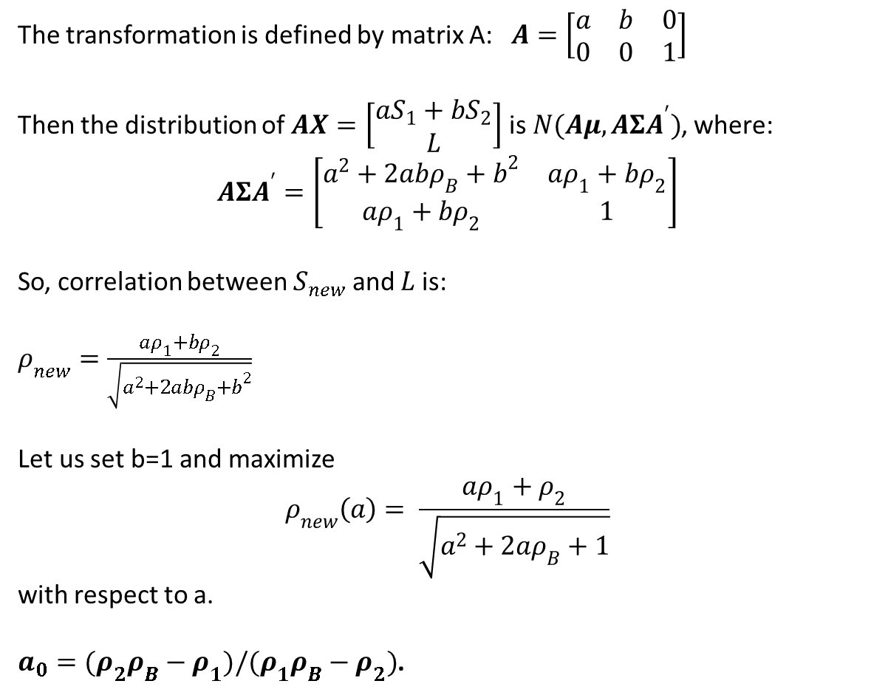
The transformation is defined by matrix A: $A=\left[\begin{matrix}a & b & 0 \\ 0 & 0 & 1\end{matrix}\right]$
Then the distribution of $AX=\left[\begin{matrix}aS_{1}+bS_{2} \\ L\end{matrix}\right]$ is $N(Aμ, AΣA^{′})$, where:
$$AΣA^{′}=\left[\begin{matrix}a^{2}+2abρ_{B}+b^{2} & aρ_{1}+bρ_{2} \\ aρ_{1}+bρ_{2} & 1\end{matrix}\right]$$
So, correlation between $S_{new}$ and $L$ is:
$ρ_{new}=\frac{aρ_{1}+bρ_{2}}{\sqrt{a^{2}+2abρ_{B}+b^{2}}}$
Let us set b=1 and maximize
$$ρ_{new}\left(a\right)= \frac{aρ_{1}+ρ_{2}}{\sqrt{a^{2}+2aρ_{B}+1}}$$
with respect to a.
$a_{0}=(ρ_{2}ρ_{B}−ρ_{1})/(ρ_{1}ρ_{B}−ρ_{2})$.

Slide 16


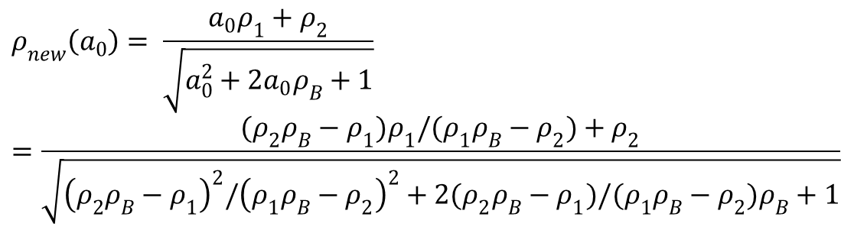


$$ρ_{B}$$
S₁
S₂
a
b
S_{N}
$$ρ_{1}$$
$$ρ_{2}$$
$$ρ_{new}$$
L
$$ρ_{new}\left(a_{0}\right)= \frac{a_{0}ρ_{1}+ρ_{2}}{\sqrt{a_{0}^{2}+2a_{0}ρ_{B}+1}}=\frac{(ρ_{2}ρ_{B}−ρ_{1})ρ_{1}/(ρ_{1}ρ_{B}−ρ_{2})+ρ_{2}}{\sqrt{{\left(ρ_{2}ρ_{B}−ρ_{1}\right)}^{2}/{\left(ρ_{1}ρ_{B}−ρ_{2}\right)}^{2}+2(ρ_{2}ρ_{B}−ρ_{1})/(ρ_{1}ρ_{B}−ρ_{2})ρ_{B}+1}}$$

Slide 17

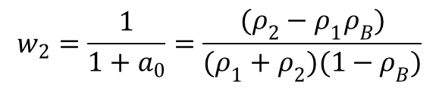
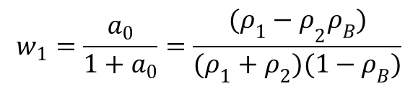
$$ρ_{B}$$
S₁
S₂
w₁
w₂
S_{N}
$$ρ_{1}$$
$$ρ_{2}$$
$$ρ_{new}$$
L
$$w_{1}=\frac{a_{0}}{1+a_{0}}=\frac{({ρ_{1}−ρ}_{2}ρ_{B})}{(ρ_{1}+ρ_{2})(1−ρ_{B})}$$
$$ρ_{new}$$
Gini_{new}
$$w_{2}=\frac{1}{1+a_{0}}=\frac{(ρ_{2}−ρ_{1}ρ_{B})}{(ρ_{1}+ρ_{2})(1−ρ_{B})}$$

Slide 18
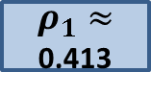

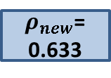
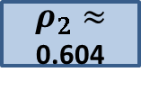
$ρ_{B}=$ 0.4
S₁
S₂
Gini₁ = 0.45
Gini₂ = 0.65
×0.28
×0.72
$ρ_{1}≈$ 0.413
S_{N}
$ρ_{2}≈$ 0.604
$ρ_{new}$= 0.633
Gini_{new}=0.678
L
d = 0.1

Slide 19
How much is 1pp increase in Gini?
Simple curve-drawing exercise: ~1-3% volume increase
Blochlinger-Leippold framework: even ~10% profit increase
Model it yourself:
Risk based pricing strategy
Take up rates
Adverse selection
…

Slide 20
References:
Vineet Agarwal and Richard J. Taffler. 2007. Twenty-five years of the Taffler z-score model: Does it really have predictive ability? Accounting and Business Research 37, 4 (Dec 2007), 285–300. https://doi.org/10.1080/00014788.2007.9663313
Andreas Blochlinger and Markus Leippold. 2006. Economic benefit of powerful credit scoring. Journal of Banking & Finance 30, 3 (2006), 851–873. https://doi.org/10.1016/j.jbankfin.2005.07.014
Joon-Ho Hahm and Sangche Lee. 2011. Economic effects of positive credit information sharing: the case of Korea. Applied Economics 43, 30, (Dec 2011), 4879–4890. https://doi.org/10.1080/00036846.2010.498364
Richard Lennart Mertens, Thorsten Poddig, and Christian Fieberg. 2018. Forecasting corporate defaults in the German stock market. Journal of Risk 20, 6 (Jul 2018), 29–54. https://www.risk.net/node/5784701
Rainer Jankowitsch, Stefan Pichler, and Walter S. A. Schwaiger. 2007. Modelling the economic value of credit rating systems. Journal of Banking & Finance 31, 1 (Jan 2007), 181–198. https://doi.org/10.1016/j.jbankfin.2006.01.003

Slide 21
Combination of scorecards is not a mixture of scorecards…
Mixture of scorecards example:
An online lender asks applicants for consent to use their Facebook data. 20% of them agree.
If you have the consent, the Gini is 0.6.
If you do not have the consent, the Gini is 0.4.
A project to increase consent rate from 20% to 50%.
How much will we gain?
Yes
Score 1
calibration
Consent for Facebook?
Final score
No
Score 2
calibration

Slide 22
Case 3: Mixing two models with different Ginis
20% ↗ 50%
Gini = 0.6
Yes
Score 1
calibration
Gini = A ↗ B ?
Consent for Facebook?
Final score
Gini = 0.4
No
Score 2
calibration
80% ↘ 50%
gini_mixture_calculator(0.6, 0.4, .2, .1)
## [1] 0.4453339
0.2*0.6+0.8*0.4
## [1] 0.44
gini_mixture_calculator(0.6, 0.4, .5, .1)
## [1] 0.5083432
0.5*0.6+0.5*0.4
## [1] 0.5

