Slide 1
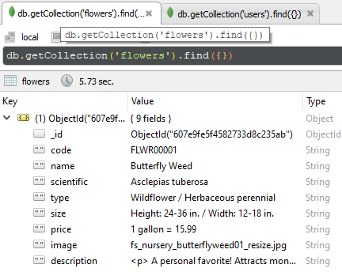
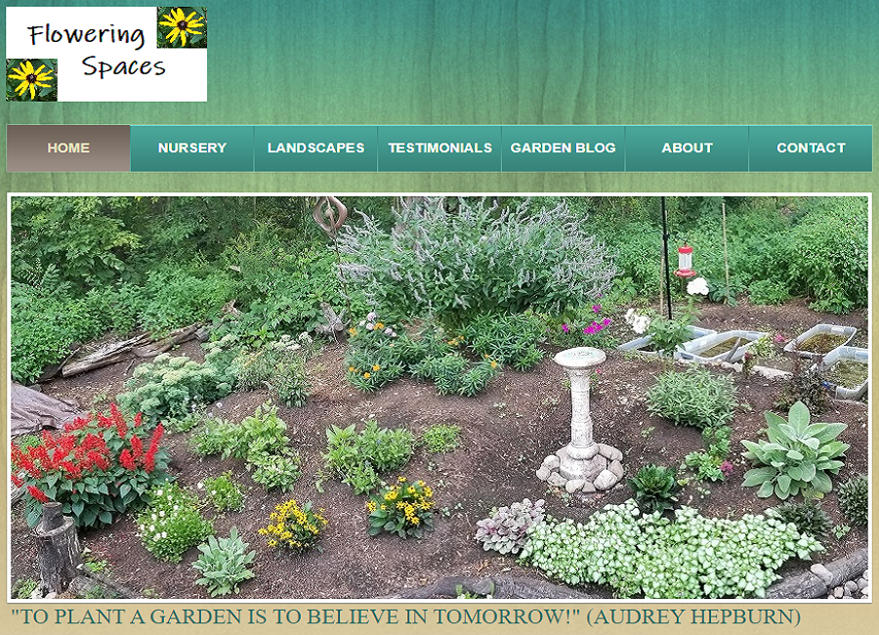
Flowering Spaces
MEAN Stack
Database: ‘flowers’ Collection
MongoDB (NoSQL - BSON)
  Database
Express (JavaScript)
  MVC Web Framework
  Routing for URL Requests
  View Engine (Handlebars)
Angular (TypeScript)
  Front-End Framework
  SPA “Admin” Server
Node.JS (JavaScript)
  Node Package Manager (NPM)
  Back-End Web Application Server
  Security Features
Back End: Web Application View
(Landing Page)

Slide 2
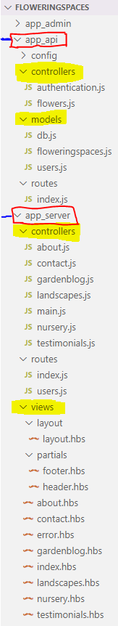
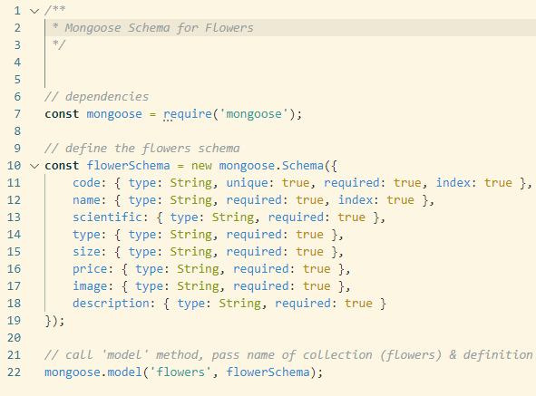
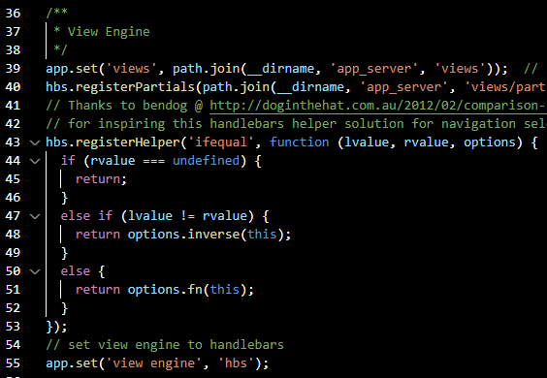
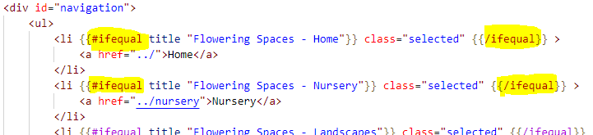
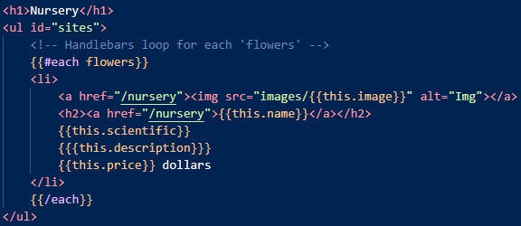
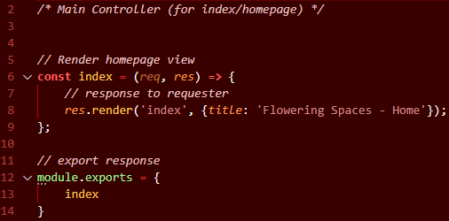
MEAN Stack
Directory Structure (MVC) →
Model w/ Mongoose Schema
View Engine: HBS (middleware)
MVC Design Pattern
Model
  API directory
  Mongoose ODM Library
View
  Server directory
  View Engine: Handlebars
  (dynamic JSON)
Controller
  API directory:
    REST API logic
    Interacts with Model
  Server directory:
    Renders View
    Interacts with View
Handlebars Helper (conditional)
Controller (render view)
Handlebars Helper (loop)

Slide 3
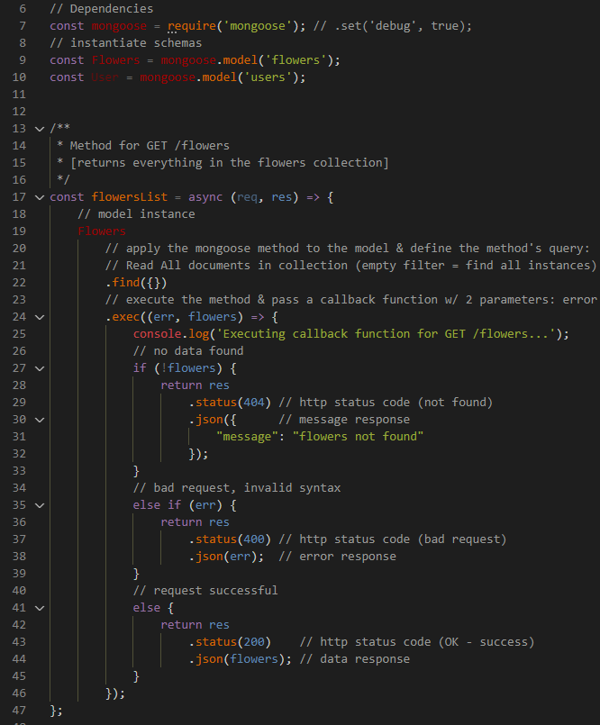
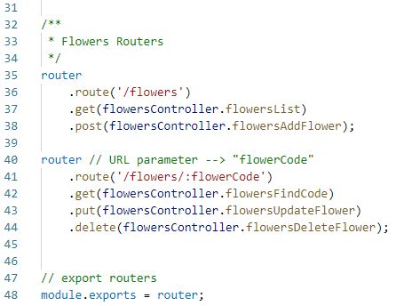
MEAN Stack
REST API: “find all” method
RESTful API
API Endpoints (URLs)
  DB collections
  Parameters
CRUD operations
  Http Requests
    Get
    Post
    Put
    Delete
  Mongoose methods
Responses
  Http Status Codes
  Data Response
  Error Response
Routers: API URLs

Slide 4
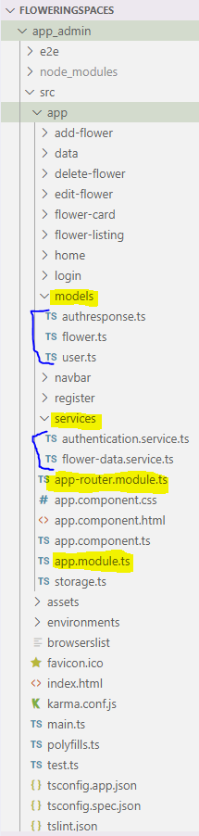
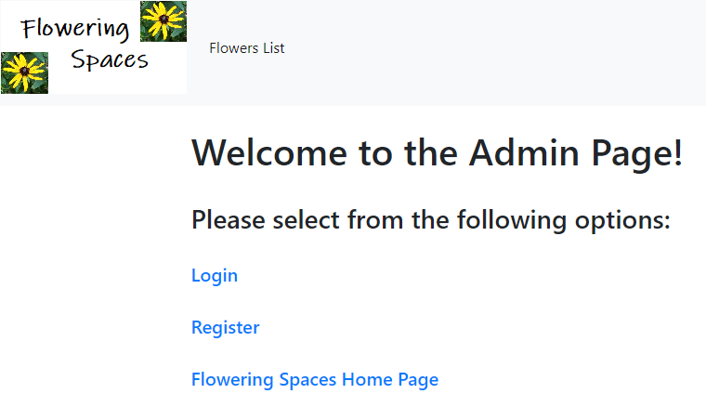
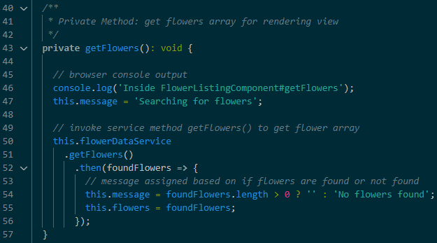
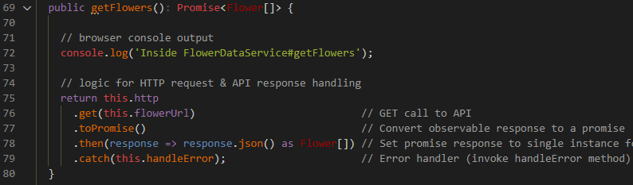
MEAN Stack
Directory Structure (SPA)→
Admin Home Page
Angular Front-End (Admin page)
Single Page Application (SPA)
App & Router Modules
Models directory
  Authresponse / Flowers / Users
Services directory
  Authentication / Flower-data
  Forwards Http Requests to REST API
  Returns API Responses to Requestor
App Components
  Home / Register / Login / Navbar
  Flower Listing / Flower Card
    Add / Edit / Delete Flower
Flower Listing Get method
Flower-Data Service Get method

Slide 5
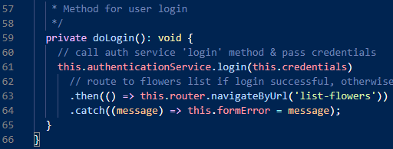

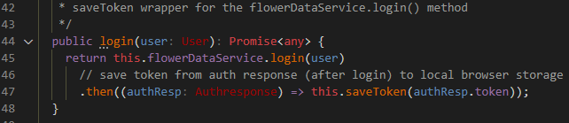
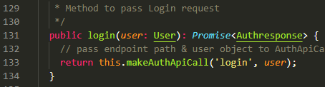
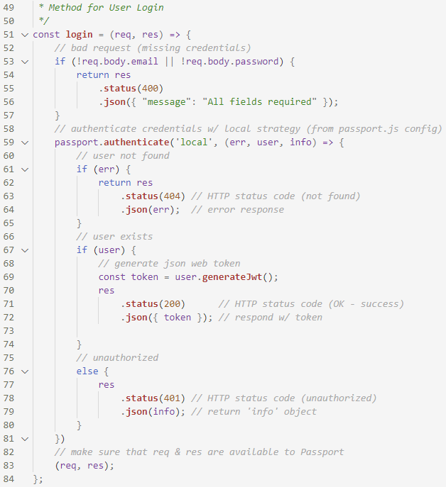
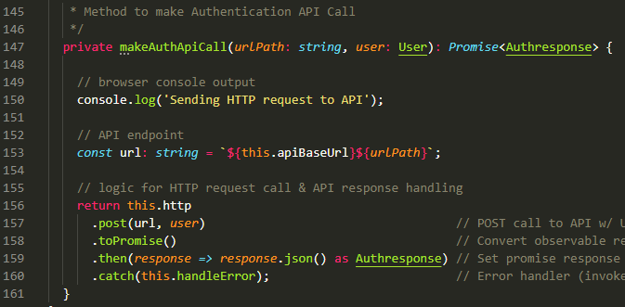
MEAN Stack
Login Component Login method
Authentication Service Login method
Security Features
User Database
  Register / Login
View Rendering
  isLoggedOn() methods
Authentication
  Authresponse Model
  Passport Configuration
  (authentication logic)
  JSON Web Token (JWT)
  Authentication Service
  API Auth Controller
Flower-Data Service Login method
API Authentication Controller
Login method

Slide 6
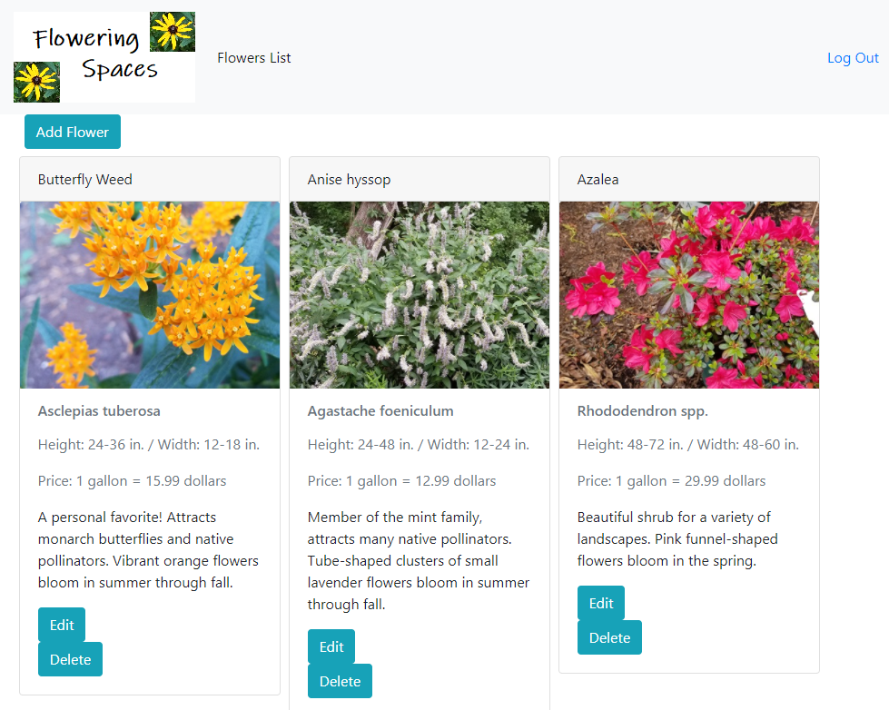
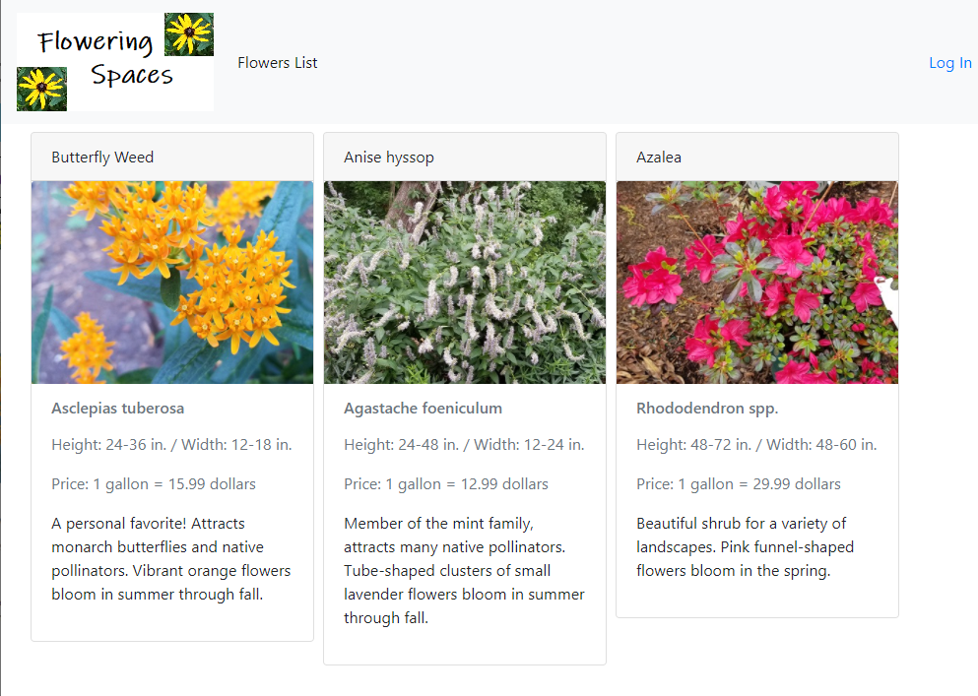
MEAN Stack
Flower Listing Authorized User View
Flower Listing Unauthorized User View

