Slide 1
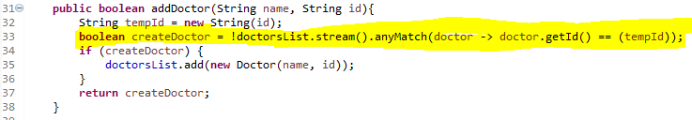
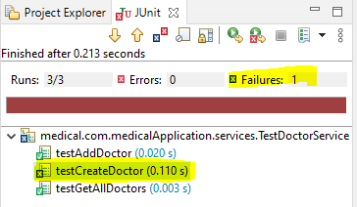
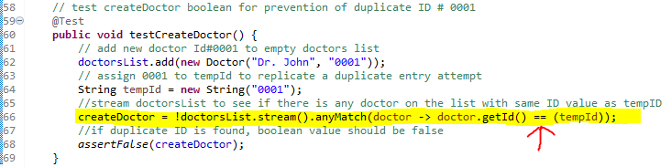
Software Testing, Automation, & QA
createDoctor : BEFORE Test
Unit Test : Identifies Bug

Slide 2
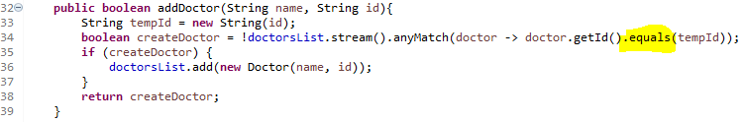
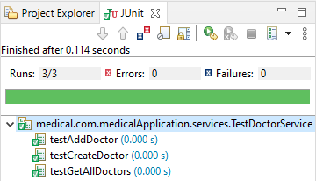
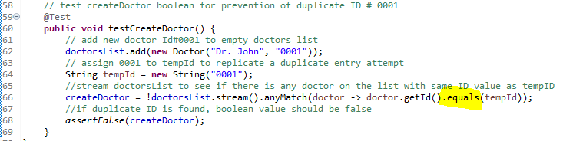
Software Testing, Automation, & QA
createDoctor : AFTER Test
Unit Test : Confirms Bug is Fixed

Slide 3
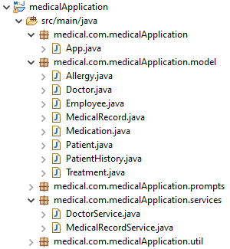
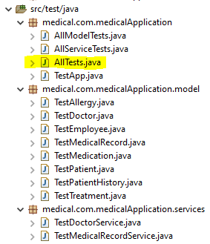
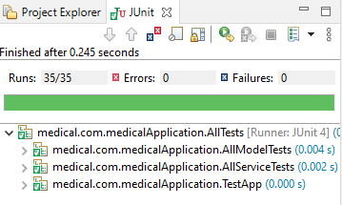
Software Testing, Automation, & QA
Application File Structure
Unit Test File Structure
Test Suite Results:

