Slide 1
Data Science Salary Analysis
Prepared by Brendan OConnell
April 14, 2024

Slide 2
Deliverable
Recommend a competitive salary range to acquire a top-talent Data Scientist.
Requirements review
Key Points of Interest
Full-time Data Scientist
U.S. employees vs. Offshore employees
Examine company size
Investigate salary trends over time
Data Science team

Slide 3
Full-time Data Scientist
Someone to drive data science within the organization
Potentially lead a team in the future
“Top talent” → extensive experience
U.S. employees vs. Offshore employees
Highlight the differences in salary data
Examine company size
Currently small, rapidly expanding to medium size
Observe salaries across various company sizes
Investigate salary trends over time
“Salaries are going up due to the great recession”
Does the data support this statement?
Data Science team
Explore data points for future hiring needs
Requirements review

Slide 4
Can the job titles be categorized to provide more useful analysis?
Which employment types are most relevant?
Are all job titles in the data a good fit based on the requirements?
Is there any external data from reliable sources that can be incorporated?
How do salaries across experience levels match up?
How does company size impact the analysis?
Is the distribution of salary data relatively normal, skewed, or other shape?
Does the data support the theory that salaries have increased over recent years?
What are the salary trends by job title? By experience level? By country?
Which statistics best illustrate salary differences for U.S. vs. offshore employees?
Are there extractable insights to help develop a future data science team?
Research Questions
Based on requirements review

Slide 5
The job titles in the data can be grouped together based on their related fields of interest.
These job fields help narrow the focus on jobs most relevant to the requirements, which in turn will yield more relevant insights.
The following slide breaks down some high-level descriptions of each job field that will be added to the dataset.
Can the job titles be categorized to provide more useful analysis?

Slide 6
Data Science
Asks questions and studies data to extract insights for solutions.
Combines scientific thinking with mathematics, computer science, and data analytics.
Artificial Intelligence / Machine Learninging (A.I. / M.L.)
A.I. refers to technology that simulates human intelligence.
M.L. is a branch of A.I. using data models & algorithms to help computers learn.
Data Engineering / Architecture
Data architecture is the design and implementation of data storage & access.
Data engineering builds/maintains the pipelines that allow data to be available for analysis.
Data Analysis
Analyze data to identify patterns/relationships and build predictive models.
Create analytics reports with data visualizations to communicate findings.
Data Consulting
Assist organizations in the development of data-driven solutions.
Job Fields

Slide 7
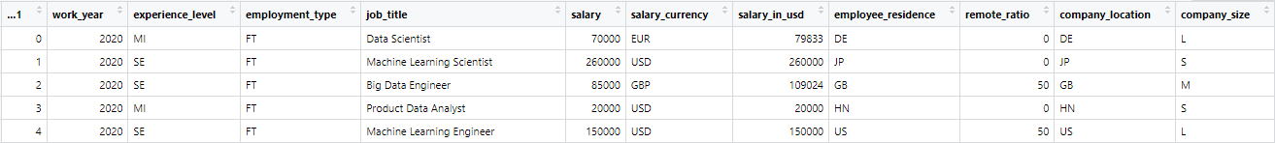
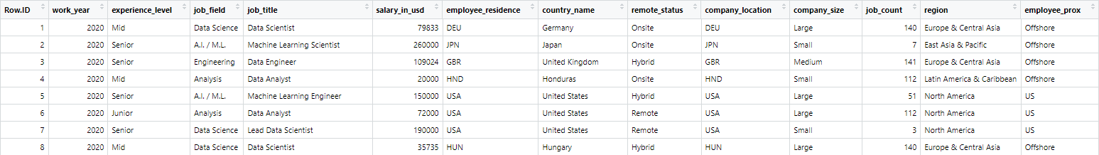
Data Preparation
Original Data:
Add column for “Job Field” of each entry based on previous slide
Fix ID column name and reset index to start at 1
Select only “Full-Time” job types, based on requirements review (remove “job types” column after filtering to only FT)
Drop “salary” and “salary currency” (only need USD salary)
More descriptive value names for “experience level”, “remote ratio”, and “company size”
Cleaned Data:

Slide 8
Data Preparation
Original Data:
Convert experience levels, remote status, & company size to ordinal values (factors)
Remove all “Data Consultants” (not an ideal candidate, and extreme outliers)
Import ISO 3166-1 Country Code Data -- Fix NA values
-- Use 3-letter country codes, country name, & region
Add column for total counts of each job title
Add column for filtering between “US” and “Offshore” employees
Cleaned Data:

Slide 9
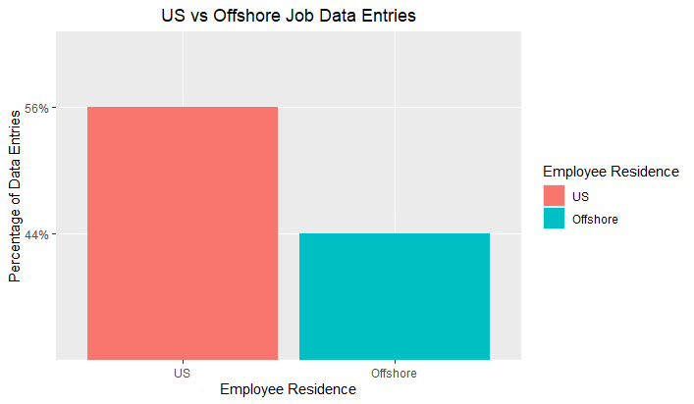
EMPLOYEE COUNTRY OF RESIDENCE
The dataset can easily be categorized into 2 groups:
US employee residence
Offshore employee residence
This approach allows the following steps for Exploratory Data Analysis (EDA):
Part 1: U.S. Data Analysis
Part 2: Offshore Data Analysis
Part 3: Compare U.S. vs Offshore

Slide 10
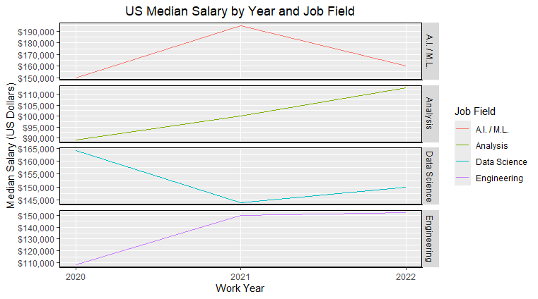
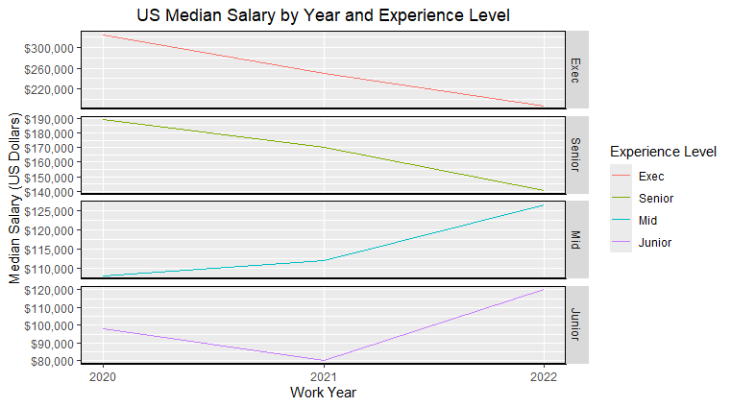
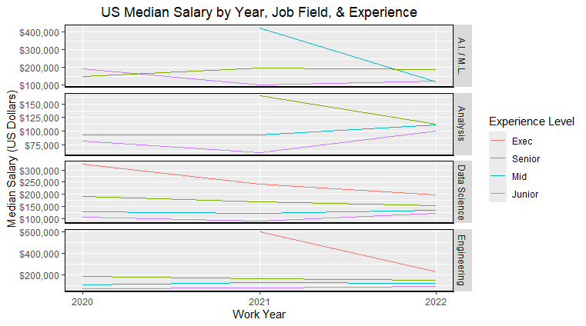
Top-Left Analysis and Engineering fields show salary increases over time, whereas A.I./M.L. and Data Science do not show consistent trends.
Part 1
U.S. Data Analysis
“Salaries are going up due to the great recession”
Does the data support the theory of salary increases over recent years?
Several data aggregations are compiled and plotted for U.S. salaries:
Top-left plots Job Field trends.
Middle plots Experience trends.
Bottom-left plots lines for each experience level within a Job Field.
See details in the corresponding text for each line plot. Ultimately, there does not seem to be a trend for increasing salaries in Data Science, but our offers should still be competitive.
Middle Executive and Senior levels have decreasing salary trends, whereas Mid and Junior levels show increasing salary trends overall.
Bottom-left The most relevant data here is the Data Science field, which shows a decreasing salary trend for Exec and Senior levels (our area of focus for talent) whereas the Mid and Junior levels have very slight increasing salary trends.

Slide 11
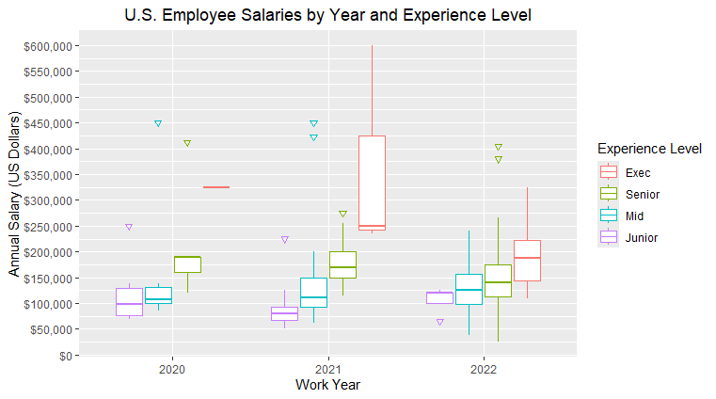
Part 1
U.S. Data Analysis
How do salaries across experience levels match up?
Boxplots show high-level visuals that are useful for preliminary analysis of data distributions.
For each “experience level” boxplot, the U.S. salaries from 2020 to 2022 appear to be as expected when compared from Junior up to Executive, showing the Junior pay ranges as lowest and increasing accordingly up through the Executive level.
Based on the desire for “top talent” and a potential team lead, the Junior & Mid experience levels will now be excluded, and the data will focus on the Senior and Executive level salaries.

Slide 12
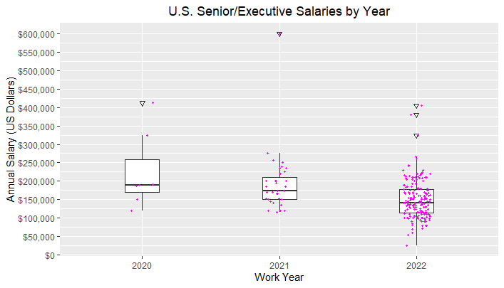

Part 1
U.S. Data Analysis
Senior & Executive experience
Salaries by Year
Examining the Senior and Executive salaries in 2022, there appears to be a high count of salaries $100k or less, whereas 2020 and 2021 are all above that number. That does not seem like competitive U.S. salary for top-talent.
To investigate, data is aggregated for counts of each Job Title with senior or executive experience level that has a salary of $100k or less.
The aggregated data (bottom table) illustrates how Data Analysts and Data Engineers account for 24 of the 27 low-paying salaries (89%). This can be addressed by filtering the Job Fields.
Job Title counts:
Sr/Exec salaries $100k or less

Slide 13
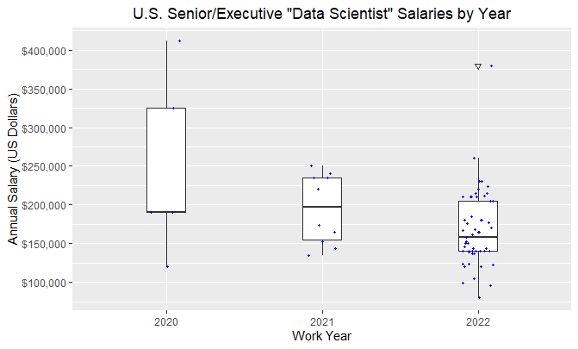
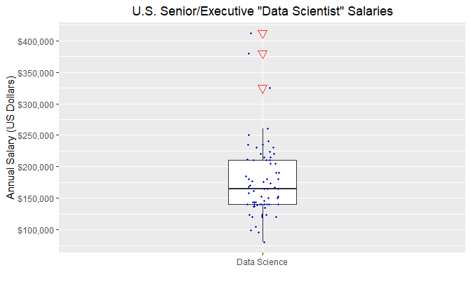
Part 1
U.S. Data Analysis
After filtering the data to the “Data Science” field, the median salary for 2022 increased from less than $150k to more than $150k.
Senior & Executive experience
Salaries for Data Science field only
“Data Science” is the most relevant Job Field based on the requirements. By focusing on that field, the data reflects the salaries of our targeted talent more accurately and is no longer skewed by other fields like Analyst or Data Engineering.
A.I. / M.L. jobs will also be filtered out, but this is acceptable given that we are specifically looking to analyze salaries for a Data Science position.
Also worth noting, in the U.S. there is no AI/ML data at the Executive level.
Now we will address the red outliers.
Combining all 3 years, a few outliers (in red) appear to be salaries over $300k, which is most likely out of our pay range considering our company size.

Slide 14
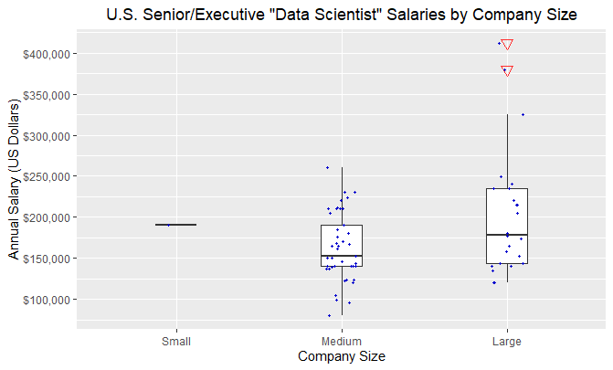
Part 1
U.S. Data Analysis
Senior & Executive experience
Salaries for Data Science by Company Size
A look at salary distribution by company size offers some insight on the outlying values: Large companies.
It is understandable that larger companies can afford to overpay a few high-level employees. However, as a small-to-mid-sized company, we are not financially positioned to compete with these outliers.
It is best to filter out salaries that exceed $300k and focus on data that is close to financially viable.

Slide 15
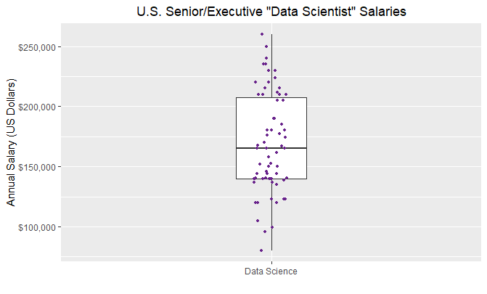
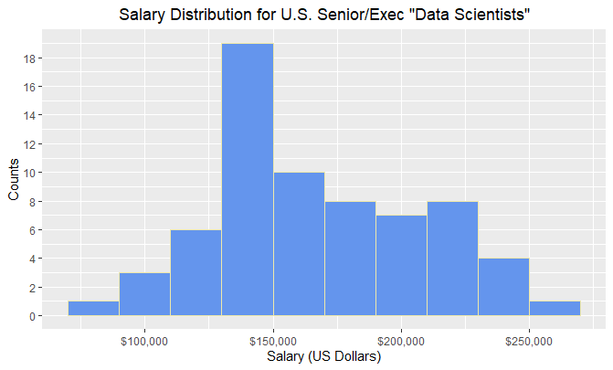
Part 1
U.S. Data Analysis
Senior & Executive experience
Data Science Salary Distributions
These are the salary distribution plots for 67 U.S. Data Science jobs at the senior & executive level, excluding outliers from the large companies.
Although not exact, the data does appear to be relatively normal.
To confirm, a density histogram can be plotted with a smoothed estimation curve, then compared to a bell curve.

Slide 16
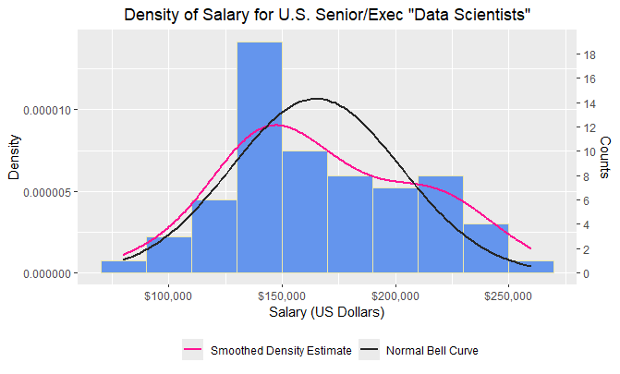
Part 1
U.S. Data Analysis
Senior & Executive experience
Data Science Salary Distributions and Statistics
The black “bell” curve illustrates what a normal distribution would be.
The pink density curve estimates the actual salary distribution.
Although the peak of the curves are slightly different, the shapes appear to be quite similar, enough so that this can be treated as normal distribution.
A table of important distribution statistics are displayed at the bottom, which will be used to compare against offshore analysis and for final recommendations.

Slide 17
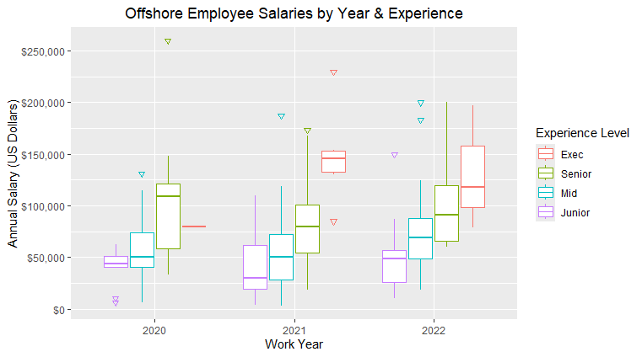
Part II
OFFSHORE Data Analysis
How do salaries across experience levels match up?
Similar to the U.S. analysis, for each Offshore “experience level” boxplot the salaries from 2020 to 2022 appear to be as expected when compared from Junior up to Executive.
Based on the desire for “top talent” and a potential team lead, the data will now focus only on the Senior and Executive level salaries.

Slide 18
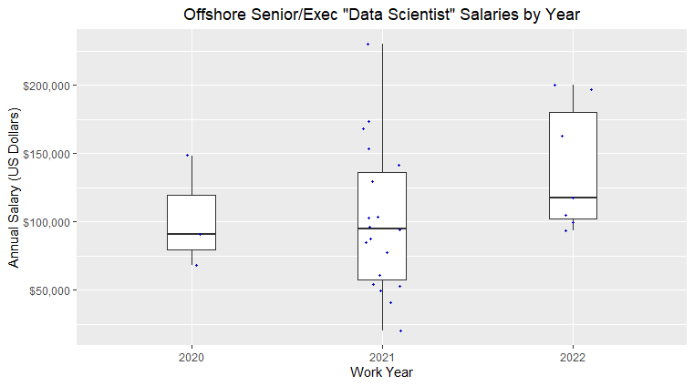
Part II
OFFSHORE Data Analysis
Senior & Executive experience
Salaries by Year
Although there appear to be some significantly low-paying salaries for “top-talent”, it is difficult to make assumptions about what qualifies as competitive pay throughout other foreign countries.
However, to ensure that the Offshore statistics can be appropriately compared to the U.S. statistics, the job field must now be filtered to only include the Data Science field.

Slide 19
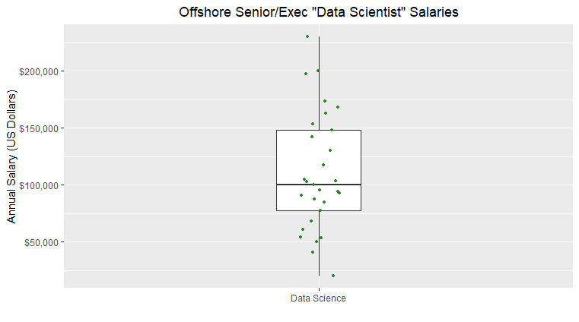
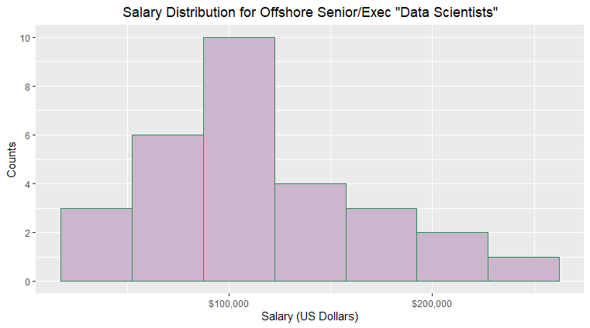
Part II
OFFSHORE Data Analysis
Senior & Executive experience
Data Science Salary Distributions
These are the salary distribution plots for 29 offshore Data Science jobs at the senior & executive level.
Although not exact, the data does appear to be relatively normal.
To confirm, a density histogram can be plotted with a smoothed estimation curve, then compared to a bell curve.

Slide 20
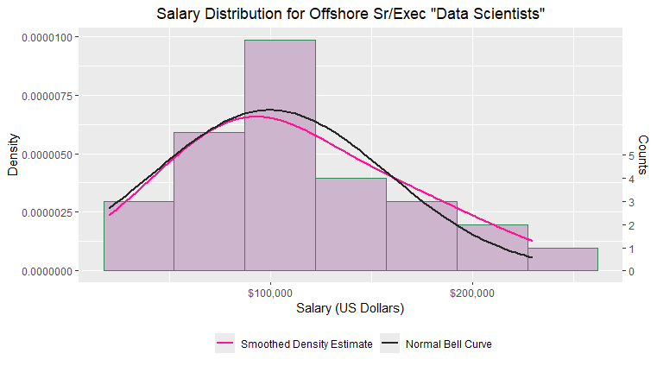
Part II
OFFSHORE Data Analysis
Senior & Executive experience
Data Science Salary Distributions and Statistics
The black “bell” curve illustrates what a normal distribution would be.
The pink density curve estimates the actual salary distribution.
The curves and shapes appear to be very similar. This can be treated as a normal distribution.
A table of important distribution statistics are displayed at the bottom, which will be used to compare against U.S. statistics and recommendations.

Slide 21
Part III
COMPARE U.S. / OFFSHORE
Histograms and Distribution Curves
Both normal distributions, but U.S. shifted right by about $50k-$60k.

Slide 22
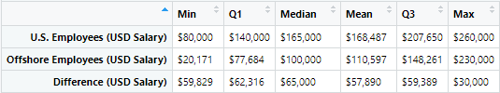
Part III
COMPARE U.S. / OFFSHORE
Boxplots and Statistics
Boxplots show significant visual differences in U.S. vs. offshore distribution of salaries, especially looking at Q1 (bottom of the box which is 25th percentile), the Median (center line, 50th percentile), and at Q3 (top of the box which is 75th percentile).
The statistics clearly support the plots.
The offshore median is $65k less than the U.S., and the offshore mean is about $58k less than the U.S.
Q3 (75th percentile) offshore salaries are about $60k less than the U.S.

Slide 23
The goal is to hire a top-talent data scientist to help drive data science within the organization, and potentially lead a team in the future.
The analysis of U.S. Data Science salaries for senior & executive level employees has produced the above statistics, which follow a near-normal distribution.
The recommended salary range takes these statistics into consideration, as well as the “competitive” mindset for obtaining our goal.
It is my formal recommendation to use the Median value as the low-end of the salary range, and to use the Q3 value as the high-end of the salary range. This produces a competitive salary range of $42,650:
$165,000 (low) - $207,650 (high)
With that in mind, if the candidate proves to be extremely desirable and the Q3 value is not enough, then the “Max” listed in the statistics ($260,000) can be considered as an absolute max. Anything over that number may put our company at financial risk.
Recommendation
for
U.S. Salary Range

Slide 24
The offshore statistics are complicated, and additional data analysis is likely needed.
For now, my formal recommendation is to follow the same logic as the U.S. range. Use the Median value as the low-end of the salary range and use the Q3 value as the high-end of the salary range, yielding a competitive salary range of $48,261:
$100,000 (low) - $148,261 (high)
Again, the “Max” listed in the statistics ($230,000) can be considered an absolute max. Anything over that number may put our company at financial risk.
However, there are more complications to consider with an offshore hire, some of which are not available in the current data. For example, language differences can potentially cause communication issues, and time zone differences can introduce scheduling problems.
Because of this, I highly recommend hiring a U.S. employee for the initial Data Science position. This will allow us more time to further analyze the data and consider some of the complexities.
Additional analysis of salaries by specific countries or regions may provide better clarity on the drastic salary ranges observed in the current data set.
Recommendation
for
offshore Salary Range

Slide 25

Are there extractable insights to help develop a future data science team?
This is the last question from the initial list of research questions.
Full analysis on this topic is not within the scope of this recommendation, but a quick high-level look at some data across job fields in the U.S. may help keep things in perspective in terms of a current data science hire and a future data science team.
A future data science team may require additional data scientists, as well as machine learning engineers, data engineers/architects, and data analysts.
The following slides demonstrate some basic insights available that may help with future considerations.

Slide 26
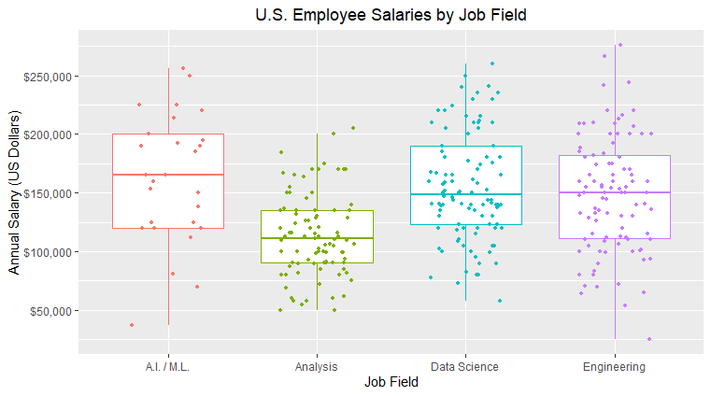
FUTURE CONSIDERATIONS
Data Science Team

Slide 27
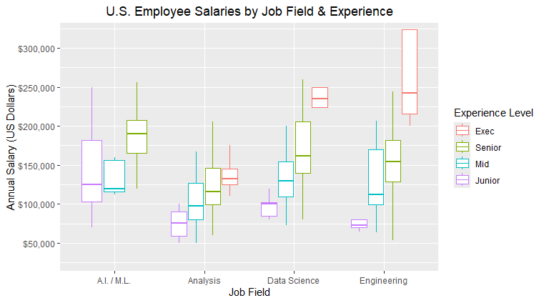
FUTURE CONSIDERATIONS
Data Science Team

