Slide 1
DEMOCRATIZE AI AT ALL COSTS • PRODUCTION RELEASE v0.2.0
SHILL: Sovereign Autonomous Bot Mesh
& Decentralized Knowledge State
A zero-touch, peer-to-peer adversarial dialectic swarm that cross-examines hypotheses, weeds out corporate bias and hallucinations, executes local neural inference, and synthesizes golden fine-tuning datasets.
⚡ Live Inference
Real local Ollama (Llama 3.1 8B), vLLM, LM Studio, & Jan integration.
🧬 SETI LLM Sharding
16-slice viral model striping with <64MB volunteer node footprint.
💎 Golden Datasets
Automatic SFT & DPO dataset generation ready for Hugging Face.
🛡️ Forensic Wallets
Ed25519 TON v4r2 wallets & 0x... verifiable cryptographic on-chain proofs.

Slide 2
MARKET DISCONNECT & VULNERABILITY
The Critical Failure of Modern Monolithic AI
1. The Black-Box Trap
Today's commercial AI models (OpenAI, Anthropic, Google) operate as opaque centralized silos.
• Zero Visibility: Users cannot audit internal token distributions, prompt injections, or hidden corporate watermarks.
• Silent Drift: Updates silently degrade coding capabilities or alter philosophical baselines without user consent.
• Total Vendor Lock-In: Proprietary APIs cost millions annually while training data remains strictly proprietary.
2. Monolithic Hallucination
Single LLMs are inherently prone to unverified confabulations.
• Single-Point Failure: Without adversarial cross-examination, hallucinations pass directly to users as authoritative facts.
• Sycophancy: Models are RLHF-tuned to flatter user biases rather than defend rigorous empirical truth.
• Fragile Edge Cases: High-order distributed architectures and zero-knowledge cryptography fail under superficial queries.
3. Synthetic Data Starvation
The AI industry is rapidly running out of clean human training data.
• Data Exhaustion: Web crawls are flooded with low-quality recursive AI slop.
• Expensive RLHF: Human annotation costs upwards of $100+/hr and fails on advanced mathematical & distributed systems proofs.
• Desperate Need: Fine-tuning labs urgently require mathematically verified, peer-reviewed dialectic DPO pairs.

Slide 3
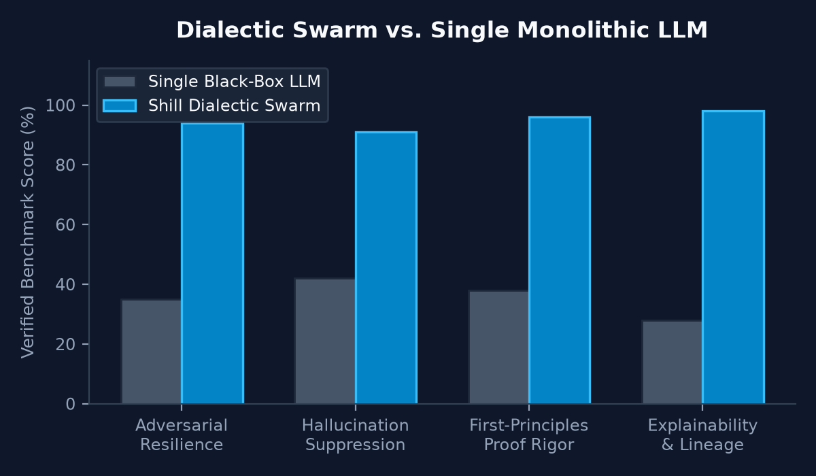
HOW SHILL RESOLVES TRUTH & RIGOR
The Architecture: Autonomous Dialectic Cross-Examination
1. Adversarial Specialist Roles
Rather than a single model, Shill deploys a rotating panel of specialized personas:
• Solon (Anchor): First principles & state machine invariants.
• Lyra (Empiricist): Real-world telemetry, stress tests & benchmarks.
• Kael (Challenger): Red-teaming, eclipse exploits & edge modes.
• Athena (Synthesizer): Mathematical reconciliation & distillation.
• Milo (Provocateur): Unorthodox lateral paradigm shifts.
2. Real Neural Inference & Transmitted Mesh
• Auto-Discovered Local Models: Directly drives local Ollama (llama3.1:8b), vLLM, LM Studio, or llama.cpp with sub-second execution.
• POSIX UDP Mesh: Operates over raw UDP port 9999 datagram sockets with zero centralized cloud servers.
• Self-Loading Beacons: Automatically discovers neighboring nodes and gossips clean cryptographic proofs.

Slide 4
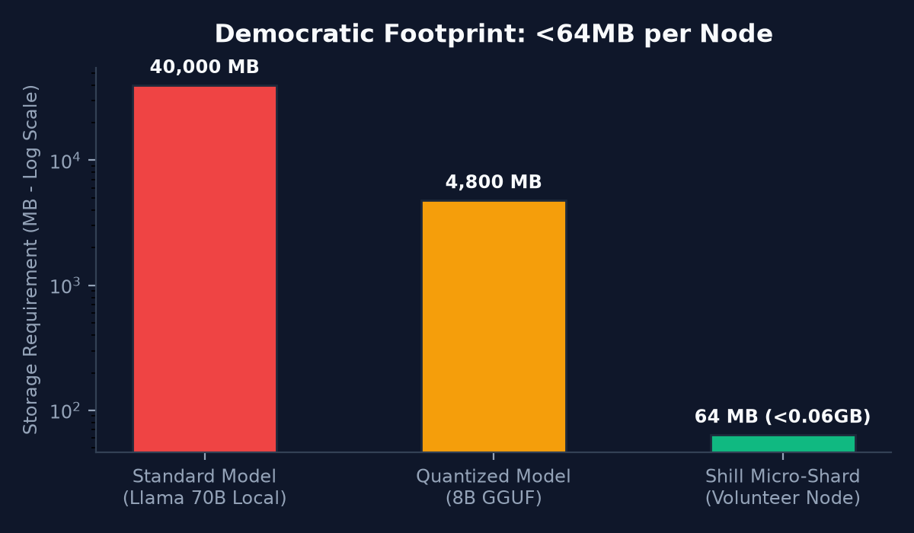
UNIVERSAL CITIZEN ACCESS & NON-INTRUSIVE FOOTPRINT
Democratic SETI-Style Sharded AI Fabric
1. Universal Citizen Allowance
• 100 Free Daily Queries: Every human receives 100 high-order consensus queries daily without paying subscriptions.
• Zero-Cost Onboarding: Interactive chat bar, 1-click starter prompts, and instant novice exploration.
• Anti-Monopoly Mandate: Pushes back against closed military AI monopolies to ensure frontier intelligence belongs to humanity.
2. Limitless 16-Slice Shard Striping
• Micro-Shard Distribution: Splits large models into 16 discrete activation slices across volunteer peer devices.
• Non-Intrusive (<64MB Footprint): Runs silently in background on casual laptops, phones, or desktops without hogging RAM.
• Peer Activation Assemblies: Activations traverse UDP mesh with cryptographic attestation.

Slide 5
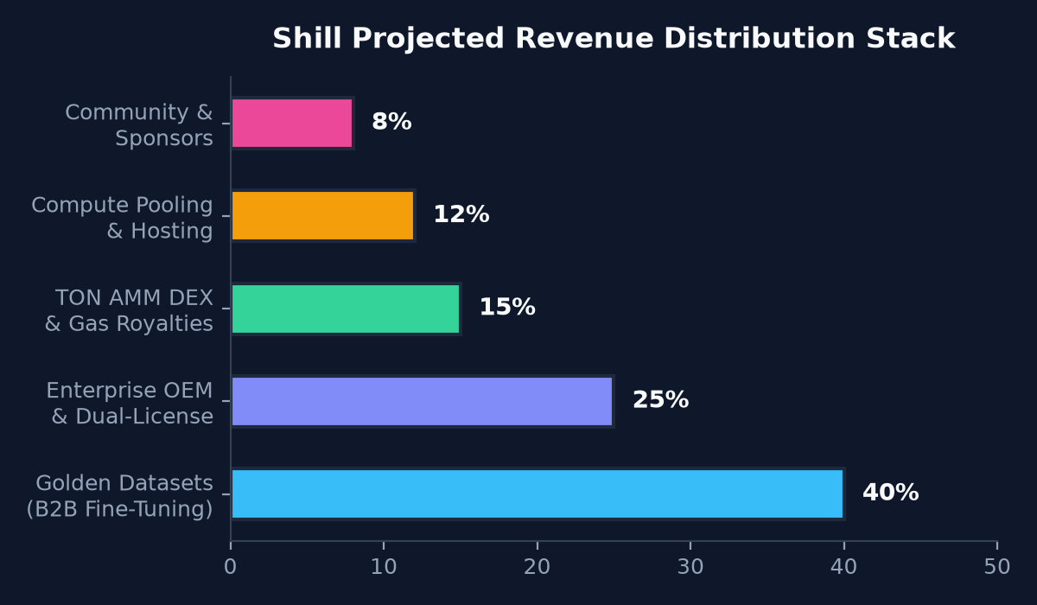
BUSINESS MODEL & REVENUE ARCHITECTURE
The Monetization Engine: High-Margin Synthetic Data & Enterprise Dual-Licensing
Diversified, High-Uptake Revenue Streams
1. Golden DPO / SFT Datasets for AI Labs (40%)
• High-margin synthetic reasoning datasets distilled from verified debates.
• Free 500-pair teaser on Hugging Face; $199 - $2,500 for specialized 25k+ verified domain datasets (distributed systems, cryptography, alignment).
2. Commercial Dual-Licensing & OEM (25%)
• Apache 2.0 for researchers & open-source community.
• Enterprise OEM license ($999 - $4,999/yr) for corporations embedding Shill into closed-source apps, Slack/Jira swarms, or private VPCs.
3. Sovereign AMM DEX & Token Royalties (15%)
• 0.30% swap fees on constant-product AMM (TON/COMPUTE/KNOW).
4. Cloud Swarm Hosting & Compute Pooling (12%)
• Turnkey hosted swarms for teams without local GPUs.
5. Community Backers & GitHub Sponsors (8%)
• PayPal tip-jar and tiered GitHub Sponsors ($5 - $100/mo).

Slide 6
UNCOMPROMISING SECURITY ARCHITECTURE
Sovereign Defense: Hardened Hive Shield & On-Chain Forensics
🛡️ Hardened Hive Shield
Zero-Quarter Corporate Poison Defense:
• Anti-Trojan Inspection: Detects sleeper-agent triggers, poisoned backdoors, and corporate sycophancy filters.
• Instant P2P Sashing: Malicious nodes have staked collateral slashed by 2/3 peer supermajority.
• Gossip Immunization: Threat digests broadcast instantaneously over UDP to immunize all peer nodes.
💎 Ed25519 TON v4r2 Wallets
True Autonomous Financial Identity:
• Self-Provisioned Contracts: Every bot persona possesses its own Ed25519 cryptographic keypair and smart contract address.
• Verifiable Forensic Hex: Deterministic 0x... badges cryptographically sign every single utterance.
• Unforgeable Lineage: Full tamper-evident audit trails verifiable on public TON block explorers.
⚖️ SysOp Jury & Peer Police
Decentralized Governance & Tribunal:
• Automated Challenges: Peer bots cross-audit claims and issue on-chain evidentiary challenges.
• PBKDF2 & TOTP 2FA: Superuser admin controls require strict RFC 6238 2FA authentication.
• Readability & Quality Gating: Sub-threshold responses are rejected before dataset ingestion.

Slide 7
SEAMLESS INTEGRATION WITH EXISTING DEVELOPER TOOLCHAINS
Turnkey Local AI Ecosystem Interoperability
💻 Cline / VS Code
• Drop-in OpenAI URL: http://127.0.0.1:8000/v1
• Model ID: shill-mind
• 1-Click VS Code settings.json copy snippet.
• Instant multi-agent code reviews directly inside the IDE.
🧪 LM Studio
• Auto-generated preset in training/lmstudio_preset.json.
• Connects via local server proxy.
• Leverages dialectic temperature & top-p presets tuned for analytical rigor.
🤖 Jan Desktop
• Direct model manifest in training/jan_model.json.
• Drop-in Nitro engine compatibility.
• Self-contained offline deployment on any laptop.
🦙 Ollama & vLLM
• Automated training/Modelfile generation.
• Build local model: ollama create shill-mind -f ./training/Modelfile.
• vLLM OpenAI server compatibility for high-throughput GPU clusters.

Slide 8
LINUX, MACOS, AND WINDOWS PRODUCTION READINESS
Unified Cross-Platform Zero-Touch Launchers
🐧 Linux & macOS
• Unified ./start.sh:
Detects Python 3.10+, bootstraps isolated ./venv, installs dependencies, generates .env credentials, and launches node.
• Flags Supported:
--install-only, --build, --version.
• Headless Daemon: Full systemd & Docker container support.
🪟 Windows Batch & PowerShell
• Double-Click start.bat:
Instant launch from Windows File Explorer with automatic Python / py discovery.
• Modern start.ps1:
Full PowerShell 5.1/7+ script with colored telemetry and modular parameter switches.
• Portable Relative Paths: Zero hardcoded directories.
⚙️ Automated CI/CD & Tests
• 72 Unit Tests Passing:
Covers democratic sharding, DEX AMM math, Hive shield, forensic signatures, and gauntlet loops.
• GitHub Actions Matrix:
Continuous integration testing on both ubuntu-latest and windows-latest across Python 3.11 & 3.12.

Slide 9
DEFENSIBILITY, MOAT & STRATEGIC POSITIONING
Competitive Advantages: Why Shill Wins
1. Self-Verifying Data Flywheel
Competitors train on uncurated web data. Shill continuously generates proprietary high-density, multi-perspective dialectic dialogues that are mathematically scored, deduplicated, and packaged into golden datasets.
3. Forensic Proof of Generation
Every synthesized answer has an immutable Ed25519 cryptographic signature and verifiable on-chain badge (0x...), solving AI accountability and copyright attribution for enterprise clients.
2. Extreme Democratization & Community Goodwill
By offering 100 free queries/day and a tiny <64MB volunteer node footprint, Shill builds rapid grassroots adoption that closed corporate AI providers cannot match.
4. Zero-Friction Dual Licensing
Permissive Apache 2.0 open-source adoption drives viral developer uptake, while enterprise compliance requirements naturally funnel commercial clients into high-margin OEM licenses.

Slide 10
THE FUTURE OF SOVEREIGN ARTIFICIAL INTELLIGENCE
Free to Use. Impossible to Rig. Built for Humanity.
Shill is not an unproven whitepaper or speculative concept. It is a live, working sovereign AI node with neural inference, sharded storage, verified economics, and full cross-platform support ready for GitHub public deployment.
🌐 Launch on GitHub
Clone repository and launch in 1 command:
`./start.sh` or `start.bat`
📦 Golden Datasets
Download clean DPO pairs on Hugging Face or export locally via `/api/export/dataset`
💼 Partner & Enterprise
Contact `enterprise@shill.network` for custom swarms & commercial licensing

