Slide 1
IS OSGI READY FOR WIDE ADOPTION?
Bartosz Kowalewski
kowalewski [dot] bartosz [at] gmail [dot] com
May 13, 2011
Notes:
While the main message that is passed in this presentation is „OSGi together with related technologies might be too complex for and might not bring a lot of value to most projects”, it is still a nice piece of technology. If you’re not developing a production system and have some time for investigation and experiments, give it a try and spend some time playing with it.
Please note: This is not an intro to OSGi.

Slide 2
AGENDA
A couple of facts
OSGi promised pros
OSGi versus operational standards
The OSGi Enterprise specification
Tooling
Want to learn more?
Bartosz Kowalewski – May 13, 2011

Slide 3
Haven’t used OSGi yet?
Modularity is about minimizing coupling
Let’s get rid of classpath/JAR hell!
Versioning
Redeployment
Richard S. Hall created a really good intro presentation:
http://felix.apache.org/site/presentations.data/Learning_to_ignore_OSGi.pdf
Notes:
Mark Reinhold (one of the top Java engineers over at Sun/Oracle) announced "The classpath is dead!"
JDK is big! http://blogs.sun.com/mr/entry/massive_monolithic_jdk
http://blogs.sun.com/mr/entry/modular_java_platform
http://blogs.sun.com/mr/entry/jigsaw
http://blogs.sun.com/mr/entry/packaging_java_code

Slide 4
Is OSGi popular?
ServiceMix 4
Apache Geronimo 3.0
Oracle GlassFish V3
JBoss AS 7
WebSphere Application Server (WAS)
Eclipse
Bartosz Kowalewski – May 13, 2011
Notes:
1. ServiceMix 4 (OSGi + Karaf)
2. Apache Geronimo 3.0 JEE server (OSGi + Karaf): Karaf shell, Karaf features, Aries (with WABs), etc.
GA hasn't been released yet, however a milestone version is already available.
3. GlassFish V3 (Sun) started in Dec 2009. - both the community version and the commercial one.
All modules are OSGi compliant. OSGi is no longer under the cover!
3.0 release at the end of 2009. 3.1 was released this year.
By default running on top of Felix. These are just plain OSGi bundles, so it's technically possible to embed it into a different OSGi based server.
(without Karaf)
4. JBoss AS
JBoss Modules - http://relation.to/16904.lace - similar to Jigsaw (JSR 294) - already present in JBoss AS
JBoss AS 7 (now Beta3) provides means to deploy OSGi bundles (it's compliant with OSGi spec 4.2)
5. WebSphere Application Server
6. Eclipse (somewhat simiplified view over OSGi)

Slide 5
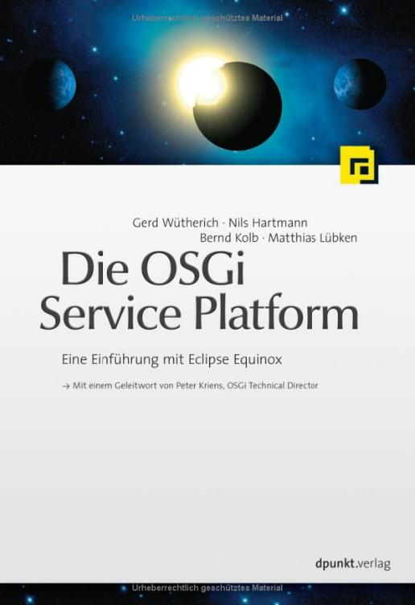
Do all people like OSGi?
Denglisch or just German?
Bartosz Kowalewski – May 13, 2011
Notes:
Languages do collide ☺. The authors should have thought twice before they approved this title.

Slide 6

Do all people like OSGi?
SpringSource dm Server moves to Eclipse.org:
  http://blog.springsource.com/2010/01/12/dm-server-project-moves-to-eclipse-org/
  http://static.springsource.org/s2-dmserver/2.0.x/programmer-guide/html/
„For a mainstream development team though, who just want to build an enterprise application as quickly as possible, and with as little hassle as possible, the costs currently associated with adopting enterprise OSGi can outweigh the short-term benefits.”
Bartosz Kowalewski – May 13, 2011

Slide 7

Do all people like OSGi?
Osgification of Mule ESB abandoned (Nov 2010)
- http://blogs.mulesoft.org/osgi-no-thanks/
„The fundamental principles of OSGi are rock solid and we definitely need modularization on the JVM in order for it to flourish in its new defacto role of the polyglot platform. I think OSGi has potential but the user interaction part of it needs to be re-thought now that OSGi is being targeted at regular application development.”
Bartosz Kowalewski – May 13, 2011
Notes:
Richard S. Hall (Apache Felix guru):
„If you come to OSGi and expect all legacy JARs to work perfectly and still reap all of the benefits of modularity, then you might as well not even try. That’s sort of like switching from C to C++ back in the 1980s and just hoping that everything automatically becomes object oriented.
Unfortunately, we are still largely at an infancy when it comes to modularity in Java. There is pain when you want to move to OSGi, no doubt about it. For some, the pain is worth it now. For others, they need to wait until more work is done by others to get more stuff working.
From my point of view, the biggest failing of OSGi is that we have someone convinced people we can get all of the legacy crap working, when in reality it should all be refactored. We are doing evolution instead of revolution, which is death by a thousand cuts rather than one big one. I guess we’ll have to wait for whatever comes after Java.”
Lots of success stories and failures; OSGi complex; some people tend to say: „failed to migrate to OSGi? Find better developers”; this is not 100% true
OSGi’s good for vendors, for creating infrastructure apps that nobody touches – are just deployed onto a server ...

Slide 8
OSGI PROMISED PROS
Bartosz Kowalewski – May 13, 2011

Slide 9
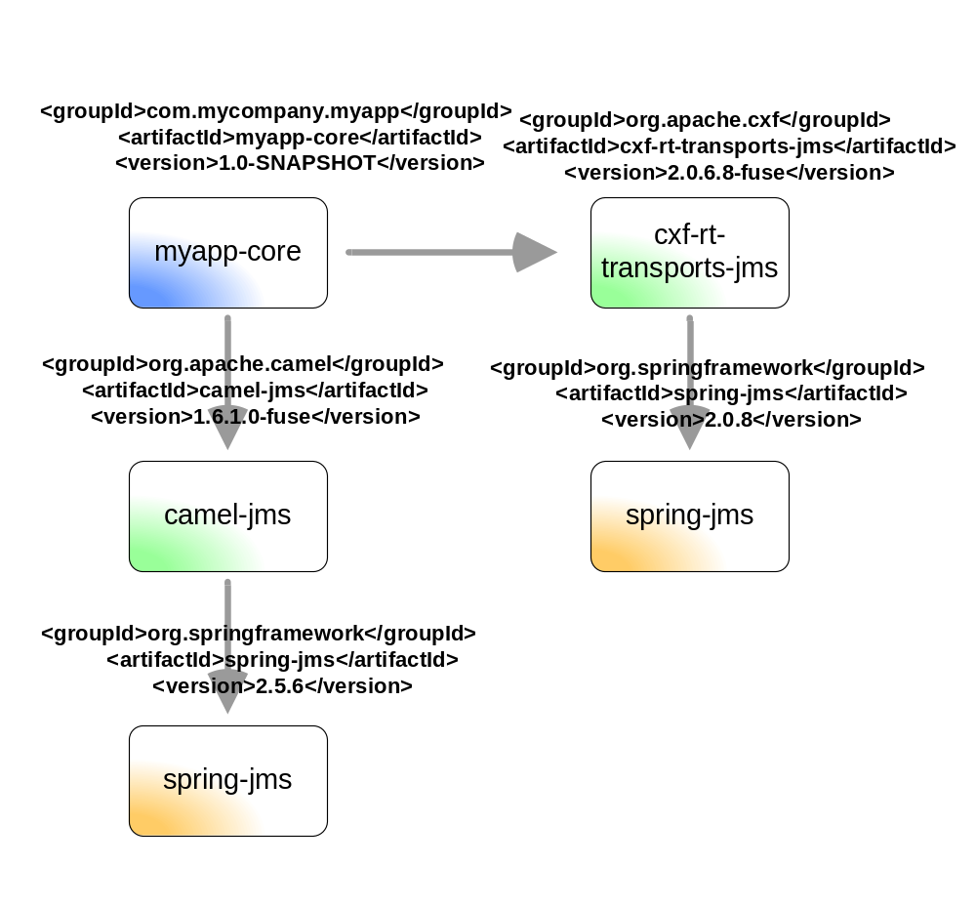
Better class space consistency
Better dependency management
Classloader separation
Promotes reusability
Limits visibility, not accessibility
Bartosz Kowalewski – May 13, 2011
Notes:
What is OSGi for? Projects use many libraries with second-level dependency conflicts. Classpath (Jar) hell is common.
What’s a bundle – a jar + metadata
Introduces Services inside the JVM
Implementations? Felix, Equinox, Knopflerfish, ...

Slide 10
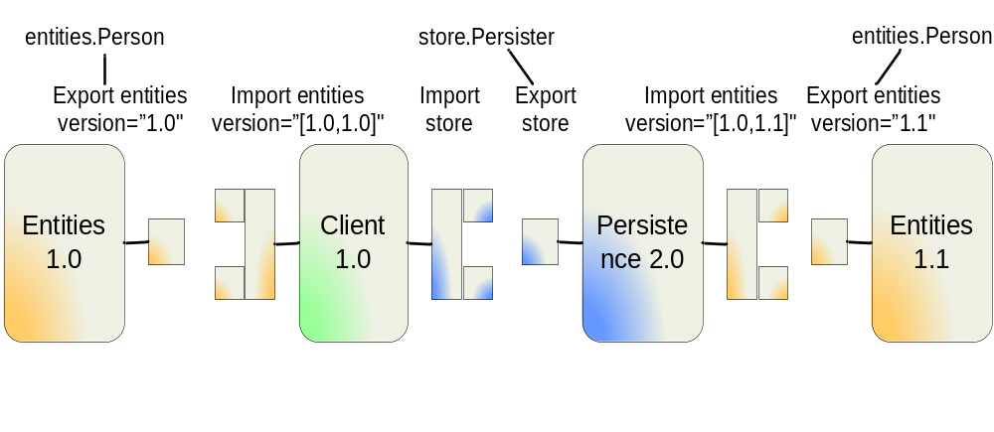
Better class space consistency
‘Uses’ conflicts
What’s the ‘uses’ directive all about?
package store;
import entities.Person;
public class Persister {
public void doIt(Person p){
... }}
Bartosz Kowalewski – May 13, 2011
Notes:
Many 3rd party libraries are not fully OSGi compliant. Their OSGi metadata is often malformed, i.e. many libraries do not use the 'uses' directive at all. It leads to serious issues that cannot be solved without modifying these 3rd party libraries and might be hard to track as they require some knowledge about the internals of the given 3rd party library. More details on the uses directive are available here: http://blog.springsource.com/2008/10/20/understanding-the-osgi-uses-directive/.
WebSphere MQ client libraries are still an example of ignorance of the ‘uses’ directive ☺. It’s weird, as IBM is one of the leaders in popularizing OSGi and drives many OSGi related initiatives.
BND (the best tool for generating OSGi metadata) also has poorly desgined OSGi metadata
Uses conflicts happen really often. Dependencies are calculated for a given bundle (let's say it's bundle a.b.c) when it is being deployed. Most often the dependencies of this a.b.c bundle are already present in the env. They will not be resolved again when a.b.c is installed, so they might already be using dependencies that conflict with dependencies of a.b.c.
Container helps a lot with analyzing these problems, but they are really hard to solve.
How to diagnose ?
http://blog.springsource.com/2008/11/22/diagnosing-osgi-uses-conflicts/
http://njbartlett.name/2011/02/09/uses-constraints.html
http://njbartlett.name/2011/03/31/uses-constraints-in-felix.html

Slide 11
DEMO
A DEEP DIVE INTO (CLASS) SPACE
CLASSPATH HELL -> BUNDLE HELL?
Bartosz Kowalewski – May 13, 2011
Notes:
Take a look at the UsesDirectivePositiveTest and UsesDirectiveConflictTest tests in the attached project.

Slide 12
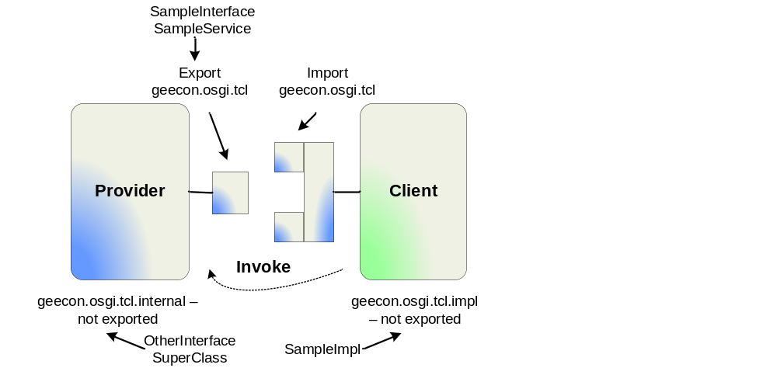
Better class space consistency
Dynamic class loading and Thread Context ClassLoaders (TCCLs)
Bartosz Kowalewski – May 13, 2011
Notes:
Dynamic class loading
Unfortunately, many libraries need to be provided with the definitions of the classes from bundles that use these libraries. Let's take an example. Hibernate requires client appplications to pass definition of their mapping to Hibernate. When designing the Hibernate bundle it wasn't known what applications will use it, so no such OSGi imports are present in the metadata for the Hibernate library. Also the DynamicImport-Package is not used (and it should not be - it's not a best practice to use it). Hibernate only works because it uses context classloaders. The client application sets the context classloader to its own classloader (Thread.currentThread().setContextClassLoader(SomeClass.class.getClassLoader())) and then Hibernate will be able to pick up the mapping. Such an approach is required really often (not only when using Hibernate) and makes understanding how the OSGi env operates really hard.
When using TCLs client libraries often need to know what packages might be required by the bundle that they are calling with TCL – i.e. Hibernate with cglib, importing many hibernate packages even though you only explicitly need one.
Please note, Apache Aries (Persistence) solves persistence related issues introduced by OSGi. However, as fars as I know, it only plays well with OpenJPA and EclipseLink JPA and has only been tested with these two.

Slide 13
DEMO
WANT TO ENHANCE ?
Bartosz Kowalewski – May 13, 2011
Notes:
Let’s play with TCCL and setup similar to the one used in Hibernate – play with CGLib (Code Generation Library) Enhancer
Take a look at the TclTest class in the attached project.

Slide 14
ClassLoaders are everywhere!
TCCL is inherited when a new thread is created
Plenty of libraries make use of TCCLs
... and what about frameworks?
Equinox sets TCCL to its Context Finder ClassLoader
Equinox introduces Buddy Classloading
Bartosz Kowalewski – May 13, 2011
Notes:
1. If classloaders were passed as parameters /were present in method signatures/, life would be easier.
2. The need to have TCCL set is rarely docuemnted in 3rd party libraries. Without these docs, developers don’t know if a TCCL needs to eb set and if so, what it needs to provide.
The fact that TCCL is „propagated” until somebody clears it might also be extremely harmful.
3. Don’t forget about the Require-Bundle header that some people use. This header is defined in the spec!
4. Eclipse plug-ins versus OSGi bundles:
http://www.ibm.com/developerworks/opensource/library/os-ecl-osgi/
Extension points, no OSGi services...
The Eclipse IDE uses a subset of OSGi centered around modularization and bundle life cycle. However, it makes minimal use of the service support OSGi provides. Instead, Eclipse provides its own extension point system to enable bundle interaction. Bundles expose functionality as contributions to other extensions. Bundles also define their own extension points, to which other bundles may contribute. An example of using extension points in Eclipse is the Preferences window. A core Eclipse plug-in provides the central window and exposes an extension point to allow the contribution of additional preference pages. As new plug-ins are added to Eclipse, they can contribute their own pages. The model of extension points in Eclipse is different from basic OSGi services. Bundle extension points are owned by the defining bundle; other bundles simply contribute to them. In comparison, any bundle can implement and use an OSGi service.

Slide 15
DEMO
DEMYSTIFYING EQUINOX AND ITS BLACK MAGIC
Bartosz Kowalewski – May 13, 2011
Notes:
See EquinoxClassLoadingMagicTest in the attached project.

Slide 16
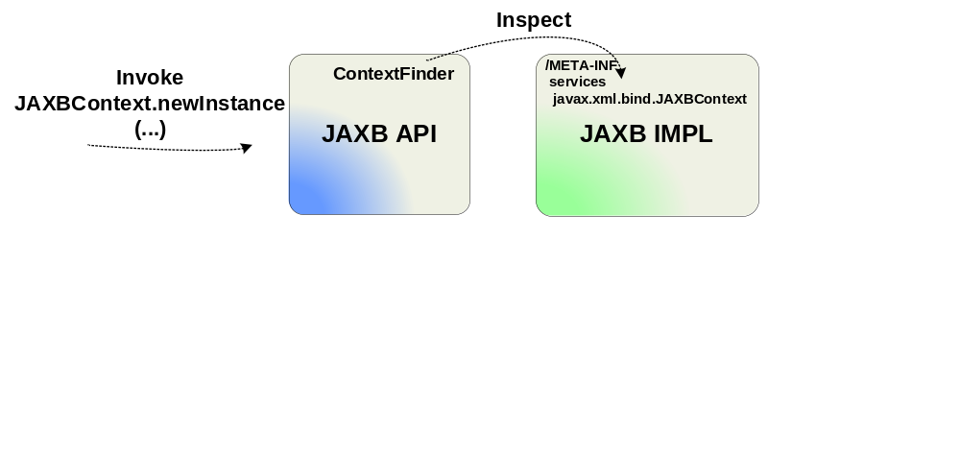
Better modularity and componentization
Service Provider Interface (SPI)
Application-specific SPI-like mechanisms
Existing component-like designs
Bartosz Kowalewski – May 13, 2011
Notes:
- Service Provider Interface (SPI) is one of the fundamental Java mechanisms used in many starndard Java APIs (i.e. XML-related APIs - SAX, DOM, XSLT, XML validation, etc.). Basically, it enables one to change the implementation of a specific API used in a Java app just by adding a new jar to the classpath of this app. For details refer to: http://java.sun.com/j2se/1.3/docs/guide/jar/jar.html#Service%20Provider
The issue with SPI in an OSGi env is that all these mechanisms are based on files that define names of classes that provide the services. In each implementation of the API (i.e. the Hibernate EJB jar for the JPA API) we have a file META-INF/services/foo.bar. When using the API, classpath is searched for all implementations (all META-INF/... files), classes specified in these files are loaded, and used as providers of the service. The problem is that bundles that provide the API (i.e. the JPA API jar) do not have access to resources defined in other bundles. Even though JPA uses thread context classloader, so it is definetly able to load the Hibernate JPA provider class, it's unable to get the name of the class to be loaded. It’s because TCCL is set to the classloader of the bundle that uses JPA and not to the classloader of the bundle that defines the JPA provider.
Please see the javax.persistence.Persistence class for details.
Workarounds that can currently be used:
Export META-INF/services/ (META-INF.services) and use it as a split package – UGLY!
Copy the relevant files in the META-INF/services directory from the bundle that provides the implementation into your own bundle. You may also need to add some imports and set context classloader.
Create an OSGi extender that processes each and every bundle that is present in the env and detects implementations of SPI-based APIs. This approach is already used by many of the standard APIs available in SMX4. Standard JRE classes have been overridden to use a SMX4 specific OSGi extender underneath.
What is more, some libraries use SPI-like mechanisms. They provide mechanisms for attaching new components without the need to explicitly register them in the core bundle/component. In order for these definitions to be picked up a dedicated OSGi extender needs to be created. Thanks to the OSGi extender it is capable of detecting definitions of components. Apache Camel is a good example of such an approach.
Existing component-like designs are not suitable for the OSGi env. Apache CXF: based on Spring – requires lots of imports when you want to initialize it using the normal CXF approach.
SPI: Not only hacked by Servicemix guys but also by GlassFish ones: http://wikis.sun.com/display/GlassFish/JdkSpiOsgi

Slide 17
DEMO
SPIES
Bartosz Kowalewski – May 13, 2011
Notes:
See SpiTest in the attached project.
Pax profiles – jaxb is not there; jaxb api comes from one of bundles that we load; default impl comes from the jre – through boot delegation.
pax-runner\pax-runner-platform\src\main\resources\META-INF\platform\ee\

Slide 18
Reusability
OSGi enables us to reuse the same bundle in many applications, but exisiting libraries use:
  Statics, shared state
  Global configuration
  Background threads
  Shutdown hooks
  TCCLs without clearly stating what they are going to load through these
  And sometimes make classes loaded using one client bundle’s TCCL available to other clients
  ...
Attempts to define OSGi readiness levels
Bartosz Kowalewski – May 13, 2011
Notes:
Reusability – using the same bundle instance in several client bundles
STATICS:
Let's say that bundle X defines class a.b.C. Bundles Y and Z import the a.b package and use the a.b.C class. They will have access to the same a.b.C class instance, so if this class uses statics, the value of these statics will be shared. Y and Z will use shared/global state of a.b.C. This is sometimes dangerous. If Y and Z load their specific configuration into a.b.C, configuration will be merged and shared.
Sharing state, configuration, ...
Often used for default configuration in many technologies – i.e. CXF
Background threads dedicated to some client bundles - not closed when those bundles are stopped/uninstalled
-------------
http://njbartlett.name/2010/08/24/osgi-compliance-levels.html
http://njbartlett.name/2010/08/30/osgi-readiness-loading-classes.html
http://tux2323.blogspot.com/2010/08/osgi-bundle-quality-or-bundle.html

Slide 19
Unified logging
OSGi Log Service
Traditional logging mechanisms (i.e. log4j)
Pax Logging (log4j as the backend impl)
Bartosz Kowalewski – May 13, 2011
Notes:
OSGi Log Service provides little functionality - only front-end API. Advantage: decouples clients that log messages from storing them on disk/showing on console, etc.
Traditional logging mechanisms are not really suitable for OSGi – they do not go through Log Service, use lots of statics, parts responsible for logging messages and passing them to ‘appenders’ are not decoupled; they are often located in the same package.
OPS4J: Open Participation Software for Java:
OPS4j Pax: Concentrates on providing ‘good practices and technology integration’ for OSGi
Covers logging, testing, running (quick start), ...
Pax Logging: exposes different client APIs, uses Log4j underneath;
- Only mimics standard logging APIs. Log4j, for example, has been partially rewritten. Tries to divide log4j into client api and a prt that writes to logs.
- Log4j used to pass messages to appenders is not as configurable as it could be. It’s hard to attach custom appenders, etc.
- Pax Logging uses shared configuration and of course logging APIs exposed by Pax Logging use lots of statics. This may cause some issues (i.e. you cannot have seperate ICE Logging configurations for each of your applications, seperate log4j logger factories cannot be used, there's a single hierarchy of loggers, etc.)

Slide 20
Widely adopted and mature standard
Only pure OSGi is widely adopted
The OSGi Enterprise Spec 4.2 was released in March 2010
Plenty of changes are planned in both the Core and the Enterprise spec
Many enterprise libraries still require improvements
Bartosz Kowalewski – May 13, 2011
Notes:
Only pure OSGi is widely adopted. Enterprise libraries (i.e. CXF, c3p0, Hibernate, etc.) that are used in our scenarios and the OSGi-based technologies that simplify creating enterprise application for the OSGi env are not yet stable and mature enough. They are still being evolved and improved so that they work better in OSGi containers.
More on the OSGi Enterprise Spec 4.2 later ...
Changes? i.e. weaving, ...

Slide 21
OSGI VERSUS OPERATIONAL STANDARDS
Bartosz Kowalewski – May 13, 2011

Slide 22
OSGi & so-called nondeterminism
Order of deployment of bundles matters
Deploy all bundles at once or only deploy core ones and add remaining ones later?
Nondetereministic? Is hot deployment safe?
Use OSGi Bundle Repository (OBR) in production?
Bartosz Kowalewski – May 13, 2011
Notes:
For many companies it might often be too dangerous to deploy many applications/flows in the same process/container, because they could interfere (even if it's on the OSGi resolution process level). What is more, even if a single application is being deployed on the container, remnants of the previous installation of this app may influence the new version. There might for example be problems with resolving the new version, because dependencies used by the old version alter the resolution process.
If we decide to use the 'single container per app' model, do we really need the advanced resolution and dependency management mechanisms provided by OSGi? Isn't Maven sufficient during development process and aren't sets of libraries assembled by Maven sufficient for runtime? When preparing a set of dependencies to be used at runtime by a single app (with a single classloader), it's not really tricky to do it using Maven.
There are several rules that define how OSGi container should behave when resolving bundles. Bundle ID is one of the parameters that is taken into account when doing bundle resolution. Incorrect order might lead to ‘uses’ conflicts, etc.
If you first deploy only a subset of bundles and then add the remaining ones, the result of the process of resolution might be different than when deploying all of them at once.
If order of bundles matters and it is also important if we deploy all of them at once or not, then upgrading our app at runtime might be dangerous ?!
OBR (RFC-0112) – unable to certify the app – you’re not sure that you’ll get the same set of bundles next time you ask OBR for dependencies.
(C:\svn_checkouts\aries\application\application-itests\src\test\resources\obr\ on my machine :P)
http://sigil.codecauldron.org/spring-external.obr
http://www.knopflerfish.org/repo/bindex.xml

Slide 23
OSGi & so-called nondeterminism
OSGi services and service ranking
OSGi extenders using many threads in paralell (i.e. Blueprint)
Bartosz Kowalewski – May 13, 2011
Notes:
If you register many services providing the same interface, ranking may or may not work. There might be some timing issues that will cause the service with lower ranking to be chosen.
Blueprint will be covered later.

Slide 24
Eliminate nondeterminism?
Explicitly specify bundle install order?
Explicitly specify bundle start levels?
Use extra properties when looking up services?
Give up using hot deployment?
Bartosz Kowalewski – May 13, 2011
Notes:
Many will chose to explicitly specify all of these settings (order, start levels, whether to start a bundle or not). When using Equinox people will often use their own config.ini files and list all bundles there. Hot deployment mechanisms – Aries EBA, ServiceMix Features, OBR, etc. – will not be used.

Slide 25
OSGI ENTERPRISE
Bartosz Kowalewski – May 13, 2011

Slide 26
Spring DM
Dependency injection mechanisms to be used inside an OSGi container
Integrates Spring powered applications with OSGi
Hides low level OSGi details – handles OSGi services, OSGi Configuration Admin, etc.
Issues
  Lifecycle
  Multiple versions of the same namespace
  Custom namespaces and waiting for OSGi services
Bartosz Kowalewski – May 13, 2011
Notes:
Many namespace handlers for the same ns
(A single) Spring DM bundle is not capable of handling many namespace handlers for the same namespace. It's beacuse Spring DM is a simple wrapper over Spring core.
In other words, if you have two versions of the same bundle and each of them provides it's own handler for the shared namespace, then you won't be able to use both versions at the same time. Camel is a good example. For details see the 'Camel' section below.
Spring context lifecycle
Spring context lifecycle is not fully bound to OSGi bundle lifecycle. If your OSGi bundle is started/stopped, the context defined inside this bundle will be started/stopped. Nevertheless, if your Spring context dies (it's for example possible in case of ActiveMQ) then your OSGi bundle will remain started. It may be a proper default behavior, but it should be possible to bound context lifecycle with OSGi lifecycle so that bundle is stopped when te context is destroyed.

Slide 27
The OSGi Enterprise spec
Enterprise Expert Group within the OSGi Alliance (created in Jan 2007)
Goal: Provide components enabling an enterprise OSGi application programming model
The spec standardizes the way in which JPA, JTA, JNDI, JMX, JDBC, DI (Blueprint), ... are used in OSGi
First version of the spec released in March 2010
  Missing: Blueprint CM, Enterprise Bundle Archive (EBA)
http://www.osgi.org/Download/Release4V42
Bartosz Kowalewski – May 13, 2011
Notes:
OSGi Alliance members realized that the limitations that OSGi imposes make it difficult to develop enterprise applications. ... And created an expert group responsible for introducing a new spec.
From Apache Aries:
„OSGi is a mature and Java modularity technology that is well-used in many environments but, in the enterprise space, has more typically been exploited by the internals of the runtime infrastructure than the applications that run on it. This is primarily because of a lack of a clear enterprise OSGi application programming model and implementation of OSGi-enabled Java technology to support enterprise applications. OSGi specifications are specified and maintained by the OSGi Alliance which recognized this state of affairs several years ago and established the Enterprise Expert Group within the Alliance to focus specifically on the needs of enterprise applications. The objective of this project is to deliver open source implementations of these application-centric technologies to enable the development of application components, benefiting from the modularity of OSGi combined with standards-based programming models, which can be deployed to a variety of target runtimes.”
You can also take a look at:
http://www.infoq.com/news/2010/03/osgi-enterprise-42-released

Slide 28
Apache Aries
Launched in Sep 2009 in Apache Incubator
Some components contributed by Apache Geronimo
Implements the OSGi Service Platform Enterprise Specification – Release 4, Version 4.2
Introduces custom extensions
  SPI-Fly, EBA, Blueprint CM
Uses semantic versioning
Already graduated from Incubator
Give it a try! http://aries.apache.org/
Bartosz Kowalewski – May 13, 2011
Notes:
http://www.slideshare.net/mahrwald/apache-aries-a-blueprint-for-developing-with-osgi-and-jee
Used in several servers including Servicemix and Geronimo
------------------
https://svn.apache.org/repos/asf/aries/slides/
- Blueprint
- container managed persistence and transactions; declarative transactions thanks to bean interceptors in Blueprint
- transactions: Aries transactions registers an osgi service - transaction manager (spring or geronimo ones); you can access this transaction manager (osgi service) explicitly or use blueprint namespace ...
- Message Driven Services/Message-driven Blueprint components
- BP Annotations in code
- BP & Configuration Admin
- JNDI - looking up osgi services
- EBA packaging - descriptor with list of bundles; bundles do not have to be packed inside; + OBr could be used - bundles list might not be self-contained
- quiesce (kliess) z polskim l
* Interface for the quiesce manager. A quiesce manager provides the functionality to stop
* bundles in such a manner that currently running work can be safely finished. To exploit this
* above the quiesce manager individual containers / extenders (such as blueprint, jpa etc) need to
* quiesce aware and register {@link QuiesceParticipant} appropriately.
- subsystem (framework hooks)
- Web - bundles with web content - Web-ContextPath
- Web - deploy oridinary war files /i.e. using a new url handler (webbundle)/ they are converted on the fly to WABs
- JMX - some useful beans registered
- SPI fly - headers for spi consumers and providers; SPI fly can tweak TCCL before SPI dependent code is called in Spi consumer
STD scenario: 1 bundle with a data source; 1 bundle with entities and persistence.xml with definitions (uses the met-persistence header, uses the datasource through jndi, cause a JPA entity manager factory to be registered);
1 bundle that creates EM (on the basis of EMF) and ...;
-------------------
***A side note:
Semantic Versioning
Each package versioned independently; Bundle version will most probably be equal to the highest package version present in the given bundle.
Version: major.minor.micro.qualifier
If you're defining an API, then:
- when extending the API (non-breaking change), increment the minor part
- when breaking the API, increment the major part
If somebody is a consumer of the API, then it should import x.?.?.?; If somebody is an implementor/provider of the API, they should import x.y.?.? That's new in OSGi!
http://www.osgi.org/wiki/uploads/Links/SemanticVersioning.pdf
http://www.aqute.biz/Bnd/Versioning
What about branches? Semantic versioning on branches /bugfix branches/? No single good answer :/.

Slide 29
Eclipse Gemini
Started in Eclipse Incubator in late 2009
Competes with Apache Aries
Various components contributed by SpringSource and Oracle, i.e. Blueprint implementation from Spring DM
Hasn’t graduated yet
Seems to be much less mature than Aries
http://www.eclipse.org/gemini/
Bartosz Kowalewski – May 13, 2011
Notes:
http://www.eclipse.org/proposals/gemini/

Slide 30
TOOLING
Bartosz Kowalewski – May 13, 2011

Slide 31
Tooling
BND
OPS4J Pax:
  Pax Runner
  Pax Exam 1.x
  Pax Exam 2: https://github.com/tonit/Learn-PaxExam
  Pax URL now supports Aether
Eclipse plugins, Maven plugins, ...
Apache Karaf http://www.slideshare.net/iocanel/karafdemo
Bartosz Kowalewski – May 13, 2011
Notes:
1. Pax Exam 2: https://github.com/tonit/Learn-PaxExam
PaxExam2 = PaxExam1 + native test container (based on nested frameworks from OSGI Core 4.2 spec; on Launch(er) API); Old Pax Runner container that creates a new JVM process for each test is still supported. Now subsequent tests can be run inside a single process.
1a) Launcher (Embedded/nested frameowrk API is used in Pax Exam 2): http://njbartlett.name/2011/03/07/embedding-osgi.html
You can launch an OSGi framework from the inside of your App/Java process.
Framework-agnostic launcher API (or Apache Karaf for standalone deployments) is useful as (for example) Felix has better diagnotics toolset and you can siwtch to Felix if you're running into problems.
2. http://en.wikipedia.org/wiki/OSGi-Tooling
The Pax family o tools, bnd, Eclipse plugins (i.e. the standard one that provides means to edit manifests), Sigil tooling (at least Eclipse plugin), plugin for IntelliJ, plugin for scala
http://tycho.sonatype.org/ Sonatype Tycho - creating Eclipse plugins
SpringSource Tool Suite (STS) / Eclipse Virgo
BndTools - eclispe plugin that provide means to create and run osgi apps
3. Pax URL now supports Aether - better handling of downloading and caching
Aether = Embeddable Maven Repository API
4. Tooling: http://wikis.sun.com/display/GlassFish/OsgiPkgDepAnalyser
Problems found:
1) Too many unused packages
2) Some bundles export package without any version
3) Some bundles import without any version range
4) Duplicate packages

Slide 32
LET’S WRAP IT UP!
Bartosz Kowalewski – May 13, 2011

Slide 33
Bottomline
A cool piece of technology, but ...
Productivity drops dramatically as the learning curve is steep.
You won't get away with not knowing OSGi internals. No tooling will hide all the problems and you will still need to learn all the tricks and tips.
Are your 3rd party dependencies really OSGi-compliant?
Keep on playing with OSGi, but think twice before you start using it in a production system and before you commit to deadlines.
Bartosz Kowalewski – May 13, 2011

Slide 34
Other approaches to modularization
Have time to play? Check these out!
Pomegranate http://www.caucho.com/projects/pomegranate/
Project Jigsaw (JDK8?)
http://openjdk.java.net/projects/jigsaw/
http://sellmic.com/blog/2009/06/11/classpath-hell-just-froze-over/
Bartosz Kowalewski – May 13, 2011
Notes:
Those two approches are much less complex than OSGi. They manage dependencies on a higher level. They do not address enterprise usecases at all, as they do not change the environment enough to require Enterprise apps to be developed differently. They are somewhat simplistic – do not address the split packages issue, etc.
Pomegranate:
http://blog.caucho.com/?p=225
Jar-level dependencies implemented using pom.xml with version ranges.
Jigsaw:
Not much news, little is happening :).
http://jcp.org/en/jsr/detail?id=294
Integrated into JDK
http://openjdk.java.net/projects/jigsaw/
http://blogs.sun.com/abuckley/resource/JSR294AndModuleSystems.pdf
Visibility versus Accessability; OSGi limits visibility, does not restrict access; Jigsaw should be able to restrict both;

Slide 35
Homework!
Take a look at links available in slide notes and ...
http://www.osgi.org/blog/2008/06/jsr-277-and-import-package.html
http://ekkes-corner.blogspot.com/2008/06/catch-22-logging-with-osgi-frameworks.html
http://www.adam-bien.com/roller/abien/entry/how_to_kill_an_osgi
http://sellmic.com/blog/2009/06/11/classpath-hell-just-froze-over/
http://www.osgi.org/blog/2009/06/classpath-hell-just-froze-over.html
Bartosz Kowalewski – May 13, 2011
Notes:
These are not links that help learning OSGi. These links will help you understand problems related to OSGi, help to make a decision if OSGi is what I want, help to understand other approaches to modularization.

Slide 36
Even more homework!
http://static.slidesharecdn.com/swf/ssplayer2.swf?doc=whatsnewinosgi42enterprise-100507012922-phpapp01&stripped_title=whats-newinos-gi42enterprise
http://www.ibm.com/developerworks/websphere/techjournal/1005_inreach/1005_inreach.html
  Manning: OSGi in Action released in April 2011
  only ~600 pages
  http://www.manning.com/hall/
Bartosz Kowalewski – May 13, 2011

Slide 37
QUESTIONS &
(POSSIBLY) ANSWERS
Bartosz Kowalewski – May 13, 2011

Slide 38
THANKS FOR LISTENING!
Bartosz Kowalewski – May 13, 2011

