Slide 1
The psychology of language – E578
The lexical cohort effect
Dr. Benjamin Kowialiewski

Slide 2
Table of Contents
The nonword point
Differences between words and nonwords
The lexical cohort effect
Spoken word recognition in context
Implications for models of language processing

Slide 3
Important notion: Spoken language is fundamentally sequential

Slide 4
Lexical decision time and nonword point
Nonword point: the temporal point from which an item can be unambiguously recognized as nonword.

Slide 5
Lexical decision time and nonword point
Treacherous
Treachery
Tread
Treadle
Treadmill
Treasure
Treasury
Treble
Trek
Trellis
Tremble
Tremolo
Tremor
Tremulous
Trench
Trenchant
Trend
Trepidation
Trespass
Tress
Trestle
…?
Late nonword point:
Tremulous ➔ Tremudous
Early nonword point:
Treacherous ➔ Tveacherous

Slide 6
Task: Identify whether the speech input is a word or a nonword (i.e., lexical decision, key press).
Nonword point
B
/Tremudous/
Time
A
Sequence onset
Subject’s response
A = Dependent variable ➔ Response time
B = Independent variable

Slide 7
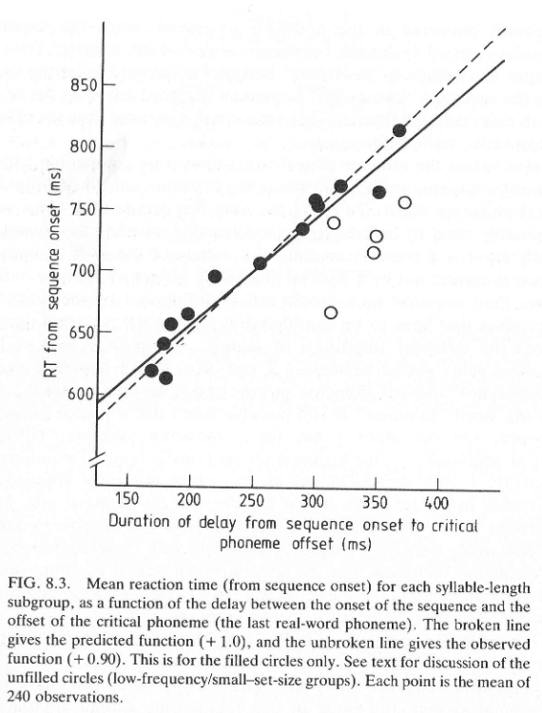
Important result:
Nonword identification slows down as the nonword point increases.
This means that the language recognition system process the speech input progressively in the sequence.

Slide 8
Lexical decision time and nonword point
We can decompose any word according to a consonant (C) vowel (V) structure:
Tre-mu-dous ➔ CCV – CV – CVC
Variations can be done within a syllable:
CCV – CV – CVC
CCV – CV – CVC
CCV – CV – CVC
Question: Is word recognition performed at the syllable or phonemic level? Do we process syllables or phonemes in spoken word recognition?
Prediction: If word identification is performed at the syllable level, then the critical phoneme within the syllable shouldn’t affect decision times in the nonword identification task, because the whole syllable itself should be recognized before reaching a decision.

Slide 9
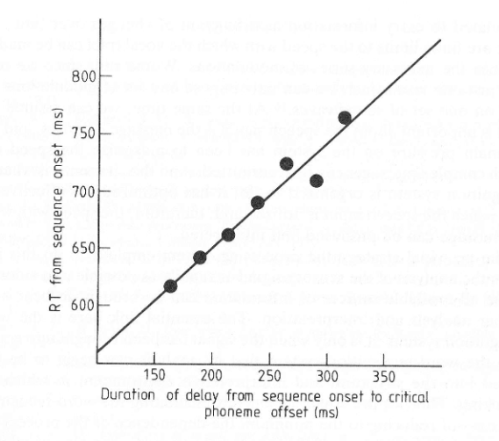
Response times increase linearly with the moment where the critical phoneme appears.
Access to the lexicon is made through a real-time analysis of the speech input signal.
It is performed online

Slide 10
Phoneme monitoring
Real words
Trein
Fluit
Tafel
Ketel
Bewust
Tekening
Fantasie
Momenteel
Kandidaat
Pseudowords
Truig
Zwoot
Teurpen
Wietel
Korbest
Togening
Poltelisch
Indentrisch
Barakaat

Slide 11
Task: to respond as soon as the phoneme /t/ appears. Participants performed the task for words and nonwords in different blocks.
Subject’s response
B
Item’s onset
Fantasie
Time
A
Onset of the target phoneme
A = Dependent variable ➔ Response time
B = Independent variable

Slide 12
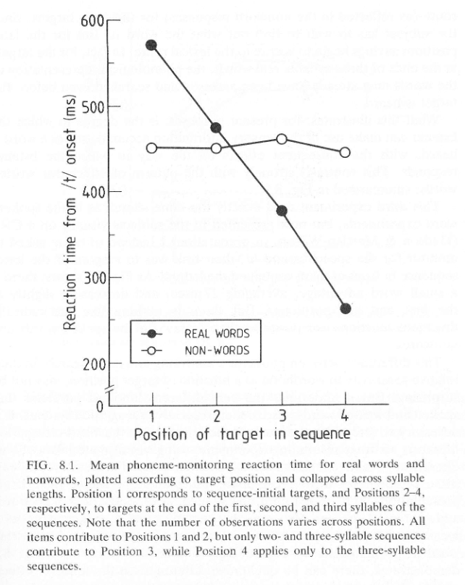
A few observations:
Response times are slower for words (compared to nonwords) when the target appears early
As the target appears late in the processing stage, response times dramatically drop
Response times as a function of the target position remains fairly unchanged for nonwords
Implications:
People use different routes to process words and nonwords
As more information is carried by the input signal, the detection of phonological information is made faster for words ➔ people make predictions
Since no lexical information is available for nonwords, people can’t make predictions for these items

Slide 13
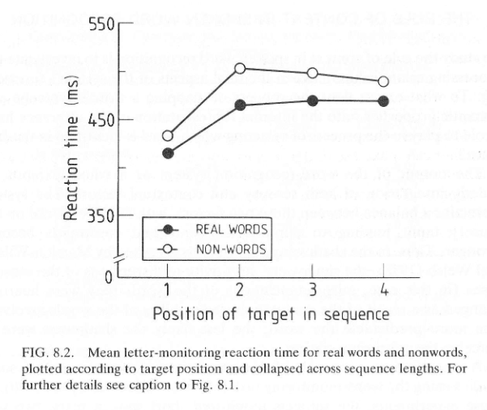
Replication with visual presentation, i.e. the items appear in a written format.
Reading is made in parallel, contrary to spoken language comprehension which is inherently sequential.
We will return to this idea later

Slide 14
The cohort effect
The size of a cohort refers to the number of words sharing the initial phonemes in the speech input.
Treacherous
Treachery
Tread
Treadle
Treadmill
Treasure
Treasury
Treble
Trek
Trellis
Tremble
Tremolo
Tremor
Tremulous
Trench
Trenchant
Trend
Trepidation
Trespass
Tress
Trestle
…

Slide 15
The cohort effect
The size of a cohort refers to the number of words sharing the initial phonemes in the speech input.
We can contrast items associated with small and large cohorts, and check the impact of this variable on response times.
Task: Lexical decision.
Manipulation: Large vs. small cohorts

Slide 16
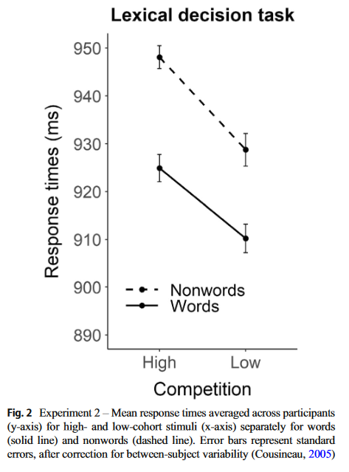
Lexicality effect: faster response times for words vs. nonwords
Cohort effect: faster response times for items drawn from small vs. large cohorts

Slide 17
Neuroimaging evidence
Putting people in an MRI
Making them perform lexical decisions on a bunch of items

Slide 18
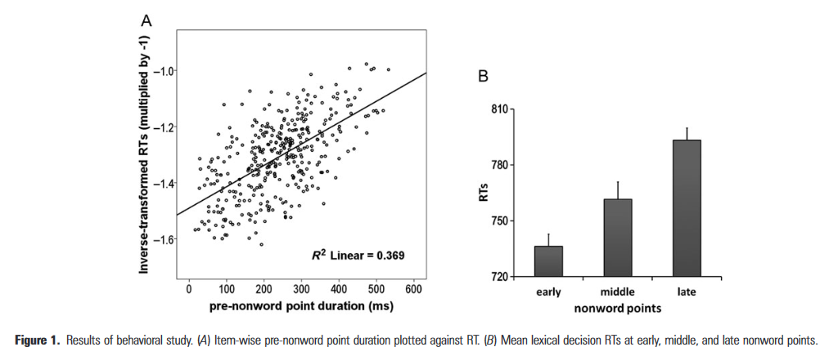
Neuroimaging evidence

Slide 19
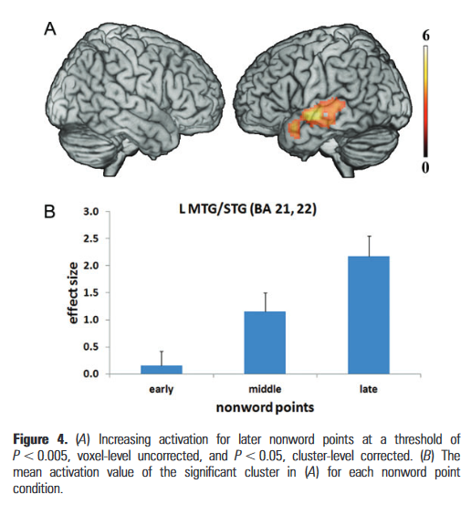
Neuroimaging evidence
Parametrical modulation of the activity in phonological – lexical regions as a function of nonword point.

Slide 20
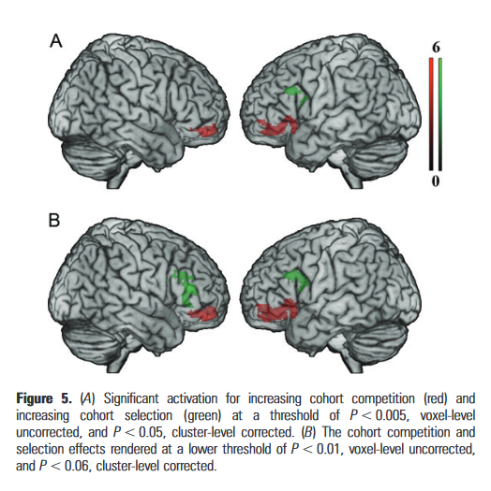
Neuroimaging evidence
Correlation between activity in prefrontal regions and cohort competition / selection.
Those regions are typically involved in controlled processes.

Slide 21
Top-down influence of spoken word recognition
Word recognition is not solely driven by the bottom-up input. It also depends on the top-down, contextual information.
Word monitoring task: people need to press a button as soon as they hear a target word. The target word is given to them before they hear the sentence.

Slide 22
Top-down influence of spoken word recognition
Word monitoring task – Late word position
Target word: cigarette
Normal context: He was stressed, so he decided to light up a cigarette before leaving
Syntactic context: Several bunch a moon, the cars fly under the cigarette that makes ketchup
Random order: Leaving he stressed light was, so he to cigarette up before decided a

Slide 23
Top-down influence of spoken word recognition
Word monitoring task – Early word position
Target word: cigarette
Normal context: The good old cigarette is still bad for your lungs
Syntactic context: Around the praying cigarette, caucasians glasses navigate
Random order: bad Lungs cigarette the old is still good for your

Slide 24
Top-down influence of spoken word recognition
Manipulations:
The type of context: normal – syntactic – random
Word position in a list – parametric modulation: early – middle – late
Word duration – the longer a word, the longer it takes to recognize it
Three variables – Relatively complex data to process

Slide 25
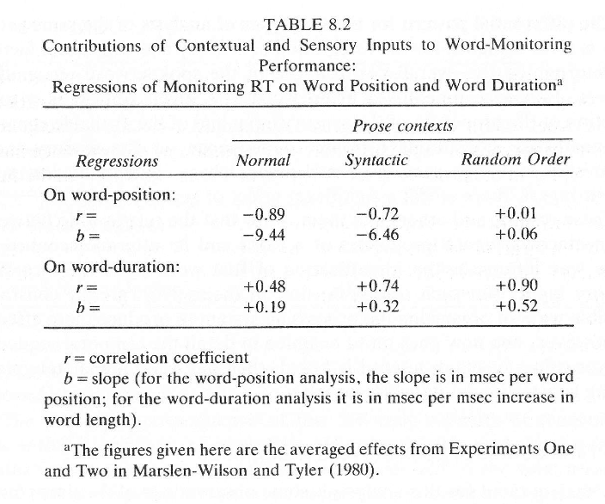
Top-down influence of spoken word recognition
Response times decreases with word position… and this is especially the case as the context is relevant in the sentence.
When context is not relevant, word position doesn’t matter.
Response times increase with word durations, and this is mostly the case when the context is not relevant.
➔ Effect of the speech input signal are more prelevant when there is a lack of contextually-relevant information.

Slide 26
Top-down influence of spoken word recognition
Hence, top-down information modulates to what extent spoken recognition is driven by the bottom-up speech input.
In other word, lower levels of language processing are modulated by people’s expectations/precitions!

Slide 27
Treble
Treadle
Tread
Treacherous
/tRE/…
Treachery
Treadmill
Treasure
Treasury
…

Slide 28
Treble
Treadle
Tread
Treacherous
/tREd/…
Treachery
Treadmill
Treasure
Treasury
…

Slide 29
Thank you for you attention

