Slide 1
The psychology of language – E578
The semantic blocking effect
Dr. Benjamin Kowialiewski

Slide 2
Table of Contents
Presentation of the task and effect
A first explanation
Problematic results
Alternative interpretation

Slide 3
Experimental design
Naming task: An image is given, and people are asked to name it.
➔ We measure response times. Usually recorded using an automated key.

Slide 4
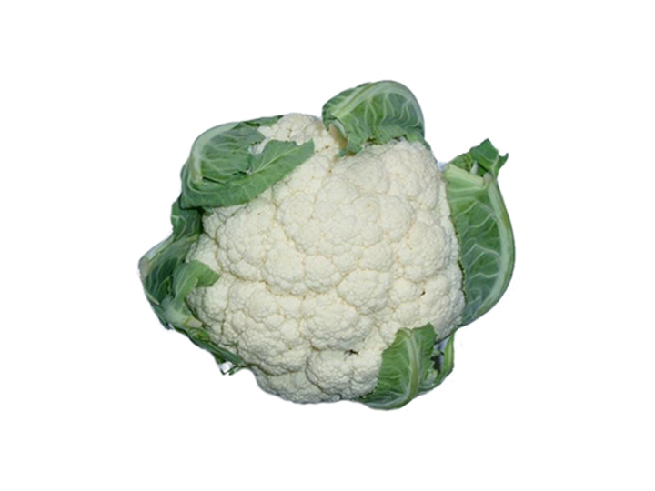
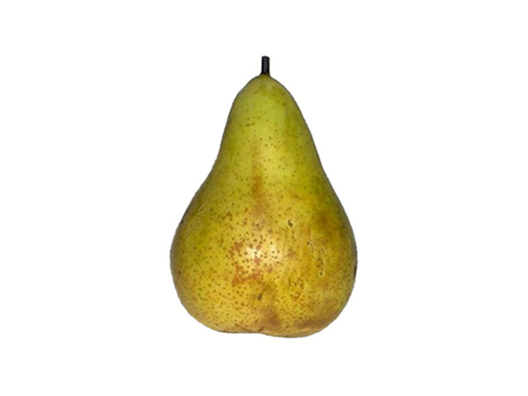
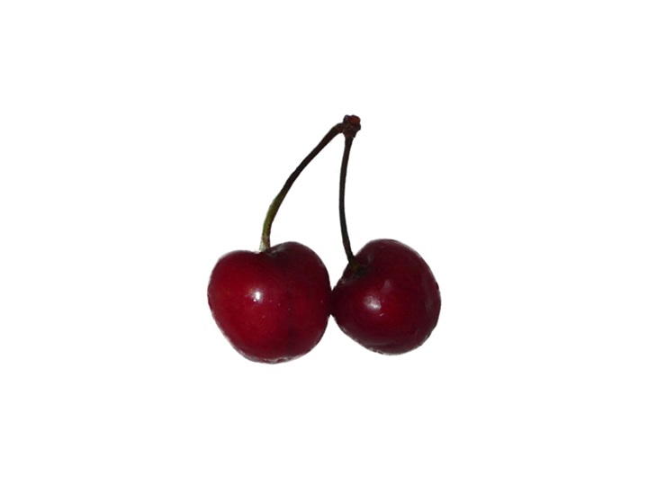
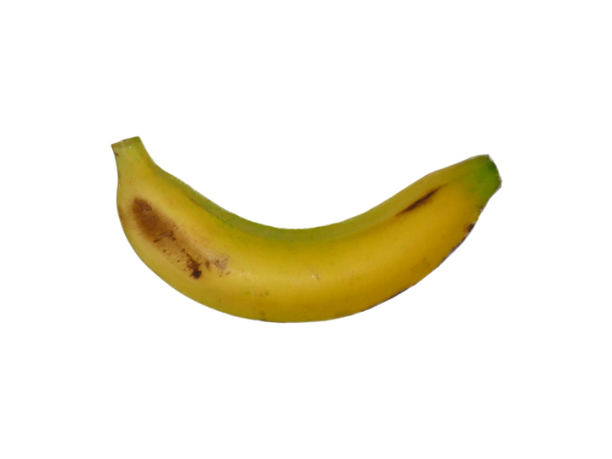



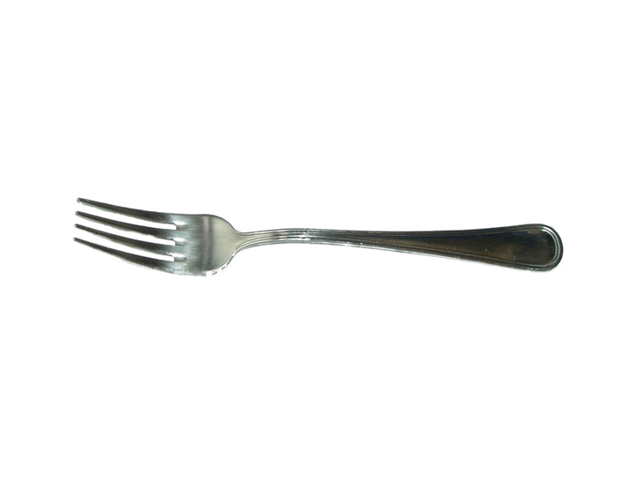
Experimental design
One cycle
Heterogeneous set
« butterfly »
« cauliflower »
« fork »
« glove »
Time

Slide 5
Experimental design
One cycle
Homogeneous set
« cherry »
« banana »
« apple »
« pear »
Time

Slide 6
Experimental design
Cycle 1 – Cycle 2 – Cycle 3 – Cycle 4…
Same objects, different presentation order
We are interested to compare homogeneous and heterogeneous sets

Slide 7
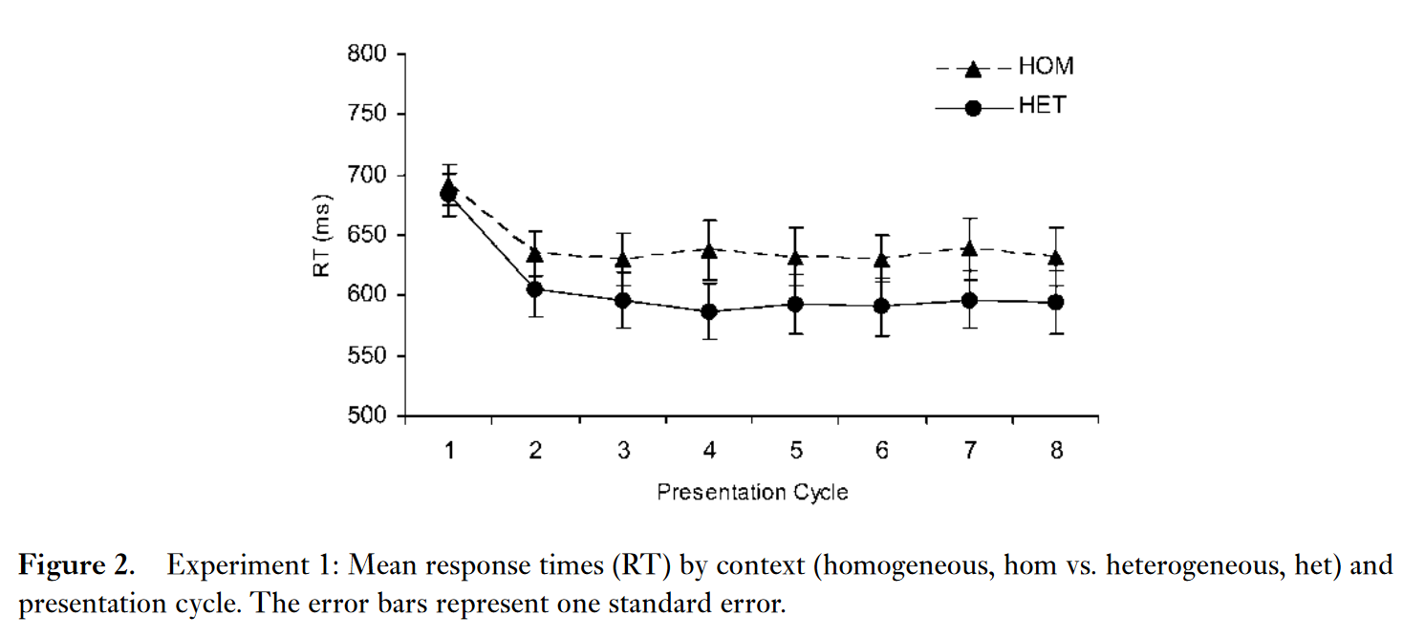
Experimental design
No effect in the first cycle
Slower naming latencies for homogeneous sets from cycle 2 on
➔ The refractory effect.
Belke, Meyer, and Damian (2005)

Slide 8
What’s happening inside a cycle?

Slide 9
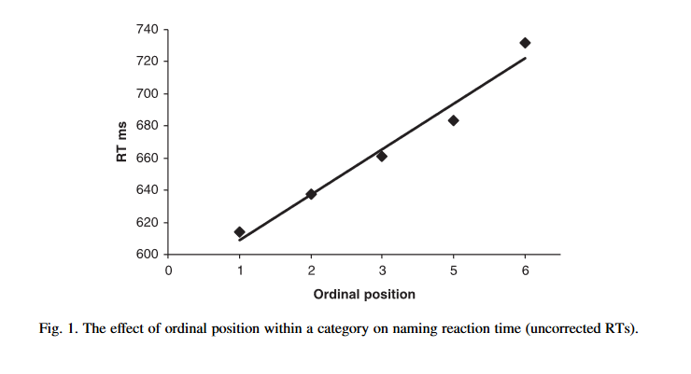
Howard et al. (2006)

Slide 10
Experimental design
In this experiment, all stimuli were kept identical throughout successive presentation cycles.
Is the effect specific to the repeated items?
Solution: we can test whether it will generalize for not-yet-presented items from the same category.
Belke, Meyer, and Damian (2005)

Slide 11
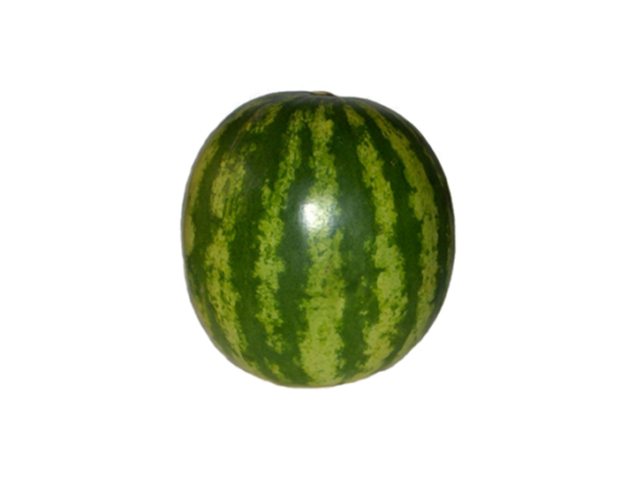
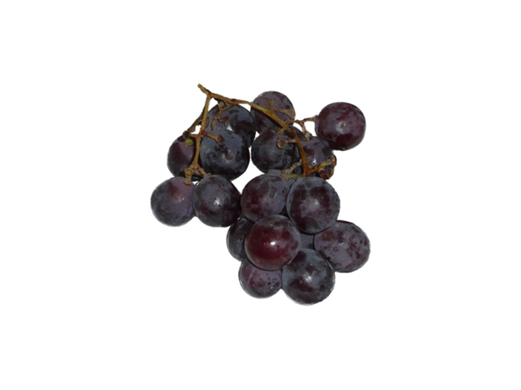
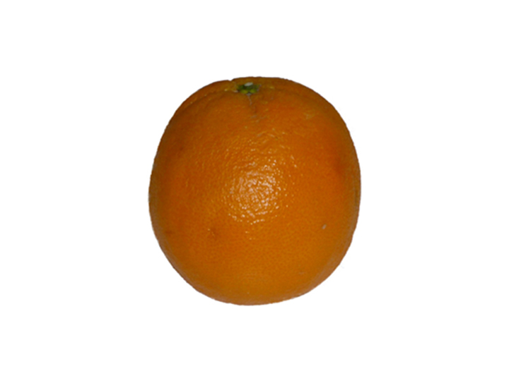
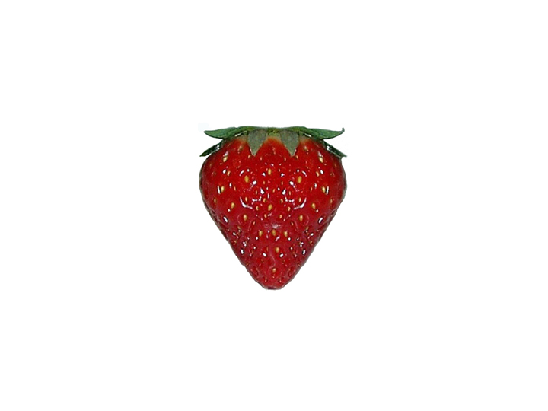
Cycle 1
Category change
Cycle 2
Cycle N
Belke, Meyer, and Damian (2005)

Slide 12
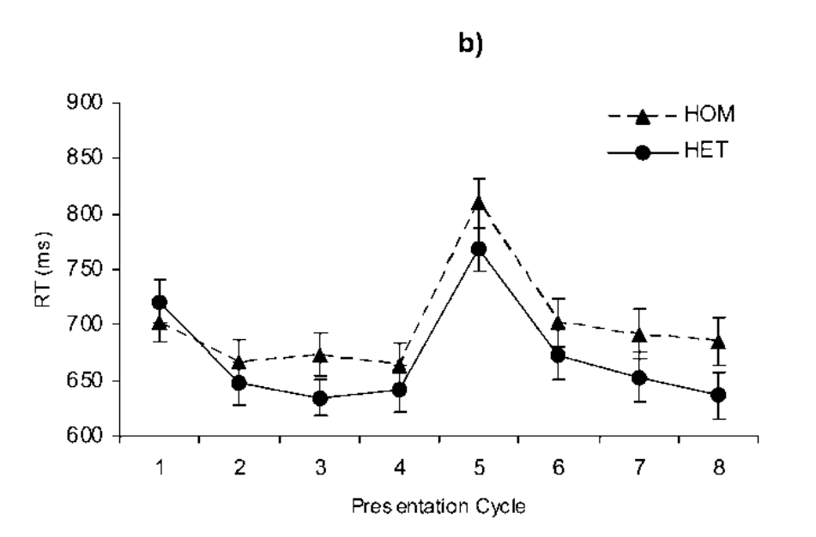
Category change
The refractory effect expands to new items!
Belke, Meyer, and Damian (2005)

Slide 13
How can we explain the semantic blocking effect?
What does it tell us about the language production system?

Slide 14
Semantic system
Lexical system

Slide 15
Heterogeneous condition
Semantic system
Lexical system

Slide 16
Homogeneous condition
Semantic system
Lexical system

Slide 17
Homogeneous condition
Semantic system
Lexical system

Slide 18
Homogeneous condition
Semantic system
Lexical system

Slide 19
Homogeneous condition
Semantic system
Lexical system

Slide 20

Luce’s choice rule:
$$P= \frac{A}{\sum_{k=1}^{N}{A}}$$
Heterogeneous condition
A (Activation) = [0.90; 0.30; 0.10; 0.10]
0.9 / sum(A)
0.3 / sum(A)
0.1 / sum(A)
0.1 / sum(A)
The sum of this vector is equal to one ➔
P = [0.64; 0.21; 0.07; 0.07]
These values represent the competition between items. Here, the target is associated to a large value relatively to other competitors, so there’s not much competition.

Slide 21
Luce’s choice rule:
$$P= \frac{A}{\sum_{k=1}^{N}{A}}$$
Homogeneous condition
A (Activation) = [0.95; 0.80; 0.91; 0.90]
0.95 / sum(A)
0.8 / sum(A)
0.91 / sum(A)
0.90 / sum(A)
P = [0.27; 0.22; 0.26; 0.25]
Increased competition!

Slide 22
Explained verbally:
Items spread activation in a semantic network.
The homogenenous condition creates an over-activation in this network.
Since selection is activation-based, an over-activation of semantically similar competitors creates a higher competition between candidates.
The Luce’s choice rule is simply a mathematical expression of this idea.

Slide 23
?
Semantic system
?
Lexical system

Slide 24
Reading words aloud relies less strongly on the semantic system than naming objects
But both rely on the selection of a lexical candidate that must be output
banana
pear
Time
Kroll & Stewart (1994)

Slide 25
If the competition occurs at the lexical stage, then the blocking effect should be preserved in these conditions.
If not, we can infer that the competition must occurs in the semantic system.
Kroll & Stewart (1994)

Slide 26
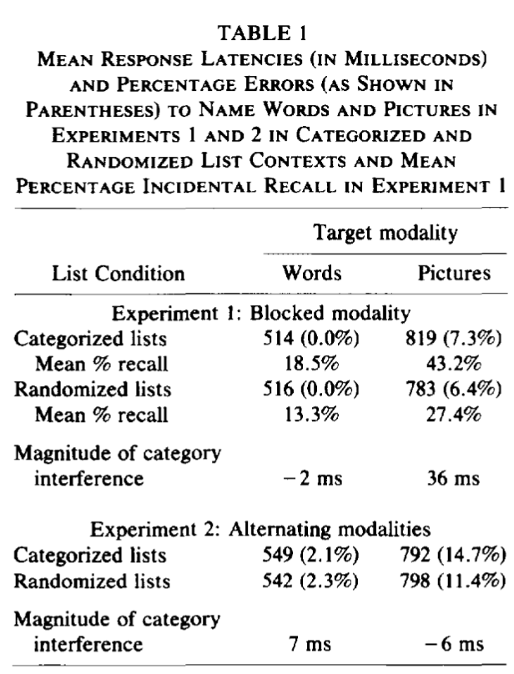
Alternating words and pictures makes the blocking effect disappear!
Kroll & Stewart (1994)

Slide 27
The blocking effect is due to a difficulty to select concepts in semantic memory
Semantic system
Lexical system

Slide 28
Is there a possibility to test this priming idea?
One characteristic of priming is that it is short-lived. It doesn’t last over time.
Let’s manipulate time in the blocking effect.

Slide 29

Naming task interleaved by mental rotations (i.e., visuospatial distractors)
« cherry »
« banana »
« apple »
« pear »
We can manipulate the number of distractors (e.g., 0; 1; 2)
Time
Damian & Als (2005)

Slide 30
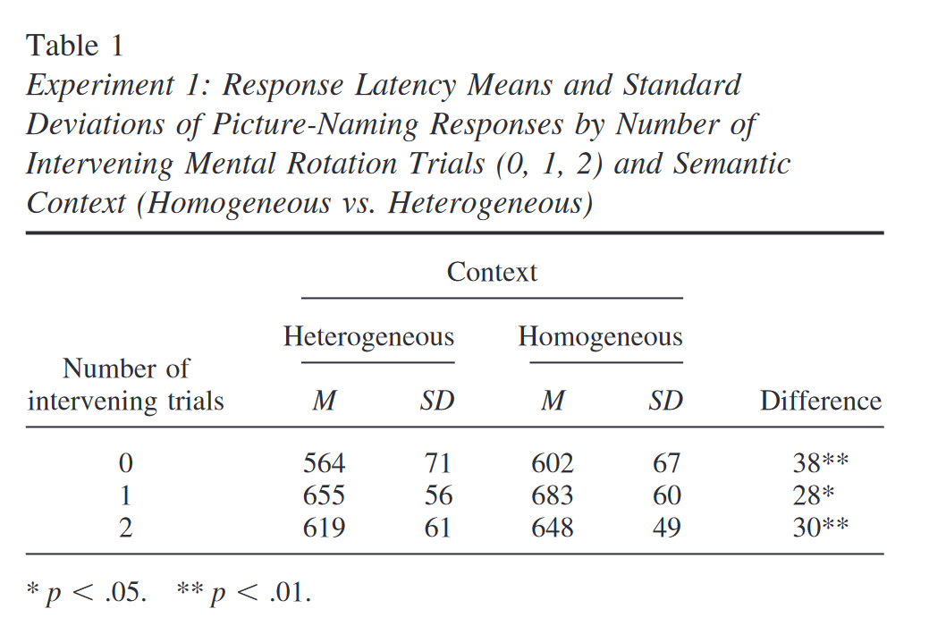
The refractory is preserved!!
It doesn’t seem to be dramatically affected by the number of interleaved distractors.
However: maybe people can keep the items’ transient activation when no verbal distractor is presented

Slide 31
What happens if we interleave the related items with unrelated naming trials?
« cherry »
« butterfly »
« banana »
« fork »
« apple »
« globe »
« pear »
Time

Slide 32
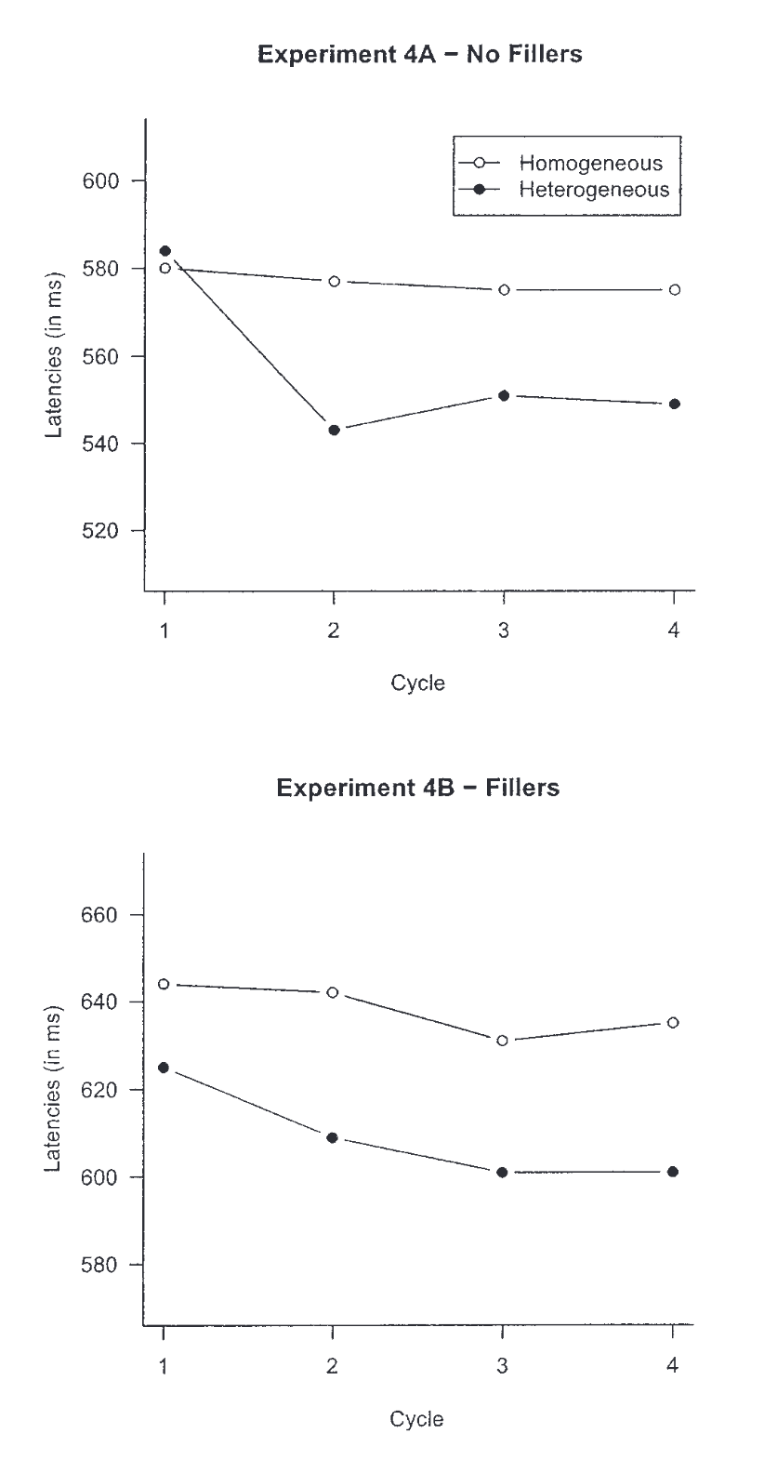
The blocking effect is preserved!

Slide 33
The fact that the blocking effect is still observed when homogeneous items are interleaved by heterogeneous items means that the effect cannot be attributed to residual semantic priming. This is because residual spreading of activation is supposed to be short-lived.

Slide 34
Semantic features
Lexical units
Oppenheim et al. (2010)

Slide 35
Semantic features
Lexical units
Competition based on activation level
Oppenheim et al. (2010)

Slide 36
Semantic features
Lexical units
Oppenheim et al. (2010)

Slide 37
Target item
Semantic features
Weight strenghtening
Weight weakening
Lexical units
Oppenheim et al. (2010)

Slide 38
Semantically similar item
Semantic features
Lexical units
Increased competition!!
Oppenheim et al. (2010)

Slide 39
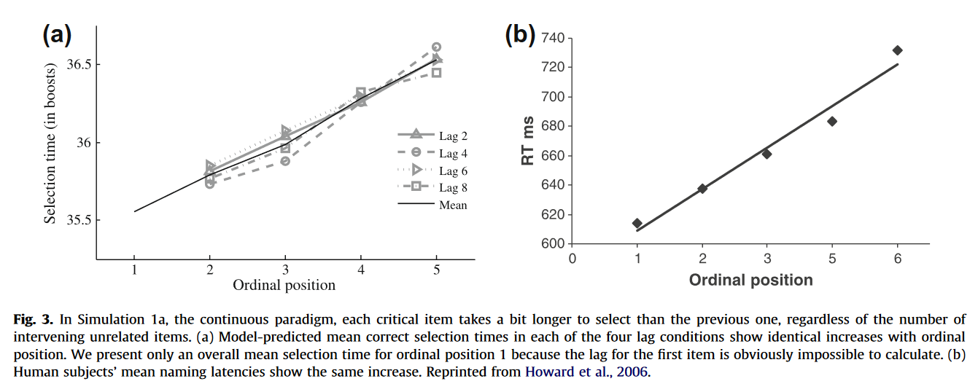
Response times increase within a cycle.
Explanation: increased competition (i.e., shared activation + incremental learning)
Oppenheim et al. (2010)

Slide 40
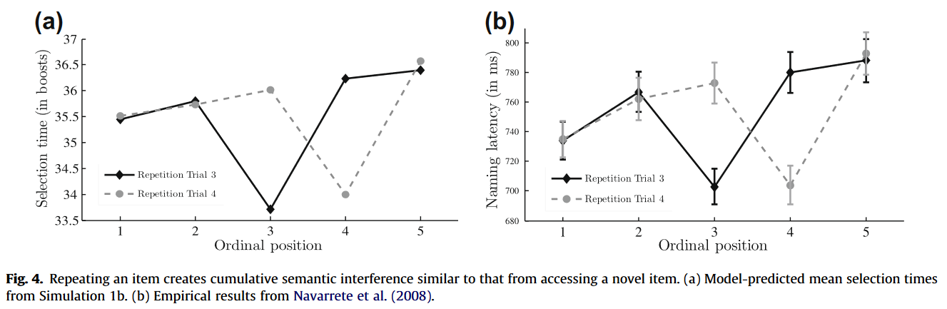
Due to incremental learning (i.e., reinforcing the links between the target and its features), the model predicts repetition priming.
First item repeated
Oppenheim et al. (2010)

Slide 41
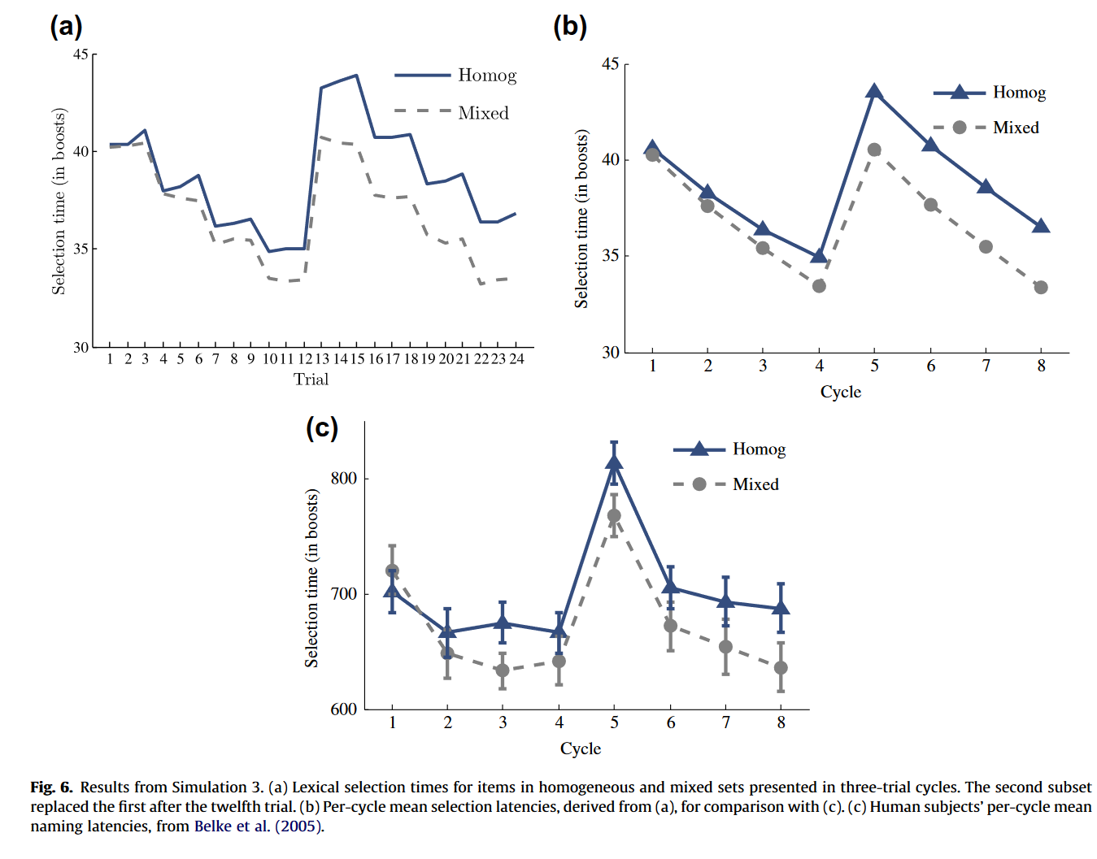
1. This decrease is due to general repetition priming
3. Bounce is due to a lack of repetition priming
4. Refractory effects generalizes to new items
2. The refractory effect appears progressively across cycles
Oppenheim et al. (2010)

Slide 42
Take-home message:
Naming latencies slow down when naming items from the same category
Due to a problem of selection at the semantic level
Is not due to short-lived semantic priming
The best explanation so far boils down to an incremental learning process

Slide 43
Thank you for you attention

