Slide 1
PERFORMANCE TESTING PILOT PROJECT
OrangeHRM Load, Stress & Endurance Testing
Apache JMeter | Leave Management Module
Scenarios: Assign Leave (Admin) • Edit Entitlement (Admin)
Tool: Apache JMeter 5.6+ Test Types: Load · Stress · Endurance · Spike

Slide 2
PROJECT OBJECTIVE
Why we ran this pilot
To evaluate the speed, scalability, and stability of OrangeHRM's Leave Management module under realistic and extreme traffic conditions, using industry-standard JMeter workload models — and to establish a repeatable performance testing framework for future releases.
1
2
3
4
Validate Responsiveness
Find the Breaking Point
Detect Long-Run Issues
Prove Recovery
Confirm 95th-percentile response times stay within 2 seconds under normal business load.
Identify the concurrency level at which Assign Leave and Edit Entitlement start to degrade.
Surface memory leaks or slow degradation using a sustained endurance (soak) run.
Verify the application recovers to baseline within 60-90 seconds after a sudden traffic spike.
02

Slide 3
SCOPE
Application & Test Scenarios
APPLICATION UNDER TEST
Scenario 51
OrangeHRM
Assign Leave
Open-source HRMS application
Admin navigates to the Leave module and assigns leave to an employee, exercising the leave-request creation workflow end-to-end.
Module
Leave Management
Tool
Apache JMeter 5.6+
Test Role
Admin
Scenario 52
Environment
Dedicated test instance
Edit Entitlement
Admin opens an employee's leave entitlement and edits the allotted number of days, exercising the entitlement-update workflow.
03

Slide 4
EXECUTION FLOW
How Each Test Run Is Executed
1
2
3
4
Launch & Login
(Default)
Launch & Login
(Created)
Prerequisite.jmx
(Data Setup)
final1.jmx
(Main Test)
Launch_and_Login.jmx opens OrangeHRM and signs in with the built-in default admin credentials to verify the environment is reachable.
→
Launch_Login_created.jmx signs in using the admin user created by the prerequisite step, confirming new accounts work end-to-end.
→
Creates the employees, admin users, and leave entitlements needed as test data before the real load test runs.
→
The actual performance test: runs Assign Leave and Edit Entitlement under Load / Stress / Endurance / Spike workload models.
Prerequisite.jmx is run once before each test cycle to (re)generate clean employee, user and entitlement data consumed via CSV Data Set Config in final1.jmx.
04

Slide 5
SCRIPT DESIGN
Test Structure Inside final1.jmx
A single reusable Test Fragment drives both business scenarios, keeping the script DRY and easy to maintain.
Test Plan
User Defined Variables · HTTP Request Defaults
Thread Group (Open Model / Ultimate)
Load, Stress, Endurance or Spike shape applied per run
HTTP Cookie / Cache / Header Manager
Session handling shared across all requests
Assign_Leave & Edit_Entitlement (Transaction Controllers)
One per business scenario
Module Controller → Include Controller → Test Fragment_Leave
Shared reusable request flow (login → navigate → act)
CSV Data Set Config
empnumber1.csv, entitlementId.csv, admin_users.csv feed unique data per thread
Regex Extractor / JSR223 PostProcessor
Correlates session IDs & CSRF tokens between requests
Response Assertion
Validates each step returns the expected result
Listeners: Summary Report · Aggregate Report · View Results Tree
Captured to .jtl for reporting & dashboards
tearDown Thread Group
Deletes employees created during the run to keep data clean
05

Slide 6
TOOLKIT
JMeter Components Used
Thread Groups
Controllers
Samplers
Open Model Thread Group (bzm)
Ultimate Thread Group
tearDown Thread Group
Transaction Controller
Module & Include Controller
Loop / While Controller
Test Fragment
HTTP Request
JSR223 Sampler
Debug Sampler
Config Elements
Pre/Post Processors
Managers
CSV Data Set Config
HTTP Request Defaults
User Defined Variables
Regex Extractor
JSON Extractor / JSR223 PostProcessor
HTTP Cookie Manager
HTTP Cache Manager
HTTP Header Manager
Assertions
Timers
Listeners
Response Assertion
Uniform Random Timer
Gaussian Random Timer
Summary Report
Aggregate Report
View Results Tree
HTML Dashboard Report
06

Slide 7
WORKLOAD MODEL
Four Load Shapes, One Framework
Both scenarios (Assign Leave & Edit Entitlement) are driven through the same four workload models, each targeting a different non-functional characteristic — following the standard Performance Testing Life Cycle (PTLC).
Test Type | Model | Peak Load | Approx. Duration | Primary Goal
Load | Open (Poisson arrivals) | 10 users/min | ~5 min / cycle | Validate expected business load
Stress | Closed (5-step ramp) | 50 concurrent users | ~11.7 min | Find the breaking point
Endurance | Closed (sustained plateau) | 10 concurrent users | ~36.3 min | Detect leaks / degradation over time
Spike | Open (sudden burst) | 10 concurrent users | ~7 min | Measure recovery from sudden surges
Ramp-up → steady-state → ramp-down / cool-down is applied consistently across all four models, per industry PTLC practice.
07

Slide 8
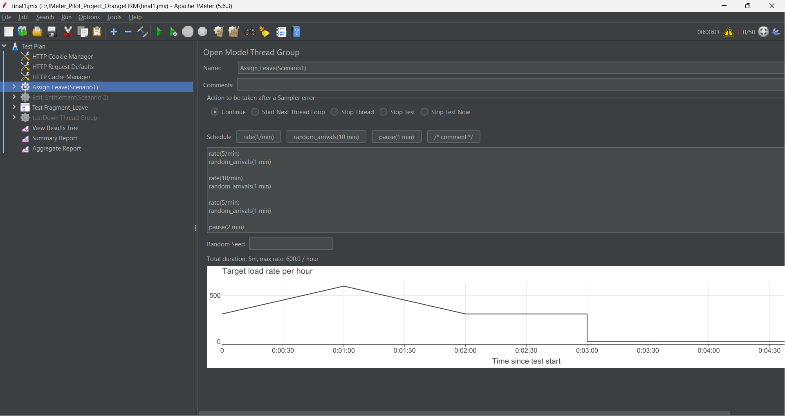
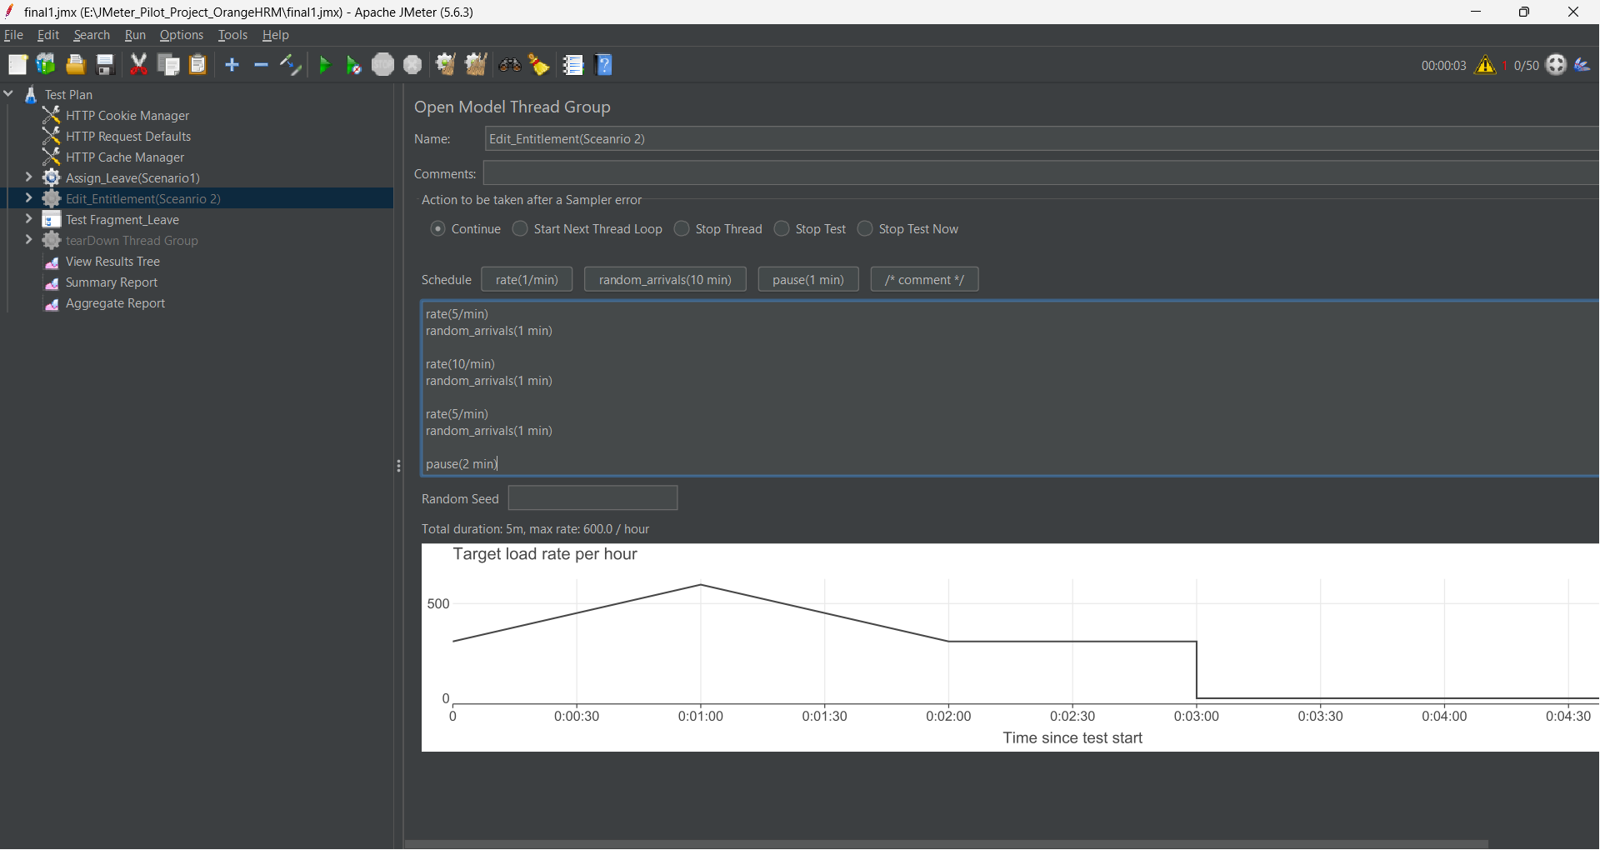
WORKLOAD MODEL · LOAD TEST
Open Model — Arrival Rate Over Time
Open Model Thread Group (bzm plugin) drives traffic by arrival rate rather than a fixed thread count. random_arrivals() spreads user arrivals randomly within each minute, mimicking genuine uncoordinated user behaviour.
Phase | Configuration | Duration
Ramp 1 | 5/min | 1 min
Ramp 2 (peak) | 10/min | 1 min
Ramp 3 | 5/min | 1 min
Cool-down | pause | 2 min
JMeter scheduler view — Load Test arrival-rate schedule
Recommendation: run 3–5 repeating cycles (~15–25 min) for a statistically stable p95 response time.
08

Slide 9
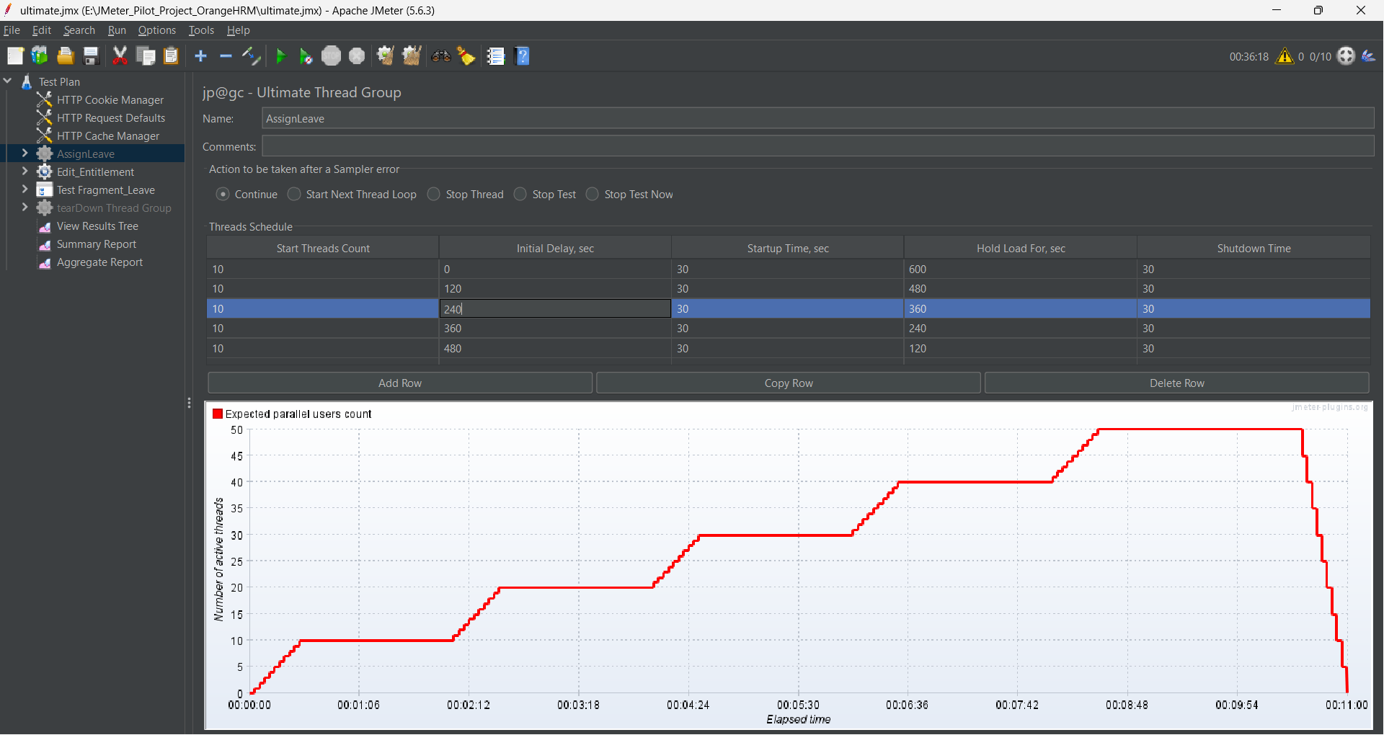
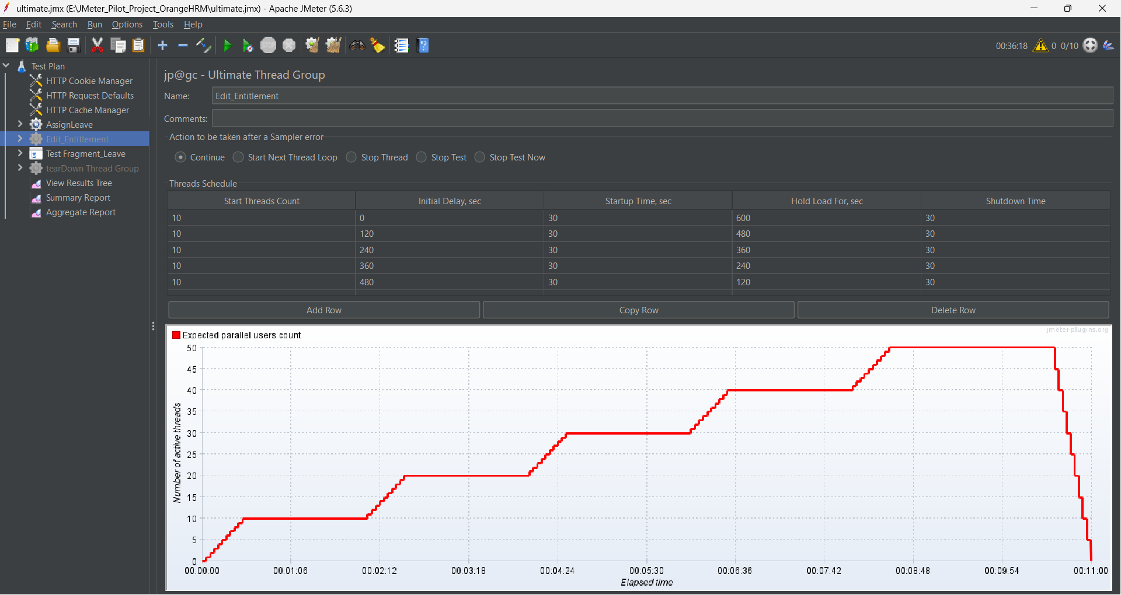
WORKLOAD MODEL · STRESS TEST
Ultimate Model — Stepped Ramp to 50 Users
Ultimate Thread Group builds concurrency in five overlapping steps of 10 users each, up to a peak of 50 concurrent users, then releases load symmetrically — letting analysts correlate each step with response-time and error trends.
Step | Threads | Hold (s)
1 | 10 | 600
2 | 10 | 480
3 | 10 | 360
4 | 10 | 240
5 | 10 | 120
Ultimate Thread Group scheduler — staircase ramp to peak concurrency (jp@gc)
Concurrency climbs 0→50 users by ~min 8:30, plateaus, then symmetrically steps back down by ~min 11:40.
09

Slide 10
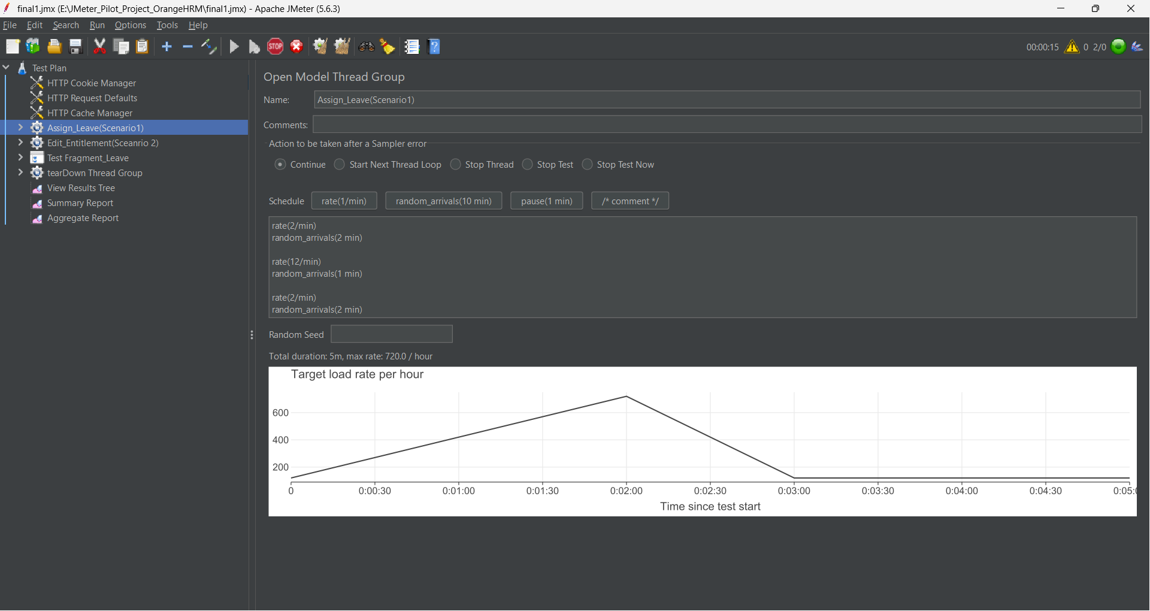
WORKLOAD MODEL · ENDURANCE & SPIKE
Sustained Soak & Sudden Surge
ENDURANCE (SOAK) TEST
Single-step Ultimate Thread Group holds a moderate, steady user count for an extended duration to expose memory leaks or gradual decay.
Ramp-up | Hold For | Ramp-down
60 s | 2000 s (~33.3 min) | 120 s
10 concurrent users held for ~33 min (~36.3 min total run) — a pilot-scaled equivalent of a multi-hour production soak test.
SPIKE TEST
Open Model Thread Group drives a sudden burst: 1 → 10 → 2 users, validating recovery to baseline response time within a 60–90 second SLA once the spike subsides.
Goal: no continuous upward trend in response time or memory/thread usage over the run.
Baseline (2) → Sudden Spike (10) → Recovery (3)
10

Slide 11
TEST REPORTS
Results Snapshot Across All Runs
Figures below are pulled directly from each run's JMeter HTML Dashboard Report (aggregate “Total” row).
Test Type | Samples | Error % | Avg (ms) | Median (ms) | p90 (ms) | Throughput (tx/s)
Load – Scenario 1 | 270 | 2.59% | 2,956 | 2,372 | 6,021 | 1.29
Load – Scenario 2 | 311 | 2.57% | 1,581 | 924 | 3,235 | 1.56
Endurance | 4,852 | 5.09% | 5,018 | 3,840 | 11,031 | 7.26
stress | 484 | 33.47% | 18,291 | 1,399 | 33,429 | 0.66
Spike – Scenario 1 | 298 | 2.01% | 5,970 | 5,391 | 10,819 | 1.09
Spike – Scenario 2 | 318 | 0.31% | 2,568 | 2,265 | 4,616 | 1.09
Load and Spike runs stayed close to target error rates. The Stress run's rising error rate marks the approach to the breaking point. The Endurance run's high error % and response-time growth flags a degradation pattern worth root-causing before the next cycle.
11

Slide 12
EVALUATION
Success Criteria & Performance Goals
1
2
3
4
5
Response Time
Throughput
Error Rate
Recovery Time
Stability
95th-percentile response time within 2 seconds under normal (Load Test) conditions.
Application must support at least 20 concurrent users without measurable degradation.
Below 1% during Load and Endurance testing.
After a spike, response time returns to baseline within 60–90 seconds.
No continuous upward trend in response time or memory/thread usage during Endurance.
Assumptions
Test environment is dedicated and representative of production.
Valid credentials & CSV test data (empnumber1.csv) are unique per virtual user.
Dynamic values (session IDs, CSRF tokens) are correlated via the Test Fragment / Include Controller.
12

Slide 13
CONCLUSION
Complete PTLC Coverage for the Leave Module
By combining an open arrival model for everyday load with staged closed models for stress and endurance — plus a recommended spike test — this pilot delivers full Load / Stress / Endurance / Spike coverage for the Assign Leave and Edit Entitlement workflows, giving a confident, repeatable baseline for OrangeHRM's performance going forward.
Load ✓
Stress ✓
Endurance ✓
Spike (recommended) ✓
Thank you
JMeter Pilot Project — OrangeHRM Leave Management Module

