Slide 1

IBM Applied Data Science Capstone
Opening Shopping Mall in Mumbai
Bharat Parekh
July 2020

Slide 2
Problem Statement
Location of shopping mall is important decision on success or failure
Objective: To analyse & select the best location of Mumbai to open an new mall
The project is timely as city is currently from shorage of rental places
Business Question
In Mumbai, if the property developer is looking to open a new shopping mal, where would you recommend that should be opened?

Slide 3
Data
Data required
List of neighborhood in Mumbai
Latitude and longitude co-ordinates of the neighborhoods
Venus data, particuarly data related to shopping malls
Sources of data
Wikipedia : https://en.wikipedia.org/wiki/List_of_neighbourhoods_in_Mumbai
Geocoder package for latitude and longitude of coordinates
Foursquare API for venue data

Slide 4
Methodology
Web scraping Wikipedia page for neighborhood list
Get latitude and longitude co-ordinates using Geocoder
Get venue data using foursquare API
Group data by neighborhood & take mean frequency of occurance of each venu category
Filter venue category by shopping mall
Perform clustering on data by using k-means clustering
Visualize the clusters in the map using Folium

Slide 5
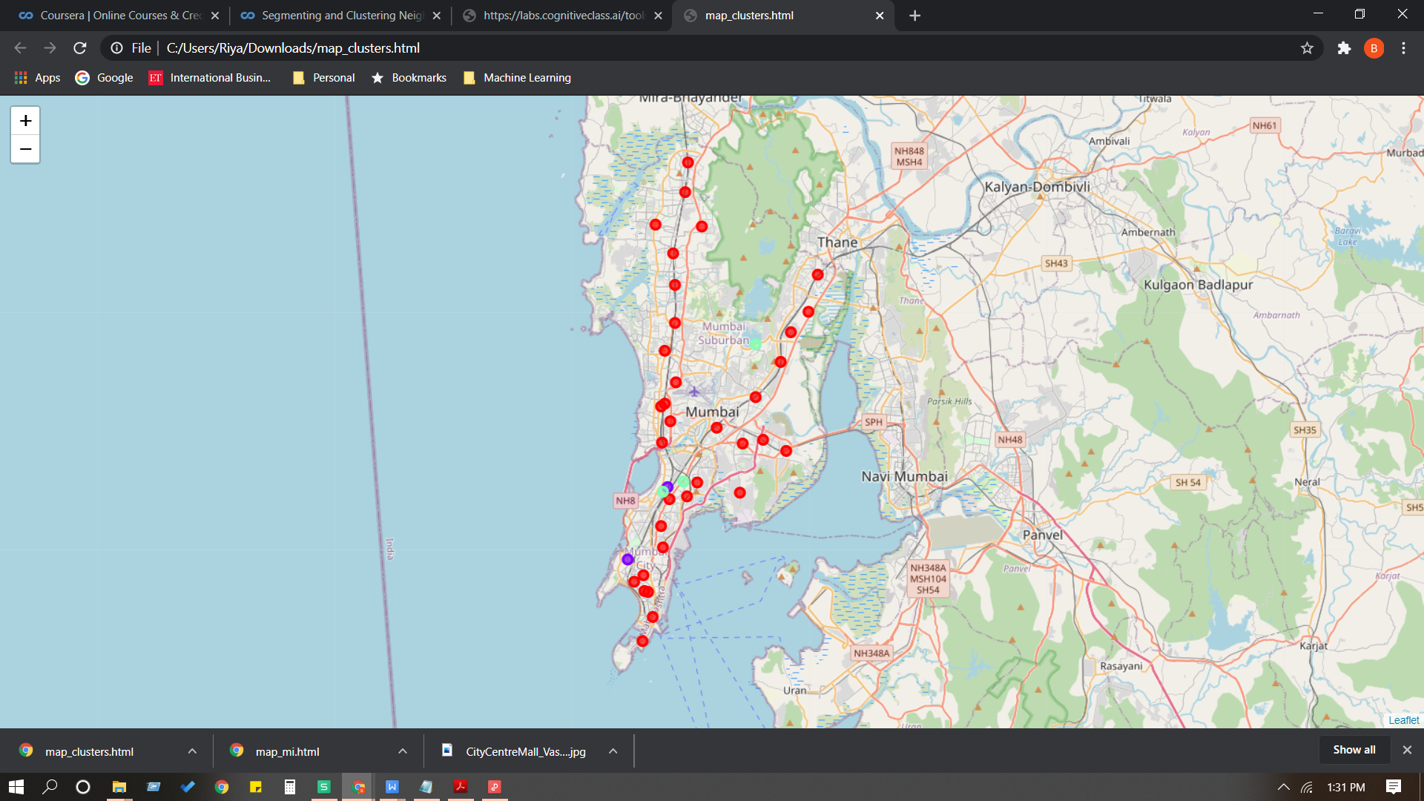
Results
Categorised the neighbrhood into three clusters
Cluster 0: Neighborhood with large number shopping malls
Cluster 1: Neighborhood with low shopping malls
Cluster 2: Neighborhood with low shopping malls

Slide 6
Discussion
Most of the malls are concentrated in eastern & western subsurbs of the city
Highest number of shopping malls in cluster 0
Low numbers of shopping malls in cluster 1 & 2
Oversupply of shopping malls mostly in eastern & western subsurbs and low shopping malls in the southen & central suburbs of mumbai

Slide 7
Recommendations
Open new shopping malls in Cluster 1 & 2 where there is low compitition
Avoid neighborhoods in cluster 0, already high concentration of shopping malls & intense compitition.

Slide 8
Conclusion
Solution of the problem statement: The neighborhood in cluster 1 & 2 are the most preferred location to open a new shopping mall
Findings will helpproperty developers, investors & business community to capitalize on the oppurtinies on high potential location while avoiding the overcrowded areas in the decision to open a new mall.

Slide 9
Thank You

