Slide 1

PROPOSAL · PRD · POC PLAN
Election Intelligence & Analytics Command Center
Unified data. Trusted analytics. AI-assisted intelligence. Faster decisions.
Prepared for the leadership of [AGENCY NAME]
by [COMPANY NAME] — AI + Data + Digital Intelligence Partner
September 2026 · Confidential · For initial approval discussion
[Client logo placeholder — official assets only with authorisation]
[COMPANY LOGO]
Notes:
Position the partner as an intelligence-infrastructure partner, not a staffing vendor. All figures in the deck marked DEMO DATA are synthetic, for a fictional constituency. No party marks are used; placeholders only.

Slide 2
EXECUTIVE VISION
From fragmented data to a continuously learning intelligence loop
Understand what is changing, where, why it may be changing — and how operations are performing
Data
Intelligence
Insight
Decision support
Measurement
Learning loop
Governed, registered, quality-scored sources
Statistics, forecasting, anomaly detection, multilingual NLP
What changed, where, plausible why — facts vs interpretation
Prioritised operational & monitoring follow-ups; humans decide
Every action has a KPI and a baseline
Results recalibrate models, KPIs and playbooks
Learning loop: measured outcomes feed back into data, models and KPIs every week
AI on a trusted data layer
Humans stay in charge
Every number is traceable
LLMs answer only from verified, lineage-tracked data — with citations
Analysts interpret; leadership decides; AI drafts and flags
Source, timestamp, quality and uncertainty on every tile
[COMPANY NAME] · Election Intelligence & Analytics Command Center · Confidential — for discussion
2
Notes:
Core proposition: convert fragmented campaign, digital, survey, media, field and public data into a single intelligence layer. The loop is the product: data to decision support to measurement to learning.

Slide 3
WHY CAMPAIGN INTELLIGENCE MATTERS NOW
2026 campaigns need speed — and an audit trail
20 Mar 2026
≥ 10%
What this means for leadership
Decisions must move faster than the news cycle — hours, not days
Every paid or AI-assisted item needs approval, certification and label records
Teams must work from one set of defensible numbers
AI is useful only on top of verified, governed data
Human judgement remains essential — the system supports it
ECI: political ads on electronic media incl. social media need MCMC pre-certification; internet spend must be reported
ECI advisory (24 Oct 2025): AI/synthetic campaign content labelled on ≥10% of display; records of AI material kept
3 hours
14 May 2027
Removal window for deepfake / unlawful content (ECI advisories; IT Amendment Rules 2026 for intermediaries)
DPDP Rules 2025 fully in force — privacy-by-design, security safeguards and 1-year logs
Sources: ECI press notes/advisories as reported (Appendix L1, L3, L6); MeitY IT Amendment Rules 2026 (L8); DPDP Rules 2025 (L13). Not legal advice — verify against primary documents.
[COMPANY NAME] · Election Intelligence & Analytics Command Center · Confidential — for discussion
3
Notes:
Regulatory context summarised from public reporting of ECI press notes and MeitY notifications. The compliance team must confirm against primary documents.

Slide 4
THE CURRENT PROBLEM
Fragmented workflows create blind spots at the worst possible time
Meta / YouTube / X dashboards screenshots
Six blind spots
Ad-platform exports CSV
✕
Teams report different numbers
Survey vendor PDF toplines
✕
Days of latency before leadership sees change
Analyst Excel
manual, versioned by e-mail
Weekly deck
stale, no lineage → leadership
Media cell WhatsApp clips
✕
No uncertainty on survey or sentiment figures
Field coordinators photos / voice notes
✕
No systematic early warning / anomaly detection
Call-centre tool exports
✕
No audit trail for approvals, certification, AI labels
Public election data ad-hoc downloads
✕
AI summaries without verified source data
[COMPANY NAME] · Election Intelligence & Analytics Command Center · Confidential — for discussion
4
Notes:
Most campaign reporting is team-shaped rather than question-shaped. The consequences are inconsistent numbers, latency, no uncertainty and no auditability.

Slide 5
OUR SOLUTION
One governed intelligence layer, not seven disconnected workflows
Dimension | Today | With the Command Center
Source of truth | Multiple spreadsheets and decks | Governed warehouse + metric store (one definition per KPI)
Latency | Weekly, manual | Daily report by 08:00; intraday for priority sources
Early warning | Someone notices | Statistical alert engine — Critical / High / Medium / Low
Uncertainty | Absent | Margins of error, intervals and coverage warnings by default
Cross-source view | Social, media, survey, field in silos | Common issue taxonomy, geography and time keys
AI | Unverified summaries | Grounded AI Analyst with citations, timestamps, confidence
Compliance | Approvals in chats | Control tower: approvals, MCMC refs, AI labels, spend, audit trail
Security & privacy | Shared credentials | SSO, MFA, RBAC, encryption, audit logs, DPDP-aligned
[COMPANY NAME] · Election Intelligence & Analytics Command Center · Confidential — for discussion
5
Notes:
Contrast the current state with the future state. The right column is what the platform guarantees as process; it does not guarantee electoral outcomes.

Slide 6
COMMAND CENTER CONCEPT
Intelligence infrastructure — not just analysts
Executive Command Center
Health score · 14 modules · alerts · reports
Capability pillars
DATA
AI
ANALYTICS
AI intelligence layer
Grounded Q&A · summaries · decision-support briefs
SOCIAL
INTELLIGENCE
MEDIA
INTELLIGENCE
DIGITAL
MEASUREMENT
Analytics, ML & multilingual NLP
Statistics · forecasts · anomalies · topics · sentiment
FIELD
INTELLIGENCE
AUTOMATION
COMMAND
CENTER
“We do not simply provide analysts. We build the intelligence infrastructure that turns fragmented campaign data into a continuously learning decision-support system.”
Governed data foundation
Registry · quality · lineage · security · privacy
[COMPANY NAME] · Election Intelligence & Analytics Command Center · Confidential — for discussion
6
Notes:
Four layers, nine capability pillars. The differentiator is infrastructure that keeps learning, owned and governed on the client's behalf.

Slide 7
DATA ECOSYSTEM
Six source families — each with owner, lawful basis, retention
A
Official / public
B
Campaign-owned (authorised)
C
Survey
ECI statistical reports & index cards
Historical results (ECI; curated research sets)
Census & official indicators
Public candidate disclosures
Website & social analytics
Ad-platform reporting
CRM / volunteer / event records (consented)
Call-centre operational data
Issue, awareness, satisfaction surveys
Event & campaign feedback
Weighting, MoE, bias & QC metadata
Consent recorded
D
Digital platforms
E
Media
F
Field
Meta, Instagram, YouTube, X, Google
Owned-account insights via permitted APIs
Ad transparency libraries
API access verified per platform
News sites & feeds (public/licensed)
Regional & hyperlocal outlets
Broadcast transcripts — licensed only
Search trends where available
Daily structured field reports
Activity completion & coverage
Local issue reports
Volunteer activity metrics
[COMPANY NAME] · Election Intelligence & Analytics Command Center · Confidential — for discussion
7
Notes:
Breadth with discipline: no source enters without an owner, lawful basis or authorisation, permitted purposes and a retention rule. Public, consented and authorised data only.

Slide 8
DATA SOURCES & ACCESS REALITY
We never assume an API exists — access is verified in Week 1
Platform / source | Likely access route | What must be verified (as of Sep 2026)
Facebook Pages | Graph API insights for owned pages | App review, permissions, fields available
Instagram | Instagram Graph API (Business/Creator) | Basic Display API ended 4 Dec 2024
Meta ads & Ad Library | Marketing API (owned); Ad Library API | Identity/country verification; disclaimers
Meta public content | Meta Content Library | Researcher-only (ICPSR); CrowdTangle closed Aug 2024
YouTube | Data API v3; Analytics API (owned) | Quotas; channel authorisation
X | X API (pay-per-use credits) | Budget caps, read limits, current terms
Google Ads / Search | Google Ads API; Transparency Center | Election-ads verification; ECI pre-certificate per ad
Google Trends | Web; Trends API alpha (gated) | Alpha access not assured — indicative only
Website | GA4 Data API; Search Console | Consent mode; no PII in events
Listening / media vendors | Licensed feeds | Lawful sourcing, licence scope, audit rights
API availability and permitted fields must be verified against the current platform documentation and access level.
[COMPANY NAME] · Election Intelligence & Analytics Command Center · Confidential — for discussion
8
Notes:
Honesty about access is a differentiator. Several popular routes have closed or become paid or restricted.

Slide 9
DATA ARCHITECTURE
Production-grade pipeline from source to executive decision
1 Sources
API · file · DB · upload · survey · licensed feed
2 Ingestion
Dagster / Airflow; idempotent; secrets from vault
3 Raw zone
Immutable object storage; checksums
4 Quality gates
Freshness · volume · schema · ranges · dupes
5 Standardised model
dbt: geography · time · language · issue
10 Executive Command Center
Health score · alerts · reports
9 AI intelligence layer
LLM + tool router + citations
8 BI / dashboards
Power BI or React/Next.js
7 ML / NLP layer
Models · embeddings · registry
6 Warehouse + metric store
PostgreSQL → BigQuery / Snowflake
Cross-cutting governance & security
Source & lawful-basis registry · permitted-use tags · column-level lineage · RBAC/SSO/MFA · encryption · immutable audit logs · retention & deletion · model registry · cost guardrails
[COMPANY NAME] · Election Intelligence & Analytics Command Center · Confidential — for discussion
9
Notes:
Each component earns its place: Postgres + pgvector for the POC, a scale warehouse only when volumes demand it, dbt for tested and documented transformations, and an AI layer that sits on top rather than beside the data.

Slide 10
DATA MODEL & ANALYTICS STACK
Aggregate, authorised records joined on geography, time and issue
Reference & public
Intelligence facts
Governance & operations
Analytics maturity ladder
campaign
survey_response (anonymous)
data_source
constituency
content_performance
data_quality
Decision support
Operational, monitoring & data-quality priorities; humans decide
geography
media_mention
compliance_record
historical_election
sentiment_record (aggregate)
alert · report
Predictive
What is likely next? Forecasts with intervals, assumptions, validation
issue
field_activity · event
model_run
operational_metric
audit_log
Diagnostic
Why did it change? Channel, content, geography, issue decomposition
campaign_spend
Descriptive
What happened? Trends, KPIs, channel & historical comparison
By design there is no table of individuals' political beliefs or preferences. Survey microdata is anonymous, binned and used only for weighted aggregates.
[COMPANY NAME] · Election Intelligence & Analytics Command Center · Confidential — for discussion
10
Notes:
Conceptual ERD in three groups. The full DDL is in poc/schema.sql. Predictions are never presented as certainty and never at individual level.

Slide 11
AI / NLP LAYER
Multilingual NLP: listening → topic → sentiment → trend → alert
Public & licensed text
permitted APIs, licensed feeds
Language ID + normalise
Hinglish, romanised, spelling
Topic / issue
campaign taxonomy classifier
Sentiment / tone
per-language validated
Trend & velocity
baselines, change-points
Alert
severity + human triage
Languages
Capability | Approach | Metric
Topic / issue | Fine-tuned multilingual encoder | Macro-F1 / language
Sentiment / tone | Encoder + calibration | Macro-F1, per-class recall
Emerging topics | Embeddings + clustering | Coherence, analyst rating
Duplicates | MinHash + cosine | Pair precision / recall
Translation | IndicTrans2 (22 languages) | Human spot-check
Misinformation-risk | Claim-matching + heuristics | Precision@k (human-confirmed)
Hindi
English
Hinglish
Regional languages
Romanised Indian languages
Also: NER · event detection · duplicate / copy detection · toxicity · misinformation-risk flags (always human-verified)
Gold sets per language, double-annotated (κ ≥ 0.70); POC gate macro-F1 ≥ 0.70 per language
[COMPANY NAME] · Election Intelligence & Analytics Command Center · Confidential — for discussion
11
Notes:
Code-mixed and romanised text is the norm in Indian social media. Accuracy is reported per language, never just overall. Misinformation flags are prioritisation aids for human fact-checkers, never automated verdicts.

Slide 12
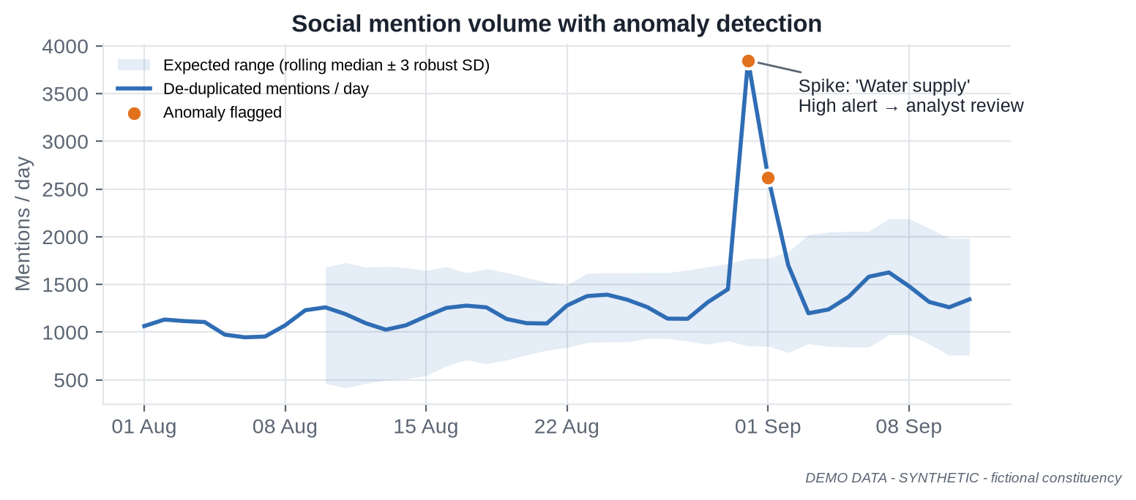
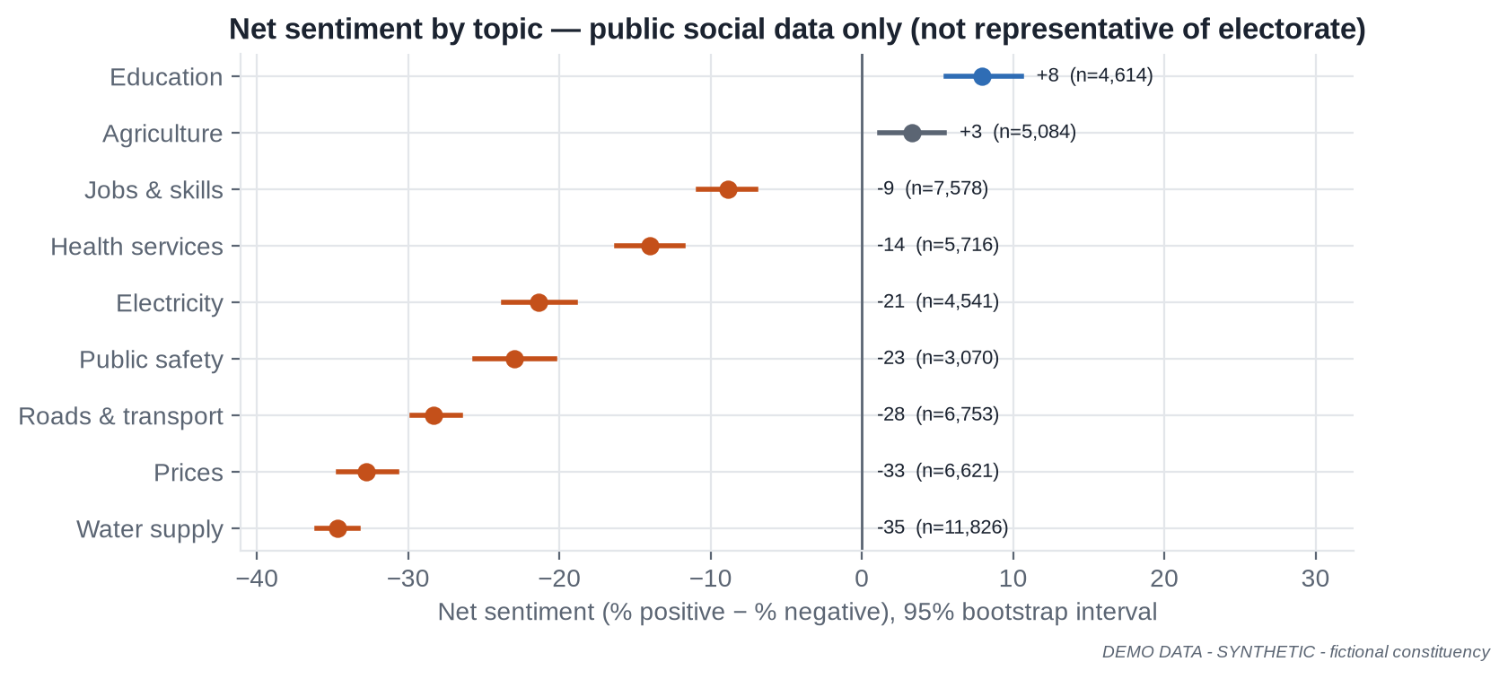
SOCIAL INTELLIGENCE
DEMO DATA — SYNTHETIC
Detect change — and state how much of the conversation we see
3,849
43.5%
mentions on 31 Aug vs 1,314 prior-week median
negative share (de-duplicated, 6 weeks)
High alert · Water supply
18.1%
7.0%
posts with usable public location — coverage limit
near-duplicates removed before counting
Modules: volume · sentiment · topic trends · issue velocity · engagement · platform comparison · amplification by account type · emerging issues
Every tile carries a Coverage & Representativeness Index
Public social data is not the electorate. Sentiment describes visible online conversation only.
[COMPANY NAME] · Election Intelligence & Analytics Command Center · Confidential — for discussion
12
Notes:
Synthetic storyline: a water-pipeline outage on 31 Aug creates a spike. The anomaly band is a rolling median plus or minus three robust standard deviations. Intervals on sentiment come from bootstrap resampling.

Slide 13
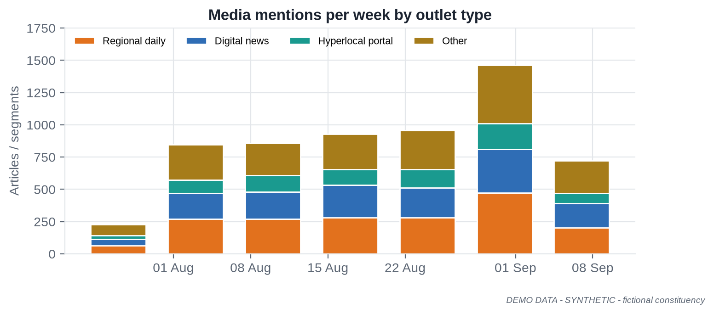
MEDIA INTELLIGENCE
DEMO DATA — SYNTHETIC
Multilingual media monitoring — licensed where required
Media Intelligence Dashboard
Article & segment classification by issue
Topic extraction & story threads across outlets
Tone towards tracked entities, with confidence
Candidate / organisation mentions (NER + entity linking)
Issue share of voice by outlet type & language
Regional-language outlets prioritised
Broadcast transcripts — only where licensed
Volume & tone alerts; daily AI summary with citations
1,030
53.6%
24.3%
items in the last 7 days
regional & hyperlocal share
negative tone, last 7 days
[COMPANY NAME] · Election Intelligence & Analytics Command Center · Confidential — for discussion
13
Notes:
Regional media often leads national coverage on local issues. Broadcast analysis only with licensed transcripts; no unlicensed recording or redistribution.

Slide 14
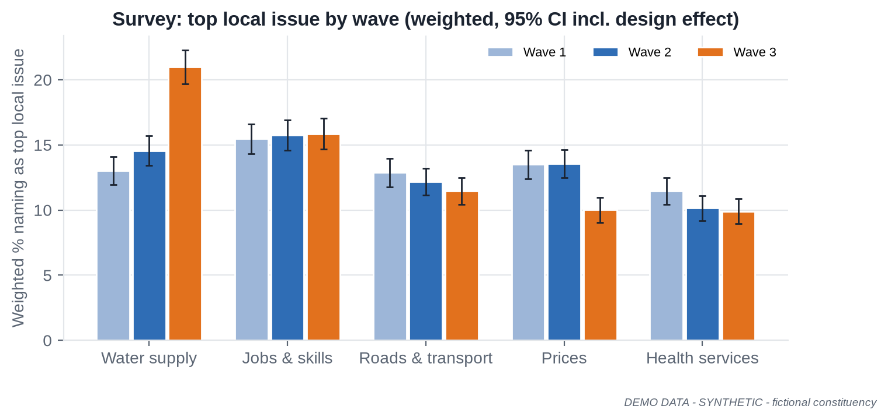
SURVEY INTELLIGENCE
DEMO DATA — SYNTHETIC
Statistically defensible — every estimate carries its uncertainty
Methodology built in
Sampling design & sample-size calculator
Post-stratification / raking with trimmed weights
Design effect → effective n → honest MoE
Weighted cross-tabs with small-cell suppression
Significance tests with multiple-comparison control
Speeders, straight-liners, interviewer & mode checks
Non-response & profile bias checks
+8.0 pts water-supply salience, Wave 1 → Wave 3
13.0% → 21.0% ± 1.3 (95% CI, n_eff 3,704); significant (z ≈ 9). QC excluded 3.5% of interviews.
Surveys describe the sampled population at fieldwork time. They do not guarantee or predict results.
[COMPANY NAME] · Election Intelligence & Analytics Command Center · Confidential — for discussion
14
Notes:
Issue, awareness and satisfaction surveys only, reported in aggregate. Margins of error use the effective sample size after weighting (Kish).

Slide 15
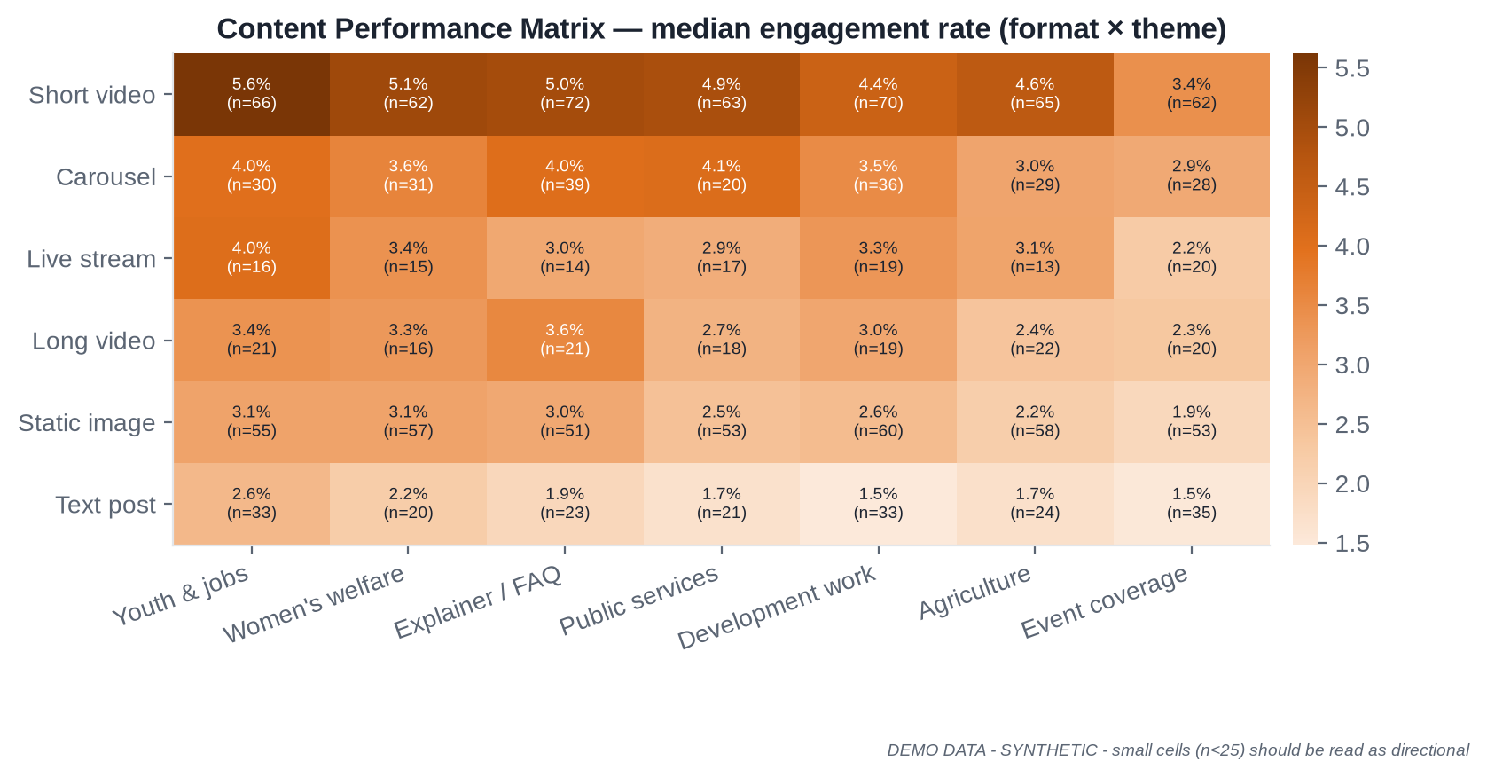
DIGITAL ANALYTICS
DEMO DATA — SYNTHETIC
Digital Performance Scorecard and Content Performance Matrix
9.21 M
3.49%
1.50 M
1.11%
₹116
100%
impressions (7 days)
engagement rate
video views
click-through rate
CPM (boosted)
boosted items with MCMC ref
+0.9% W/W
+0.18 pts W/W
−3.8% W/W
−0.03 pts
+4.5% W/W
Compliant
What leadership learns
Short video leads engagement across themes (~1.8× static images)
Explainers and youth & jobs content over-index
Test before scaling: pre-registered experiments with power analysis
Format & theme planning at aggregate level — never individual-level targeting.
[COMPANY NAME] · Election Intelligence & Analytics Command Center · Confidential — for discussion
15
Notes:
Platform-reported metrics; cross-platform totals are indicative because definitions differ. Conversions only where legitimately measurable on owned, consented forms.

Slide 16
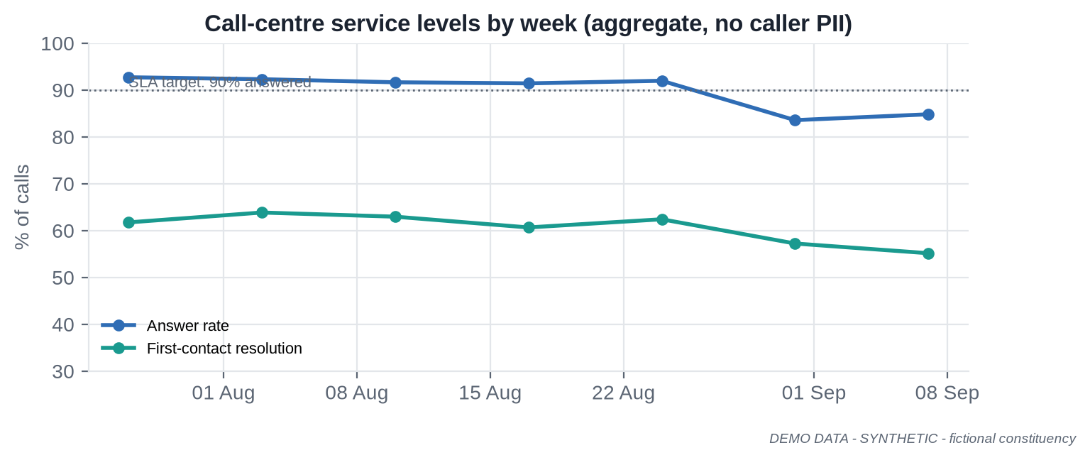
FIELD OPERATIONS & CALL-CENTRE INTELLIGENCE
DEMO DATA — SYNTHETIC
See where operations are behind — and why
Field operations (last 7 days)
83.2%
79.3%
activities completed (target 85%)
reports submitted on time
67.4%
1,842
Hill Block completion
local issue reports logged
84.4%
55.6%
37 s
Bottleneck
answer rate, 7 days
first-contact resolution
median wait (answered)
Tracks completion, coverage, attendance estimates, response time, submission quality
Bottleneck list with named owners; late-report reconciliation avoids false alarms
SLA 90% — breach
Call-centre analytics use aggregate operational data only — no private communications, no inference about callers' views.
[COMPANY NAME] · Election Intelligence & Analytics Command Center · Confidential — for discussion
16
Notes:
Operational analytics, not surveillance. Attendance is an estimate; no identity capture at events.

Slide 17
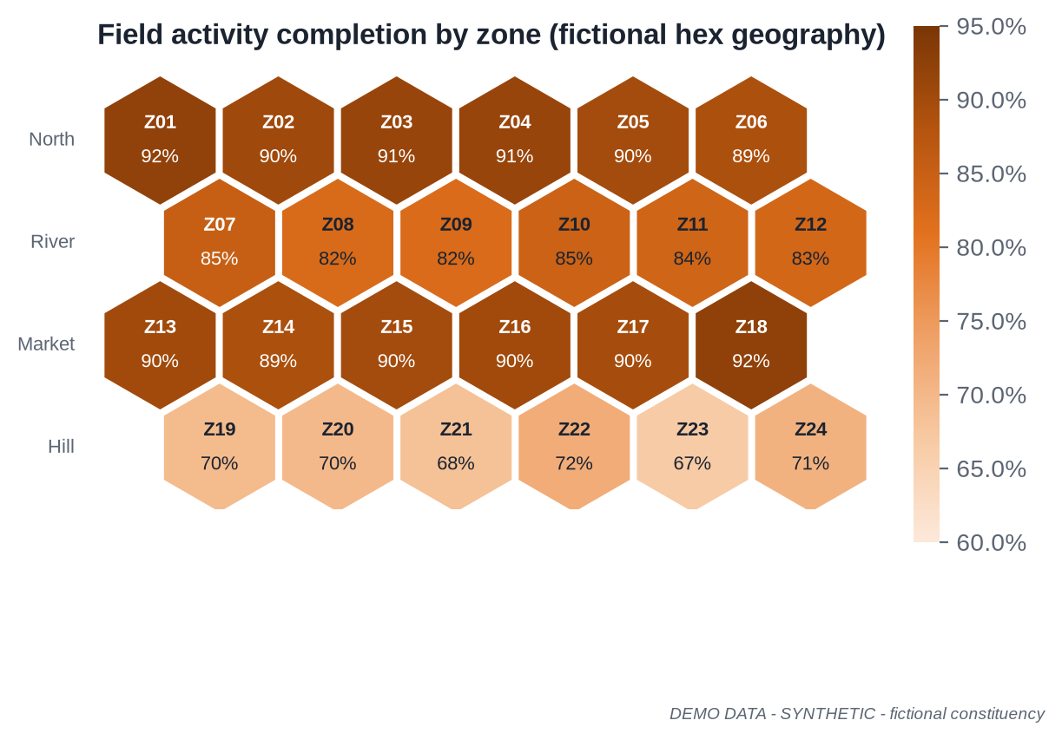
GEOGRAPHIC INTELLIGENCE
DEMO DATA — SYNTHETIC
Aggregate maps for coverage — never individual targeting
Map layers
Constituency & admin boundaries
Historical results (public)
Turnout trends (public)
Survey coverage
Campaign activity coverage
Event locations (public events)
Issue distribution
Media distribution
Operational coverage
Guardrails
No household or individual plotting
Small-area suppression (cells < 10 hidden)
Official Survey of India boundaries for any national/state outline
Delimitation vintage recorded for every boundary layer
[COMPANY NAME] · Election Intelligence & Analytics Command Center · Confidential — for discussion
17
Notes:
Fictional hexagonal geography for the demo. Real deployments use official boundaries and record their vintage; community boundary datasets are used with attribution and verification.

Slide 18
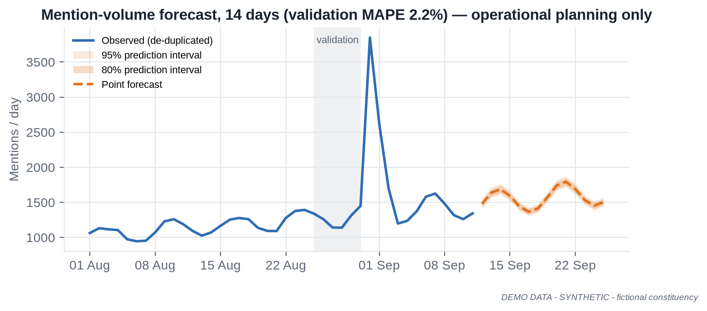
FORECASTING & MACHINE LEARNING
DEMO DATA — SYNTHETIC
Forecasts with intervals and validation — never certainty
Model card | issue_volume_forecaster v0.3
Purpose | Monitoring-capacity planning
Training window | 01–24 Aug (validation 25–30 Aug)
Method | Trend + weekly seasonality (OLS)
Validation | MAPE 2.2% (synthetic; real error higher)
Assumptions | No new shocks; stable platform access
Limitations | Cannot anticipate events
Human review | Signed off by Lead Data Scientist
Status | Approved — internal planning only
Model toolkit (fit for purpose, simplest first)
Regression
Logistic regression
Classification
Clustering
Time-series
Anomaly detection
Random Forest
Gradient boosting / XGBoost
PCA
Topic modelling
Embeddings
Similarity search
No model infers an individual's political preference
[COMPANY NAME] · Election Intelligence & Analytics Command Center · Confidential — for discussion
18
Notes:
Every model has a card: purpose, data, window, features, metrics, validation, bias checks, limitations, owner, version and approval status.

Slide 19
AI CAMPAIGN ANALYST
Grounded answers with citations, timestamps and confidence
User (SSO, role)
Metrics API
What changed in the last 24 hours?
Policy & intent guard
SQL templates
FACTS
Public mentions 3,849 vs prior-week median 1,314 — High anomaly [social.mentions_daily · alert A-0931]
61% of mentions on Water supply [model M3 v1.2]
Regional media on the issue: 123 items vs 9.9/day [media.mentions_daily]
Helpline answer rate 85% vs 90% SLA [ops.call_answer_rate]
INTERPRETATION
Signals are consistent with a local service-disruption story; geographic spread uncertain (18% geo-coverage).
FOLLOW-UPS
Validate with field issue reports; review helpline category mix; consider a survey item in next wave.
Search
LLM planner
Vector / RAG
Tool router
Analytics APIs
Verified data + source IDs
Numeric & citation check
Answer + audit log
Confidence: Medium · data as of 07:00 IST
Refuses: profiling · persuasion · predictions
[COMPANY NAME] · Election Intelligence & Analytics Command Center · Confidential — for discussion
19
Notes:
The LLM never answers numbers from memory. Citations are generated from tool metadata, not by the model. Every prompt, tool call, source and model version is logged. DEMO DATA in the sample answer.

Slide 20
REAL-TIME ALERT ENGINE
Four severity levels, owners and response clocks
CRITICAL
Compliance-breach risk, priority pipeline outage, security incident, extreme KPI anomaly
Ack ≤ 15 min · act ≤ 1 h
Alert catalogue
Social-volume spike
Abnormal sentiment movement
Viral content
Digital-performance movement
Media spike
Pipeline failure
Survey anomaly
Data-quality deterioration
Compliance deadline
Abnormal spend
Unexpected KPI movement
AI label missing
HIGH
Significant anomaly (> 4 robust SD), fast-growing issue, high-reach media story
Ack ≤ 1 h
MEDIUM
Notable movement (3–4 SD), sustained trend change, data-quality degradation
Same day
LOW
Informational deviations, stale approvals, minor forecast misses
Weekly review
[COMPANY NAME] · Election Intelligence & Analytics Command Center · Confidential — for discussion
20
Notes:
Alert hygiene matters as much as detection: grouping, suppression windows, owner assignment and a weekly precision review keep alert fatigue down.

Slide 21
EXECUTIVE DASHBOARD
DEMO DATA — SYNTHETIC
One screen, eight domains, drill-down to 14 modules
Overview Digital Social Issues Media Survey Field Geo Forecast Alerts Compliance Data Quality AI Analyst Reports
Domain scores (0–100)
Top changes · last 24 h
H
Helpline answer rate 84% < 90% SLA
74
M
Hill Block completion 67% (target 85%)
M
X connector latency — amber source
L
'Jobs & skills' share +1.8 pts
Campaign Intelligence Health
AMBER · operational, not electoral
L
ER 3.49%, +0.18 pts W/W
1,344
41.2%
122
3.49%
83.2%
84.4%
1 High
0
mentions (day)
negative share
media items
engagement rate
field completion
answer rate
open alerts
compliance exceptions
● source ok
● source ok
● source ok
● source ok
● source ok
● source ok
● source ok
● source ok
[COMPANY NAME] · Election Intelligence & Analytics Command Center · Confidential — for discussion
21
Notes:
The Health Score is an operational indicator. Any domain below 50 caps the headline at Amber so good news cannot hide bad news. Every tile shows its data-quality status.

Slide 22
ELECTION COMPLIANCE CONTROL TOWER
DEMO DATA — SYNTHETIC
Approvals, certification, AI labels, spend — one audit trail
Item | Type | Approval (owner · time) | MCMC certification | AI disclosure / label | Spend | Alert
CT-0417 | Paid video | Approved · Compliance · 12 Sep 16:42 | Certified · MCMC-DEMO-0417 | AI-generated · label ✓ · entity ✓ | ₹1.8 L | —
CT-0422 | Paid carousel | Approved · Compliance · 12 Sep 18:05 | Applied · awaiting | Not AI | ₹0.9 L | Block publish
CT-0425 | Organic video | Legal review | Not required (organic) | AI-assisted edit · label ✗ | — | CRITICAL
CT-0431 | Bulk SMS | Approved · Compliance · 13 Sep 10:11 | Certified · MCMC-DEMO-0431 | Not AI | ₹0.4 L | —
CT-0433 | Paid static | Draft | — | Not AI | — | —
SP-TOTAL | Digital spend | Finance reconciled 13 Sep | — | — | 82% of limit | HIGH
Rules engine (configured by legal)
Regulatory anchors (verify with legal)
Paid item without certification ref → block “ready”
AI flag without label → Critical
Scheduled post inside silence window → block
Takedown notice unactioned at 2 h → Critical (3 h limit)
MCC & social media — ECI 2013
MCMC pre-certification — ECI 20 Mar 2026
AI labels & records — ECI 24 Oct 2025
SGI labelling — IT Rules 2026
Silence period — RP Act s.126
Exit polls — RP Act s.126A
[COMPANY NAME] · Election Intelligence & Analytics Command Center · Confidential — for discussion
22
Notes:
The control tower supports the compliance team; it does not make legal determinations. This is an analytics/technology proposal, not legal advice.

Slide 23
SECURITY & DATA GOVERNANCE
Enterprise controls from day one — privacy by design
✓
✓
✓
✓
Data governance
Source & lawful-basis registry
Permitted-use tags enforced at query time
Data dictionary & metadata
Column-level lineage
Consent / authorisation tracking
Minimisation & purpose limitation
Quality monitoring on every source
Exit plan: export + deletion certificate
RBAC + RLS
SSO
MFA
Encryption
Least privilege by role & geography
SAML / OIDC with agency IdP
Mandatory; passkeys for admins
At rest (KMS) · in transit (TLS 1.2+)
✓
✓
✓
✓
Secrets
Audit logs
Key rotation
Environments
Vault; scanning; no creds in chat
Immutable; ≥ 1 yr; 180 d in India
≤ 90 days; revoke on exit
Dev / test / prod separated
✓
✓
✓
✓
Backup & DR
Incident response
Retention
Vendors
PITR; RPO ≤ 1 h; RTO ≤ 4 h
CERT-In 6 h path; DPDP breach workflow
Per-source schedules; deletion certs
DPAs, residency, audit rights
[COMPANY NAME] · Election Intelligence & Analytics Command Center · Confidential — for discussion
23
Notes:
Built to the fully in-force DPDP standard now. CERT-In requires specified incidents reported within 6 hours and ICT logs kept for 180 days in India.

Slide 24
RESPONSIBLE AI
Human oversight, no fabrication, full traceability
Human oversight
No fabricated information
AI-assisted analytics
AI-generated content
AI-generated campaign creative
No unsupported prediction
Explainability
Internal analysis & drafting
Any AI-produced text/image/audio
Synthetic media published for campaigning
Source traceability
Data minimisation
Topic/sentiment models
Forecasts
AI Analyst answers
Draft summaries
Translations
Internal visuals
AI video/image/audio ads
AI-altered posts
Privacy
Security
Bias monitoring
Model monitoring
Controls
Model governance · citations · human review
Controls
Marked internal · reviewed before any external use
Controls
ECI label ≥10% · entity disclosed · records · 3-h takedown · not generated by this platform
Synthetic-content safeguards
Compliance review
Aligned to MeitY India AI Governance Guidelines (Nov 2025), NIST AI RMF, ISO/IEC 42001.
[COMPANY NAME] · Election Intelligence & Analytics Command Center · Confidential — for discussion
24
Notes:
Keep the three categories separate. The platform performs AI-assisted analytics; it tracks, but does not generate, campaign creative.

Slide 25
TEAM STRUCTURE
A multidisciplinary intelligence team — sized to the election
Programme Director
Client: Political / Comms liaison
Product & Delivery
Product Mgr · Project Mgr
Analytics & Data Science
Analytics Lead · DS · DA
Data & Platform Eng.
Data Eng · BI · ML/NLP · Security
Intelligence Ops
Social · Media · GIS · QA
A · POC / MVP
B · Single constituency / by-election
C · Multi-constituency / state
5–7 people · 4–6 weeks
8–15 core people · + ops support
20–50+ people · 24×7 war-room
Analytics Lead
Data Scientist
Data Engineer
ML/NLP Engineer
Data Analyst
PM (+0.5 BI, shared Director & Security)
+ 2nd Data Scientist, 2–3 Analysts
Social & Media analysts
BI Developer, QA/Data Ops
0.5 GIS, 0.5 Security/Privacy
Domain leads per module
4–8 DS · 6–12 DA
Language pods for social/media
24×7 Data Ops rota · annotators
[COMPANY NAME] · Election Intelligence & Analytics Command Center · Confidential — for discussion
25
Notes:
Role cards with responsibilities, skills, daily outputs, tools and experience are in PRD section 24.

Slide 26
THE DATA SCIENTIST ROLE
Converting data into statistically defensible decision-support
“A Data Scientist is not just someone who builds ML models; the role is to convert data into statistically defensible decision-support.”
1
2
3
4
5
Statistics & surveys
Forecasting & detection
Language & AI
Measurement
Trust & communication
Statistical analysis
Survey analysis
Trend detection
Uncertainty estimation
Bias checks
Forecasting
Anomaly detection
Model validation
Model monitoring
NLP
Sentiment analysis
Topic modelling
AI-agent development
RAG analytics
Content-performance analysis
Experiment analysis
Attribution (where valid)
KPI modelling
Data-quality analysis
Executive insights
Automated reporting
Reproducibility
Documentation
[COMPANY NAME] · Election Intelligence & Analytics Command Center · Confidential — for discussion
26
Notes:
23 contributions grouped into five clusters. A typical day: pipeline and alert review at 06:30, report sign-off, war-room stand-up, deep-dive analysis, model monitoring, insight note to leadership.

Slide 27
PROOF OF CONCEPT
4–6 weeks to a working Command Center on realistic DEMO data
W1
W2
W3
W4
W5
W6
Acceptance criteria (13)
Discovery, sources, KPIs
Dashboards P95 < 3 s
ETL ≥ 99% success, 5 days
Lineage for 10/10 sampled tiles
NLP processes 50k texts
Sentiment macro-F1 ≥ 0.70 / language
Issue detection ≥ 90% of test events
AI: 0 fabricated numbers; 100% refusals
Citations + data-as-of on every answer
RBAC: 0 exposures in 40 tests
Audit log captures 100% of events
Daily report ≥ 70% auto-drafted
Alerts at correct severity ≤ 5 min
Model card for every model
Ingestion, cleaning, DB
First dashboards
NLP, survey, historical
AI Analyst, alerts, reports
Validation, security, UX
Exec demo & handover
Demo: fictional Aranyapur AC · 100,000 synthetic records · every screen labelled DEMO DATA
[COMPANY NAME] · Election Intelligence & Analytics Command Center · Confidential — for discussion
27
Notes:
POC success means all Must criteria met and at least two of the remaining three, with a leadership usability score of at least 4 out of 5.

Slide 28
TECHNOLOGY POC
A lean, production-ready POC stack
Python · FastAPI · PostgreSQL · pgvector/FAISS · SentenceTransformers · LLM · scheduled ETL
Power BI / React UI · Streamlit prototypes
Method | Endpoint | Returns
GET | /dashboard/overview | Health, domains, KPI strip
GET | /social/trends | Volume, anomalies, sentiment CIs
GET | /media/intelligence | Outlets, tone, threads
GET | /survey/summary | Weighted estimates, MoE
GET | /field/operations | Completion, bottlenecks
GET | /digital/scorecard | Scorecard vs targets
GET | /alerts | Alert queue
GET | /compliance/items | Approval, cert, AI label
GET | /lineage/{metric} | Source-to-metric graph
POST | /ai/query | Facts, citations, confidence
FastAPI service — SSO token, RBAC, audit middleware
LLM + tool router (AI Analyst) · report generator
PostgreSQL + metric views · pgvector / FAISS index
NLP pipeline: LID → normalise → topic/sentiment/NER → embeddings
Scheduled ETL (Dagster / cron): raw → quality tests → dbt models
[COMPANY NAME] · Election Intelligence & Analytics Command Center · Confidential — for discussion
28
Notes:
Full OpenAPI sketch in poc/openapi.yaml and conceptual schema in poc/schema.sql.

Slide 29
ROADMAP
30 / 60 / 90 days to a full Command Center — then the election cycle
30 days Foundation
60 days Intelligence
90 days AI + Automation
Indian-region cloud, SSO/MFA/RBAC
Source registry; 10–15 sources
Metric store v1
Overview, Digital, Social, Field
Automated daily report
Media, Survey, Issue, Geo modules
Regional-language NLP
Alert tuning; experiments
Compliance tower v1
AI Analyst GA + eval harness
RAG library; forecasting
Weekly report automation
War-room screens; DR & pen-test
Pre-campaign
Campaign
High-intensity
Final phase
Poll day
Post-poll
Baselines, Wave 0, taxonomy, authorisations
Daily reports, alerts, MCC-aware workflows
Intraday refresh, 24×7 war-room, DR standby
Silence-period guard; no publishing workflows
Operational analytics, incidents, misinformation-risk triage
Measurement, spend reconciliation, deletion
[COMPANY NAME] · Election Intelligence & Analytics Command Center · Confidential — for discussion
29
Notes:
Poll-day and post-poll work is limited to operational analytics, compliance and measurement.

Slide 30
COMMERCIAL MODEL
Transparent components across three tiers (indicative INR, excl. GST)
Component | Starter | Professional | Enterprise
Typical scope | 1 AC / by-election, 8–12 wks | 1 PC or ≤ 10 ACs, 3–6 months | Multi-constituency / state
Core team | 6–8 FTE | 12–15 FTE | 30–60 FTE
POC (4–6 weeks) | ₹18–35 lakh | ₹18–35 lakh | ₹25–45 lakh
One-time setup | ₹15–30 lakh | ₹40–80 lakh | ₹1.2–3.0 crore
Monthly analytics retainer | ₹12–22 lakh | ₹30–50 lakh | ₹0.8–2.0 crore
Technology / platform fee (monthly) | ₹1.5–3 lakh | ₹4–8 lakh | ₹10–25 lakh
Cloud / API (monthly, pass-through) | ₹0.5–1.5 lakh | ₹2–6 lakh | ₹8–30 lakh
24×7 war-room (per pod / month) | Optional ₹8–12 lakh | ₹10–15 lakh | Included
Survey vendor · field enablement · custom AI · travel | Quoted / at actuals | Quoted / at actuals | Quoted / at actuals
Indicative only; final commercial proposal depends on constituency, election timeline, data availability, staffing, SLA and technology requirements.
[COMPANY NAME] · Election Intelligence & Analytics Command Center · Confidential — for discussion
30
Notes:
Worked example (Professional, four months): about 3.2 crore rupees, range roughly 2.3 to 4.5 crore. POC fee 50% creditable against setup if contracted within 30 days.

Slide 31
KPIS & VALUE
We measure what the platform can credibly change — not election outcomes
Campaign Intelligence Health
−60%
≥ 70%
analyst time on recurring reports
report content auto-generated
Digital
Social
Media
Survey
Field
Operations
Data Quality
Compliance
≤ 2 h
100%
issue onset → alert (priority sources)
paid / AI items with complete compliance record
Leading: issue velocity, ER, field completion, alert ack time
Lagging: survey awareness, cumulative reach
Diagnostic: platform, format, theme, zone mix
Data-quality: freshness, coverage, test pass rate, n_eff
≥ 80%
≥ 95%
weekly active leadership users
field activities with structured reports
[COMPANY NAME] · Election Intelligence & Analytics Command Center · Confidential — for discussion
31
Notes:
Value is measured against a Week-1 baseline. We never claim guaranteed victory or guaranteed ROI.

Slide 32
RISKS & MITIGATION
Named owners, explicit mitigations — no surprises
High
R17
R7 R11
R12 R13
Risk | Mitigation | Owner
R1 Poor data quality | Quality gates, badges, data-ops rota | Data Eng Lead
R5 Social ≠ electorate | Coverage index, caveats, triangulation | Analytics Lead
R7 LLM hallucination | Tool-first, numeric & citation checks | ML Lead
R11 Compliance breach | Blocking rules, legal sign-off | Compliance
R12 Privacy | Minimisation, purpose tags, audits | Privacy Lead
R13 Cyber | SSO/MFA, least privilege, pen-test | Security Lead
R14 Expectations | Explicit non-promises, acceptance criteria | Programme Dir.
Medium
R3 R4
R10 R18
R1 R14
Low
R6 R8
R15 R16
R2 R5 R9
Low
Medium
High
Rows: impact · Columns: probability (full 18-risk register in PRD §30)
[COMPANY NAME] · Election Intelligence & Analytics Command Center · Confidential — for discussion
32
Notes:
Top risks are data quality, representativeness of social data, hallucination, compliance, privacy, cyber and unrealistic expectations.

Slide 33
BOUNDARIES & DEPENDENCIES
Clear expectations protect the campaign, the agency and the partner
What we will not promise
What we need from you
Guaranteed election outcome
Exact vote prediction
Complete voter-preference prediction
Individual political-belief inference
Unauthorised personal-data access
Secret tracking
Illegal scraping
Private-message monitoring
Guaranteed viral content
Guaranteed persuasion
Guaranteed ROI
Campaign scope, geography, timeline
Existing data & authorised first-party data
API / dashboard access for owned accounts
Survey data & methodology
Field report formats & media-monitoring access
Named compliance & legal contacts
Cloud preference & security requirements
Reporting cadence, decision-makers, SLA
Language priorities & annotators
Brand assets — only with authorisation
[COMPANY NAME] · Election Intelligence & Analytics Command Center · Confidential — for discussion
33
Notes:
These lists go into the statement of work. Most are needed in Week 1 of the POC.

Slide 34
From Campaign Data to Campaign Intelligence
Unified data. Trusted analytics. AI-assisted intelligence. Faster decisions.
Platform
Team
Technology
Governance
Measurable outcomes
Command Center, AI Analyst, alerts, compliance tower
Data scientists, engineers, analysts — sized to the election
Governed warehouse, multilingual NLP, grounded AI
Privacy by design, audit trails, responsible AI
Faster reporting, earlier detection, better data
Next step: approve a 4–6 week POC with 13 measurable acceptance criteria.
No guaranteed outcomes — guaranteed rigour, transparency and accountability.
Notes:
Close on the ask: a time-boxed POC with measurable acceptance criteria.

Slide 35
SOURCES & NOTES
Key references (full list with URLs and dates in PRD Appendix A)
LEGAL & REGULATORY
ECI press note on political advertising & digital campaigning — 20 Mar 2026 (as reported by ANI / Akashvani)
ECI: print-ad pre-certification — 6 Apr 2026 (Akashvani)
ECI advisory: labelling AI-generated / synthetic content — 24 Oct 2025 (Business Today, ANI)
ECI advisories: 16 Jan 2025 (labelling); 6 May 2024 (deepfakes, 3-hour removal)
ECI instructions on social media — 25 Oct 2013; ECI FAQ on social media
RP Act 1951 ss. 77, 126, 126A (India Code); Committee on s.126 report — Jan 2019
MeitY IT Amendment Rules 2026 — notified 10 Feb, in force 20 Feb 2026
DPDP Act 2023; DPDP Rules 2025 — notified 14 Nov 2025 (phased to 14 May 2027)
CERT-In Directions — 28 Apr 2022; MeitY India AI Governance Guidelines — 5 Nov 2025
DATA · TECHNICAL · AI/ML · DESIGN
ECI Statistical Reports; PIB on ECINET index cards (2026); TCPD Lok Dhaba; Census 2027 (PIB, Apr 2026)
Meta Graph / Instagram Platform / Ad Library docs; Meta Content Library; CrowdTangle closure 14 Aug 2024
YouTube Data & Analytics APIs; X API pay-per-use (2026); Google Trends API alpha (24 Jul 2025)
Google political content policy & India pre-certificate requirement; Meta SIEP policy
AI4Bharat IndicTrans2 & IndicBERT (MIT); MuRIL; NIST AI RMF; ISO/IEC 42001
Visuals: all charts and cover generated for this deck from synthetic data; no third-party images
This is an analytics/technology proposal, not legal advice. Final campaign compliance should be reviewed by the campaign's authorised legal/compliance team. DEMO DATA is synthetic. Party marks are placeholders unless authorised.
[COMPANY NAME] · Election Intelligence & Analytics Command Center · Confidential — for discussion
35
Notes:
Several ECI items were verified through reputable reporting of the press notes; confirm against the primary ECI documents before reliance.

