Slide 1
Refactoring Follow-Up
Improving the Design of Existing Code

Slide 2
Code smells
Refactoring Follow-Up

Slide 3


Bad Smells In Code
Long Method
Large Class
Duplicated Code
Long Parameter List
Comments

Slide 4
Bad Smells In Code
Improper Naming
Magic Numbers
Data Clumps
Switch Statements
Dead Code
Lack of Unit Tests

Slide 5
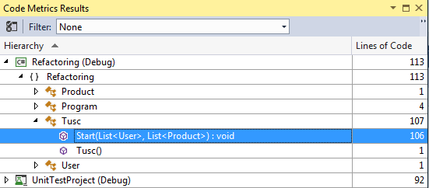
Long Method/Large Class

Slide 6



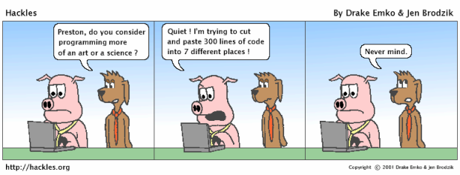
Duplicated Code

Slide 7







Duplicated Code

Slide 8











Comments

Slide 9

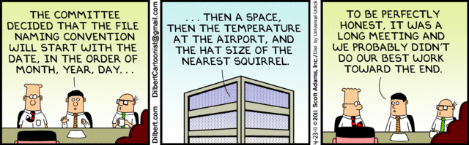

Improper Naming

Slide 10

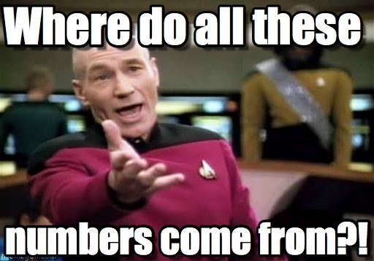



Magic Numbers

Slide 11
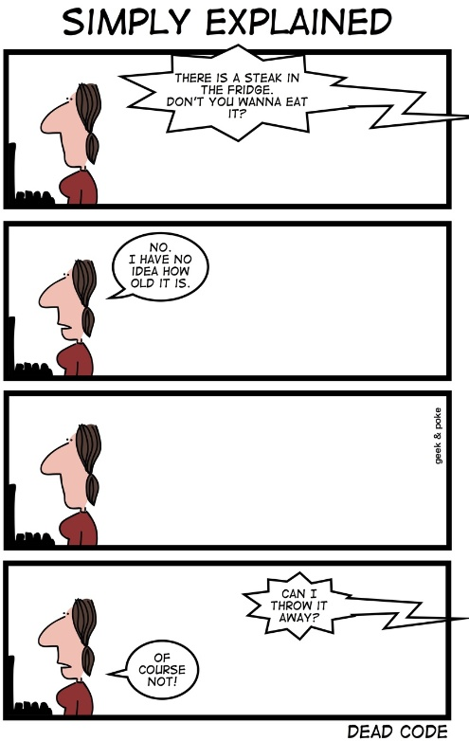

Dead Code

Slide 12
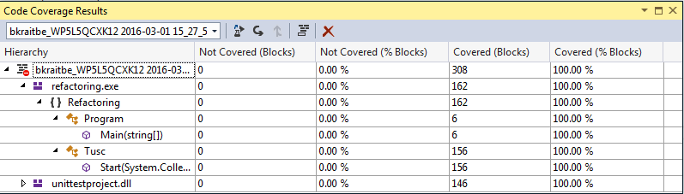
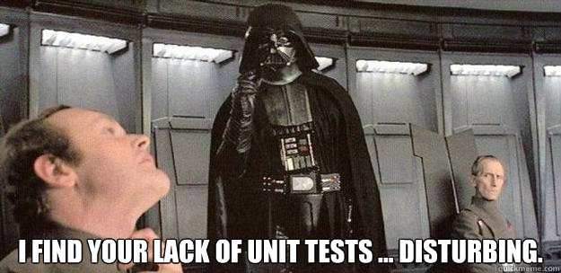
Lack of Unit Tests

Slide 13
Refactoring Methods
Refactoring Follow-Up

Slide 14
Methods
Extract Method
Meaningful Names
Introduce Explaining Variable
Replace Magic Number with Symbolic Constant
Do One Thing
Don’t Mix Levels of Abstraction
Explain Yourself
Comments

Slide 15
Other
Hard-coded strings instead of string resources
Bugs
Did you realize if you clicked X to close the window instead of using the menu to exit that you could buy anything and never have to pay for it?
You could not buy the last of an item in stock. If there was only 1 left, the app would tell you it was out of stock.
Anything else?

Slide 16
Solutions
Refactoring Follow-Up

Slide 17


Slide 18
Refactoring Goals
Separation of concerns
Easier unit testing
Long methods
Custom exceptions
Duplicate code
Magic constants
Appropriately named fields
Validate user input

Slide 19
Separation of Concern
DataManager:
public DataManager(
List<User> users,
List<Product> products)
public List<User> Users
public List<Product> Products
public void SaveUser(User user)
public void SaveProduct(Product product)

Slide 20
Unit Testing
Dependency Injection pattern used for mocking dependencies in unit tests
public Store(User user, DataManager dataManager) // ... dataManager.SaveUser(user);
dataManager.SaveProduct(product);
Store does not know how to persist data
Different DataManager implementations can be used

Slide 21
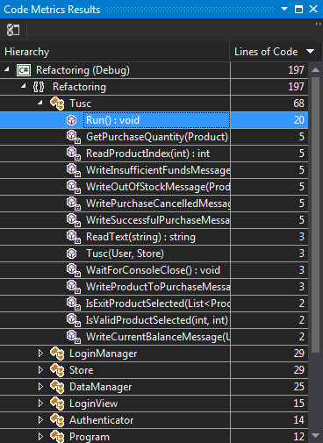
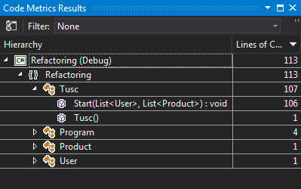
Long methods
Before
After
Notes:
Lines of code increased after by 2x
Largest method size decreased to 20 lines
Goal isn’t necessarily to write the most concise code, but to write code that is clean, easy to understand, and easy to test.

Slide 22
Custom Exceptions
Handle application errors through exceptions
if (String.IsNullOrEmpty(username))
throw new EmptyUsernameException();
if (!UserHasFundsForPurchase(product, quantity))
throw new InsufficientFundsException();

Slide 23
Magic Constants
Console.WriteLine("What would you like to buy?");
for (int i = 0; i < 7; i++) {
Product prod = prods[i];
foreach (var item in dataManager.Products.Select( (product, index) => new { index, product }) )

Slide 24
Appropriately Named Fields
[JsonProperty("Password")]
public string Pwd;
[JsonProperty("Balance")]
public double Bal; [JsonProperty("Password")]
public string Password;
[JsonProperty("Balance")]
public double Balance;

Slide 25
Validated User Input
Console.WriteLine("Enter amount to purchase:");
answer = Console.ReadLine();
int qty = Convert.ToInt32(answer); bool validIntegerEntered =
Int32.TryParse(ReadText("Enter amount to purchase: "), out purchaseQuantity);

Slide 26
Project Structure
Authentication
User DTO
LoginManager, LoginView, Authenticator
Data Management
DataManager
Store
Main App
Tusc

Slide 27
Hands-on Exercises
Refactoring Follow-Up

Slide 28
Hands-On Exercise Tasks
As in the last training session, first fork a copy of my repo to your account
Then complete the tasks in the following pages
You can attempt to do each of these tasks for each of the following repos under my account:
Refactoring-training-2.3 (Copy of Glen’s refactored code)
Refactoring-training-2.0 (Copy of original code)
Your own repo from the previous exercise (Optional)

Slide 29
Hands-On Exercise Tasks
Task 1
Write a new test called: Test_UserCanPurchaseProductWhenOnlyOneInStock
The setup for this test should set the quantity of a product such as Chips to 1, and set the desired amount to purchase to 1
The assert statement in the test should be similar to:
Assert.IsTrue(writer.ToString().Contains("You bought 1 Chips"));
You can model it after the existing test: Test_ErrorOccursWhenProductOutOfStock
The test should fail when you first write it
Fix the code to make the test pass
Commit the changed code to your repo with comment “Task 1”

Slide 30
Hands-On Exercise Tasks
Task 2
Add a new Product to Products.json with Name: Soup, Price: $1.25, Quantity: 50
Note that after changing Products.json you will need to Rebuild the app before running tests, so that the updated json file is deployed to the output folder
Run all the tests. Do they all pass?
Fix any failing tests by fixing the broken code. You may also have to modify some tests to account for the new data.
Commit the changed code to your repo with comment “Task 2”

Slide 31
Hands-On Exercise Tasks
Task 3
Uncomment the test: Test_UserCanExitByEnteringQuit.
The test should fail when you run it
Change the application so that the user must enter the word “quit” to exit the application rather than type a number for exit.
Make sure to change the menu to show “Type quit to exit the application” rather than “8: Exit”
After making this change, some tests will need to be modified to account for your change.
Commit the changed code to your repo with comment “Task 3”

Slide 32
Hands-On Exercise Tasks
Task 4
Change the Product class to have an Id field of type String
Add Ids to Products.json for each product. You can use “1”, “2”, “3”, etc.
Change product menu to display “ProductId: ProductName” instead of “LineNumber: ProductName”
Change the code to allow the user to enter the ProductId rather than the line number to select an item
Fix any broken tests
Commit the changed code to your repo with comment “Task 4

Slide 33
Hands-On Exercise Tasks
Bonus Task
Write a new test called Test_ProductsWithZeroQuantityDoNotAppearInMenu
In the test, set the quantity of a product like Chips to 0.
The assert statement should be similar to:
Assert.IsFalse(writer.ToString().Contains(": Chips"));
Modify the code to prevent products with zero quantity from appearing in the menu
Run the tests. Do any of the other tests now fail?
Modify Test_ErrorOccursWhenProductOutOfStock to test the case where the quantity is greater than 0, but the user attempts to buy more than the available quantity
Commit the changed code to your repo with comment “Bonus Task”

Slide 34
Hands-On Exercise Tasks
When complete, push all of your commits to your repo, and then submit a pull request back to my repo
Note that you will have to do this for each of the repos you worked on

